Slide 1
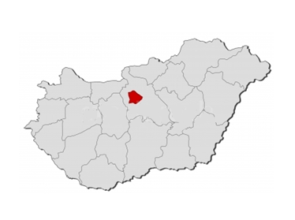
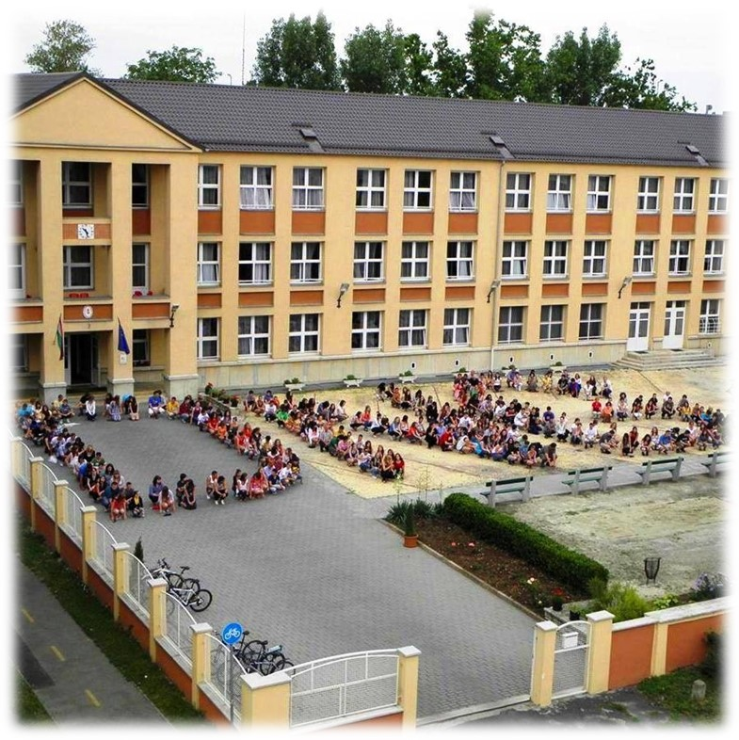
Hungary Budapest
Deutsches
Nationalitätengymnasium
und Schülerwohnheim

Slide 2
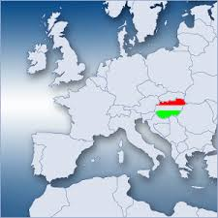
Where is Hungary?
Middle Europe
Population: appr. 10 Million
Neighbouring countries: Serbia, Slovakia, Ukraine, Croatia, Austria, Slovenia, Romania
Minister President: Viktor Orbán
Biggest rivers: the Danube, the Tisza
Lake Balaton

Slide 3
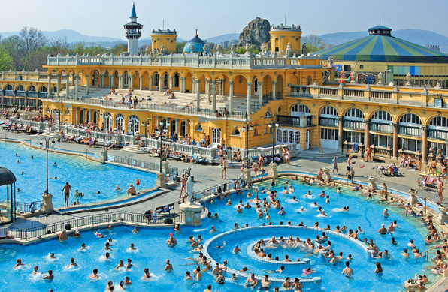
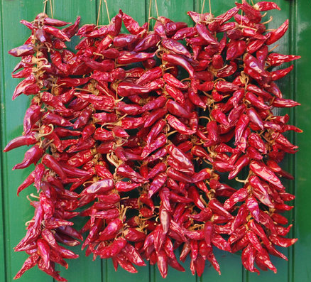
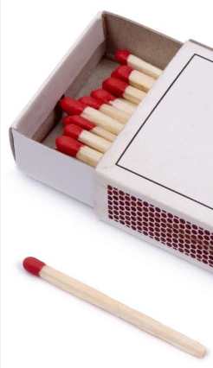
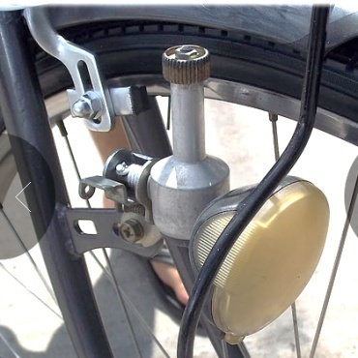
Learn more…
Hungary is the home of:
Thermalwater
Fatty and spicy dishes, Paprika, Pálinka
Lot of inventions
matches
pen
Rubik’s Cube
Dinamo
Vitamin-C
Sport nation

Slide 4
Beautiful folk-songs
Erdő, erdő, erdő, marosszéki kerek erdő,
Madár lakik abban, madár lakik tizenkettő.
Cukrot adnék annak a madárnak, dalolja ki nevét a babámnak.
Csárdás kisangyalom, érted fáj a szívem nagyon.

Slide 5
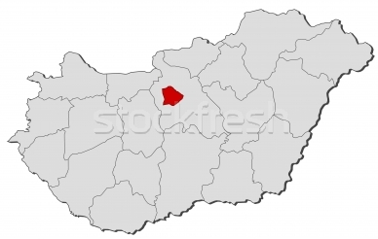
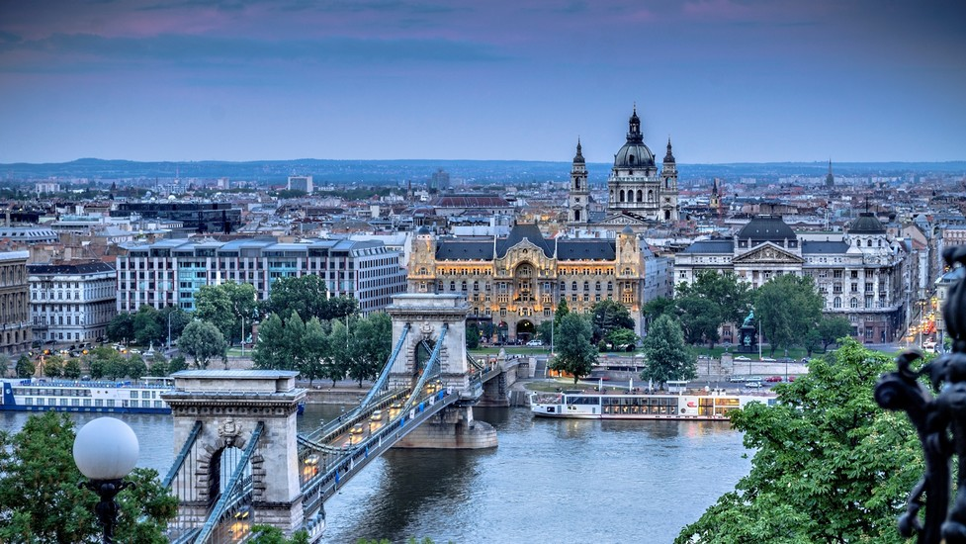
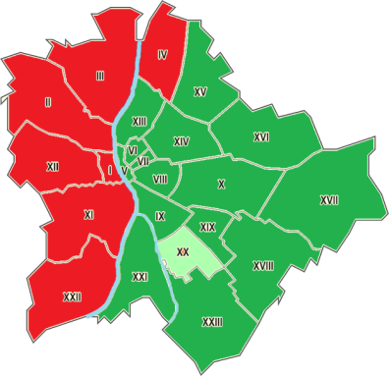
Budapest
ninth largest city in the EU
population:
1,7 million people
1873: Buda + Óbuda + Pest = Budapest
many beautiful sights
the Danube flows through Bp.: 9 Bridges
(for example: Chainbridge)
It has 23 districts

Slide 6
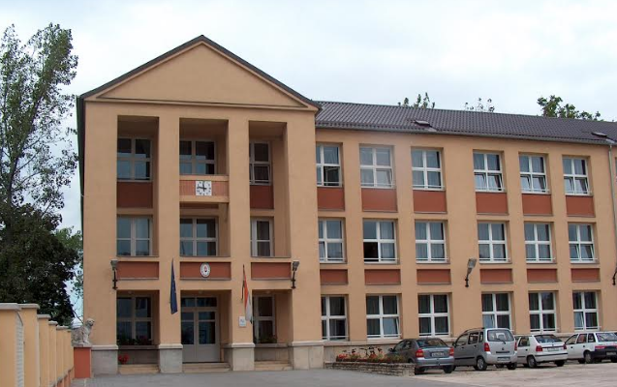
German National High School
XX. district of Budapest (Pestelisabeth)
School for the Hungarian Germans
Bilingual education (Hun. + Ger. + Eng..)
Traditions:
At celebration: traditional outfit ,so called „Tracht”
Dance, songs
Traditional dishes

Slide 7
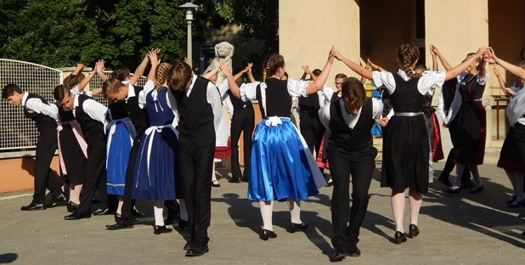
Performance of a Hungarian-German dance

Slide 8
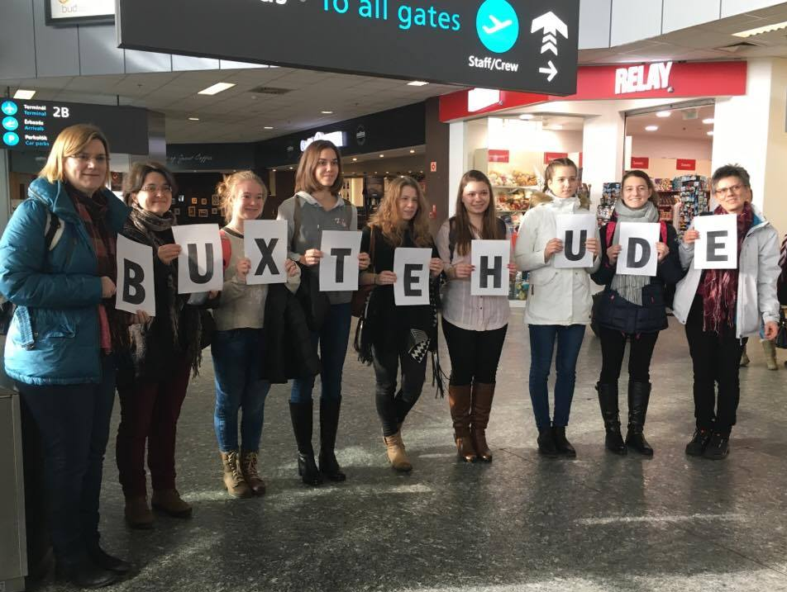
We present ourselves…

Slide 9
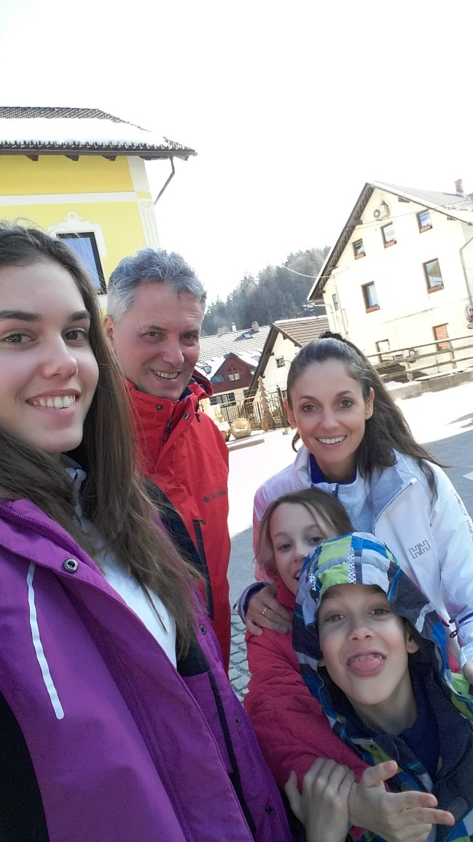
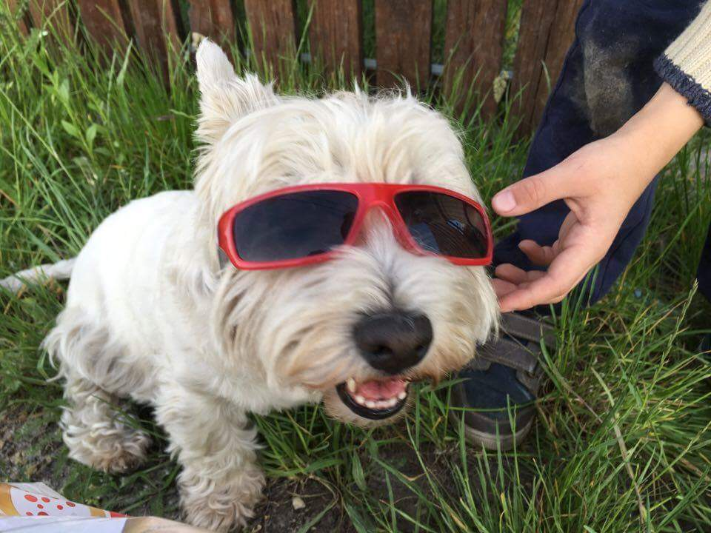
Noémi Hopka
5 in the family + 1 dog
16 years old
Dance, swim, play tennis and synchronized swimming
Travelling, reading, playing the guitar

Slide 10
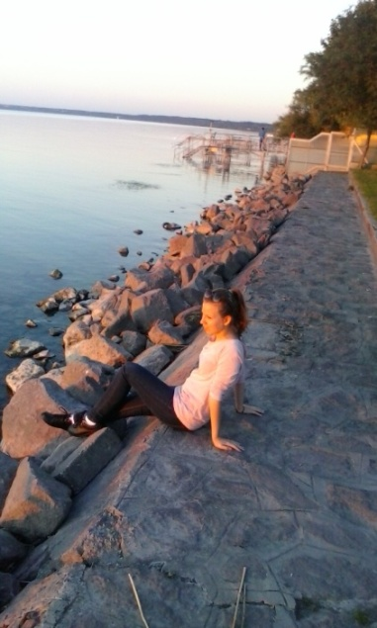
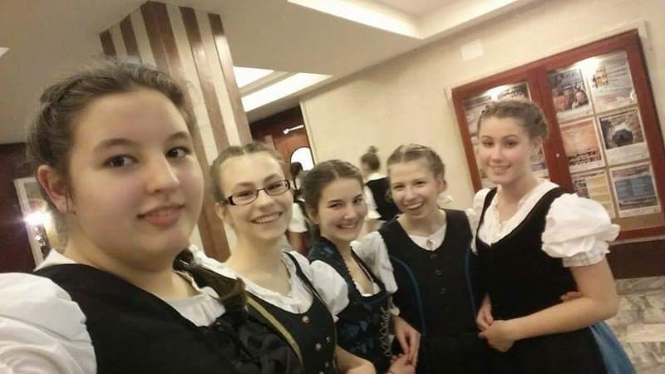
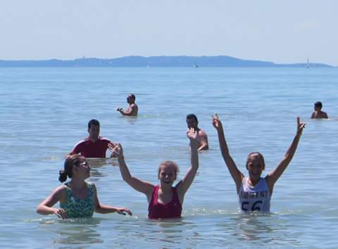
Magdolna Lányi
16 years old
My nickname: Magdus
I live in Budapest
My hobbys: dance, play the piano for 10 years

Slide 11
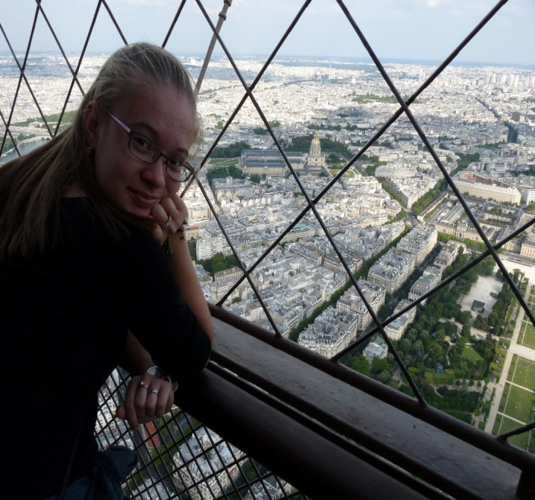
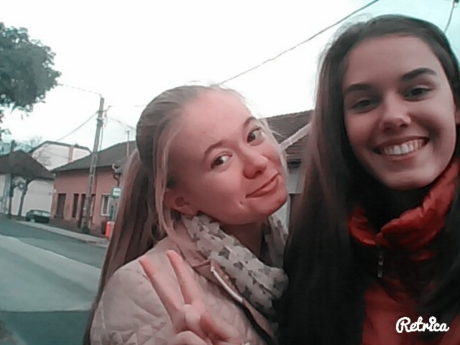
Nikolett Kóczán
I live in Budapest
I am 16 years old
My hobby is cooking and I like all kind of sweets
I do balett

Slide 12
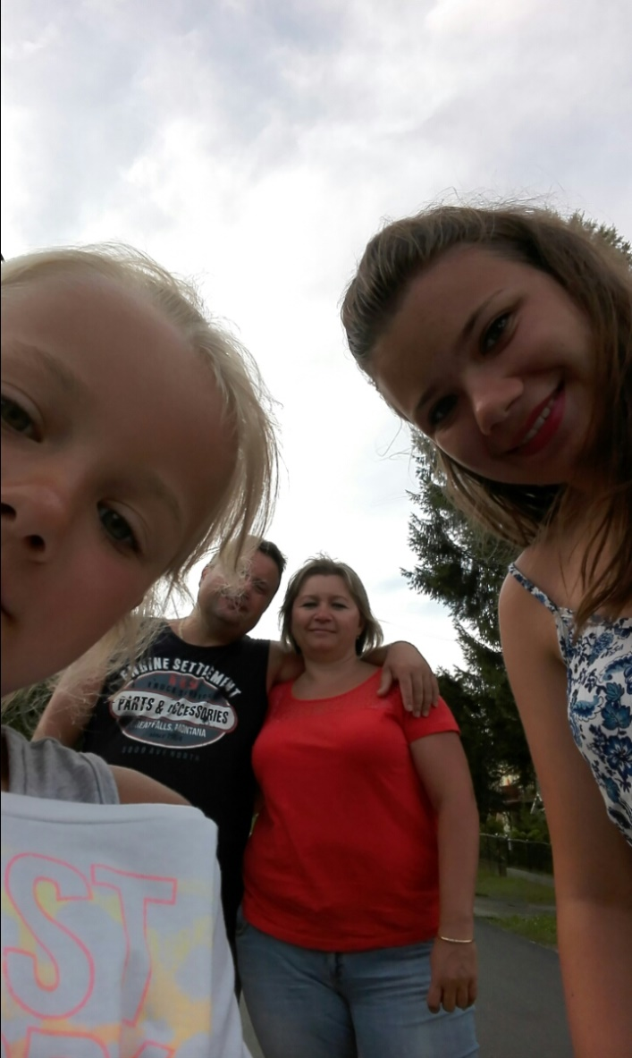
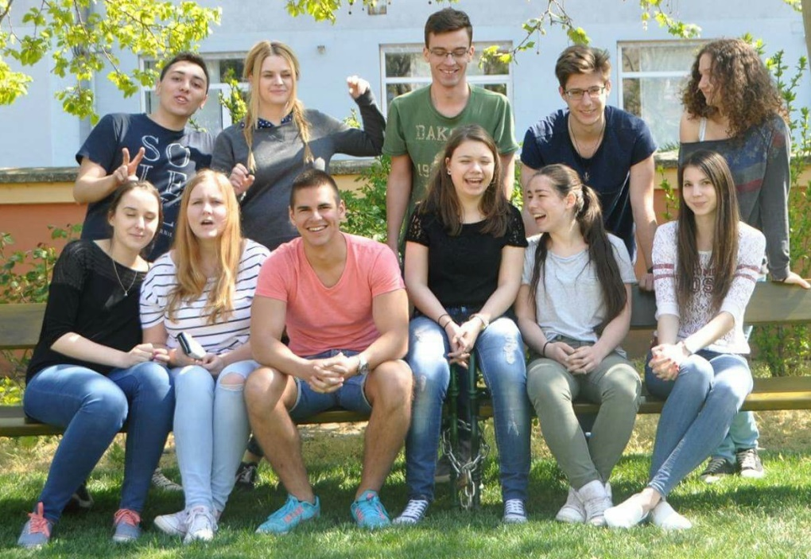
Szandi Szabó
18 years old
Budapest
Family: parents, sister (9)
Free time: friends, swimming
Dream: to study law

Slide 13
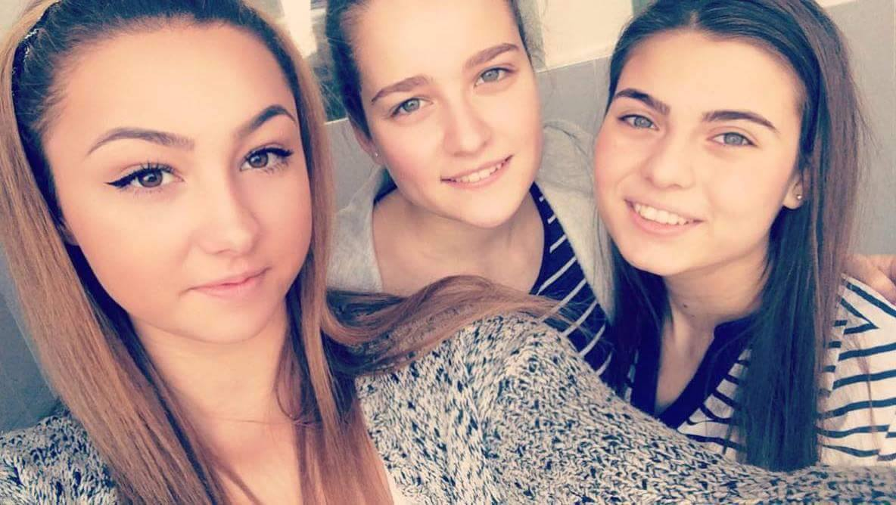
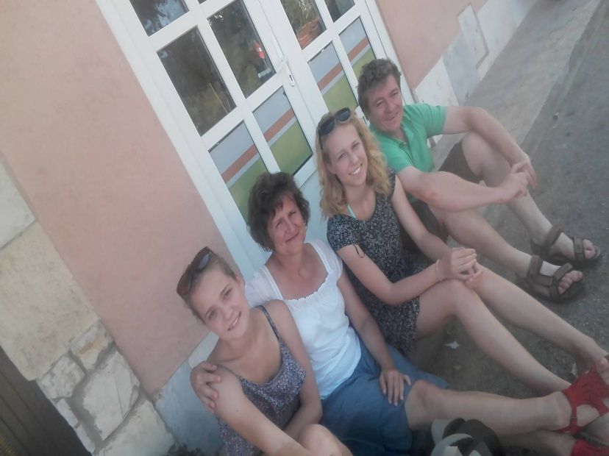
Léna Schwarczkopf
17 years old
Budapest
My family: parents, sister (20)
Flute
Friends

Slide 14
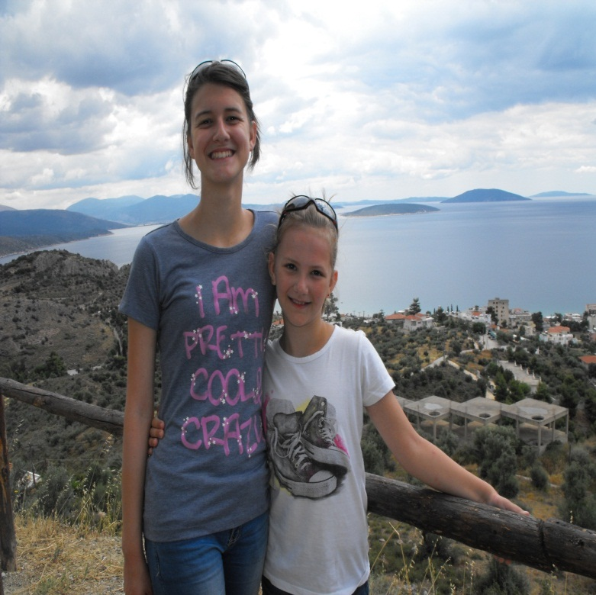
Domi Balogh
18 years old
Budapest ->Makó
Family: parents , sister (10)
Book , animals

Slide 15
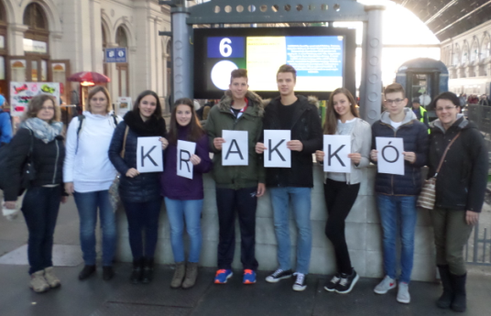
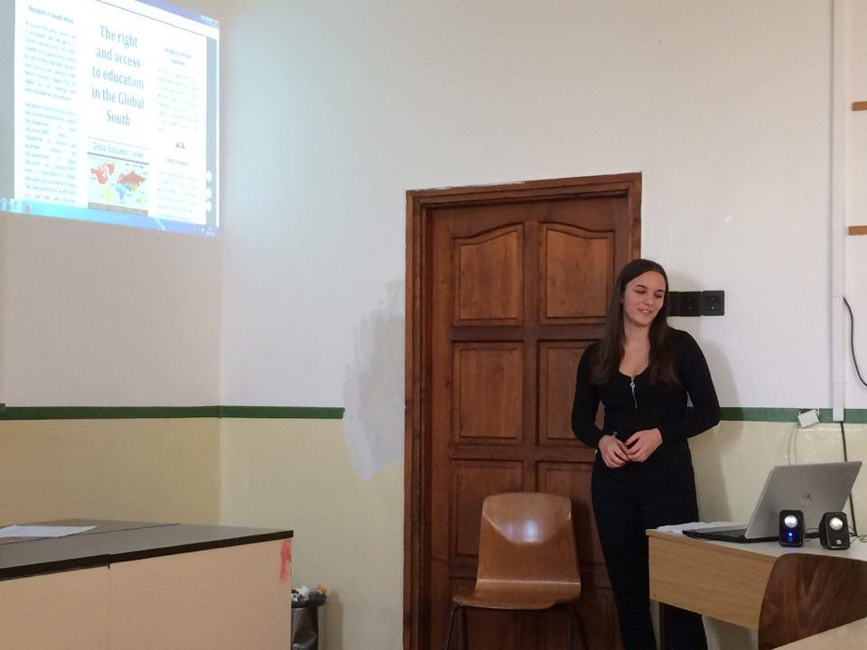
Project in Krakow
Teachers:
Leading from workshopgroups+ sections
Prepairing+holding from lessons for intercultural classes
Students:
Topic: qualification and labour market
+5 subtopics
Labour process: teamwork+5 sections
Homeland: information campaign

