Slide 1
ERASMUS + Project The Art of Recycling and Reuse
Class 5C IIS Benedetti-Tommaseo

Slide 2
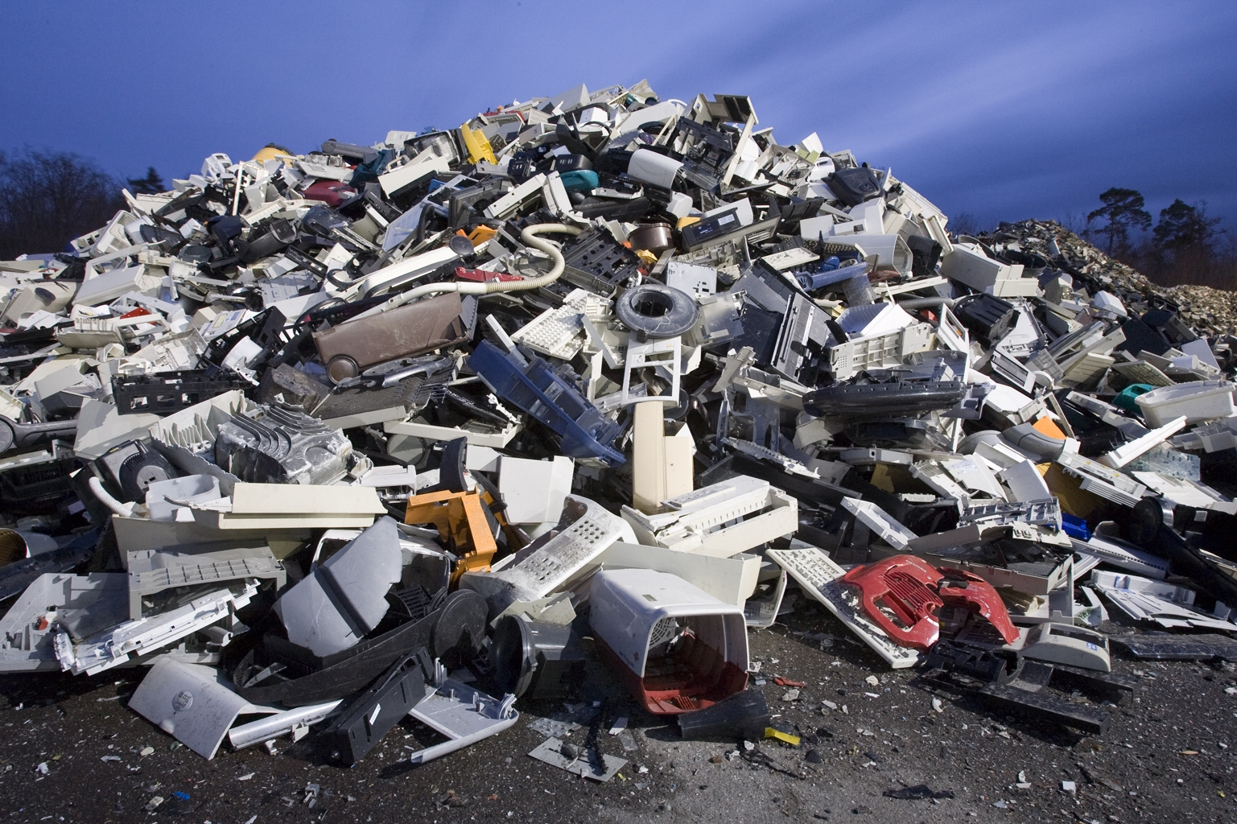
WEEE
Where do our phones end up?

Slide 3
What are WEEEs?
Waste
Electrical
and
Electronic
Equipment

Slide 4
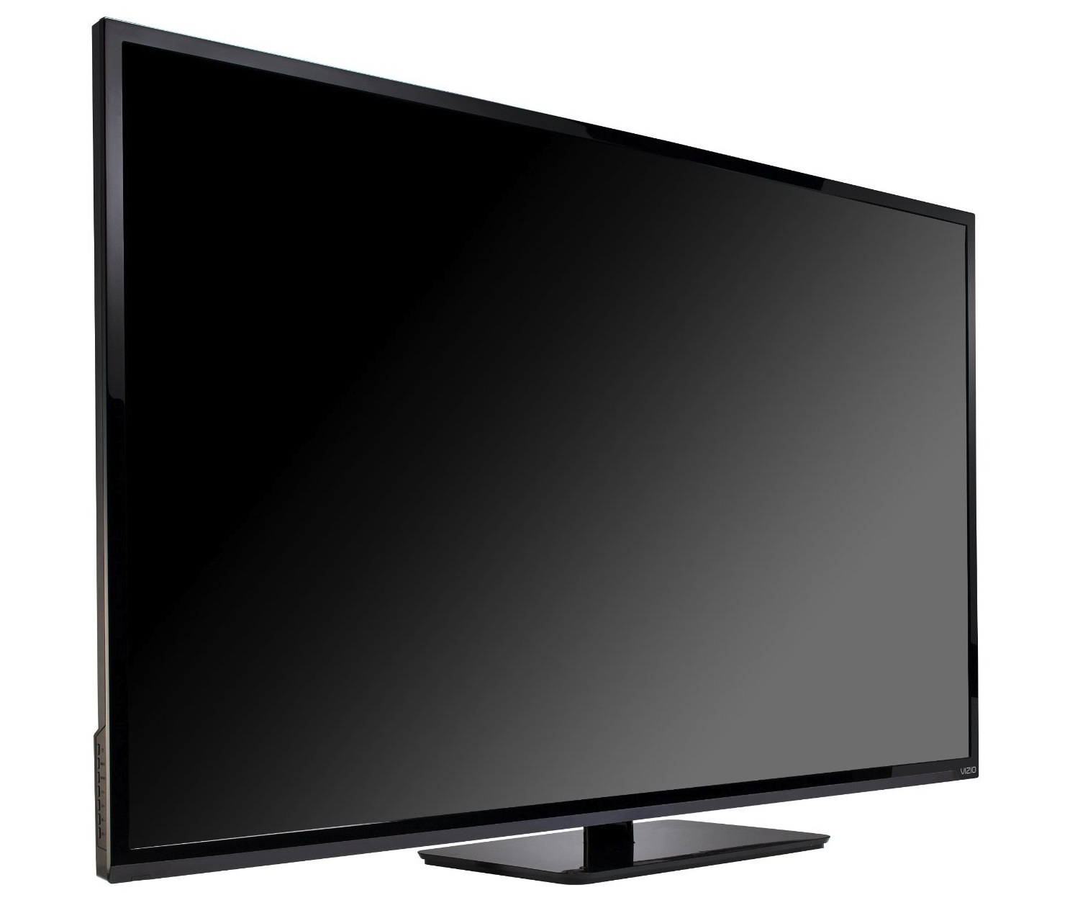
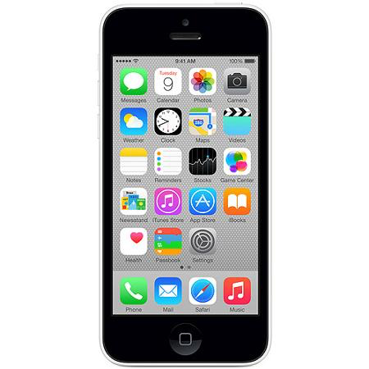
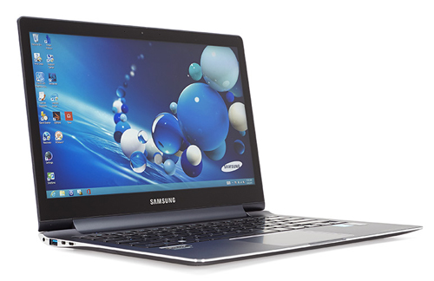
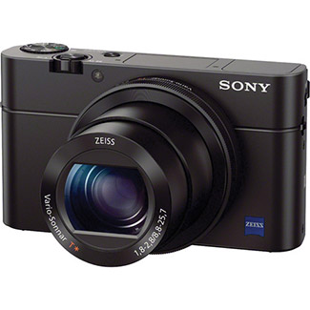
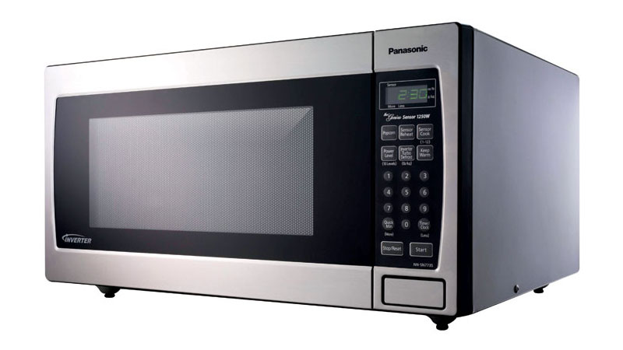
Some Examples

Slide 5
Why are WEEEs important?
Hazardous Content
Precious Materials

Slide 6
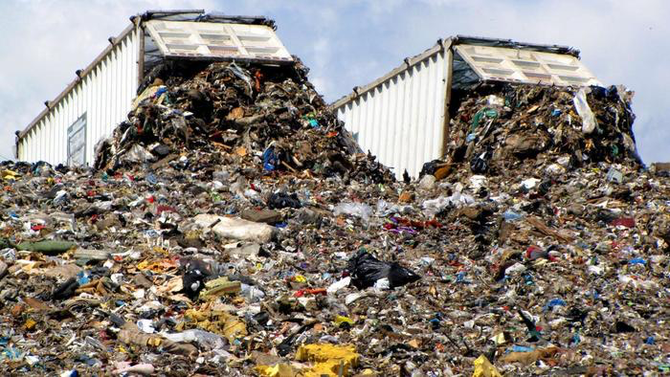
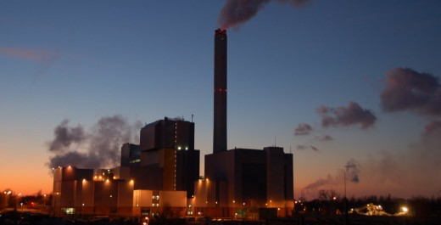
WEEE Disposal
Landfills
Incineration
Reuse & Recycle

Slide 7
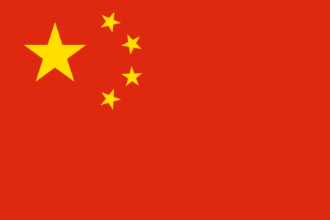
The Exportation problem
WEEEs are exported (sometimes illegally) into
developing countries, where their treatment is less
expensive

Slide 8
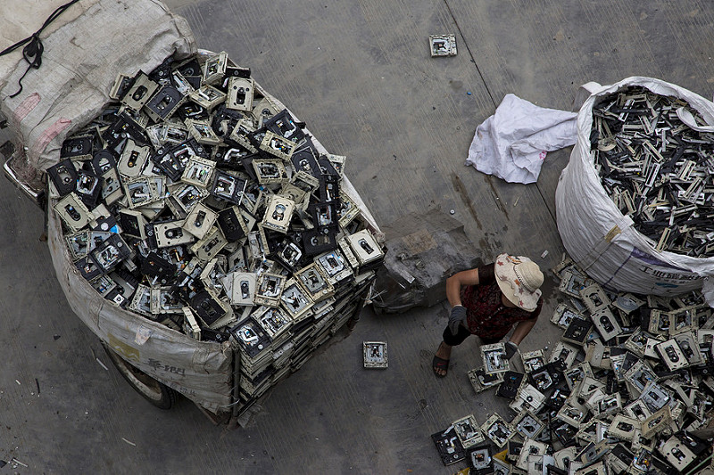
The Guangdong province
Workers and people living near the dumps
are exposed to dangerous diseases

Slide 9
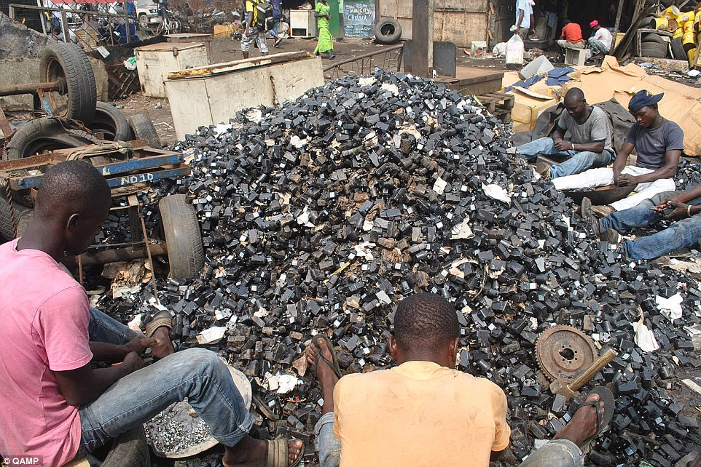
Electronic Graveyards
Western Africa is full of e-waste dumps, containing dangerous and toxic devices

Slide 10
Production of WEEEs
Every year 20-25 million tonnes of WEEEs are produced:
the weight of nearly four million elephants!
x 4,000,000

Slide 11
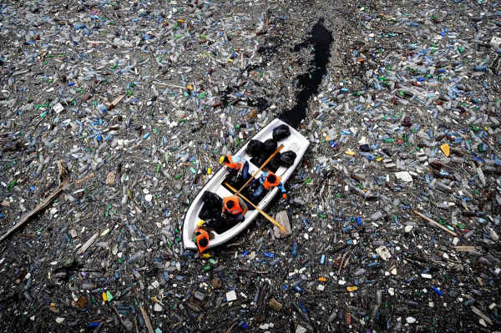
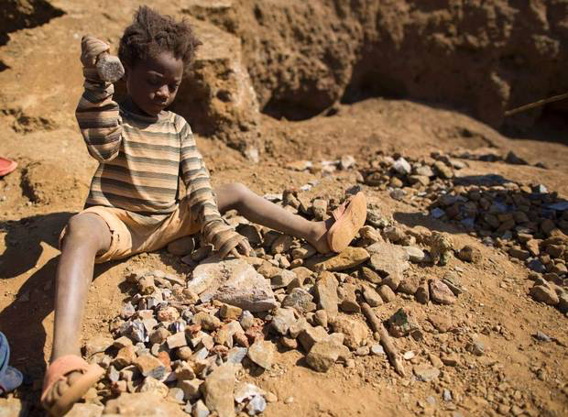
The Consequences
The production of electronic devices and the resulting WEEEs have disastrous consequences on the environment and also on the people

Slide 12
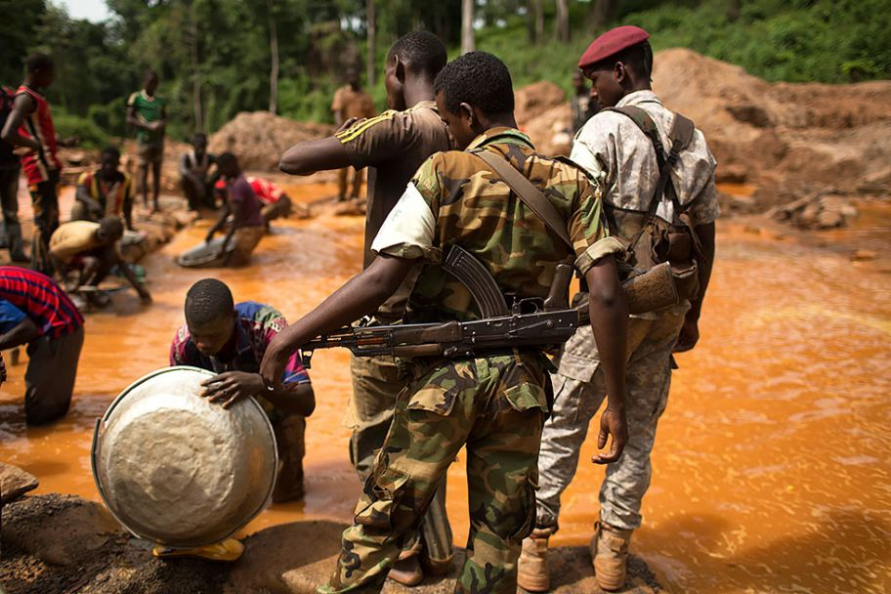
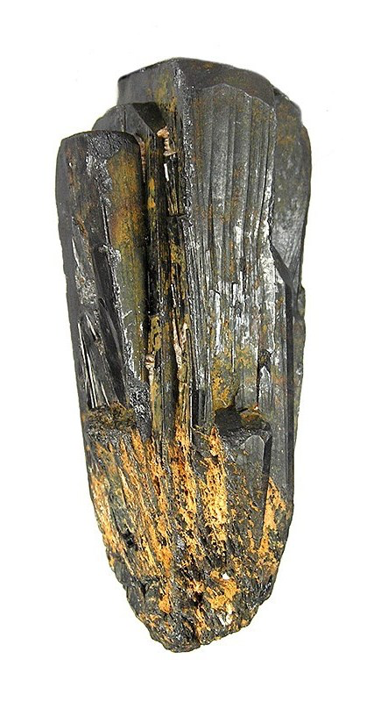
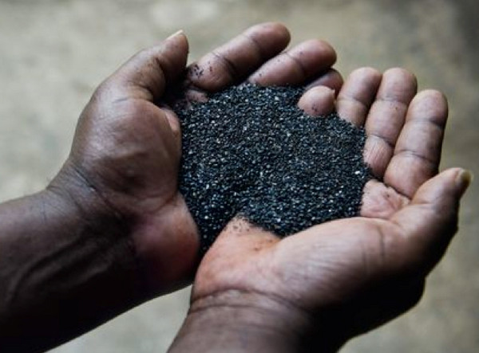
Coltan
1 kilogram
600 US$ (in 2001)
Coltan has caused a War in the Congo

Slide 13
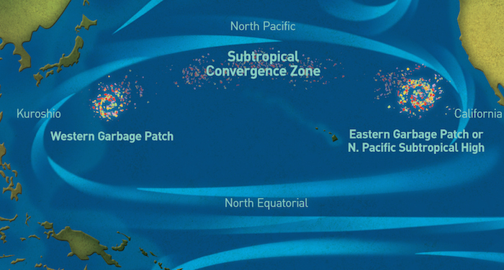
Great Pacific Garbage Patch
It is a concentration of marine debris, divided into two huge garbage “islands”
=
Eastern Patch

Slide 14
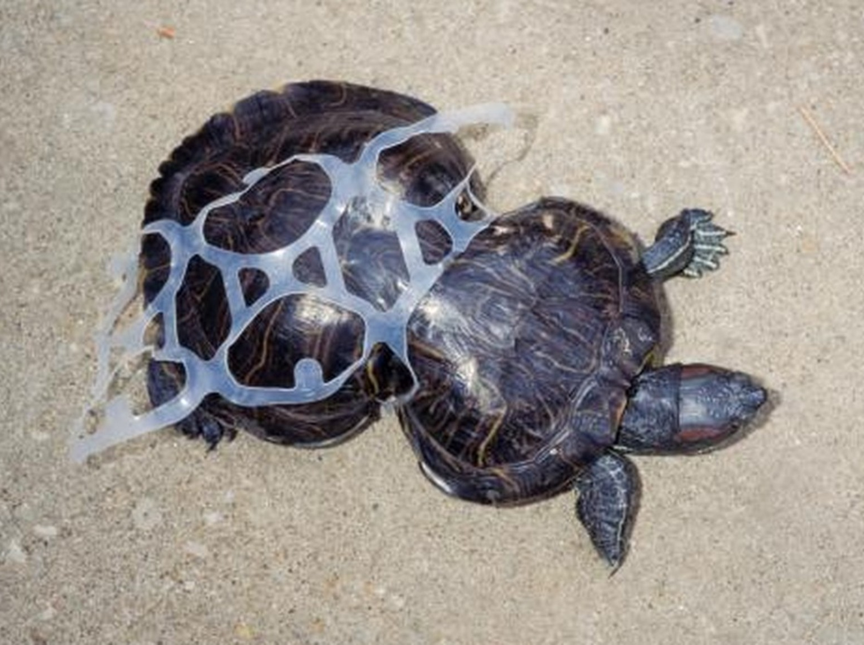
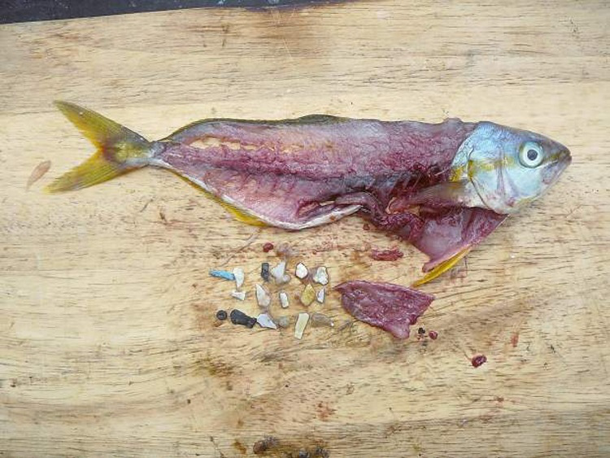
Endangered Animals
The garbage patch is dangerous both for small fish and large sea mammals and birds
A turtle entangled in a plastic ring
Plastic eaten by a fish

Slide 15
What can we do about it?
The WEEE problem is not given enough importance: everybody should help spreading awareness!

