Slide 1
Coffee mug project Hamburg
How to minimize the waste of one-way-mugs

Slide 2
The one-way-mug problem
In Germany:
320.000 mugs end up in trash every hour
More than 3 billion mugs every year
40.000 tons of waste
110000 tons of Co2 emissions every year
70 % of the Germans are using one-way-mugs

Slide 3
Project `Refill it!`
11 cafés are taking part in a coffee-mug deposit system in Hamburg
Customers buy reusable mugs for 1,50 Euro
Cafés wash used mugs and customers get a clean one

Slide 4
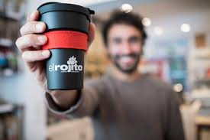

Slide 5
Plans for our school
Ask students if they want to take part
Cooperation between `refill it!´ the `Saftladen´ (small canteen run by parents) and our canteen
Creating Altona mugs
explaining the project to students

Slide 6
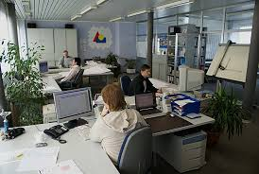
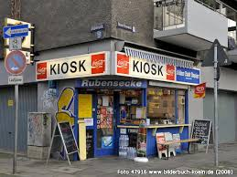
More ideas

