Slide 1
Slovakia
Slovakia

Slide 2
Slovakia

Slide 3
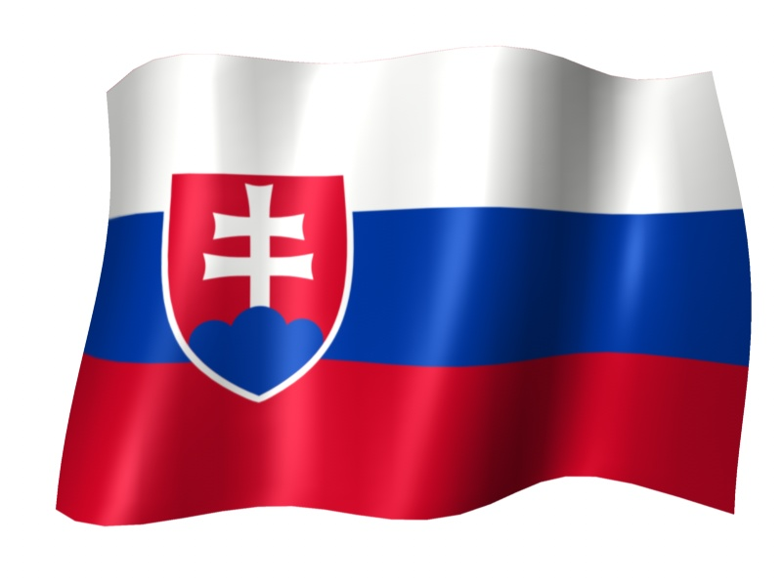
Slovakia
Official name: the Slovak Republic (SR) State formation date: 1 January 1993 State system: republic Political system: parliamentary democracy Head of state: President State symbols: national coat of arms/emblem, national flag, state seal and national anthem „Nad Tatrou sa blýska“

Slide 4
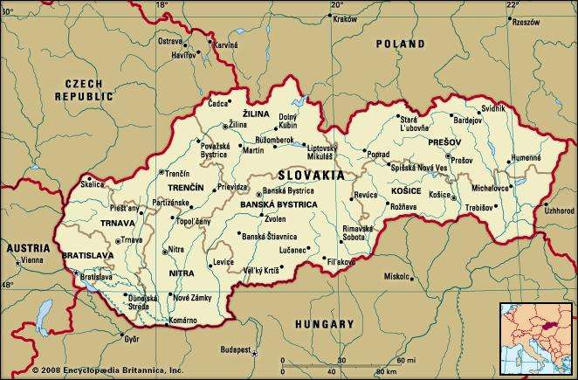
Slovakia
Area: 49 035 km² Location: Central Europe (17° – 22° E, 47° – 49° N)
Border countries: Hungary (654.8 km), Poland (541.1 km), the Czech Republic (251.8 km), Austria (106.7 km), Ukraine (97.8 km)
Capital city: Bratislava Population: 5 412 008
Official language: Slovak

Slide 5
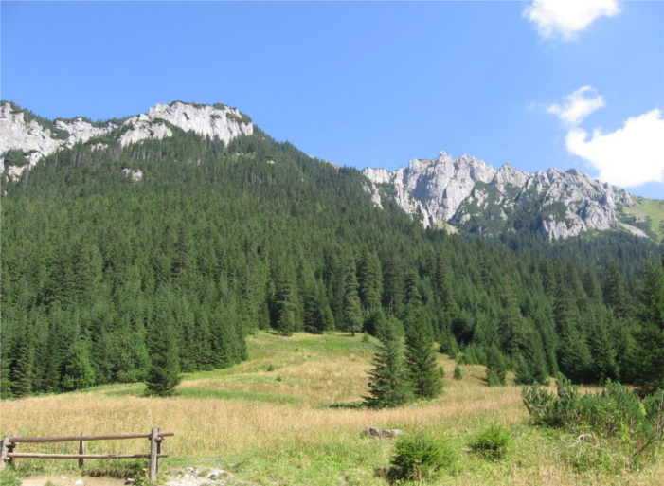
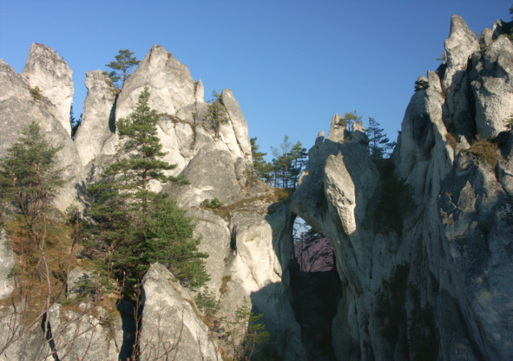
Natural conditions for tourism in Slovakia
There are a lot of caves, mountains, hills and valleys on the territory of Slovakia.

Slide 6
LOW TATRAS

Slide 7
ŠTIAVNICKÉ MOUNTAINS

Slide 9
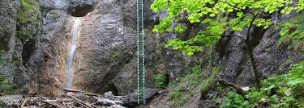
SLOVAK PARADISE NATIONAL PARK

Slide 10
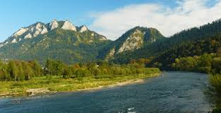
PIENINY NATIONAL PARK

Slide 13
Ochtinská Aragonite Cave

Slide 14
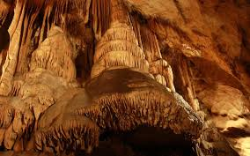
Belianska Cave

Slide 15
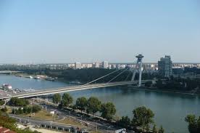
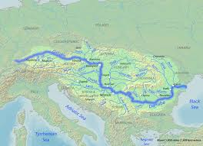
DUNAJ – DANUBE is the biggest and the most important river

Slide 16
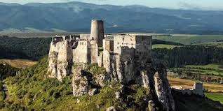
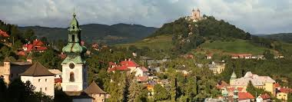
Cultural and historical monuments
Mining town Banská Štiavnica, Bardejov, Spiš castle, Vlkolínec folk village, Carpathian forests, town Kežmarok and others are included in the UNESCO World Heritage List.

Slide 17
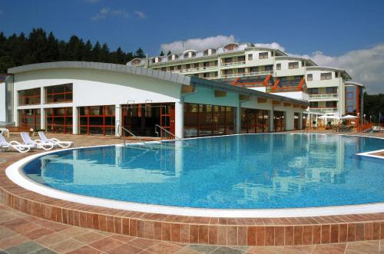
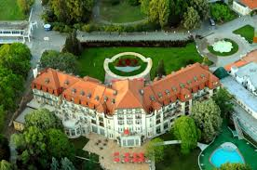
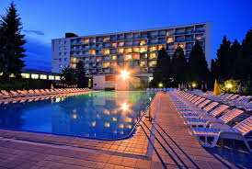
Slovakia SPAS -There are a lot of thermal spas in Slovakia, for example, Piestany, Dudince, Sliač, Bardejov.

Slide 18
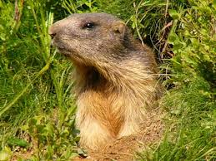
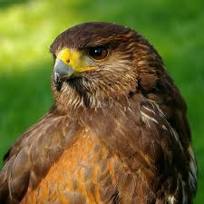
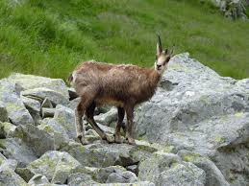
Fauna in Slovakia
FAUNA – There are a lot of different species of animals and plants in Slovakia, e.g. squirrel, fox, wild boar, lynx, wolf, bear, deer, roe deer, fallow deer, mouflon.
In Slovakia we have good conditions for hunting.
Birds are owl, grouse, buzzard, eagle, in caves there are a lot of bats.
The symbols of the High and Low Tatras are chamois and marmots.

Slide 19
Thank You for Your attention

