Slide 1
Historical development of Slovakia
From middle ages to nowdays

Slide 2
Timeline
4. - 6. century
1. 1. 1993
833 - 906
1939
1945
623 - 658
1000 - 1918

Slide 3
4. - 6. century – The great movement of people
the arrival of our ancestors to Central Europe from the east of the Visla and Odra rivers

Slide 4
623 - 658 - Sam's Empire
the first tribe of Slavs
at the head of the Franconian merchant Samo
it disappeared after Sam's death

Slide 5
833 - 906 - Great Moravian Empire
It was created by joining two principalities - the Nitra and the Moravian ones
the importance of Great Moravia:
the first state unit
spreading Christianity
creating writing for the Slavic language

Slide 6
1000 - 1918 - Slovakia as part of Hungary
The territory of Slovakia gradually became a part of the emerging Hungarian state, which was founded in 1000 Sv. Stephan
since 1526 a new dynasty ruled in our territory - the Habsburgs
in 1867 the Austro-Hungarian Constitutional dualistic monarchy was established

Slide 7
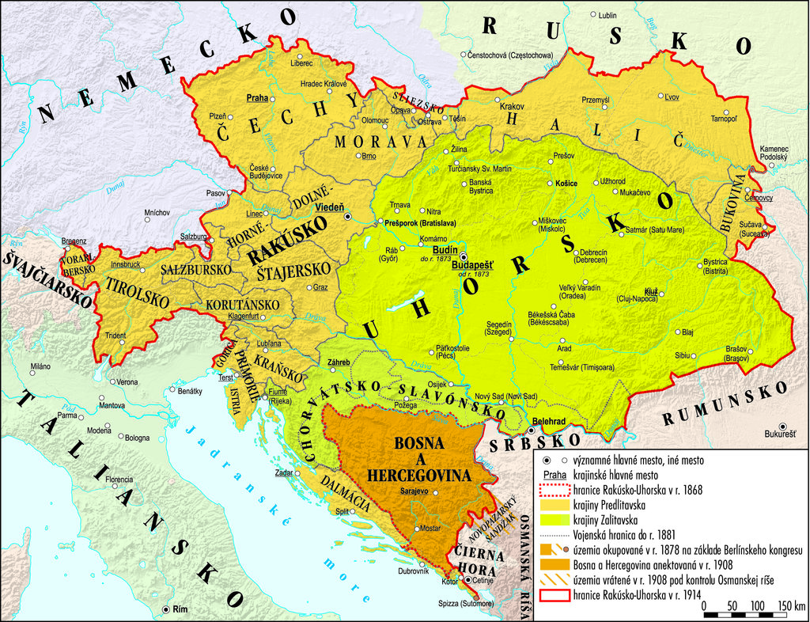
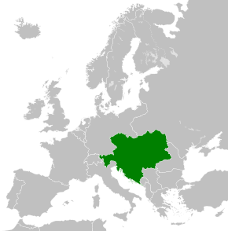
Austria - Hungary

Slide 8
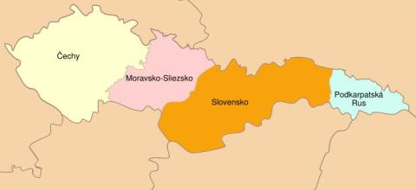
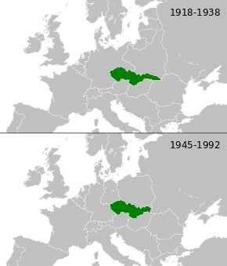
1918 - Establishment of the Czechoslovak Republic (ČSR)
ČSR was established as a state after the disintegration of Austria - Hungary October 28, 1918
ČSR was a democratic parliamentary state.
The first president of ČSR was Tomáš Garrique Masaryk
Prague became the capital city

Slide 9
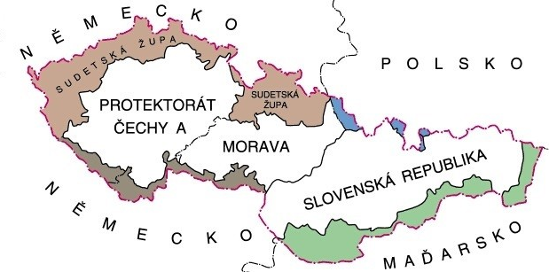
1939 - 1945 - independent Slovak Republic
In 1939, Czechoslovakia split
14. March. 1939 Slovak Republic was established
15. March. 1939 Protectorate of Bohemia and Moravia was established
the division lasted throughout the World War II

Slide 10
1945 - restored Czechoslovak
On 5 April 1945 the Czechoslovak Republic was restored as a common state of two equal nations
in 1948 a totalitarian regime was established after the Communist Party took over power
in 1960 was renamed the Czechoslovak Socialist Republic (ČSSR)

Slide 11
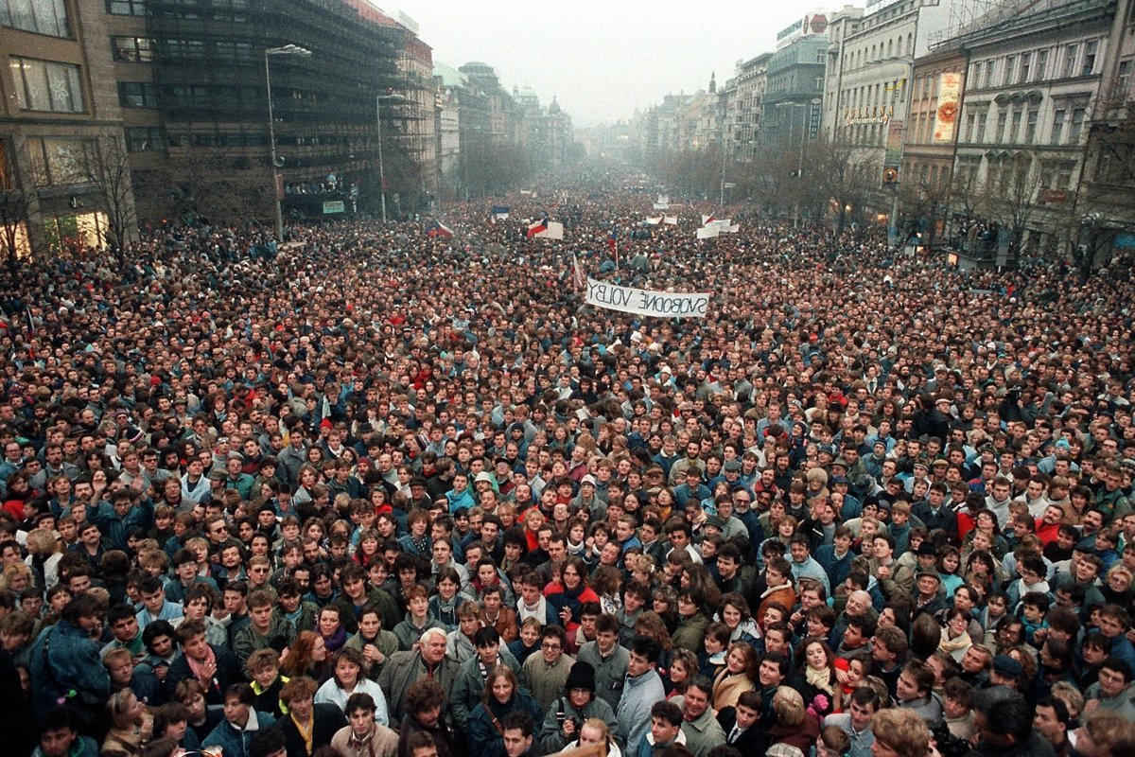
1989 - Velvet revolution
in November 1989:
students manifestations
declared a general strike
the fall of communism and the iron curtain
Václav Havel the playwright and the dissident became the President
in 1990 the first free elections were held

Slide 12
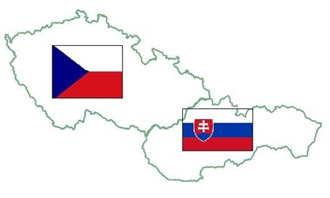
1. January 1993 - formation of the Slovak Republic
after a common agreement, Czechoslovakia was divided into two separate republics - the Czech Republic and the Slovak Republic
the first president of the Slovak Republic was Michal Kováč

Slide 14
Thank You for attention!
Slovak team

