Slide 1
“EUROSTAR”
“EUROpean Sustainable Tourism And entRepreneurship”
KA229- School Exchange Partnership
Activity code: 2019-1-CY01-KA229-058244_3
2019-2022
Presenting Collaborative Startups

Slide 2
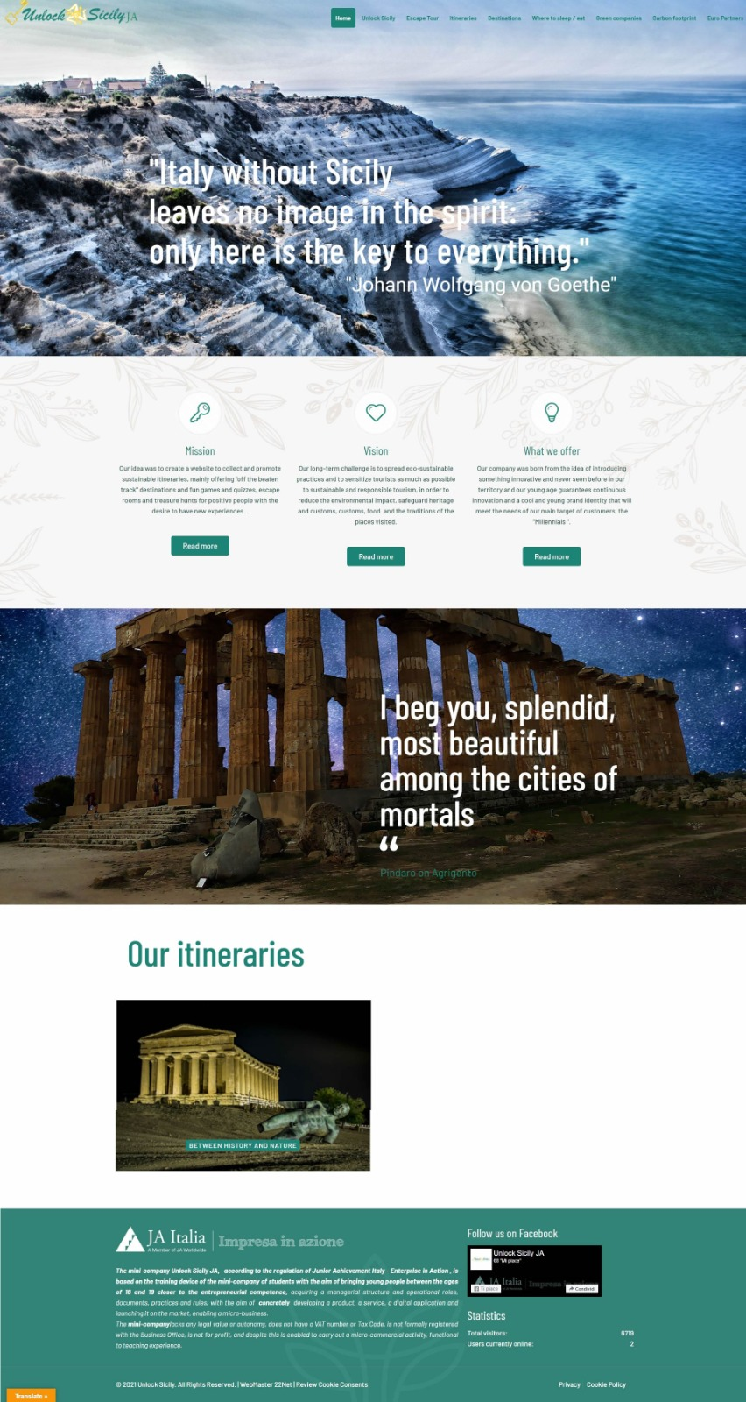
http://www.unlocksicilyja.com

Slide 3
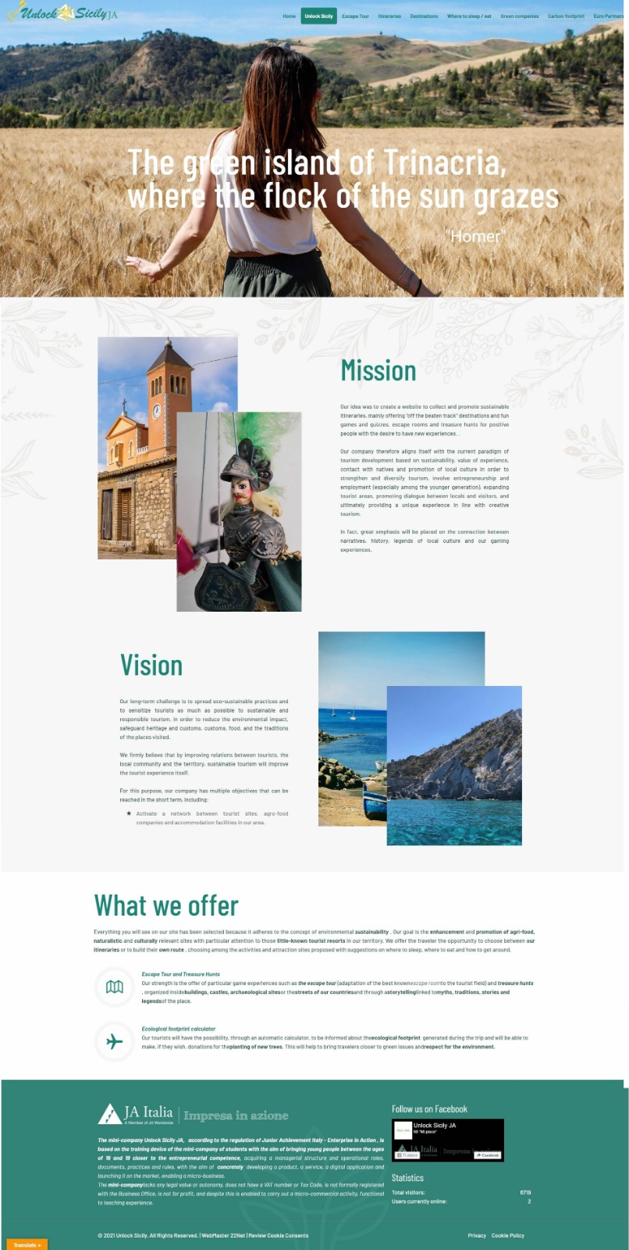
http://www.unlocksicilyja.com

Slide 4
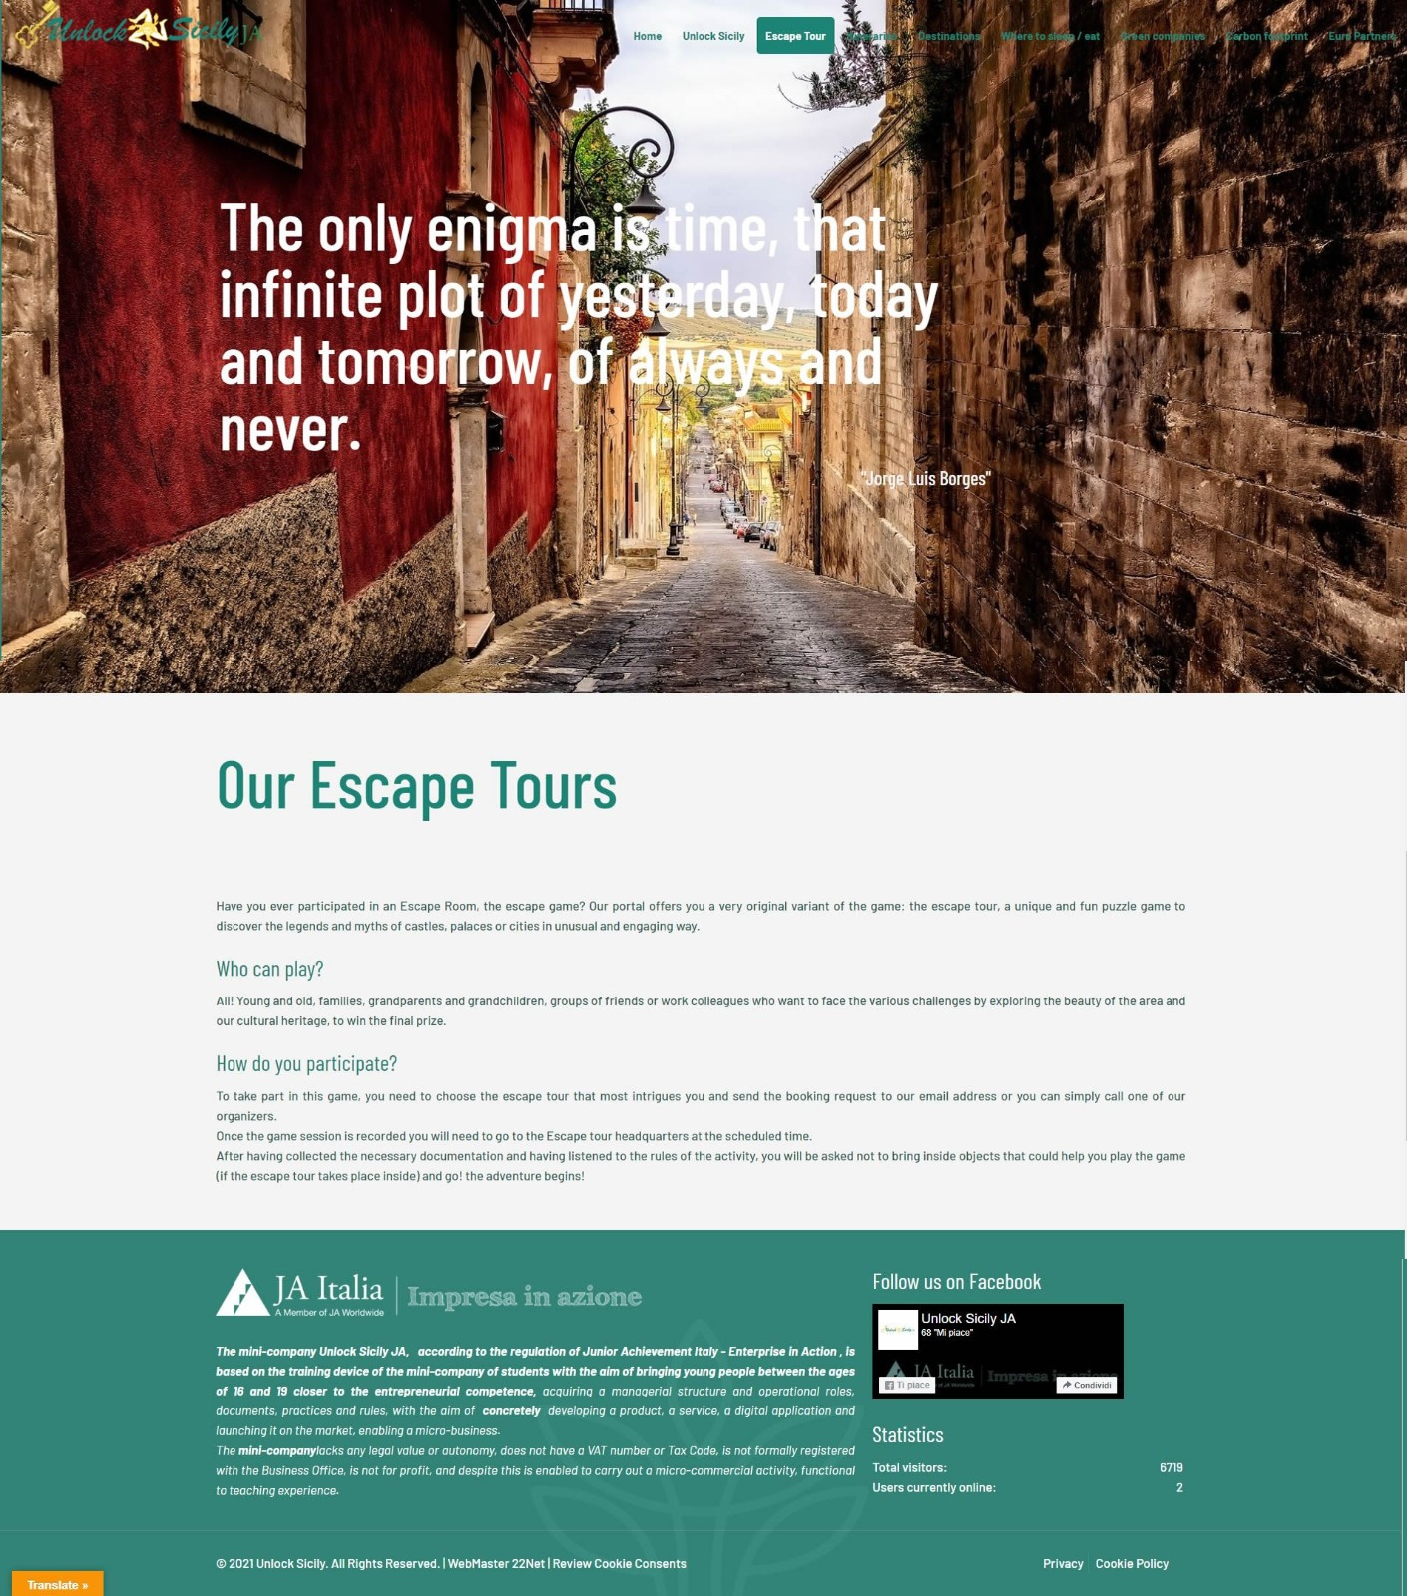
http://www.unlocksicilyja.com

Slide 5
http://www.unlocksicilyja.com

Slide 6
Financial Outcomes

Slide 7
DEED OF INCORPORATION AND ARTICLES OF ASSOCIATION
OF THE JA MINI-COMPANY
1. | Name of the JA Mini-Company: |  |  |  | Unlock Sicily JA
2. | Legal and operational address: |  |  |  |  |  | Via Pirandello, 6 92024 Canicattì (Ag)
3. | The objectives of the JA Company are:
 | •To acquire skills in organization and commercial practice • To manage a mini-business, create and sell a product / service • To manage any other economic / social activity • To collect the capital necessary for the activities of the company
4. | Members’ liability is limited.
5. | The initial share capital amounts to |  |  |  |  | €320,00
 | Divided into n. | 160 |  | shares
 | of | € 2,00 |  | which give the right to privileges and advantages.
 | Each single shareholder cannot own more than 5 shares.

Slide 8
How do we earn money?

Slide 10
Financial Statement
and forecasting

Slide 11
OUTFLOW |  |  |  | INFLOW
Description | May 2022 | May 2023 | May 2024 | Description | May 2022 | May 2023 | May 2024
Expenditures |  |  |  | Revenues
Stationery | €15,00 | €15,00 | €15,00 | Sale of standard affiliation contracts * | €120,00 (12X €10) | €600,00 (n30x €20,00) | €800,00 (n40x €20,00)
Escape tour s and Escape rooms set up |  | €150,00 | €300,00 | Sale of premium affiliation contracts * |  | €500,00 (n10x €50,00) | €1500,00 (n30x €50,00)
Escape tour s and Escape rooms management |  | €200,00 | €400,00 | Sale of golden affiliation contracts * |  | €300,00 (n3x €100,00) | €500,00 (n5x €100,00)
Promotional material: brochures, bookmarks, posters etc.. | €100,00 | €200,00 | €200,00 | Sale of escape tours and escape rooms to schools and families |  | €1500,00 (n150x €10,00) | €3000,00 (n 300x €10,00)
Personnel cost |  | €1000,00 | €2000,00 | Sale of escape tours and escape rooms for teambuilding |  | €450,00 (n30x €15,00) | €1050,00 (n70x €15,00)
Website domain | €13,41 | €13,41 | €13,41 | Donations and sponsors | €500,00 (Chamber of commerce First Prize) | €1000,00 | €1500,00
 |  |  |  | Commissions for the sale of gaming experiences from affiliated companies (20% each) |  | €200,00 (n100x €2,00) | €600,00 (n300x €2,00)
 |  |  |  | Crowdfunding |  | €400,00 | €800,00
Total | €128,41 | €1578,41 | €2037,41 | Total | €620,00 | €4950,00 | €13800,00

Slide 12
Net income up to May 2022
Balance sheet up to May
Revenues | €620,00
Expenditures | €128,41
Net income | €491,59
Share Capital | €320,00
+Net income | €491,59
Total | €811,59

Slide 13
ARTICLES OF ASSOCIATION
………………….
Article n.27
 | The distribution of the company's net profits occurs as follows: a) Assignment of the percentage of 25% to donations in support of environmental sustainability b) Allocation of the percentage of 25% to the students who will be employed in the student enterprise according to actually worked hours c) Allocation of the percentage of 50% to the shareholders

Slide 14
Promotional outcomes

Slide 18
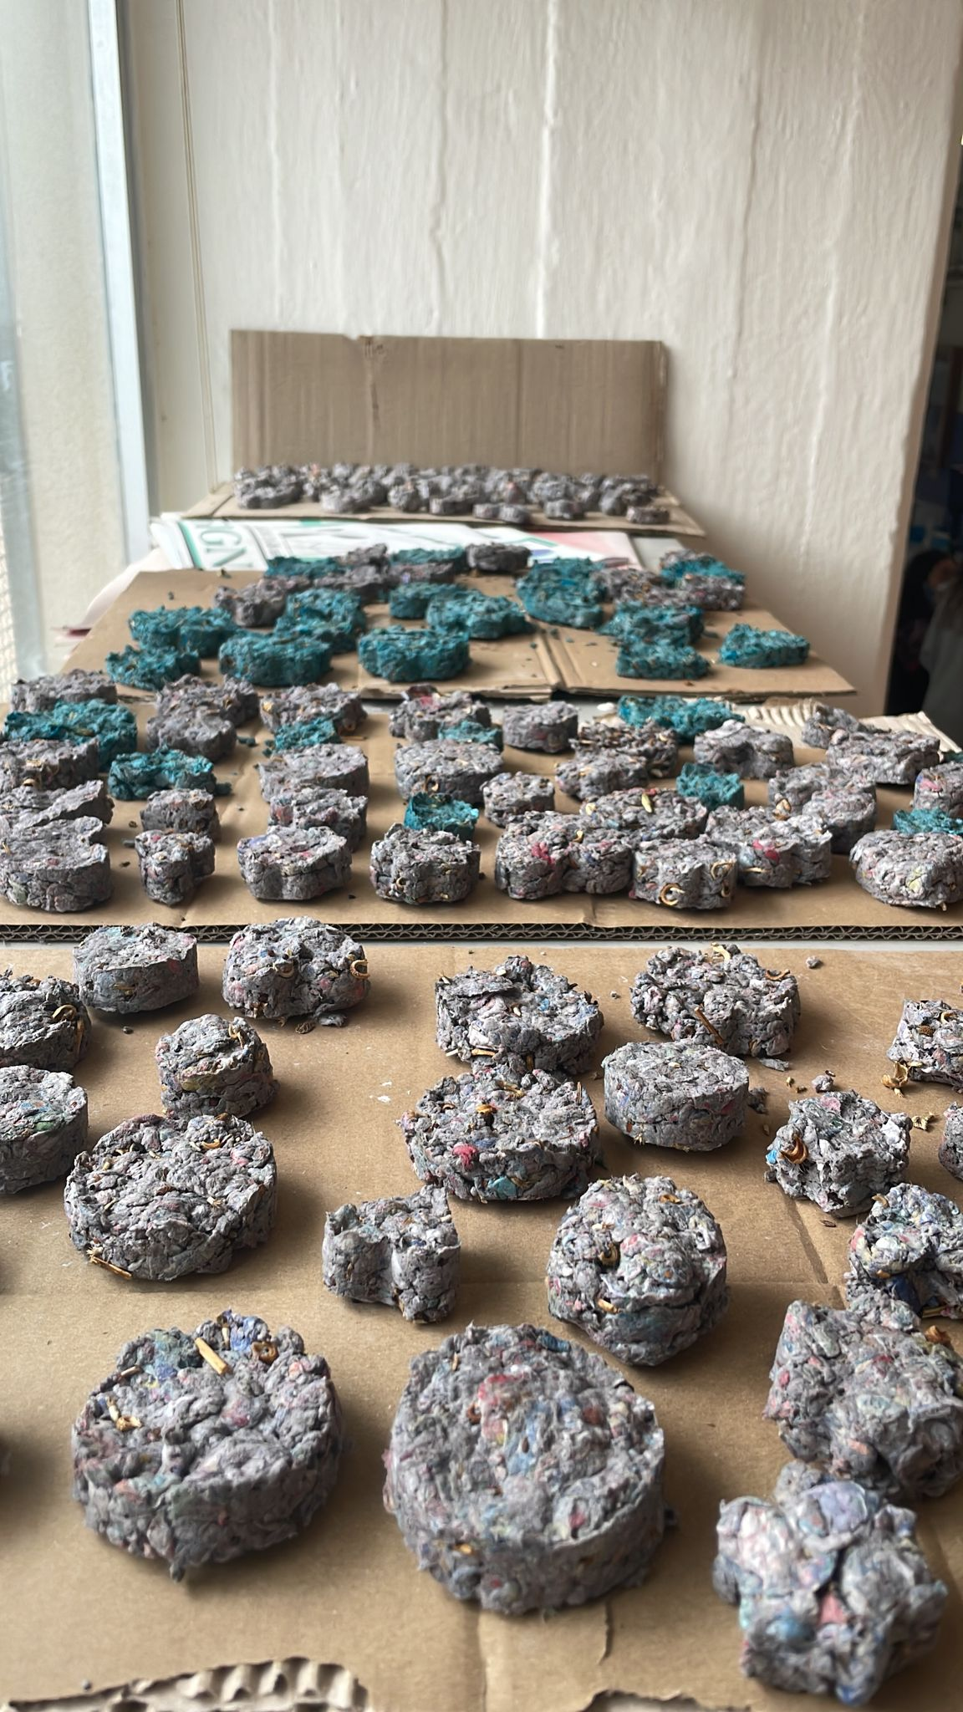
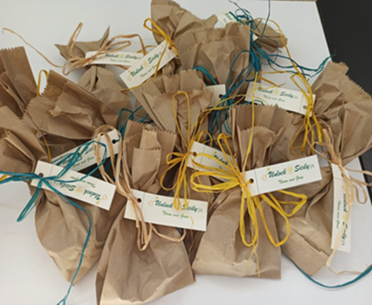

Slide 19
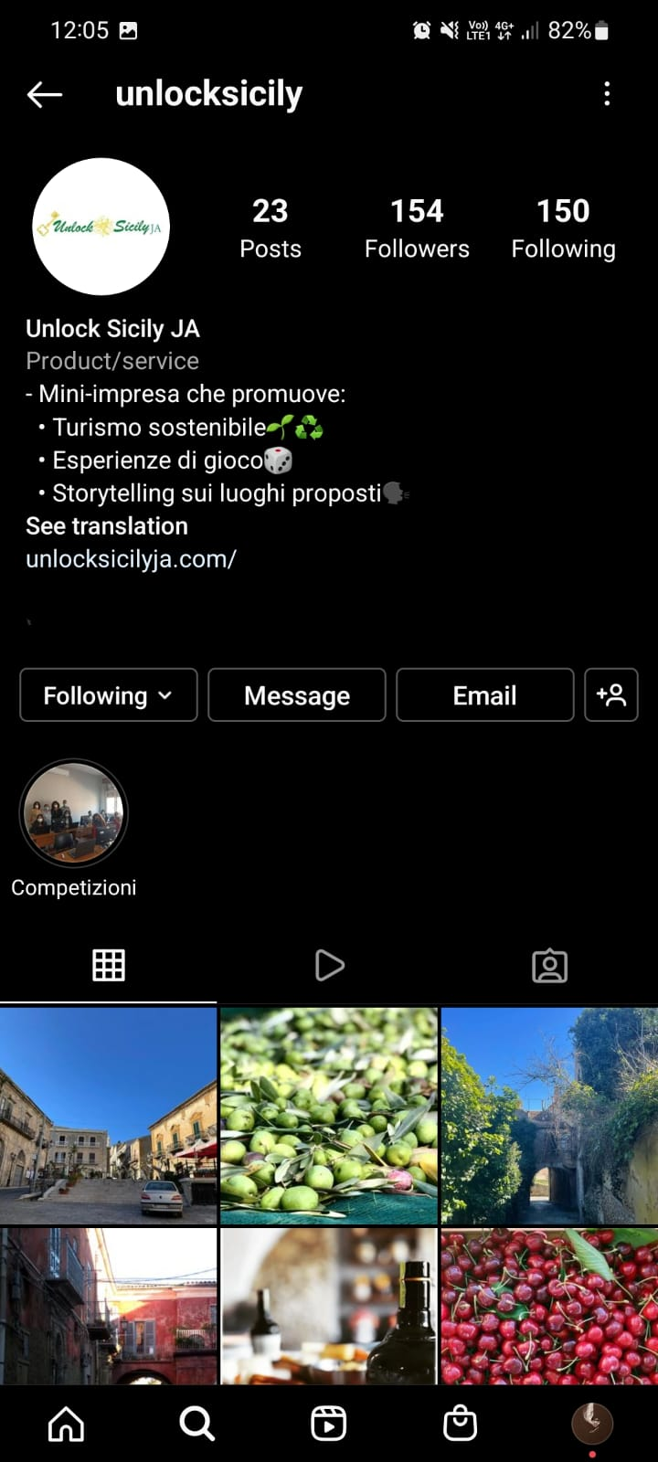
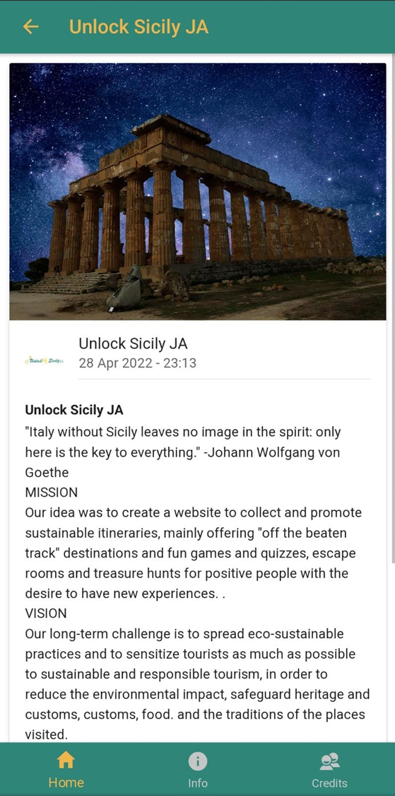

Slide 20
E:\ERASMUS EUROSTAR\Lithuania\Unlock Sicily Promotional video.mp4
promotional video

Slide 21
Closing remarks

Slide 22
https://youtu.be/Uj_iJ983Ie4

Slide 23
