Slide 1
Creating collaborative startups Related to Sustainable Tourism
Presented by:
Nina Papaioannou
Stelios Papaioannou
Christina Charilaou
Notes:
Hi, I am Nina
I am Stelios
And I am Christina
Nina: We come from Scholi Omodous in Cyprus and today we will present to you our start-up. We look forward to taking any questions and hearing your feedback at the end of our presentation.

Slide 2
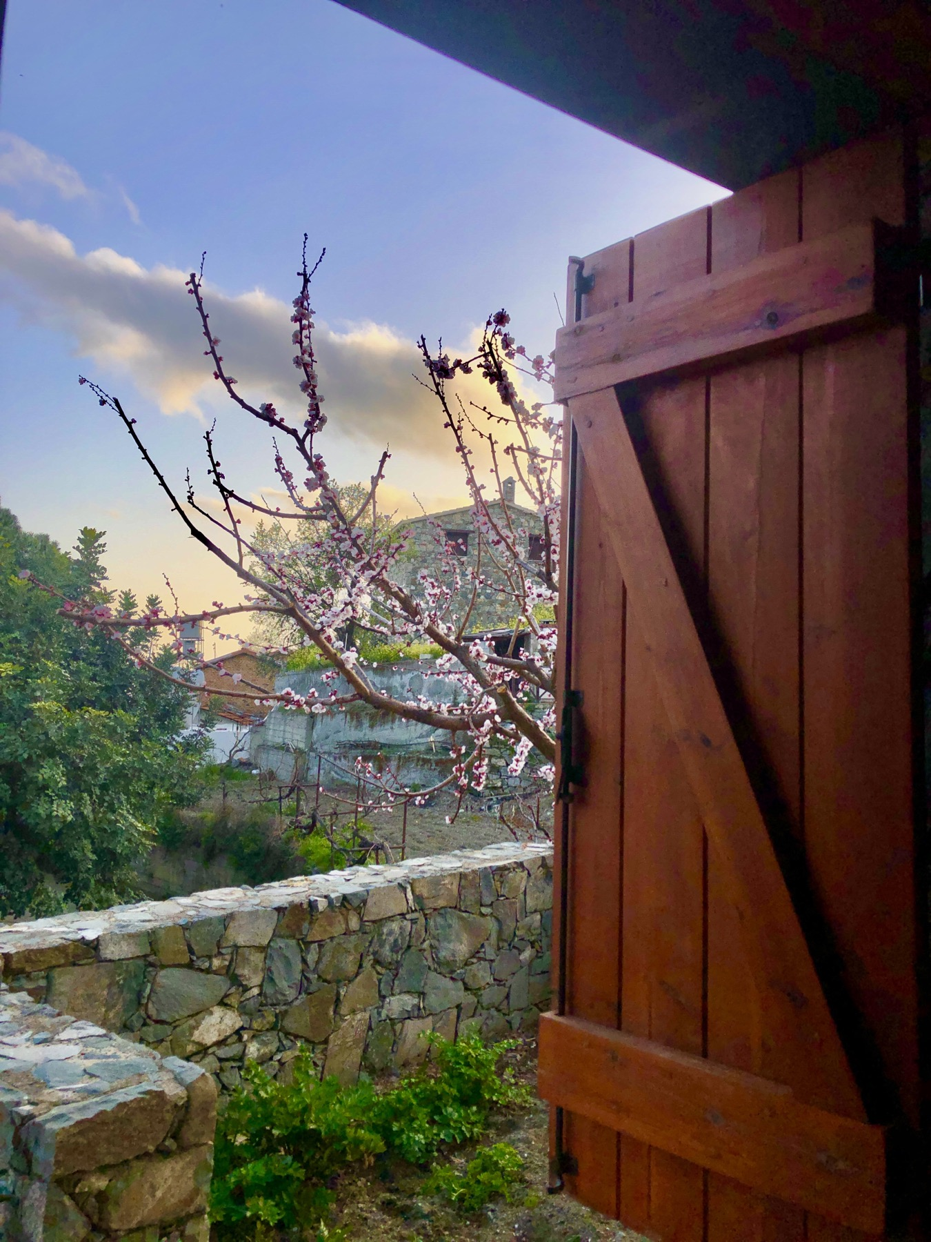
The idea
After brain storming ideas on sustainable tourism, we searched the internet for a one-stop web-page where tourists could find information related to sustainable tourism in Cyprus having decided to create a student company for this.
One site with all the information needed to meet all tourists’ personal needs and desires.
Notes:
Nina: We began by brain storming ideas based on our theme of sustainable tourism and search the internet trying to determine what was ‘missing’. We liked the idea of a one-stop web-page where tourists could find information related to sustainable tourism in Cyprus. None were available. Thus, we decided to create a student company that would address this, where you could find all the information needed related to sustainable tourism in Cyprus, that would meeting all personal needs and desires.

Slide 3
ARTICLES OF ASSOCIATION CHAPTER Α: NAME-PURPOSE-HEADQUARTERS-DURATION
ARTICLE 1
The company name is set as «CYlife» student company.
The Company Logo
ARTICLE 2
The purpose of the company is to promote the sustainable tourism of Cyprus through a website that will provide services to people who want to live the lifestyle of local people but also to bring them closer to anything that is related to activities falling within the category of sustainable tourism.
Notes:
Nina: Having created the idea, we needed to set up the company and so drew up our articles of association. Here we present the most important.
Chapter A addressed the name, purpose, location, duration and vision of our company
We choose Cylife as a company name that means the life in Cyprus
And for the logo we used the Yellow color which is the color of Cyprus and green which is the color of the nature and the arrows for sustainability .
And we established the purpose of our company, to make sustainable tourism more accessible to the tourist

Slide 4
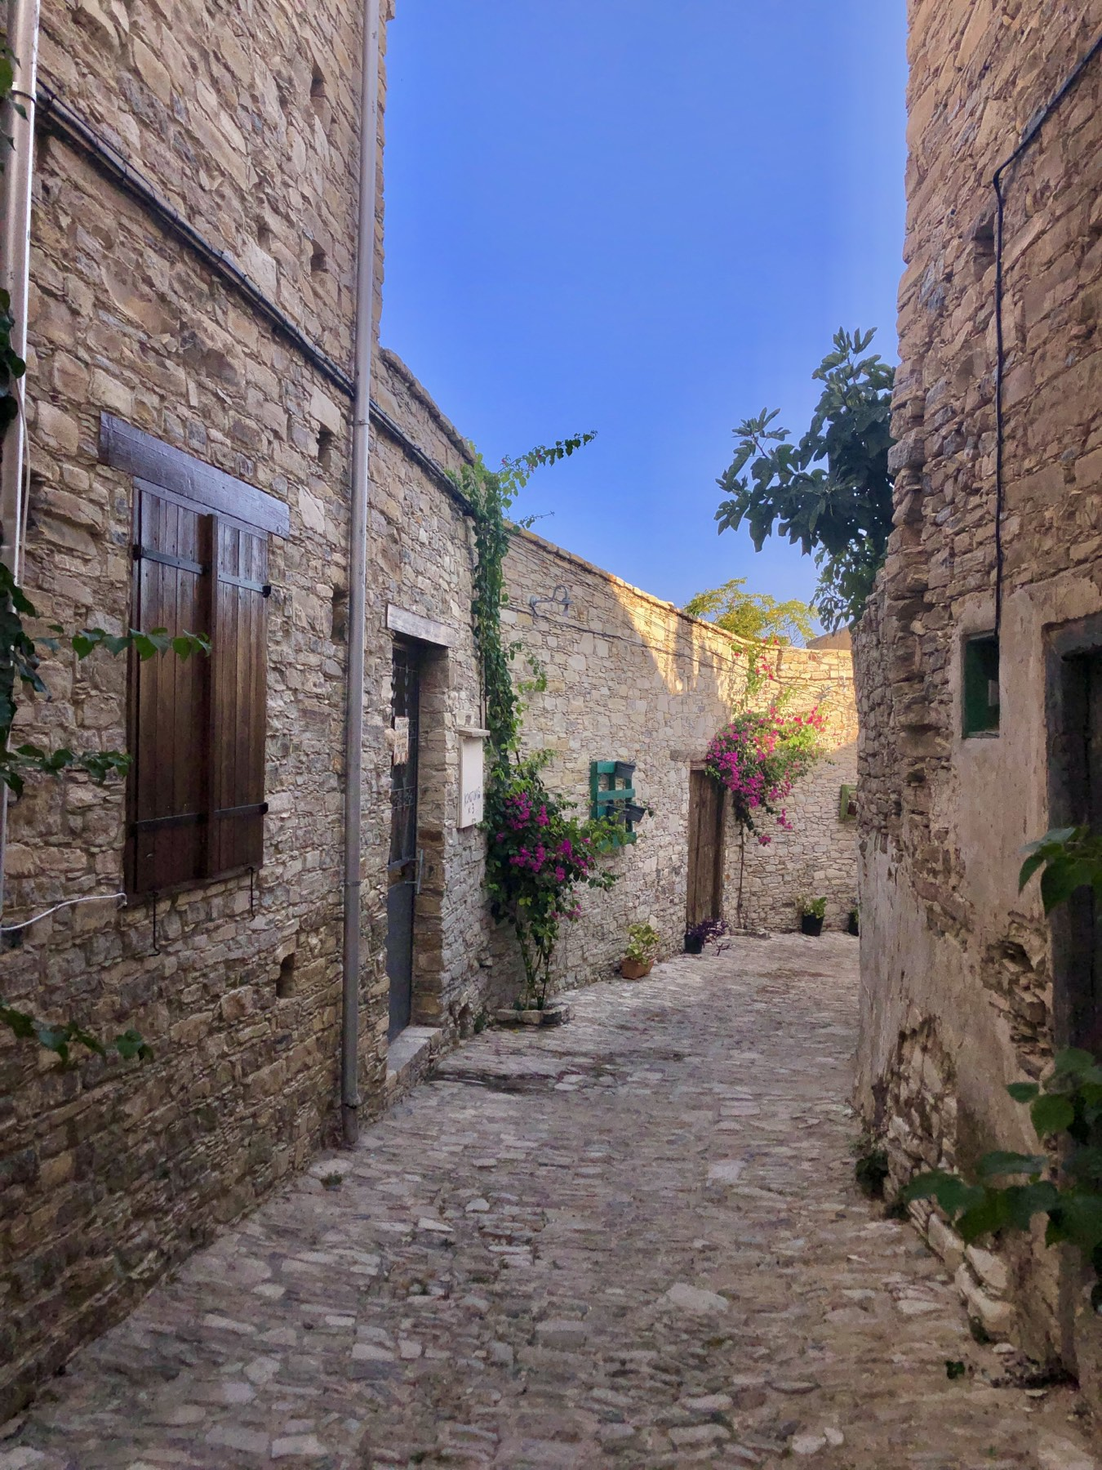
ARTICLES OF ASSOCIATION CHAPTER Α: NAME-PURPOSE-HEADQUARTERS-DURATION-VISION
ARTICLE 4
The Duration of the company is set at (5) months. The General Meeting of the Company shareholders may decide to amend this article, and to extend or shorten the duration of the Company.
ARTICLE 6
The vision was the promotion of and access to authentic sustainable tourism in Cyprus offering local and foreign visitors unique experiences at competitive prices, thus strengthening local economy.
Notes:
Nina: We set the operation duration at 5 months with the option to extend this, hoping that our vision to promote sustainable tourism would be a success as we are the only one-stop website making sustainable tourism accessible to the local and foreign visitors. Our associates, companies related to sustainable tourism, offer unique experiences at competitive prices. This is not only good for our company but also for the local economy.

Slide 5
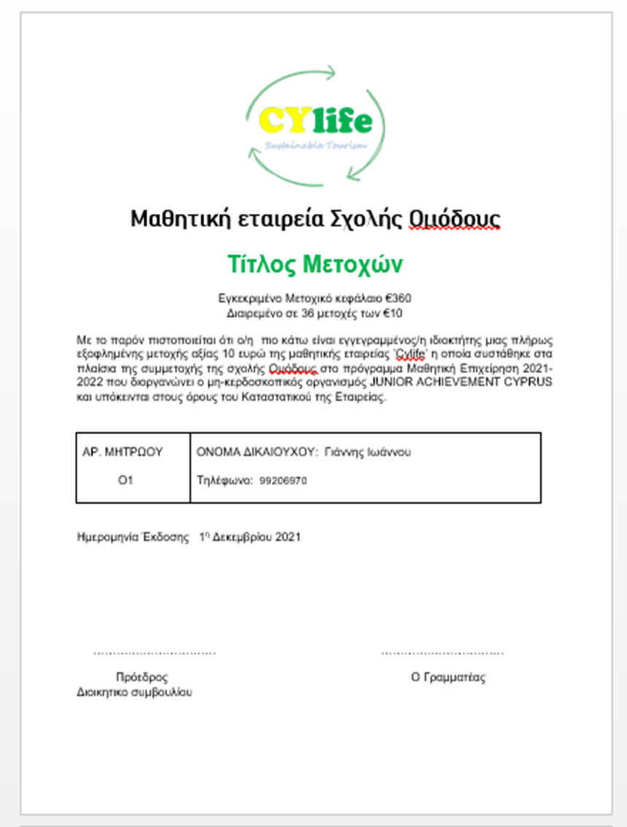
ARTICLES OF ASSOCIATION CHAPTER B: SHARE CAPITAL - SHAREHOLDERS - SHARE CAPITAL INCREASE- SHARE RIGHTS AND OBLIGATIONS
ARTICLE 7
The Share Capital of the company was initially set at the amount of 360 euros divided into 36 shares with a nominal value of each 10 euros.
ARTICLE 8
One shareholder cannot raise more than one share of the amount of € 10.
Notes:
Nina: Chapter B addressed all issues related to shares. Shares were set at 10 euros each and 36 shares were issued. The number of shares was based on our decision NOT to borrow any money in order to set up the company.
This is a sample of our share certificates
Shareholders can only own one share.

Slide 6
Αριθμός Πιστοποιητικού Μετοχών ` | Ονοματεπώνυμο Μετόχου | Αριθμός Τηλεφώνου | Αριθμός Μετοχών | Ονομαστική Αξία Μετοχής | Ποσό Είσπραξης
1 | Γιάννης Ιωάννου | 99206970 | 1 | € 10.00 | € 10.00
2 | Γιάννης Στυλιανού | 97847437 | 1 | € 10.00 | € 10.00
3 | Γιάννης Κολώνας |  | 1 | € 10.00 | € 10.00
4 | Συμεών Συμεού | 99437797 | 1 | € 10.00 | € 10.00
5 | Γρίβας Αλέξανδρος | 99093468 | 1 | € 10.00 | € 10.00
6 | Χαράλαμπος Παπαδόπουλος | 99578787 | 1 | € 10.00 | € 10.00
7 | Νεοφύτα Κωνσταντίνου |  | 1 | € 10.00 | € 10.00
8 | Μαρία-Χαρα Ζήνωνος |  | 1 | € 10.00 | € 10.00
9 | Μάριος Κυριακίδης | 99483400 | 1 | € 10.00 | € 10.00
10 | Μαριος Καύκαρου |  | 1 | € 10.00 | € 10.00
11 | Ηροδότου Χρυσοβαλάντω | 97788468 | 1 | € 10.00 | € 10.00
12 | Κορότκα Αναστασία | 99527433 | 1 | € 10.00 | € 10.00
13 | Μαρία Στυλιανού | 99459355 | 1 | € 10.00 | € 10.00
14 | Κατερίνα Χριστοδούλου | 99917189 | 1 | € 10.00 | € 10.00
15 | Γιάννα Καλλινίκου | 99575063 | 1 | € 10.00 | € 10.00
16 | Νικολέττα Λιμίση | 99850059 | 1 | € 10.00 | € 10.00
17 | Νάταλι Ταγίμ | 99872094 | 1 | € 10.00 | € 10.00
18 | Ζώη Ανθούση |  | 1 | € 10.00 | € 10.00
19 | Νίκη Νικολάου |  | 1 | € 10.00 | € 10.00
20 | Δημήτρης Καππαής | 99436813 | 1 | € 10.00 | € 10.00
21 | Παντελής Οικονόμου | 99604575 | 1 | € 10.00 | € 10.00
22 | Δήμου Δημητρής | 96275132 | 1 | € 10.00 | € 10.00
23 | Κούλλα Κυριάκου | 99860245 | 1 | € 10.00 | € 10.00
24 | Χριστόδουλος Καύκαρος |  | 1 | € 10.00 | € 10.00
25 | Έλενα Κωνσταντινίδου | 99473499 | 1 | € 10.00 | € 10.00
26 | Αθανασίου Σύλβια |  | 1 | € 10.00 | € 10.00
27 | Ιωσήφ Ευγενία |  | 1 | € 10.00 | € 10.00
28 | Ανδρέας Δημοσθένους | 96092912 | 1 | € 10.00 | € 10.00
29 | Νικόλας Χρυσάνθου | 95172795 | 1 | € 10.00 | € 10.00
30 | Πρόδρομος Χαραλάμπους | 99062271 | 1 | € 10.00 | € 10.00
31 | Νινα Παπαιωάννου | 99757603 | 1 | € 10.00 | € 10.00
32 | Στέλιος Παπαιωάννου | 97655956 | 1 | € 10.00 | € 10.00
33 | Ελένη Χαριλάου | 96937706 | 1 | € 10.00 | € 10.00
34 | Μαρία Ιωάννου | 99315071 | 1 | € 10.00 | € 10.00
35 | Μαργαρίτα Μαρκίδου | 99526668 | 1 | € 10.00 | € 10.00
36 | Χαράλαμπος Βρασίδας | 99383899 | 1 | € 10.00 | € 10.00
 |  |  | 36 |  | € 360.00
Συνολικός Αριθμός Μετοχών που Εκδόθηκαν |  | 36
Συνολικό Κεφάλαιο που Αντλήθηκε |  | € 360.00
LIST OF COMPANY SHAREHOLDERS
Notes:
Nina: Here you can see a list of our shareholders, with their details

Slide 7
ARTICLES OF ASSOCIATION CHAPTER C: BOARD OF DIRECTORS
ARTICLE 9
COMPOSITION - TERM OF THE BOARD OF DIRECTORS
1. The company is managed by the Board of Directors which consists of three (3) members. 2. The members of the Board of Directors, the number of which is determined within the limits mentioned in the above par. 1, are elected in the General Meeting of Company shareholders. 3. The election of alternate members of the Board of Directors is allowed, the number of which is determined by the relevant decision of the General Assembly that elects them and is within the limit referred to in the above paragraphs. 4. The term of office of the members of the Board of Directors is five months. 5. The members of the Board of Directors are elected by the shareholders.
Notes:
Stelios: Chapter C, as you can see, contains everything concerning the board of directors.

Slide 8
ARTICLES OF ASSOCIATION
CHAPTER D: ACCOUNTS - PROFIT DISTRIBUTION
ARTICLE 16
ALLOCATION OF PROFITS
The distribution of the company's net profits is conducted in the following manner:
Allocation of the percentage of 50% to Omodos School students with economic difficulties
b) Allocation of the percentage of 25% to the students employed in the student enterprise
c) Allocation of the 25% percentage to the shareholders
Notes:
Stelios: And the final chapter deals with the accounts and profit distribution.
The distribution of the company's net profits is conducted in the following manner:
50% is allocated to Omodos School students with economic difficulties
25% is allocated to the students employed in the student enterprise
25% is allocated to the shareholders

Slide 9
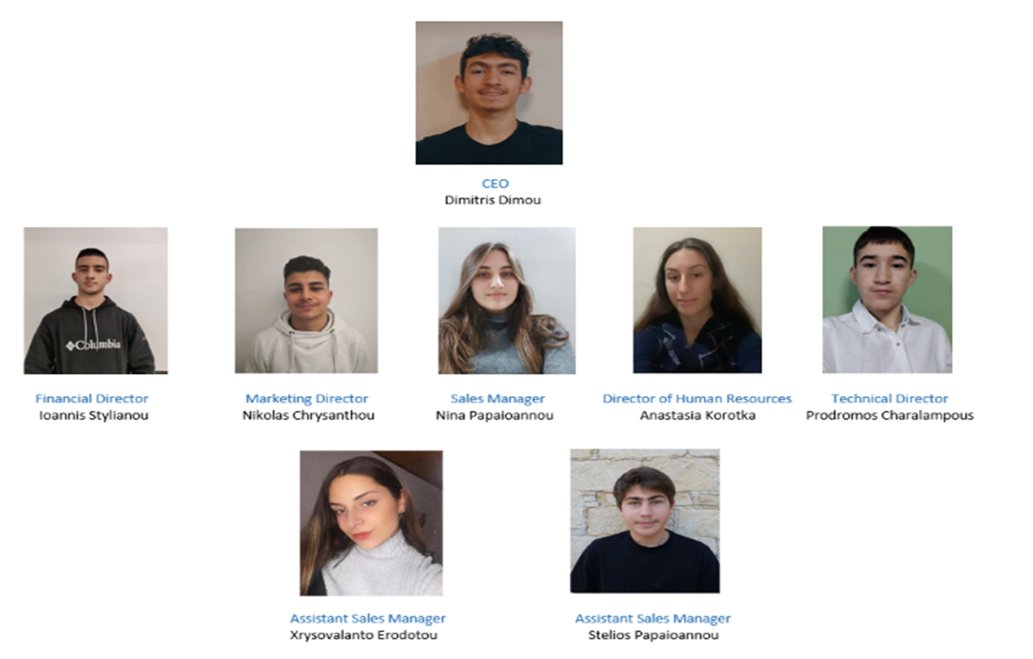
Organization structure
Notes:
Stelios: Meet the team. Our CEO is Dimitris Dimou, the financial director is Ioannis Stylianou, the marketing director is Nikolas Chrysanthou, the sales director is Nina Papaioannou, the director of human resources is Anastasia Korotka, the technical director is Prodromos Charalampous, the assistant sales managers are Xrysovalanto Herodotou and Stelios Papaioannou

Slide 10
Business Model Canvas
KEY PARTNERS:
-Shareholders -Local population -Local sustainable businesses
ΚΕΥ RESOURCES:
-Associates -Customers (Tourists, advertisers, etc.) -Web page -The members of the company
Notes:
Christina: After researching and brainstorming we designed our business model canvas, which present to you here.
Our key partners are our shareholders, the local population and local businesses.
Key resources include our associates, customers, our web page and the members of our organization

Slide 11
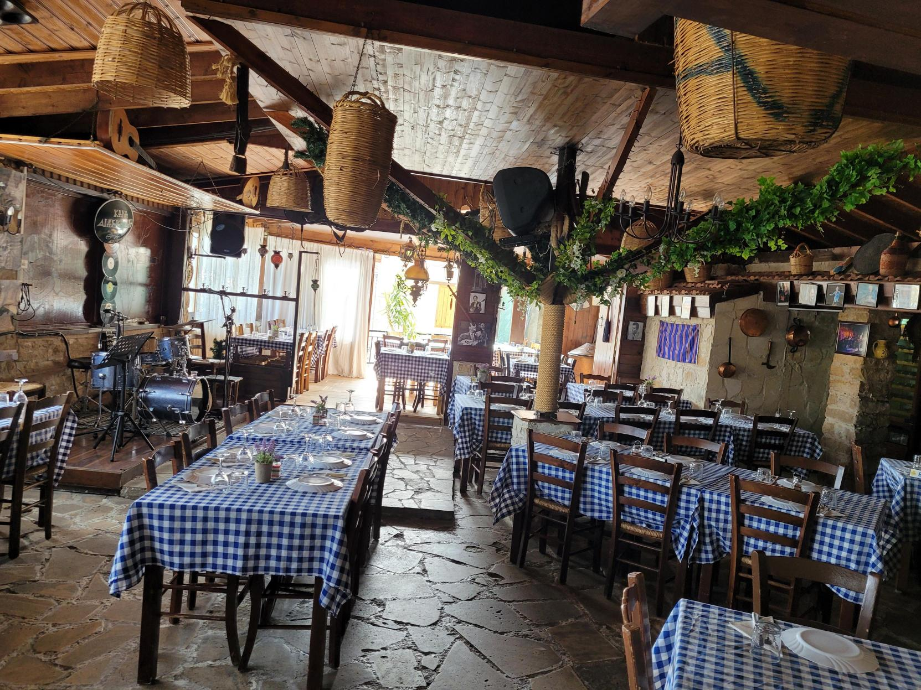
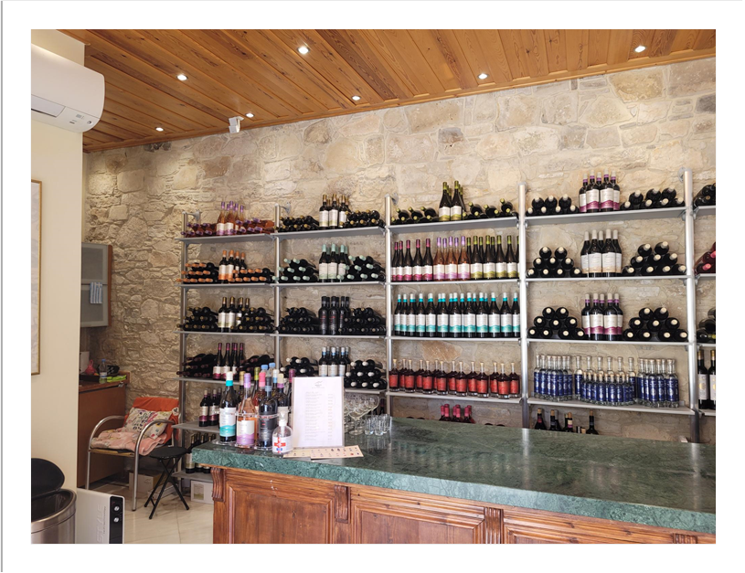
KEY ACTIVITIES:
-Promotion of traditional products and services through restaurants with traditional dishes, local wineries, agrotourism accommodation and retail stores -Promotion of traditional businesses, tourist destinations and theme parks for activities, exercise and contact with nature
-Promotion of Cypriot tradition and culture through the local population -Customer service -Company advertising online -Communication with customers through telephone calls and/or messages -Staff training
Notes:
Our KEY ACTIVITIES are-Promotion of traditional products and services through restaurants with traditional dishes, local wineries, agrotourism accommodation and retail stores -Promotion of traditional businesses, tourist destinations and theme parks for activities, exercise and contact with nature
-Promotion of Cypriot tradition and culture through the local population -Customer service -Company advertising online -Communication with customers through telephone calls and/or messages -Staff training

Slide 12
Business Model Canvas
COST STRUCURE:
-Wages for employees -Marketing costs (website, email, maintenance, etc.)
REVENUE STREAMS:
-Revenue from businesses advertising their products or services -Possible state sponsorships
CUSTOMER SEGMENTS:
-Foreign tourists wishing to live the Cypriot traditional way of life -Cypriots who want to experience agrotourism -Local traditional businesses that wish to promote their products -Local population which will promotes Cypriot traditions and the Cypriot way of life
Notes:
Christina: The company’s cost structure includes handling wages and marketing costs.
The REVENUE STREAMS include Revenue from businesses advertising their products or services and possible state sponsorships
POTENTIAL CUSTOMERS for the business include Foreign tourists wishing to live the Cypriot traditional way of life -Cypriots who want to experience agrotourism -Local traditional businesses that wish to promote their products and Local population which will promote Cypriot traditions and the Cypriot way of life- CYlife

Slide 13
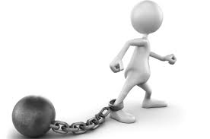
Swot Analysis
STRENGTHS
-Our business can take advantage of its innovative service and uniqueness in its field. -It works with entrepreneurs who are engaged in sustainable tourism. -It is and easy to make services available by advertising online and through social networks. -Attractive prices. -The company’s founders are locals who are familiar with traditional Cypriot life. -Through our one-stop website people can access all sustainable tourism establishments.
WEAKNESSES
-Marketing is time consuming, for the company, as it is something new to the market. -Our student employees are inexperienced in running a company.
Notes:
Christina: In assessing our potential strengths, we concluded that the advertising service that we are offering is unique, and furthermore, we are working with entrepreneurs who are motivated to advertise their product and so willing to purchase our services. We are an economical advertising option too as we use social networking as well as the webpage.
However, we also recognize our weaknesses. Marketing is time consuming, for the company, as it is something new to the market. -Our student employees are inexperienced in running a company, at this stage.

Slide 14
Swot Analysis
OPPORTUNITIES:
-For local sustainable companies in our area to promote and increase their profitability. -With pandemic restrictions, locals choose to discover Cyprus. -Participating entrepreneurs can claim EU grants in support of the rural population and young entrepreneurs
THREATS:
-Other companies to follow our footsteps -If COVID pandemic restrictions again lead to a reduction in tourism
Notes:
Christina: :THIS IS AN OPPORTUNITY FOR local sustainable companies in our area to promote and increase their profitability. -With The opportunities are endemic restrictions still in place, locals cannot travel easily and so choose to discover areas of Cyprus which they are not familiar with. -Participating entrepreneurs have the opportunity to claim EU grants in support of the rural population and young entrepreneurs
There are however also potential threats to our business,
-Other companies could follow in our footsteps and copy our idea. -If COVID pandemic restrictions are made stricter again, this could lead to a reduction in tourism

Slide 15
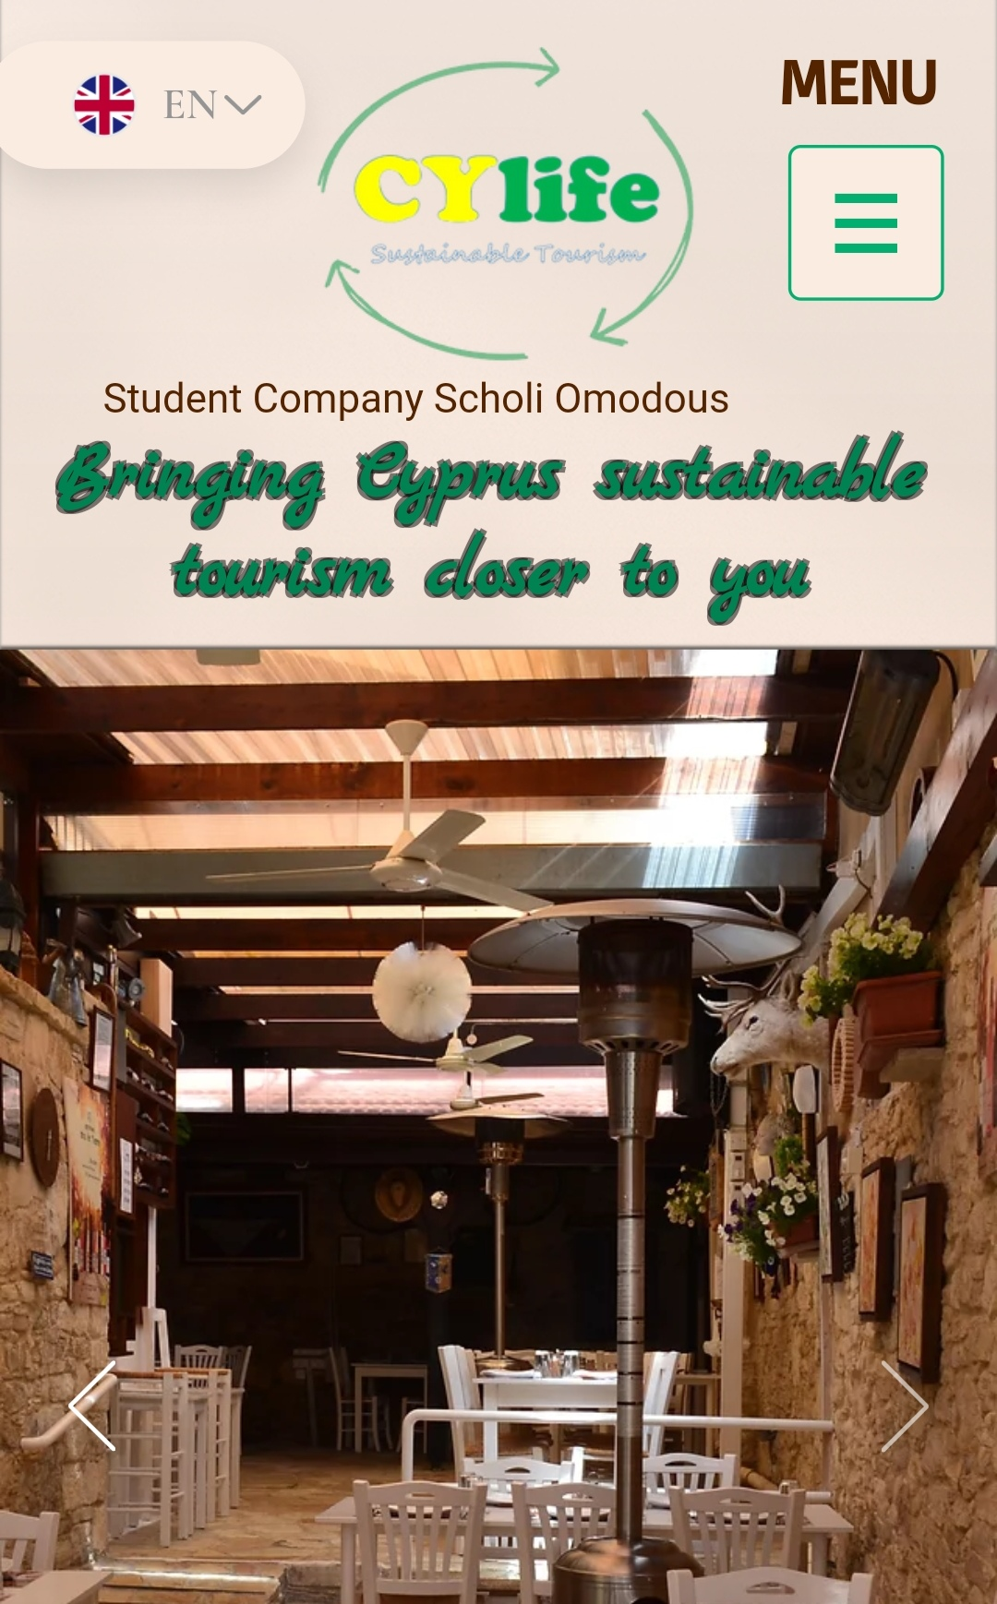
Our website
Notes:
Nina: Let us now, show you our website ( show the website)
More about this and the results of running our company, we will present them to you at our next meeting in Lithuania.

Slide 16
Thank you for your attention
Notes:
Nina Thank you for your attention!

