Slide 1
Startup company „Eime per Kelmę!“

Slide 2
Eime per Kelmę! – Let’s go through Kelme

Slide 3
Mission
Vision
Create quality guide services for your customers and meet the need of each customer
We aim for the business we have established to be in demand in the future for tourists and residents in Kelmė

Slide 4
Goal
To get acquainted with the stone sculptures in Kelmė and their authors

Slide 5
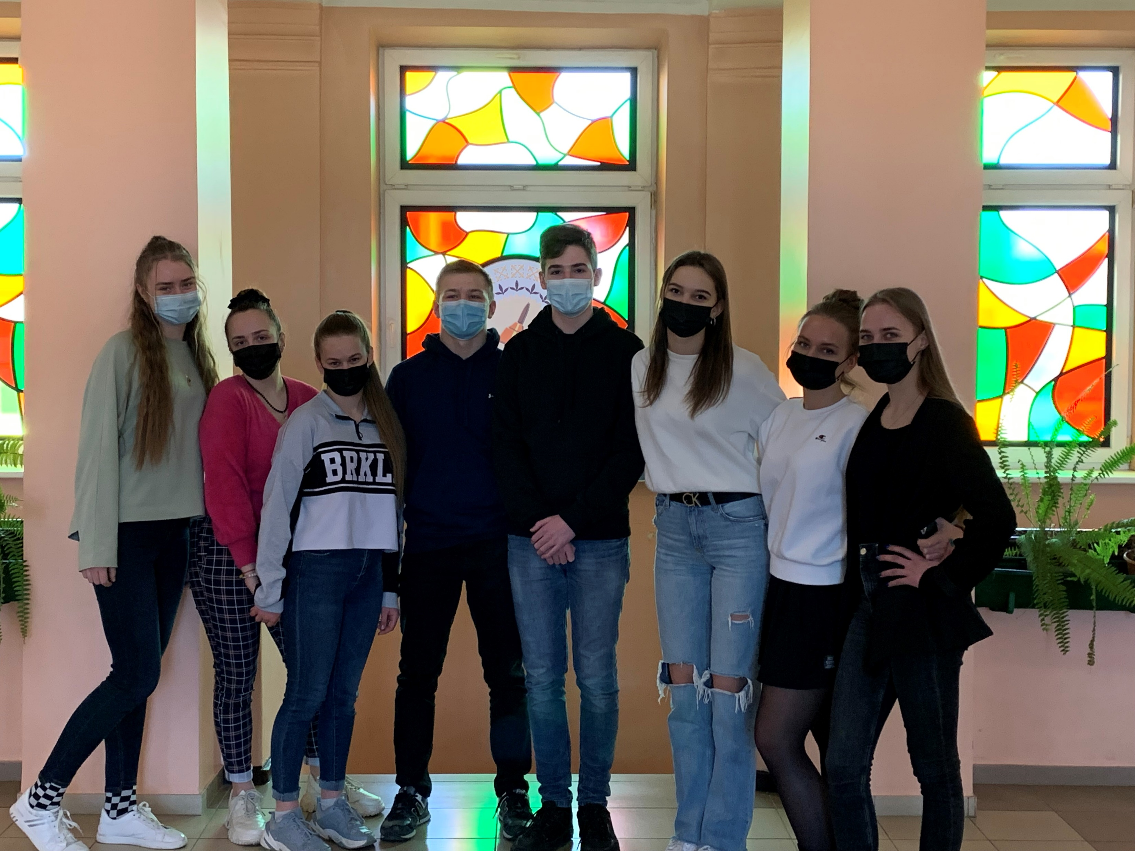
Structure of the company
Service development team
Marketing team
Finances team

Slide 6
Activity
Start – November of 2021
Creating website and other social media
Contacting people and gathering information
Deciding on the prices

Slide 7
The most innovative business idea

Slide 8
SWOT
Strengths Unique idea | Weaknesses Our age
Opportunities New routes Spreading the word about our town | Threats Time management Weather

Slide 9
Social media
Eime per Kelmę!
eime_per_kelme
Website: eimeperkelme.jggimnazija.lt

