Slide 1
The traditional dancing festival ŠALČIOS ALELIUMAI

Slide 2
Action ,,Let's hug the earth“

Slide 3
A lesson with a circus clown

Slide 4
The song festival,,because of our Homeland.....“

Slide 5
The teachers fashion show the 5th of October

Slide 6
The last day at school before summer holidays. The dancing and playing games evening called May

Slide 7
The leaving school party

Slide 8
Christmas carnival

Slide 9
Kaziukas fair

Slide 10
A trip around the region Aukštaitija

Slide 11
In Kernave

Slide 12
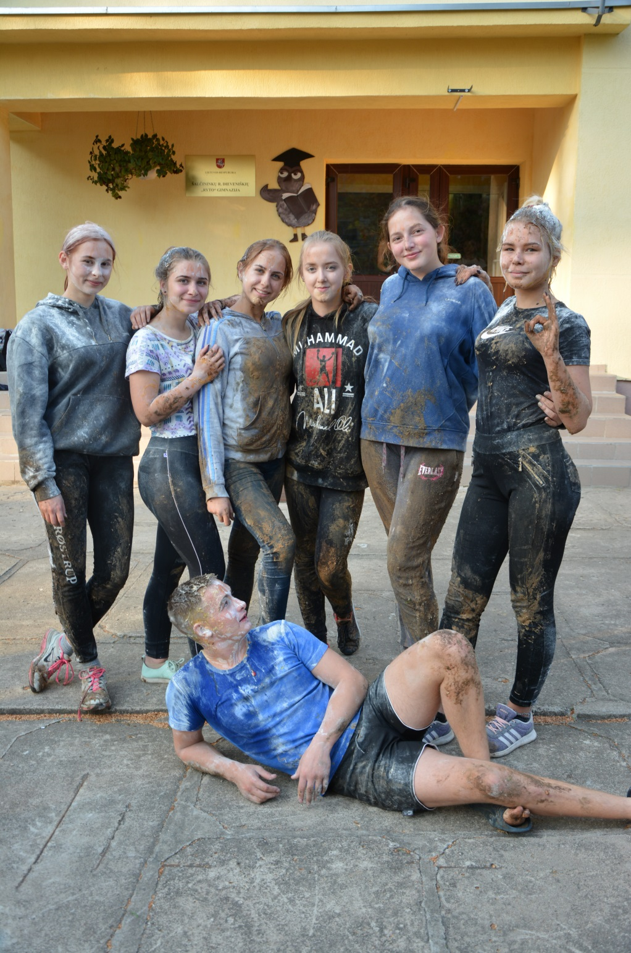
The Immatriculation festival

Slide 13
The mothers day

Slide 14
We are painting eggs before Easter

Slide 15
The Shrove Tuesday

Slide 16
St. Valentines day

Slide 17
The commemoration of the Independence Day on the 16 th February

Slide 18
The trip of Independence Day in Šalčininkai

Slide 19
The summer camp

Slide 20
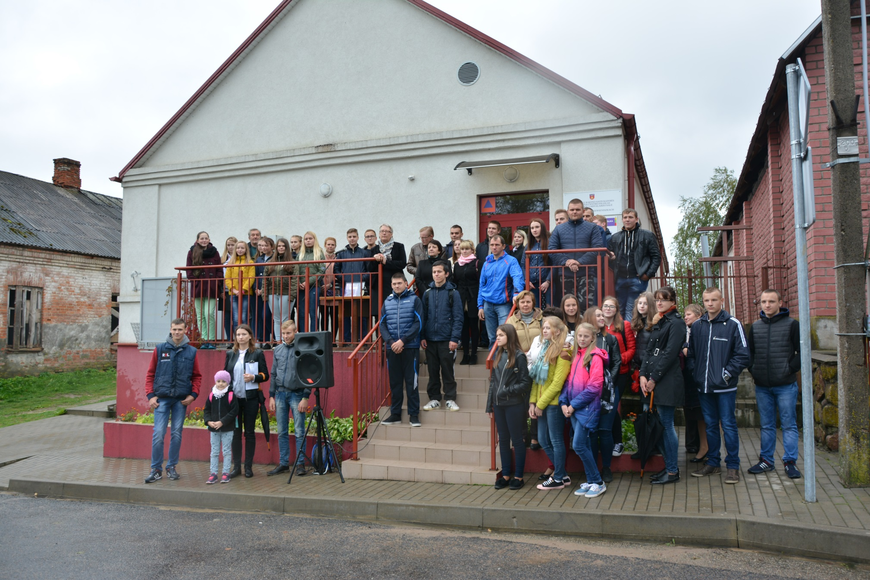
The commemoration of the Jewish genocide day

