Slide 1
THE CAPITAL OF GOLDEN DOBRUDZHA
DOBRICH

Slide 2
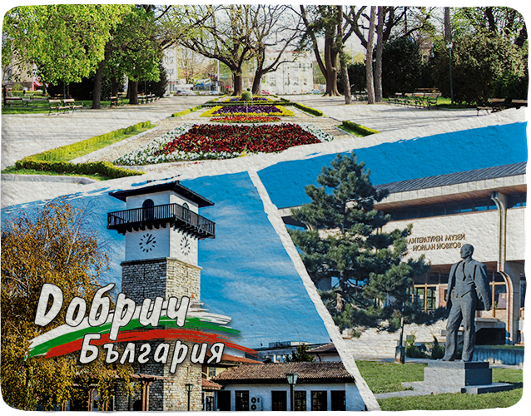
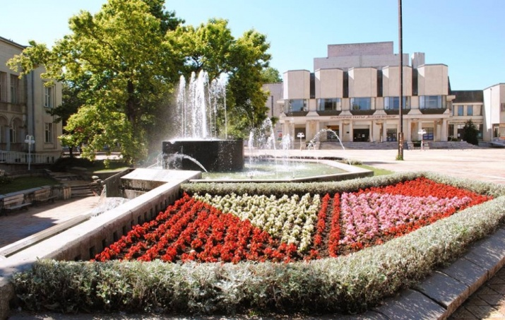
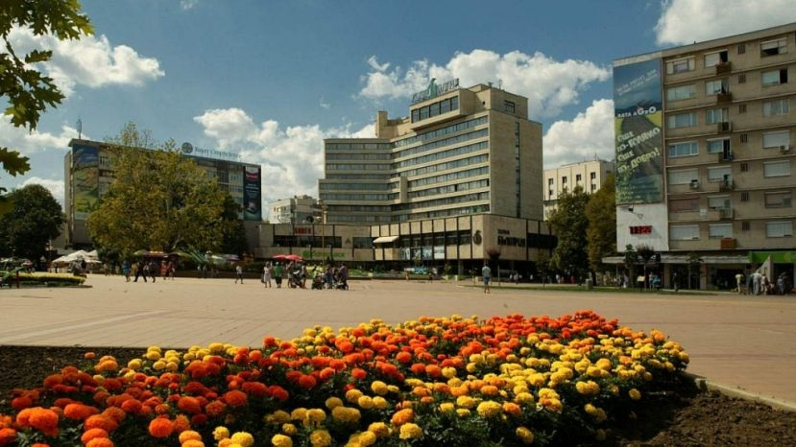
SUMARRY INFORMATION
The population of Dobrich is 100 000 people
From 1949 till 1991 the town bore the name of Tolbouhin but after that it regained its old name.
It is located in the northeastern part of the country
220 m above sea-level
It is situated on the Dobrudzha Plateau by the small Dobrich River.
Is known as the capital of ‘’Golden Dobrudzha’’

Slide 3
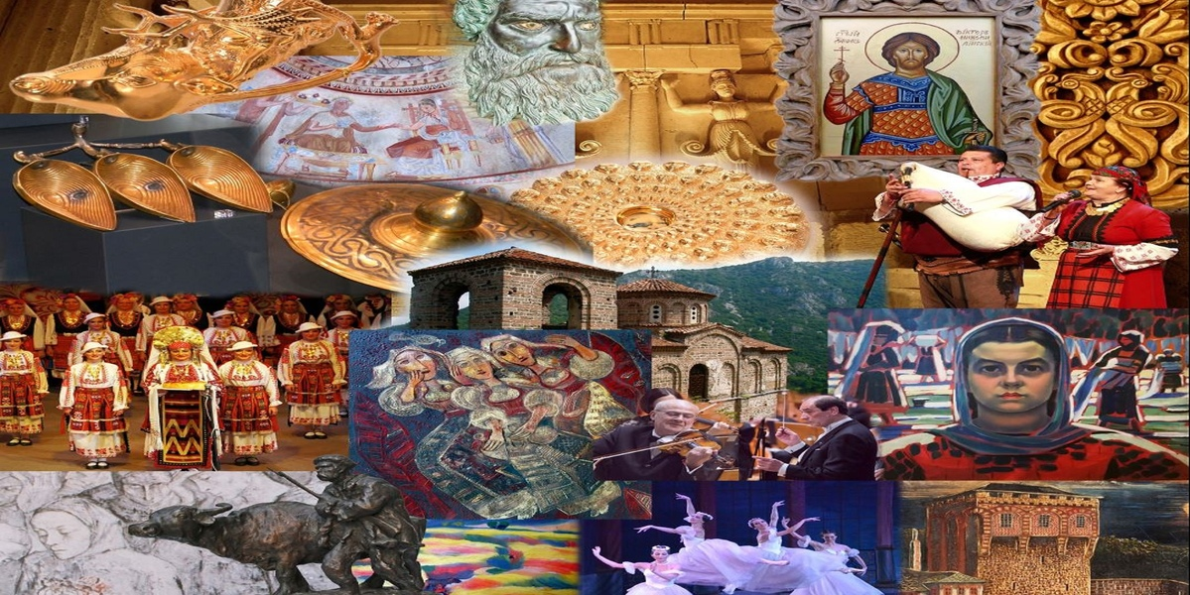
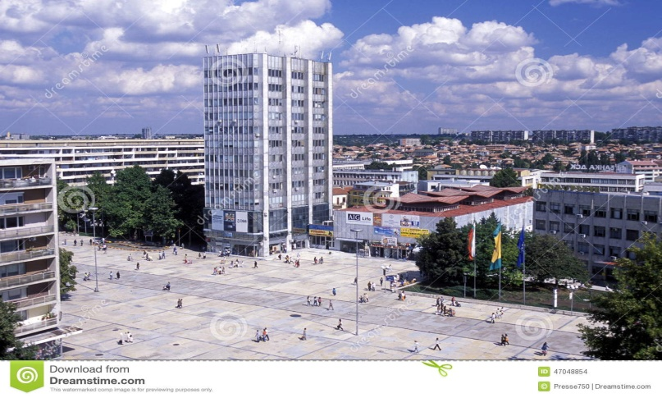
INFRASTUCTURE
The town of Dobrich is the administrative, economic, and service-providing centre of a district that encompasses eight municipalities. The town is the second biggest economic centre in northeast Bulgaria. It lies on an area of 10,950 hectares, and its territory is highly urbanized.
Dobrich has a beautiful nature and architecture
Tourist visit the town of Dobrich, especially in summer or spring
Dobrich has a rich heritage of culture
For the young people, the center of Dobrich is an extremely
lively pedestrianised area with cosmopolitan
cafes, bars, cinema
restaurants and night clubc and discos

Slide 4
Best things to do in Dobrich
Whether you're visiting Dobrich for a few days or are a localite, Dobrich is sure to have something new for you.Dobrich is the place , where families, groups or romantic cuples can organisate their weekend or a long vacation..
Looking at the activities for adventure junkies in Dobrich will get the blood rushing and adrenaline pumping through your veins.
Check out free places to visit in Dobrich which you can visit without spending a penny. Handpicked tours, day trips, and excursions in Dobrich will make your visit comfortable.

Slide 5
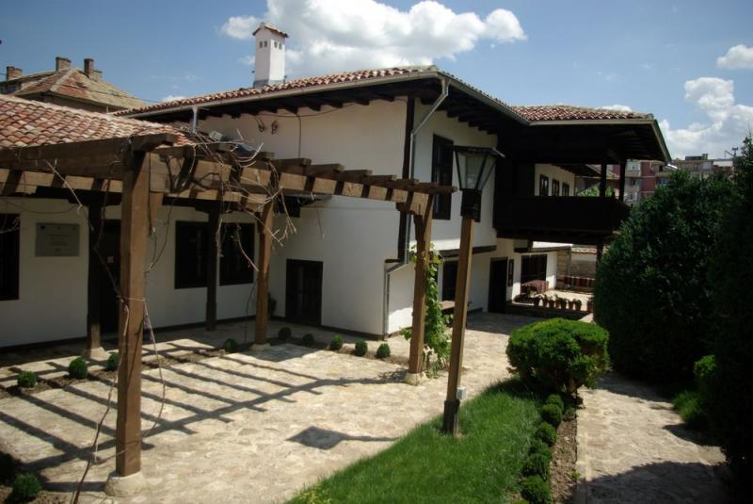
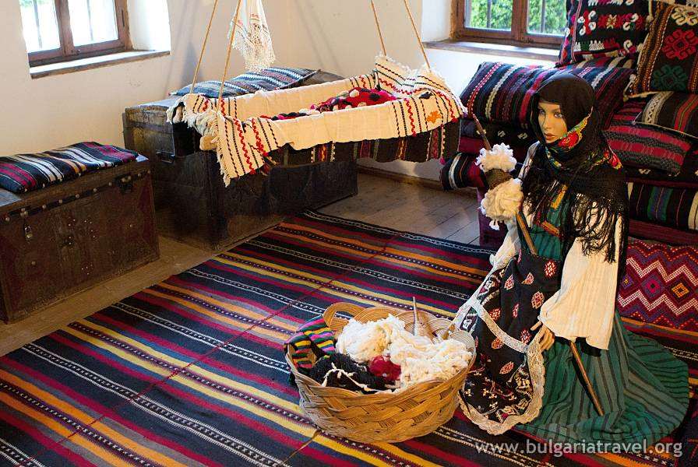
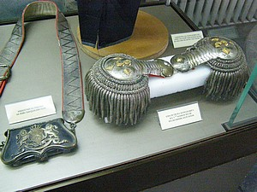
Sights of Dobrich
Museum Ethnographic House
The "Ethnographic House" Dobrich is a part of theRegional Historical Museum of Dobrich. It is located in the center of the town, near the church of "St. George". It was built between 1860-1861 by unknown master in the typical for Bulgarian Renaissance style.
Today the house was restored and turned into a museum. There are represented the life and livelihood of the population of Dobrudza region the late XIX-th

Slide 6
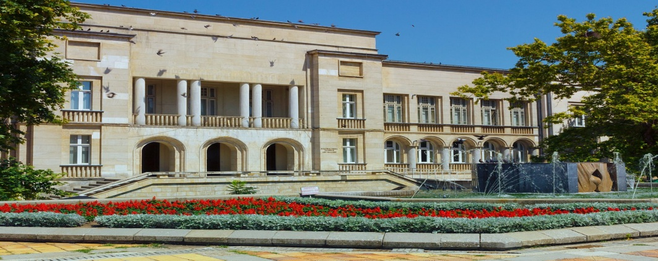
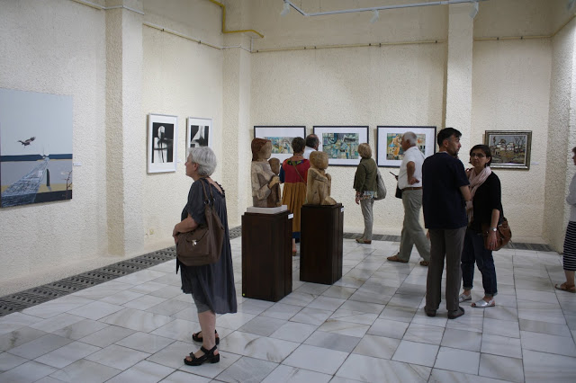
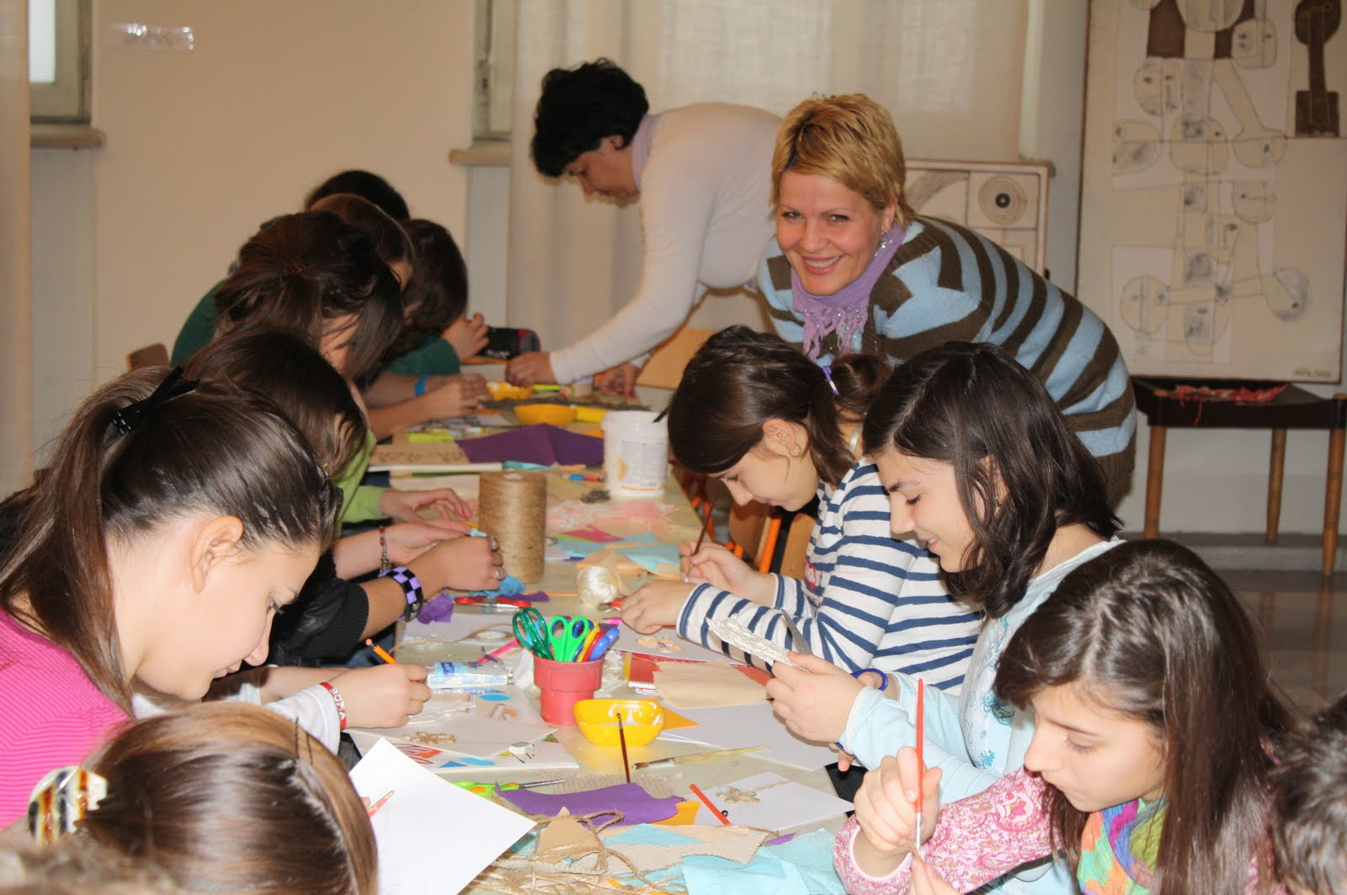
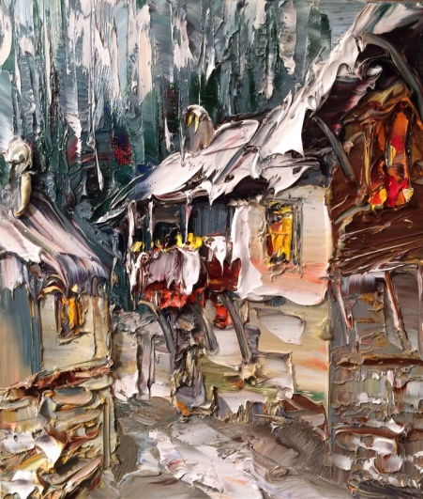
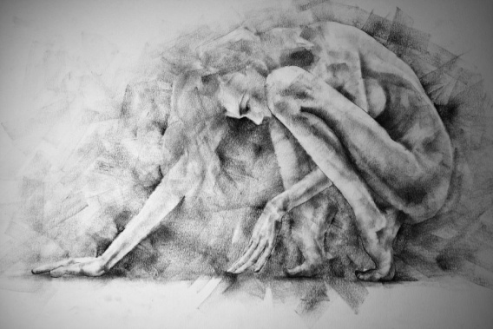
The Art Gallery
Art Gallery Dobrich is one of the 100 National Tourist Sites of Bulgaria. Its building is a cultural heritage site. It was built as a courthouse in the period 1933-1935 by Italian and Romanian architects and exemplifies the European influence our country felt in the first half of the 20th century. It occupies a leading place in the architectural and historical memory of Dobrich and dominates the independent administrative and cultural center of the town.

Slide 7
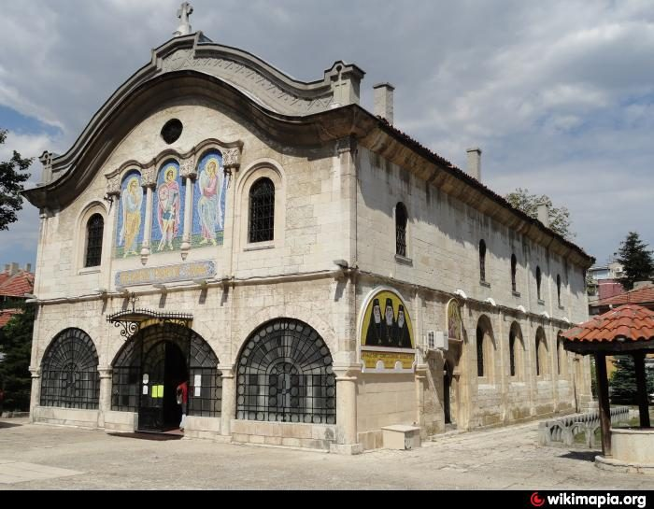
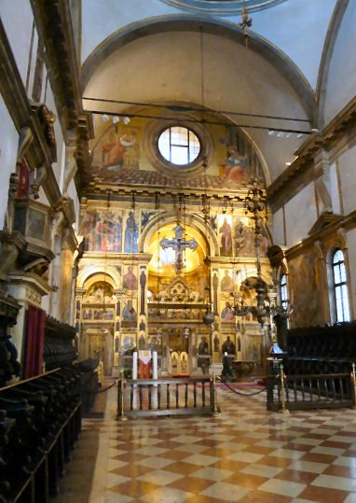
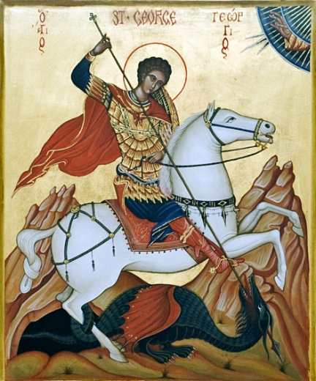
The Church of “St. George”
The Church of St. George was built in 1842 and it is the oldest Orthodox church in the town of Dobrich.
During the Crimean War in 1853-1856 the church was burned and it was rebuilt in its actual form in 1864.
The Church of St. George was built in 1842 and it is the oldest Orthodox church in the town of Dobrich.
The Church was painted in 1889, during the Metropolitan Simeon, then consecrated by him.
Today inside the church erected in honor of St. Georgi in Dobrich can be seen incredible mural paintings and icons.

Slide 8
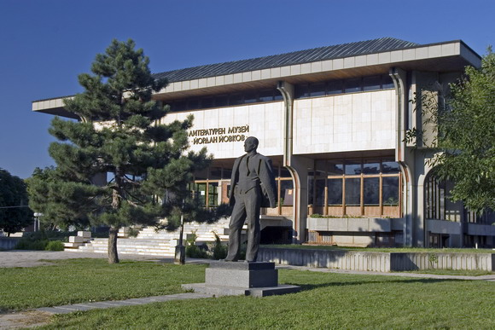
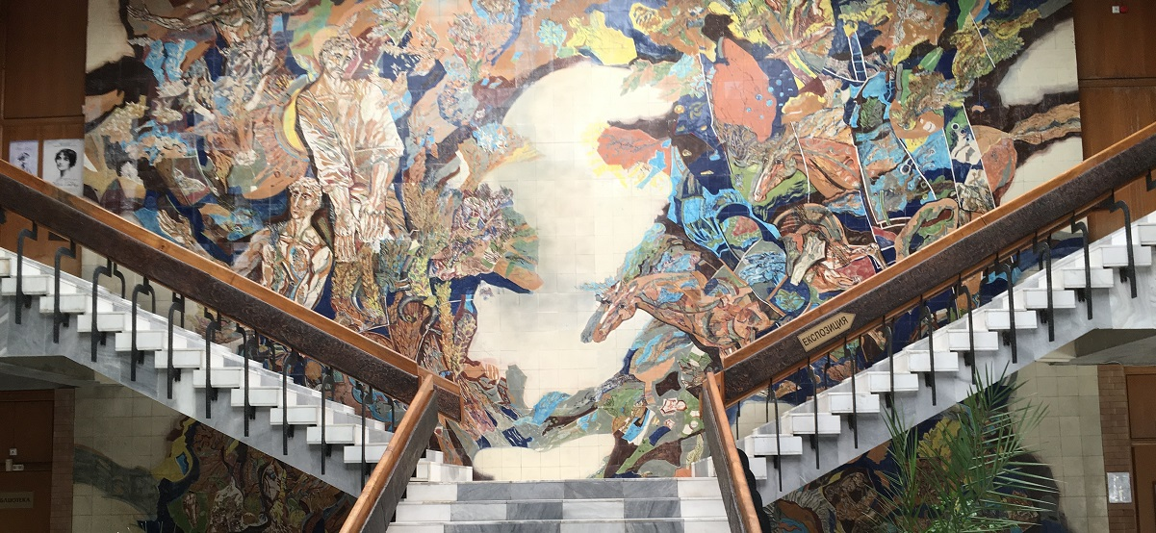
The House Monument “Yourdan Yovkov”
The House-Monument “Yordan Yovkov” was opened in 1980, in connection with the Bulgarian author Yordan Yovkov classic centenary – the one of the most popular storytellers, humanitarians and master of narrative
The reprezentativ building of the”Y. Yovkov” house-monument is a combination of Bulgarian Renaissance traditions and contemporary architectural thinking, a welcoming environment for appropriate representation of the life and creative work of the narrator

Slide 9
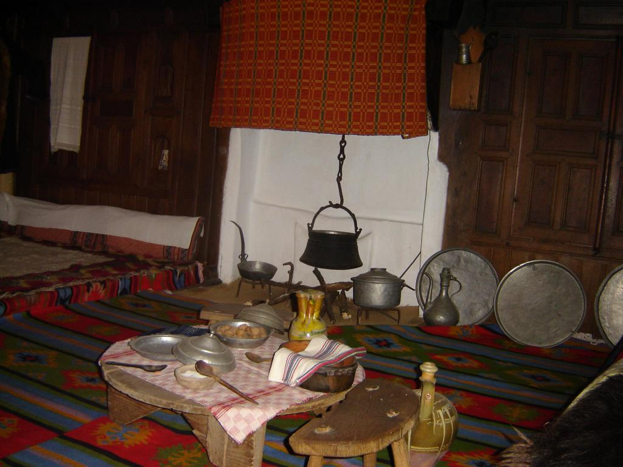
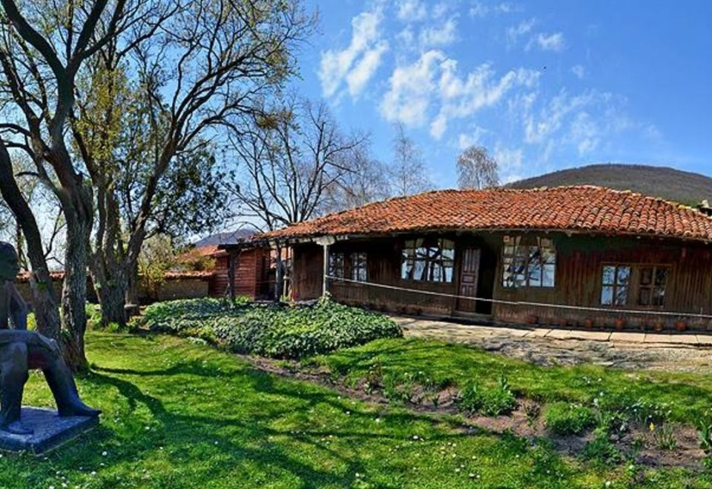
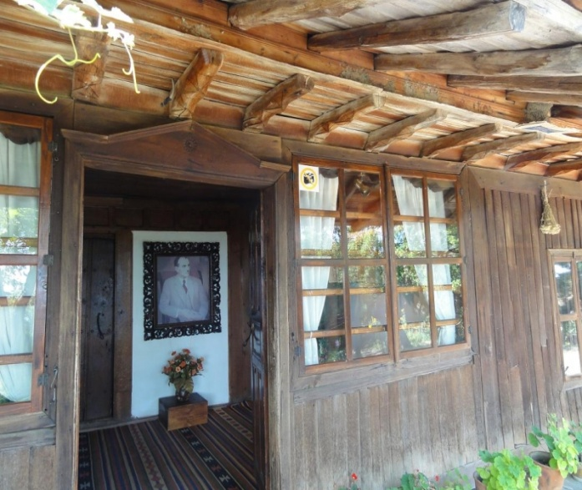
The House Museum “Yourdan Yovkov”
Yovkov lived there until he turned 13 when his entire family moved to Dobrudzha.
The house is a simple one-storey building consisting of two rooms and a small anteroom.
One of the chambers preserves the atmosphere of the typical room of the region with the furniture, the vessels, and the sleeping spot of the family. The other room keeps a collection of works by Yordan Yovkov.

Slide 10
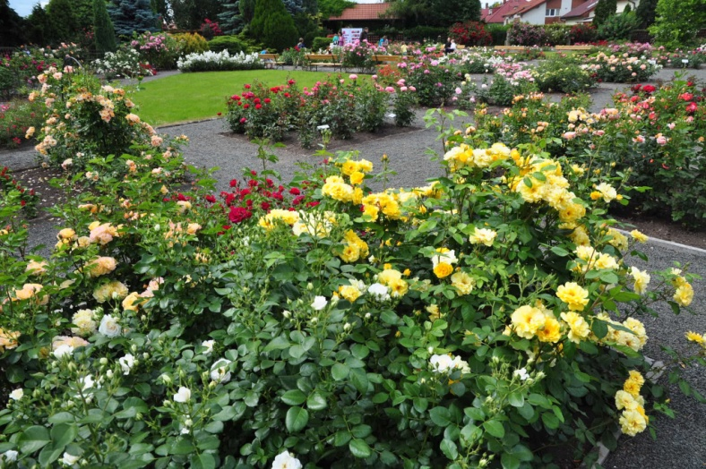
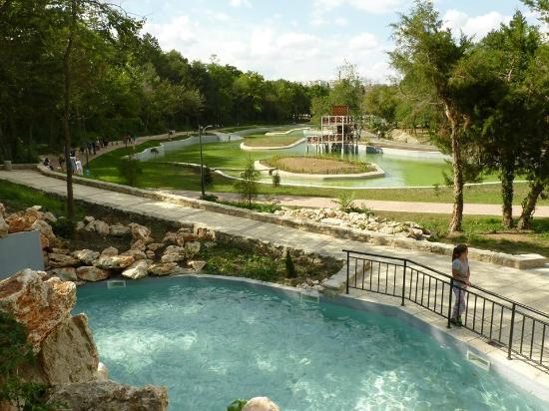
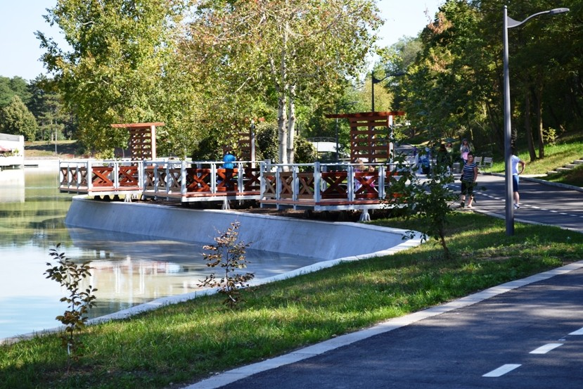
The “St. George” city park
It was founded in 1867 and has since become a favorite place for walks, recreation, sports and entertainment to citizens and guests of the town.
is divided into several sections – the old garden, declared to be a cultural heritage site, a children's area, lakes, terraced rock gardens and a sports area.

Slide 11
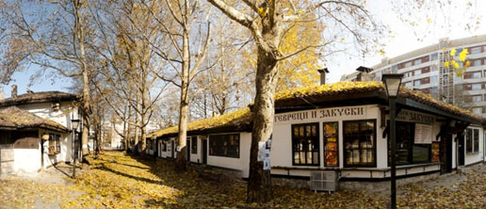
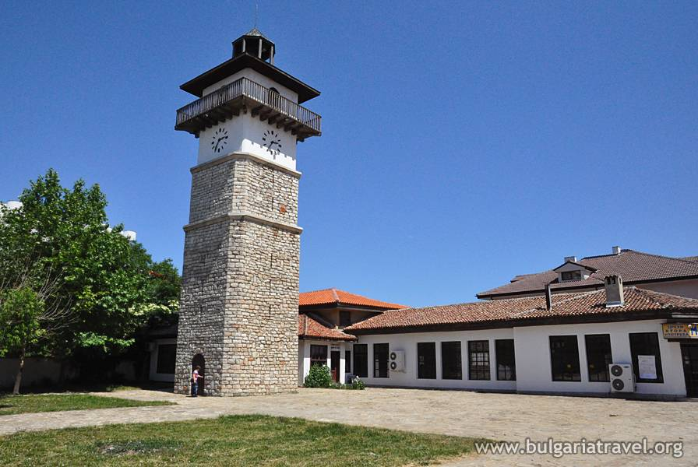
The ‘’Old Dobrich’’
Old Dobrich Architectural-Ethnographic Museum is an open-air museum where the traditional crafts of the Dobrudzha Region since the end of the 19th century
The old clock tower built in the 18th century is now reconstructed in the centre of the complex and is open for tourists.

