Slide 1
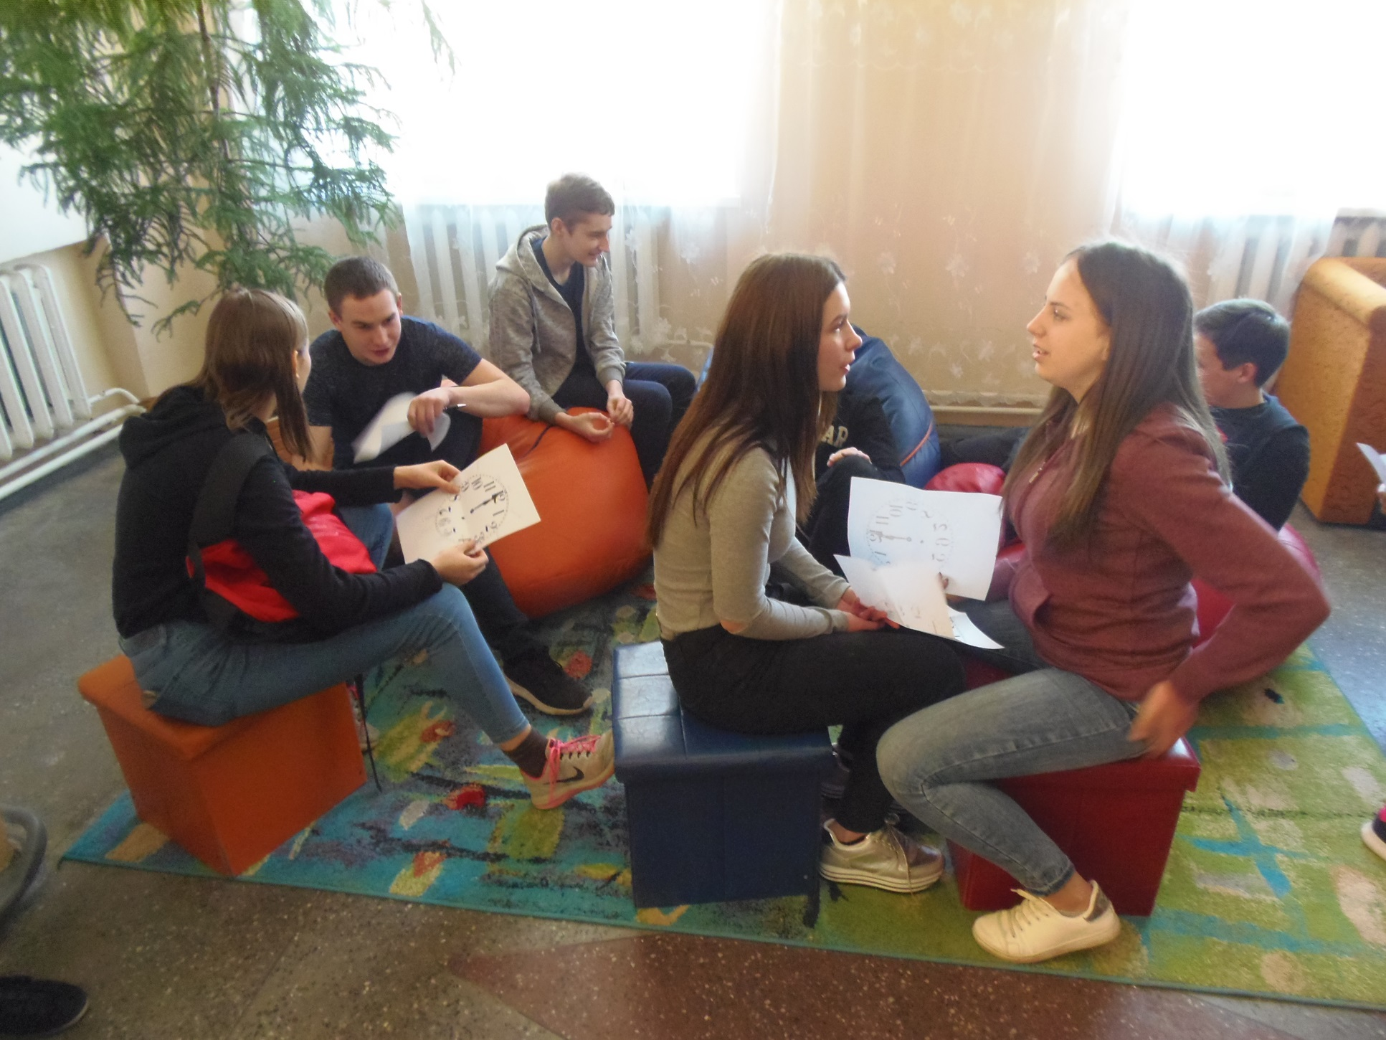
A week without teasing

Slide 2
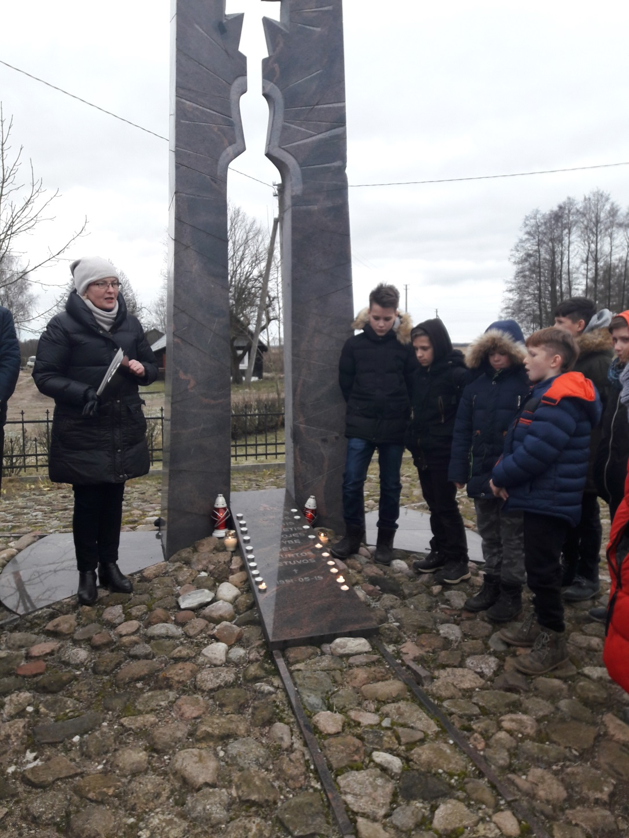
Were are remembering people killed in Freedom fighting battles

Slide 3
The first day at school

Slide 4
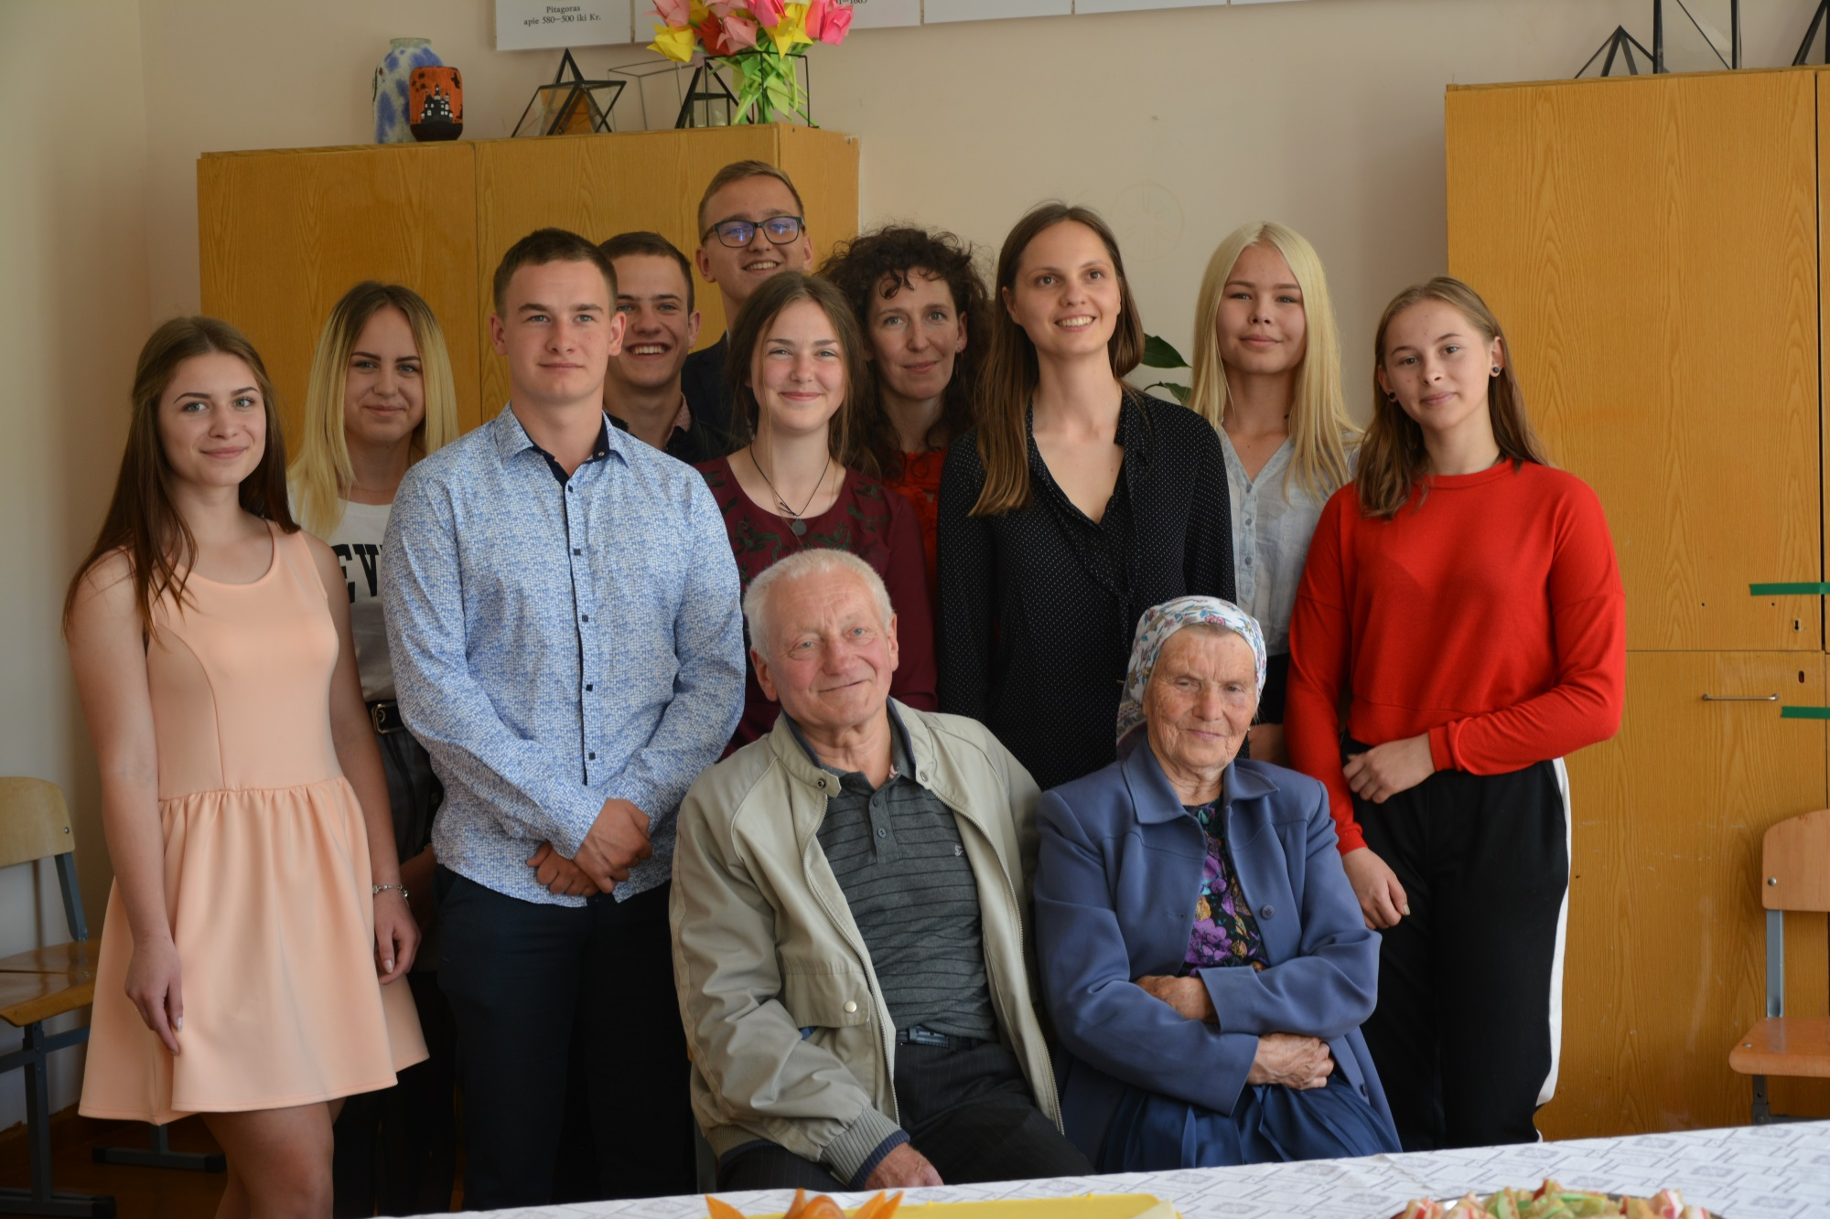
Project ,,The social education , by involving biographycal and theatre methods: Šalčininkų district case

Slide 5
The professional orientation lesson ,,at the Levandas port“

Slide 6
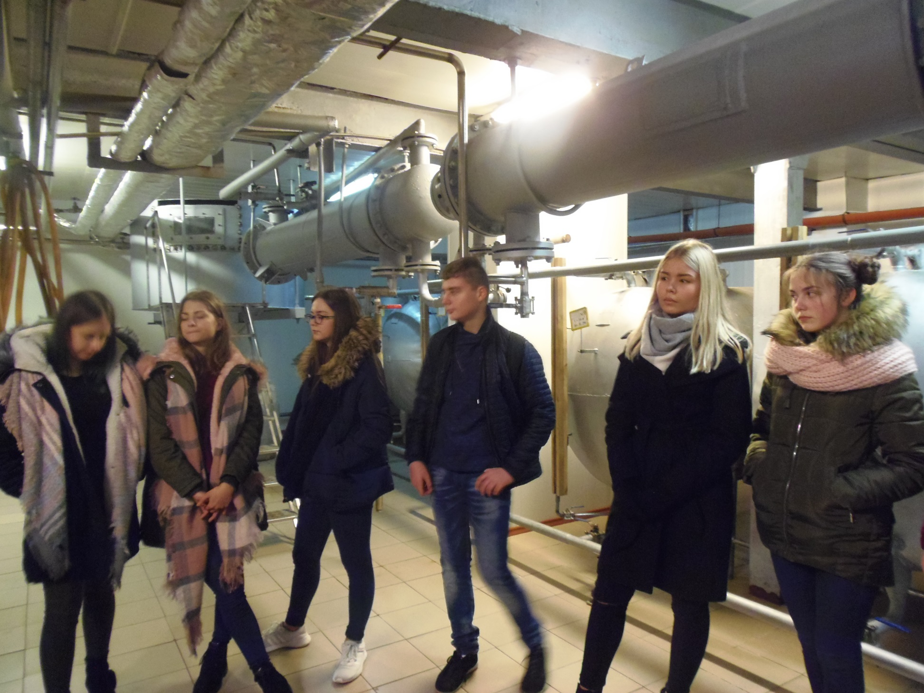
Professional orientation lessons in the Jašiūnai vinegar factory

Slide 7
The primary school students in the vocational school

Slide 8
The Independence Day festival for primary school students

Slide 9
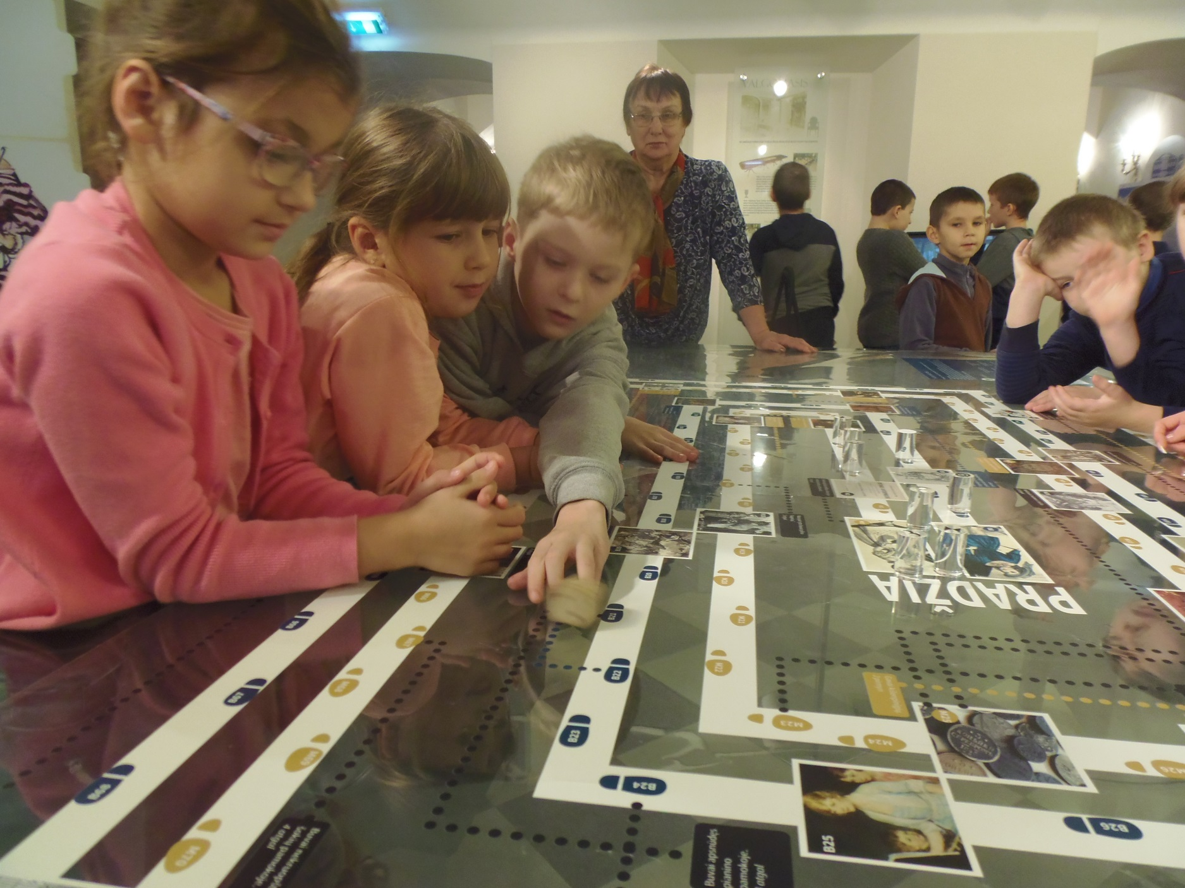
The primary school children at the Jašiūnai palace

Slide 10
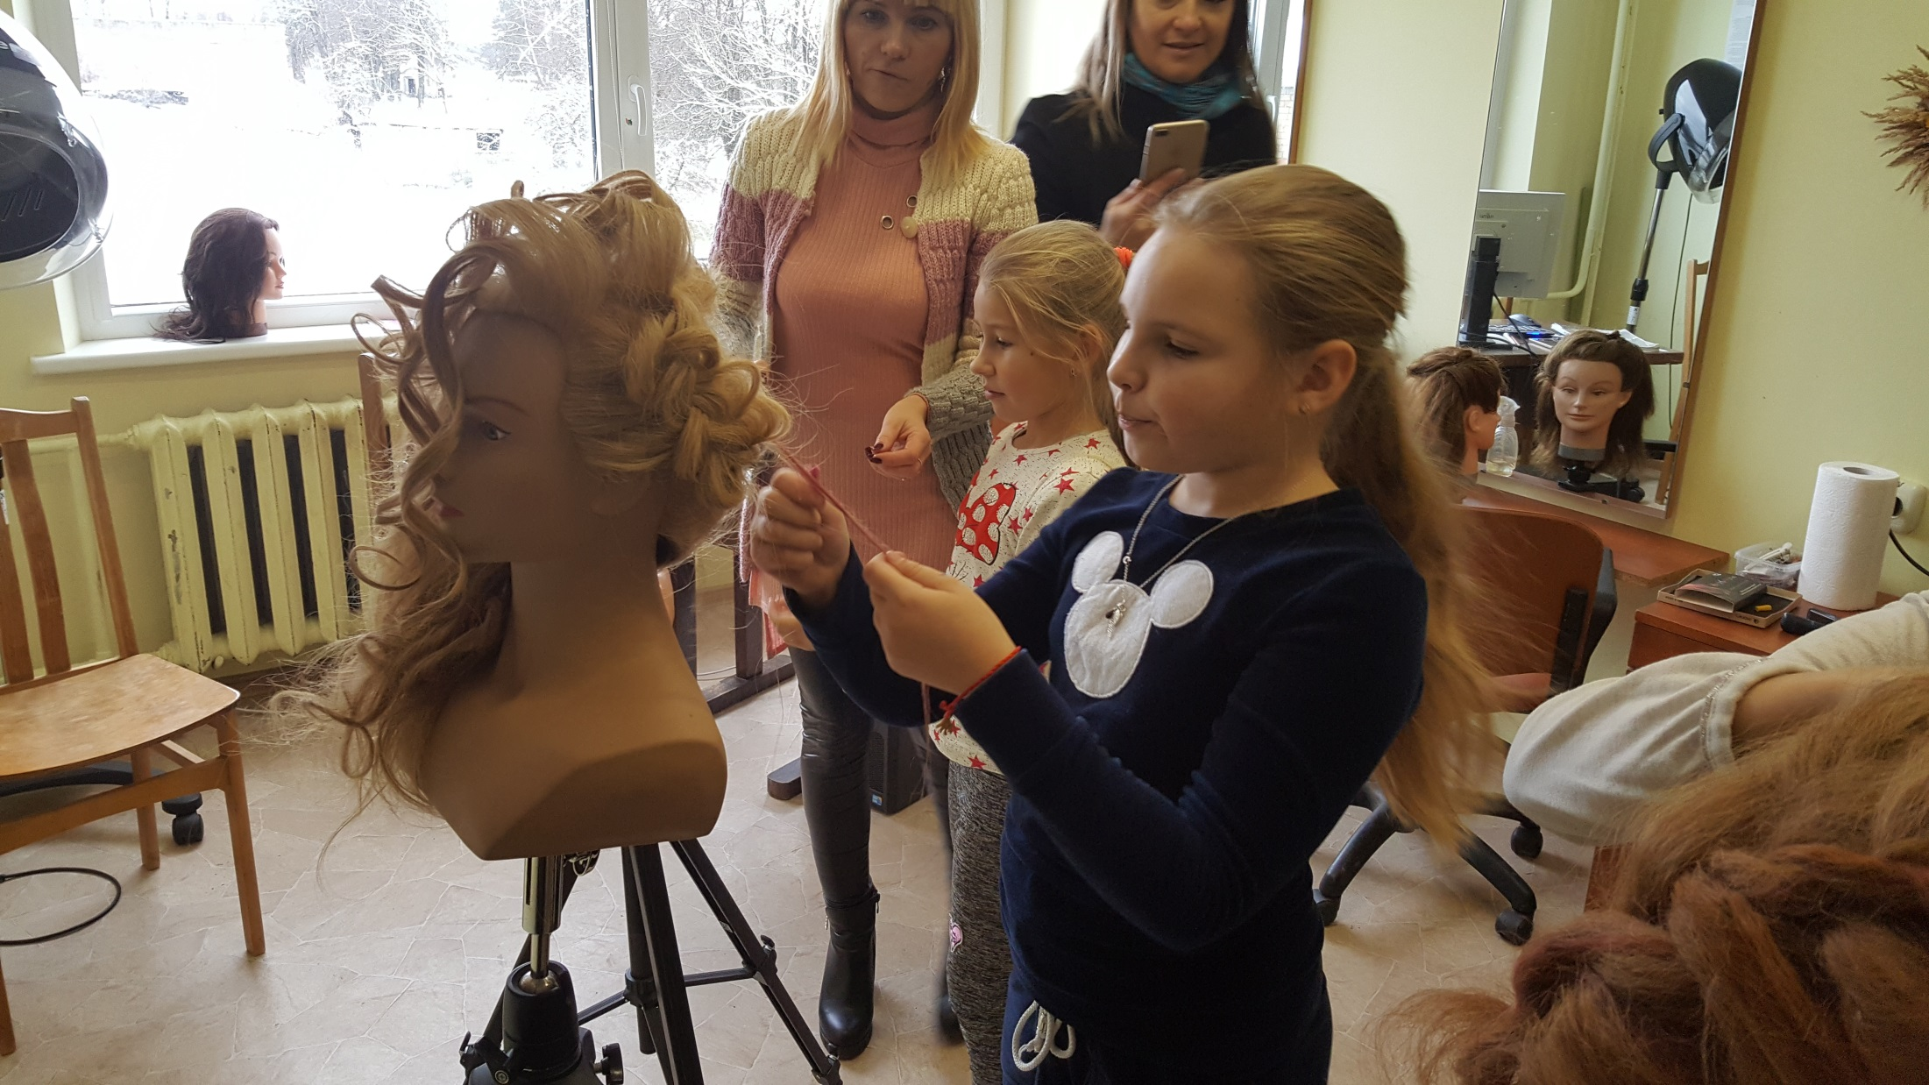
Professions consultation lessons in Dieveniskes vocational school

Slide 11
The last Bell of 12th class formers

Slide 12
The last bell of primary school students

Slide 13
II g class last Bell festival

Slide 14
The teachers disco party

Slide 15
The teachers day

Slide 16
The Grandparents festival

