Slide 1
The making of straw dolls

Slide 2
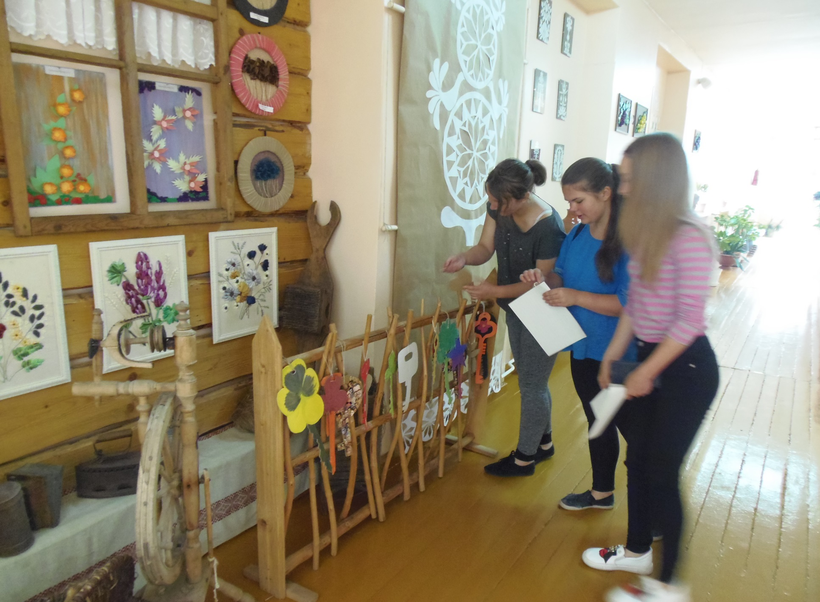
The commemoration of The Mourning and Hope day / The 14 th of June

Slide 3
Project ,,Say thank you“

Slide 5
The traditional Christmas festival

Slide 7
The Creative Workshop before Christmas 2017

Slide 8
The celebration of the Freedom fighters day on the 13 of January

Slide 10
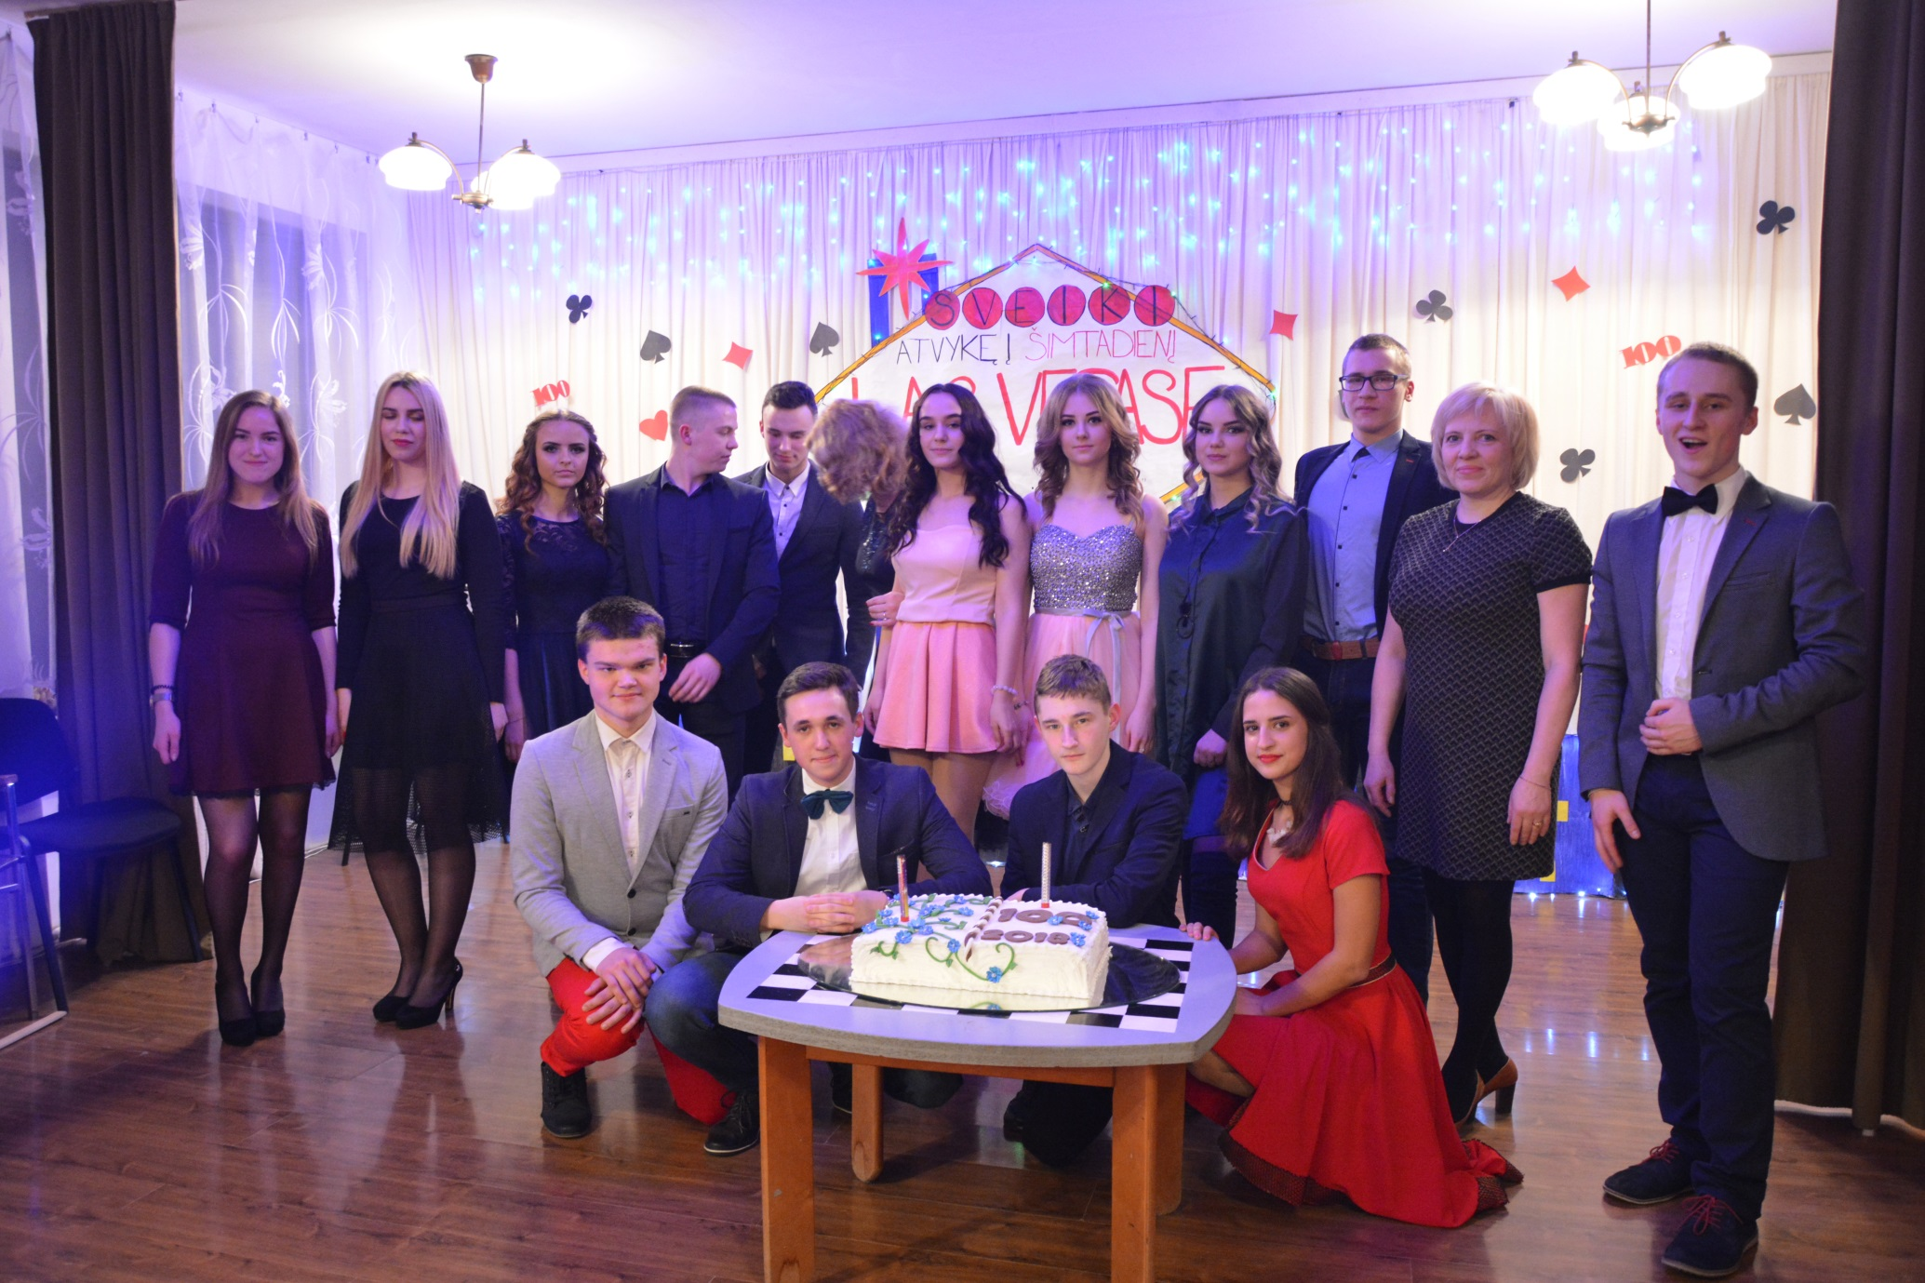
The traditional school event Hundred days are left

