Slide 1
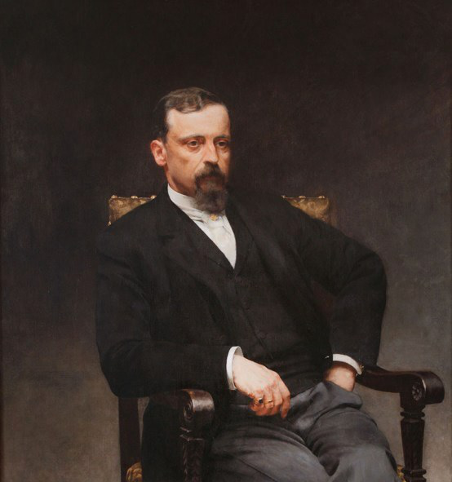
Henryk Sienkiewicz

Slide 2
The most important information:
•He was born in 1846 and died in 1916
•He was a Polish journalist and a Nobel-Prize-winning novelist in 1905

Slide 3
WORKS
Quo Vadis
In Desert and Wilderness (Polish: W pustyni i w puszczy)
The Teutonic Knights (Polish: Krzyżacy)
The trilogy: The Fire and the Sword (Polish: Ogniem i Mieczem), The Deluge (Polish: Potop) and Colonel Wołodyjowski (Polish: Pan Wołodyjowski)
The lighthouse keeper (Polish: Latarnik)
Sachem

Slide 4
Quo Vadis
In Latin means "Where are you going''.It's a retelling of a story from the apocryphal Acts of Peter, in which Peter flees Rome but on his way meets Jesus and asks him why he is going to Rome. Jesus says, "If thou desertest my people, I am going to Rome to be crucified a second time", which shames Peter into going back to Rome to accept martyrdom.
The novel Quo Vadis tells of a love that develops between a young Christian woman, Lycia (Ligia in Polish) and Marcus Vinicius, a Roman patrician. It takes place in the city of Rome under the rule of emperor Nero in AD 64.

Slide 5
Official poster for the film Quo Vadis, 1951

Slide 6
In Desert and Wilderness
It's the author's only novel written for children/teenagers. The story takes place in the 19th century Egypt, during the Mahdist War. A 14-year-old Polish boy Stanisław (Staś) Tarkowski and 8-year-old English girl Nel Rawlison live with their fathers and grow up in the city of Port Said. Their fathers are engineers who supervise the maintenance of the Suez Canal. One day an anti-British rebellion begins in Sudan, led by a Muslim preacher Mahdi. Staś and Nel are captured as hostages by a group of Arabs who hope that they can exchange the children for Fatima, Mahdi's distant relative, who had been arrested by the British at the beginning of the novel.

Slide 7
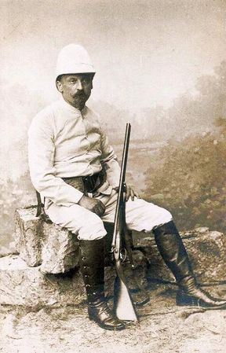
Sienkiewicz in a Safari outfit, 1890s

Slide 8
The Teutonic Knights
Krzyżacy tells the story of a young nobleman, Zbyszko of Bogdaniec, who together with his uncle Maćko of Bogdaniec returns from the war against the Order (Knights of the Cross) in nearby Lithuania. In a tavern inn Zbyszko falls in love with the lovely Danusia, who is traveling with the court of the Duchess Anna. He swears to her his knight's oath and promises to bring her "three trophies" from the Teutonic Knights.
One of Sienkiewicz's goals in writing The Knights of the Cross was to encourage and strengthen Polish national confidence against the occupying powers. To circumvent Russian censorship, he placed the plot in the Middle Ages, around Prussia (region) and the State of the Teutonic Order.

Slide 9
The trilogy
The series follows dramatized versions of famous events in Polish history, weaving fact and fiction.
The first novel, titled With Fire and Sword, chronicles the mid-17th century Ukrainian Cossacks revolt in Polish-Lithuanian Commonwealth known as the Khmelnytsky Uprising.
The second book, The Deluge, describes the Swedish invasion of Poland in the mid 17th century known as The Deluge, which followed the Khmelnytsky Uprising.
The final novel, Fire in the Steppe (title of the original: Pan Wołodyjowski), follows wars between Poland and the Ottoman Empire in the late 17th century.

Slide 10
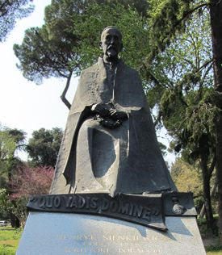
Statue of author of Quo Vadis, near Villa Borghese in Rome

Slide 11
A granddaughter of Henryk Sienkiewicz

Slide 12
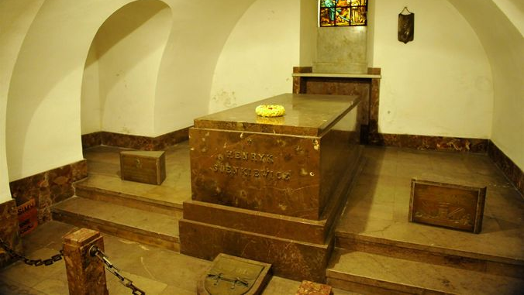
Sienkiewicz's tomb, St. John's Cathedral, Warsaw

Slide 13
Thank you for your attention!

