Slide 1
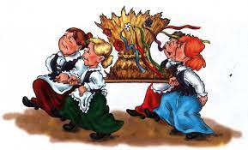
Harvest Festival in Sulmierzyce

Slide 2
Dożynki - harvest festival celebrations take place all over Poland from mid of August to early September every year. The festival is a like a reward for hard labor in the fields.

Slide 3
The festival is still celebrated with a colorful parade of people. They are organized by local governments, agricultural clubs, and parishes. Dożynki was a peasant manifestation of their pride and testimony to the power of national tradition.

Slide 4
They wear beautiful regional costumes, carrying a wreath and a loaf of bread baked from the current year’s crops.

Slide 5
The wreath is usually brought to the church by a ceremonial procession. It is often blessed by a Christian priest.

Slide 6
It is an opportunity to thank God for a successful harvest, for fun after hard work.

Slide 7
The celebration involves a number of interesting customs and traditions, of which today we associate perhaps the best harvesting wreath, donated as a gift to the altar of the parish church.

Slide 8
A lot of times there is a contest for the most beautiful wreath in the village. On the top of it all, there are picnics and fairs, farming exhibitions and performances.

