Slide 1
System of Education in Poland

Slide 2
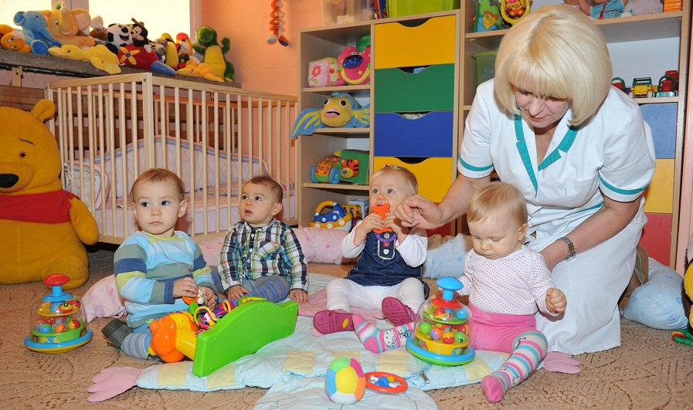
Crèche/kids club
For children aged 0-3 years
Attending a crèche is not obligatory
crèches are not a part of education system

Slide 3
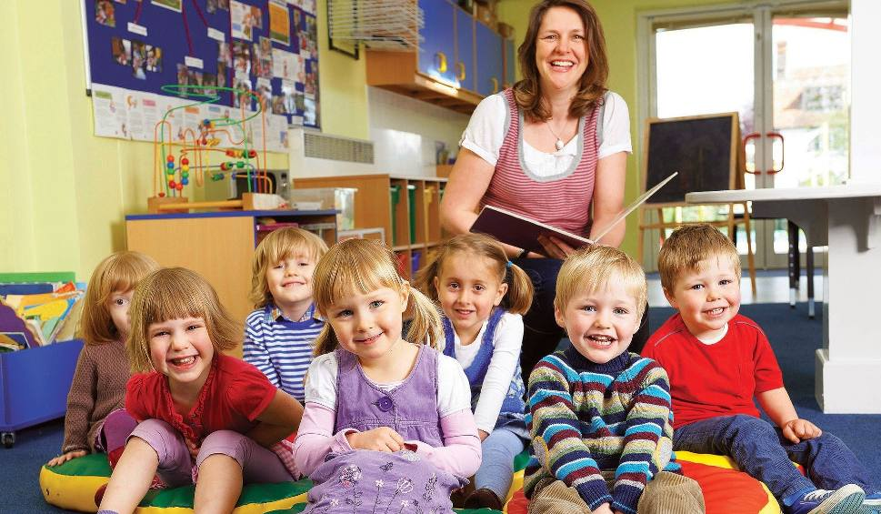
Kindergarten
For children aged 3-6 years
provide care for children while parents are at work, but are also conducive to their social (contacts with peers in the same group) and intellectual development (learning activities).
Attendance is not compulsory

Slide 4
Primary school
For children aged 6/7-15 years
It includes two stages:
grades 1-3 (early school education),
grades 4-8 where teaching is done by subject.
Attendance is compulsory
School-leaving exam is compulsory

Slide 5
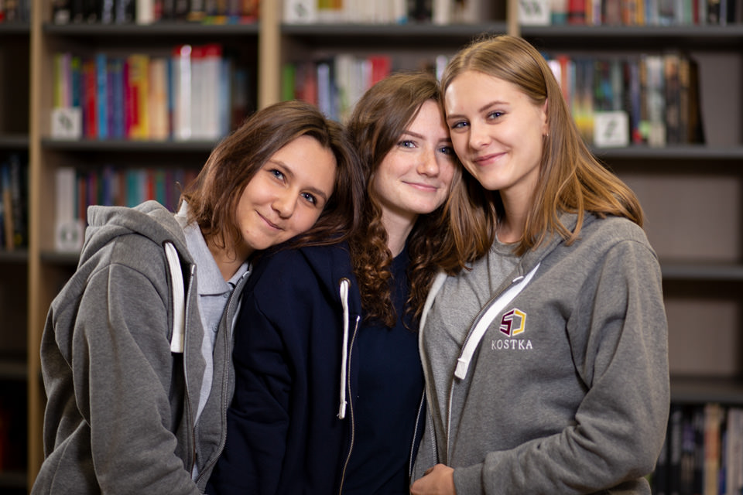
Secondary school
It is compulsory to stay in education until 18
You have to choose where you want to learn:
4-year general secondary school
5-year technical secondary school
3-year sectoral VET school (stage I)
2-year sectoral VET school (stage II)
It is mandatory to attend in school-leaving exam ( called Matura)

Slide 6
Higher education
Higher education in Poland is divided in two parts:
The Bachelor’s degree (3 years)
The Master’s degree (2 years)

Slide 7
Grading system
Grade | Grade Description
6 | Celujący (Excellent)
5 | Bardzo Dobry (Very Good)
4 | Dobry (Good)
3 | Dostateczny (Satisfactory)
2 | Dopuszczający (Passing)
1 | Niedostateczny (Unsatisfactory)

