Slide 1
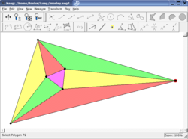
What is KSEG
KSEG is a free interactive geometry program for exploring
Euclidean geometry.You create a construction,such as triangle
with a circumcenter,and then,as you drag vercetes of the
triangle , you can see the circumcenter moving in real time.
Of course , you can do a lot more than that, these are in
the other page.

Slide 2
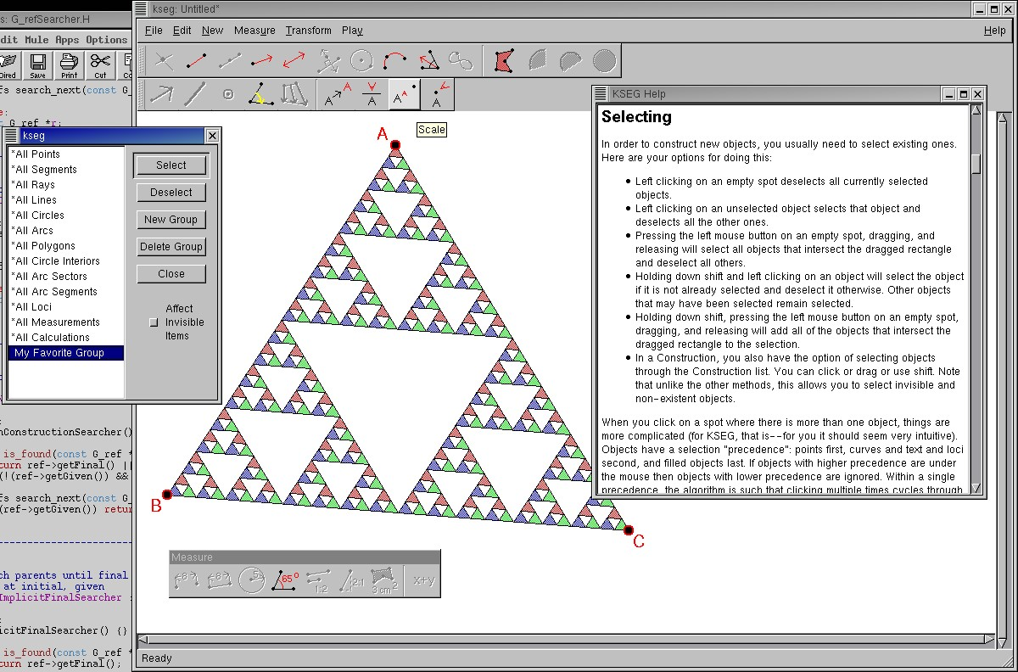
KSEG can be used in the clasroom,for personal exploration
of geometry,or for making high-quality figures for LaTeX.
It is very fast,stable and the UI has been designed for effiency and consistency. I can usually make a construction
in KSEG in less than half the time it takes me to do it with
similar programs.Despite the name,it is Qt based and does
not require KDE to run.

Slide 3
Features of KSEG
Fast core which supports large constructions
Supports multiple languages
Make measurements
Transformations
Construction of adaptively sampled loci for better quality and speed
Reverse dragging
Infinite undo and redo
Ability to easily redefine points to edit drawings
Editable scripting/macro with support for recursion
Small files
Calculation based transformations
Improved selection to given matching in construction
★
★
★
★
★
★
★
★
★
★
★
★
★

Slide 4
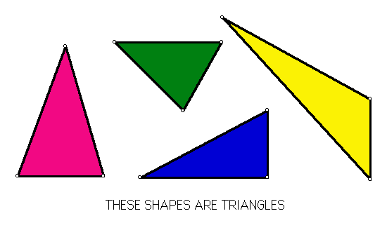
What is Triangle
A triangle plane is a combination of three straight pieces connecting three non-linear points in the plane. A triangle has 3 corners and 3 edges. The internal angles of the triangle are 180 degrees.

