Slide 1
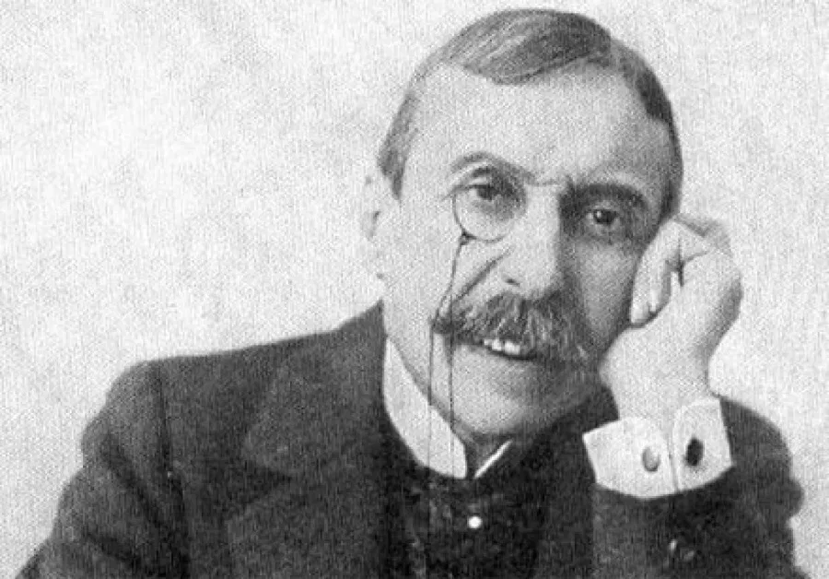
EÇA DE QUEIRÓS

Slide 2
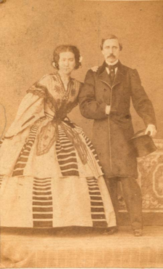
Where and when was he born?
José Maria de Eça de Queirós was born on 25 of November 1845 in Póvoa de Varzim (a city in Portugal).
His father was brazilian and his mother was portuguese. His parents got married after Eça de Queirós was born.

Slide 3
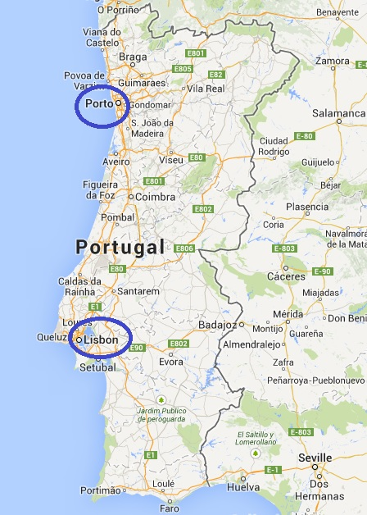
Childhood and studies:
Eça de Queirós was raised by his grandparents.
His school was an intern school in Porto (Oporto). Then, when he was older he went to a Law College in Coimbra.
After his graduation, he went to his parents’ house to live there, in Lisboa (Lisbon). He worked as a lawyer for a while.

Slide 4
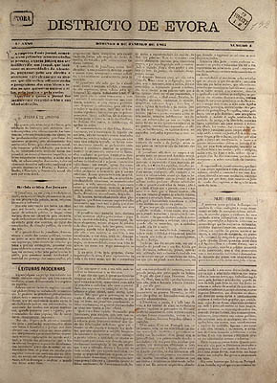
Literary career:
He started his literary career on 1867, by directing the newspaper of the opposition in Évora.
He worked as a journalist and it was gave to him the opportunity to travel to Egypt. This journey inspired him to write his famous book “O Egito” (“The Egypt”).

Slide 5
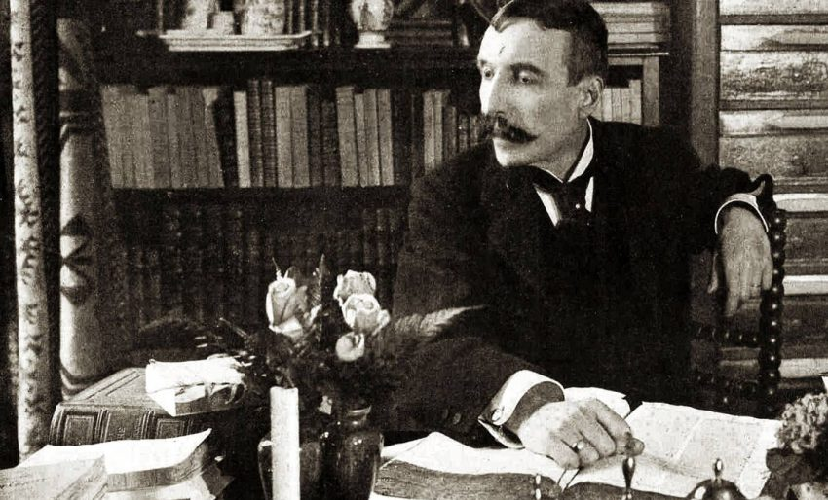
Literary carrer:
In 1865 he published his first book called “O Crime do Padre Amaro” (“The Sign of Father Amaro”) which was a politic and social criticism.
He kept writing books since then.
In 1888, he released his most famous book “Os Maias” (“The Maias”), starting a new phase of his literary carrer.

Slide 6
Some of his famous books:
“O Mistério da Estrada de Sintra” ("The Mystery of the Sintra Road"), in collaboration with Ramalho Ortigão
“O Crime do Padre Amaro” ("The Sign of Father Amaro”)
“O Primo Basílio” ("Cousin Bazilio")
“O Mandarim” (“The Mandarin”)
“A Relíquia” ("The Relic")
“Os Maias” ("The Maias")
“Uma Campanha Alegre” ("A Cheerful Campaign")
“A Ilustre Casa de Ramires” ("The Illustrious House of Ramires“)
“A Cidade e as Serras” (“The City and the Mountains”)

Slide 7
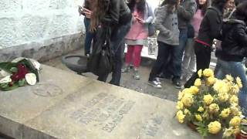
His death:
Eça de Queirós died on the sixteenth of August in France, 1900.
At this time, he was married with Emília de Castro Pamplona Resende and they had two children.

Slide 8
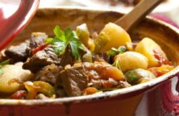
His favourite dishes:
During his books he mentioned an amount of his favourite dishes just like:
- Folhados de coco (Coconut Puffs)
- Coelho guisado à moda da Porcalhota (a type of rabbit stew)
- Bacalhau com batata à murro (Codfish with baked potato)
- Maçãs assadas com calda de vinho tinto, mel e canela (Baked apples with red wine, honey and cinnamon syrup)

Slide 9
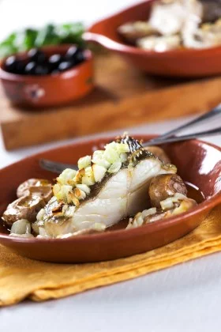
Recipe of Codfish with baked potato:
Ingredients:
- 4 soaked cod slices
- 400 g of new potatoes
- 1 onion
- 4 cloves of garlic
- 1 dl of oil
- Salt and pepper q.s.

Slide 10
Recipe of Codfish and baked potatos:
Preparation:
- Wash the potatoes with their peel, place them on a baking tray, temper them with 2 crushed garlic cloves and a dash of olive oil and put them in a preheated oven at 170̊ C, until they are roasted.
- Peel the onion and remaining garlic, coarsely chop the onion and finely chop the garlic. Place the codfish pieces in a pyrex, temper with pepper, add the onion and garlic over and around the codfish, drizzle with the remaining oil and put in the oven to 170̊ C just about 12 minutes.
- Remove the potatoes, press them a little to open. Place them around the codfish and put back in the oven for another 10 minutes. Remove, rectify the tempers and serve.

Slide 11
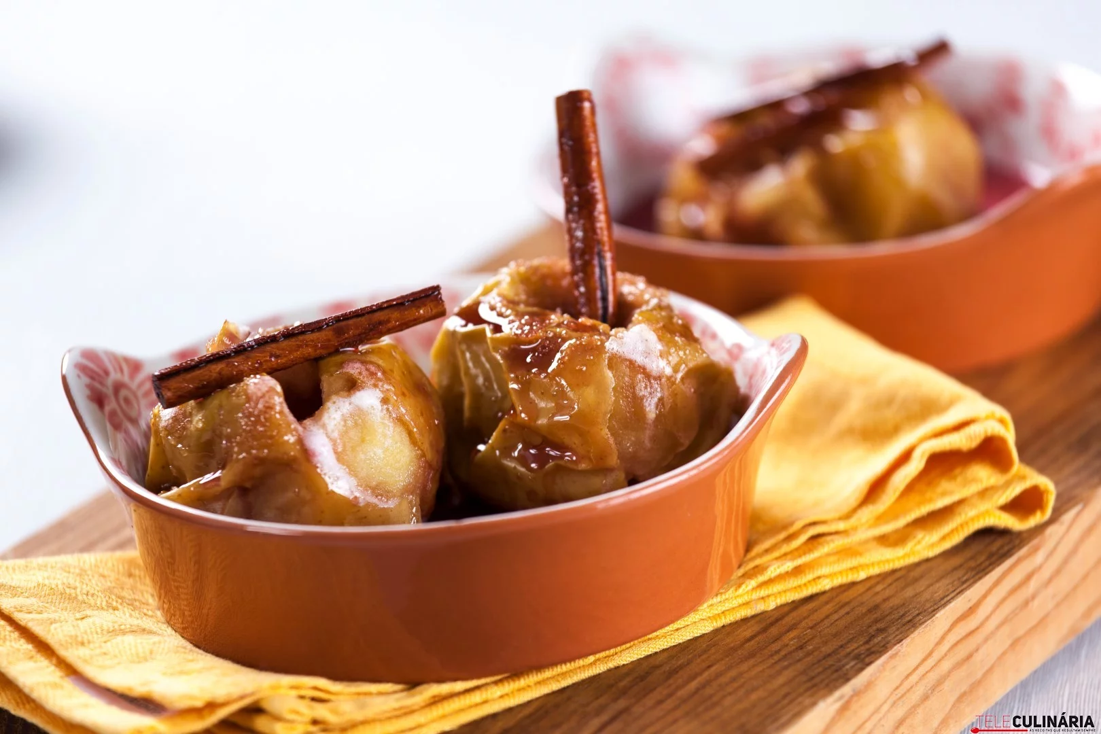
Recipe of baked apples with red wine, honey and cinnamon syrup
Ingredients:
- 4 apples
- 80 g of yellow sugar
- 1,5 dl of red wine
- 2 tablespoons of honey
- 1 cinnamon stick

Slide 12
Recipe of baked apples with red wine, honey and cinnamon cyrup
Preparing:
- Wash the apples, remove the heart of the apples and place them on a tray. Sprinkle with yellow sugar, add 4 tablespoons of the red wine to the bottom of the tray and place in a preheated oven at 170̊ C for about 25 minutes.
- Meanwhile, pour the remaining red wine, honey and cinnamon stick into a pot, stir and simmer until it reduces to about 1/3.
- Remove the apples from the oven, let them warm and serve them drizzled with the red wine syrup.

Slide 13
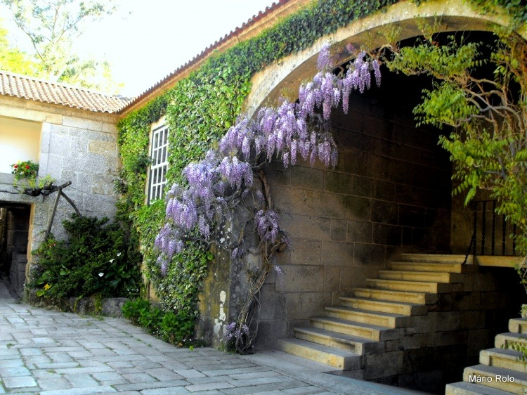
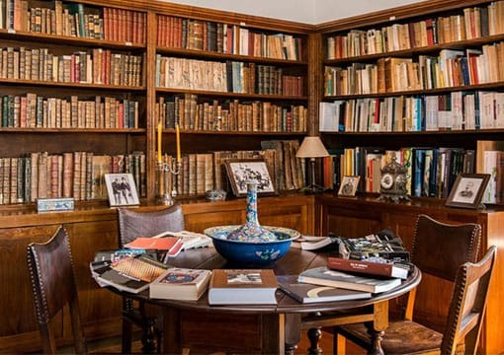
The Tormes House
The Tormes House (A Casa de Tormes) is located in Santa Cruz do Douro. This was Eça de Queirós’ house and it is famous for the description in the literary work “The city and the mountains”. This house is visited by national and international tourists.
In the house we find some of the furniture present in the novel, as well as the daily objects of Eça de Queirós and his photographs.

Slide 14
THANK YOU!
Work done by:
Ana Branco, Beatriz Bourbon, Cláudia Santos, Leonor Lima, Sofia Rodrigues

