Slide 1
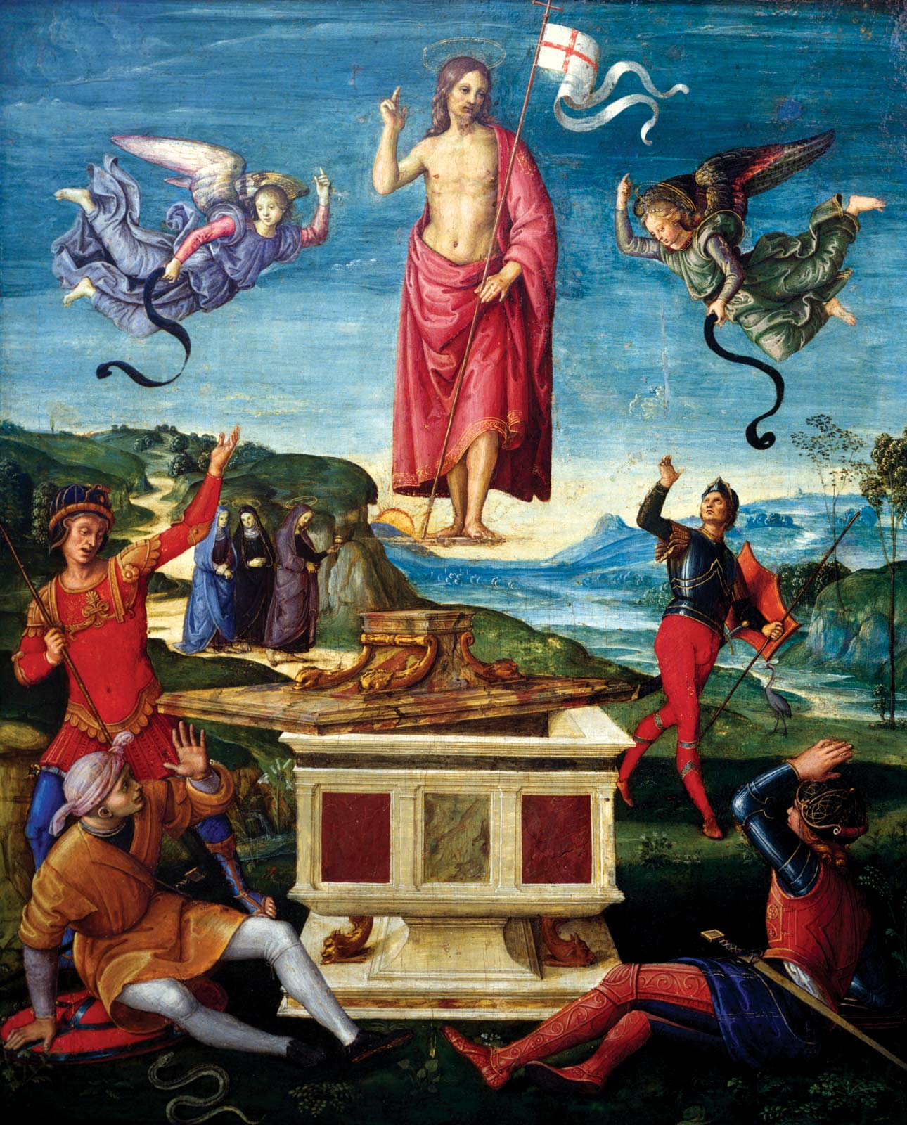
Easter in Sulmierzyce

Slide 2
Easter is a Christian holiday that celebrates the belief in the resurrection of Jesus Christ.

Slide 3
The holiday concludes the “Passion of Christ,” a series of events and holidays that begin with
Lent—a 40-day period of fasting, prayer and sacrifice—and ends with Holy Week, which includes:
- Holy Thursday (the celebration of Jesus’ Last Supper with his 12 Apostles, also known as “Maundy Thursday”),
Good Friday (on which Jesus’ crucifixion is observed)
and Easter Sunday.

Slide 4
Palm Sunday commemorates the entrance of Christ into Jerusalem. For Christians, it is a reminder of the welcoming of Jesus into our hearts and of our willingness to follow him.
The palm branch is a symbol of victory, triumph, peace and eternal life. He was solemnly entering as a humble King of peace.

Slide 5
Palm Sunday marks the beginning of Holy Week, the final week of Lent. Here is the procession.

Slide 6
The inhabitants of Sulmierzyce, walking along the streets of the town, are carrying Easter palms, which symbolize victory, triumph, peace and eternal life.

Slide 7
Holy Week culminates in the Paschal Triduum, the three days commemorating the crucifixion, death, and resurrection of Jesus Christ. He was bodily raised from the dead on the third day — Sunday, the day of Easter.

Slide 8
Holy Thursday (the celebration of Jesus’ Last Supper with his 12 Apostles, also known as “Maundy Thursday”),

Slide 9
Good Friday- is the day on which Christians commemorate the crucifixion and death of Jesus.

Slide 10
Easter Sunday - resurrection of Jesus. The victory of life over death.

Slide 11
Resurrection - On this day there is a very solemn Holy Mass. with the participation of all parishioners in honor of the risen Lord.

