Slide 1
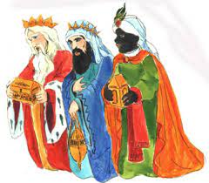
The feast of the Epiphany-
The three Wise Men
- January 6th

Slide 2
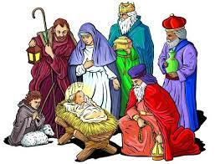
Most Poles associate January 6th with the feast of the Epiphany, commonly known as the Wise Men . On this day, the faithful of the Catholic Church remember the journey of the three wise men who came to Bethlehem to worship Christ. Casper, Melchior and Balthazar brought gifts: gold, incense and myrrh.

Slide 3
The people of Sulmierzyce celebrate the feast of the Three Kings very solemnly. It is a day off from work. Adults and children are very eager to participate in the procession of the Three Kings, which travels through the streets of our town every year.

Slide 4
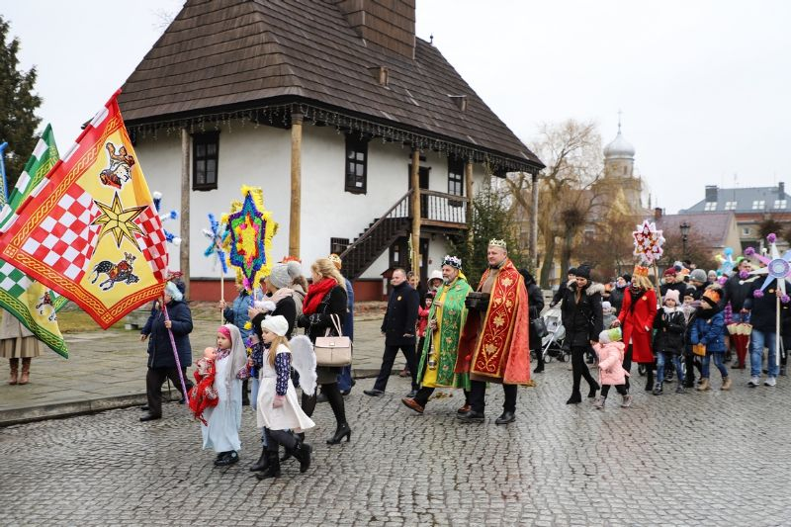
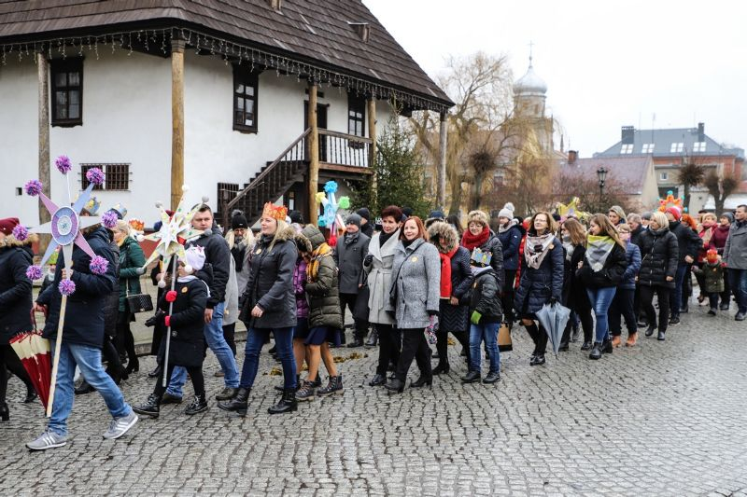
In Sulmierzyce, the Epiphany is accompanied by colorful processions and nativity plays.

Slide 5
The three Kings are often described:
Gaspar (or Caspar), who has brown hair and a brown beard and wears a green cloak and a gold crown with green jewels on it. He is the King of Sheba.
Melchior, who has long white hair and a white beard and wears a gold cloak. He is the King of Arabia.
Balthazar, who has black skin and a black beard and wears a purple cloak. He is the King of Tarsus/Macedonia and Egypt..

Slide 6
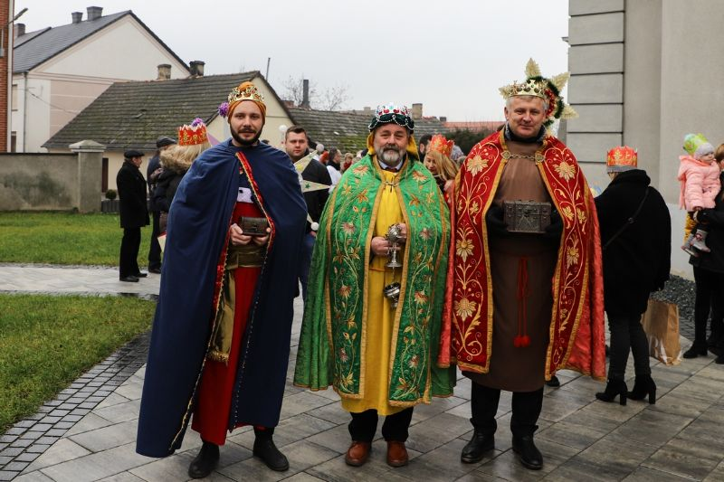
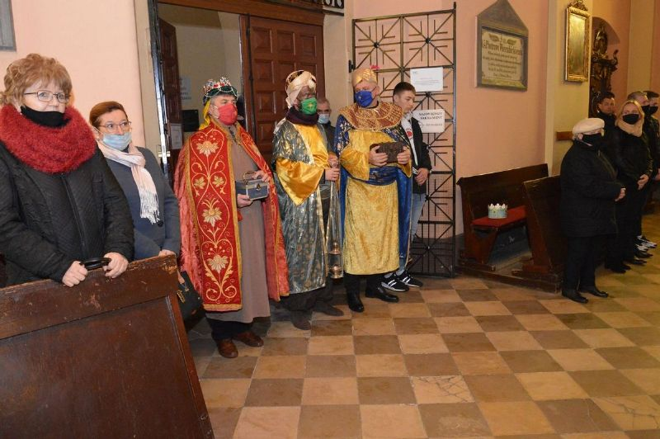
Caspar, Melchior or, Balthazar brought gifts: gold, incense and myrrh.

Slide 7
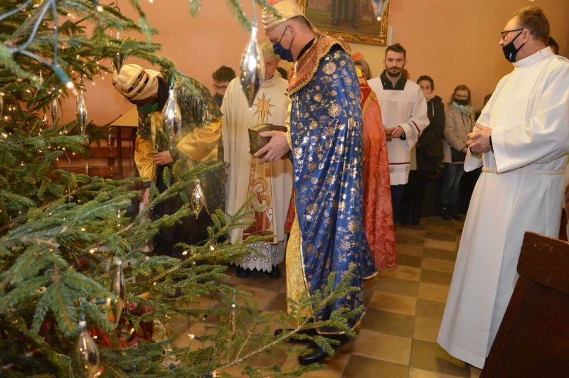
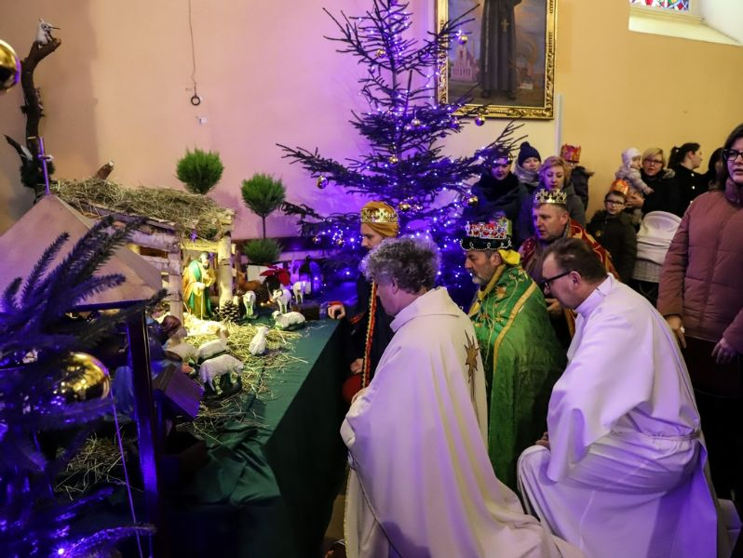
The gifts seem quite strange to give to a baby, but Christians believe that they had the following meanings: Gold: is associated with Kings and Christians believe that Jesus is the King of Kings. Incense: is sometimes used in worship in Churches and showed that people would worship Jesus. Myrrh: is a perfume that is put on dead bodies to make them smell nice; Christian believe that it showed that Jesus would suffer and die.

Slide 8
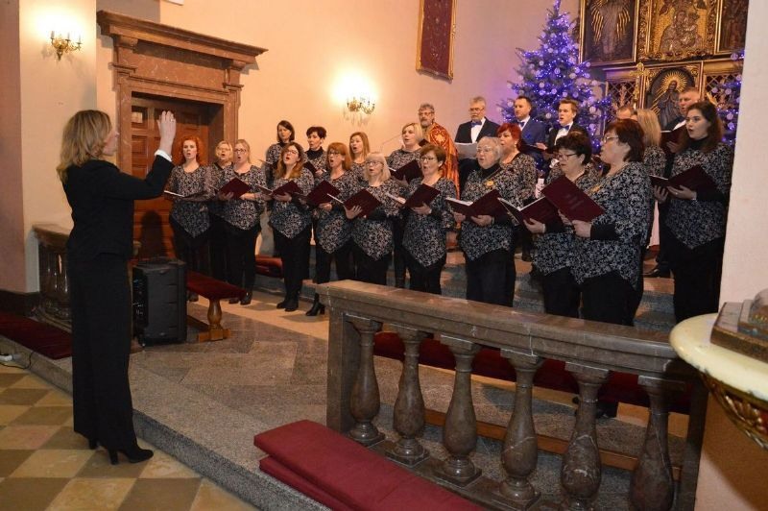
On this day there is a concert of Christmas carols and Christmas songs performed by our choir "Cecylia”"

Slide 9
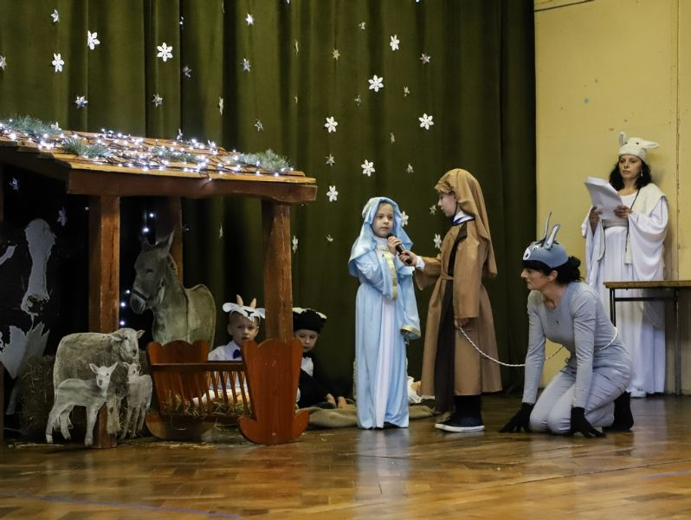
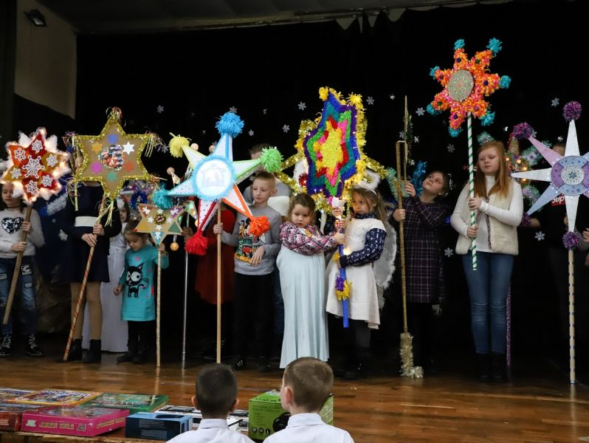
The celebration of Polish Christmas includes also nativity plays called "Jasełka" Every year we can watch nativity play prepared by students of our school.

