Slide 1
Digital Training Tool Skaitmeninė Mokymo Priemonė
https://smp2014ma.ugdome.lt/Mokomieji-objektai-11-12-klas%C4%97ms.aspx

Slide 2
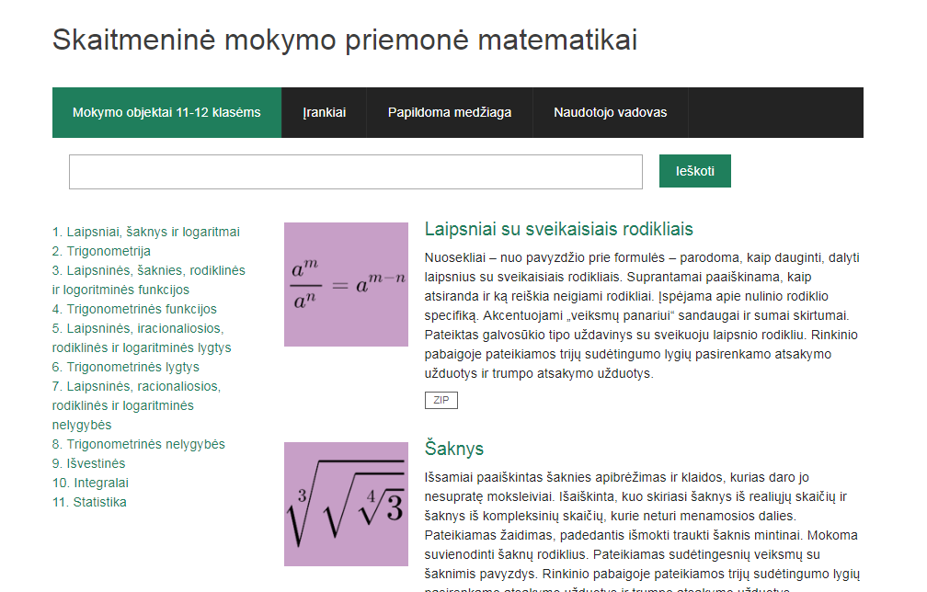

Slide 3
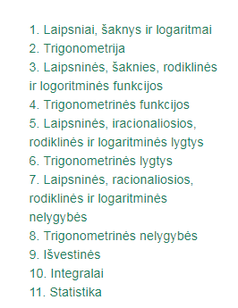
Different topics
Degrees, roots and logarithms
Trigonometry
Gradual, root, index and logistic functions
Trigonometric functions
Gradual, irrational, index and logarithmic equations, etc.

Slide 4
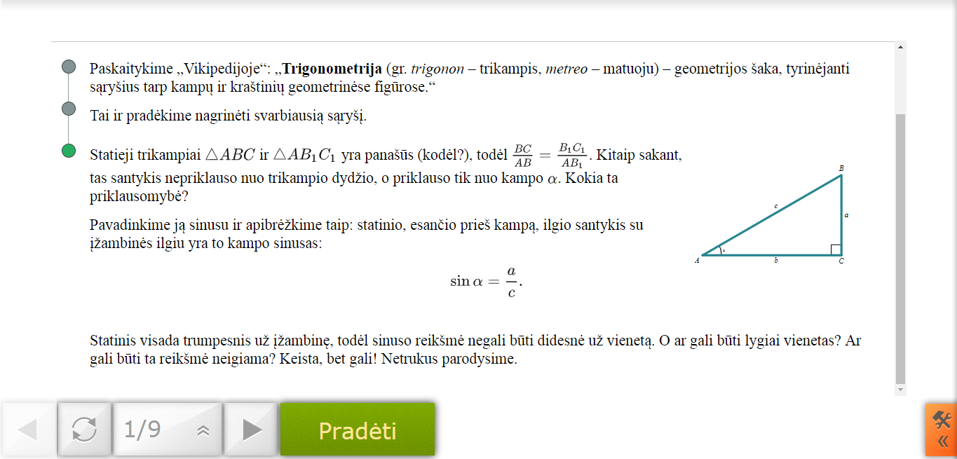
Trigonometry

Slide 5
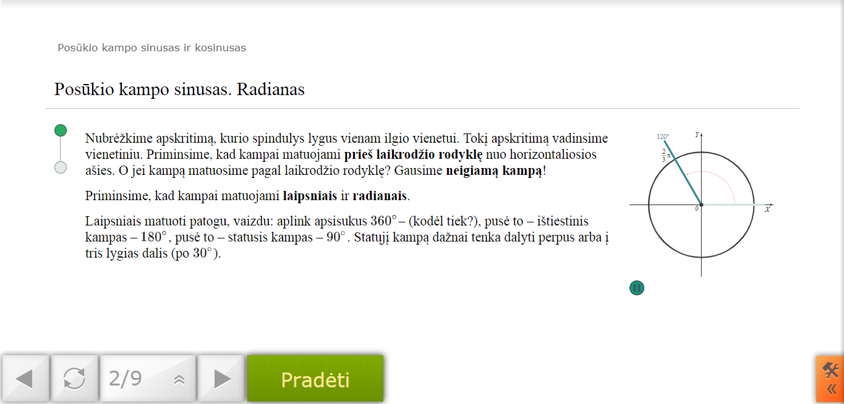
Trigonometry

Slide 6
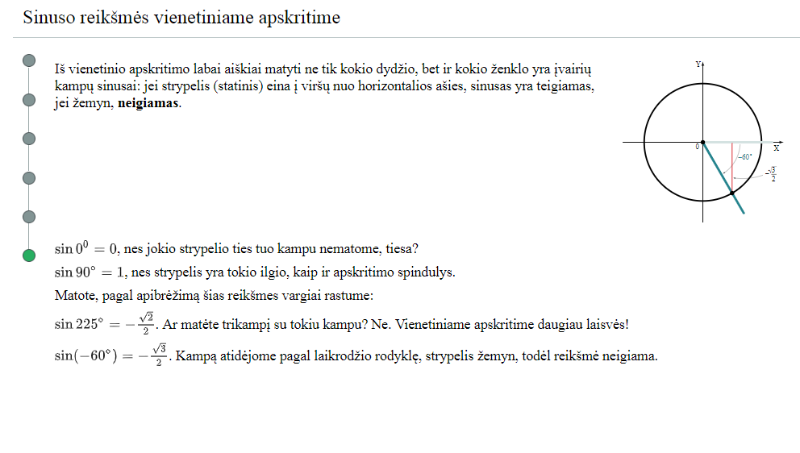
Trigonometry

Slide 7
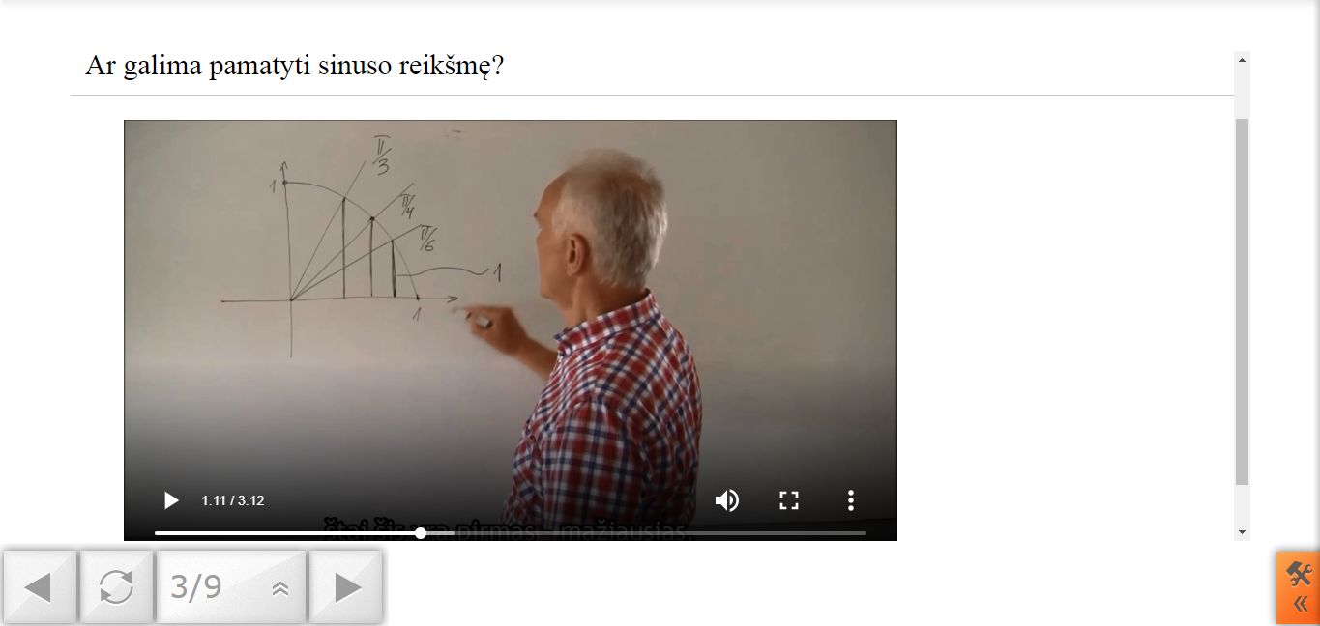
Video lessons

Slide 8
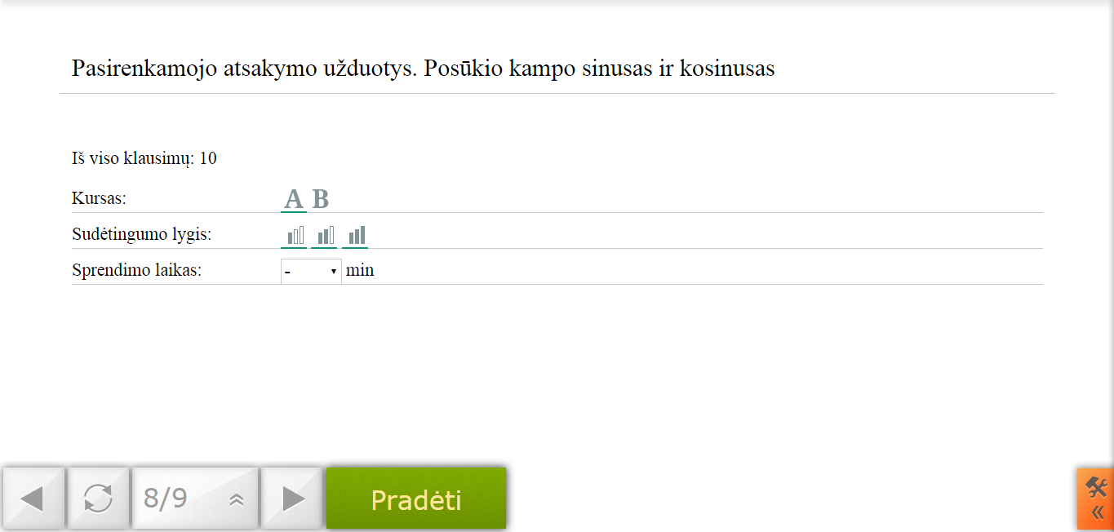
Tests

Slide 9
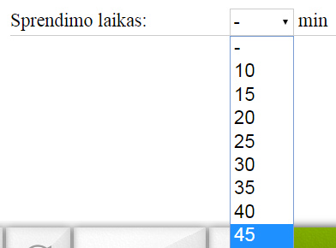
Tests
2 courses „A“ and „B“, what in Lithuanian means „Higher“ and „General“ and in 3 different difficulty levels.
Solving time

Slide 10
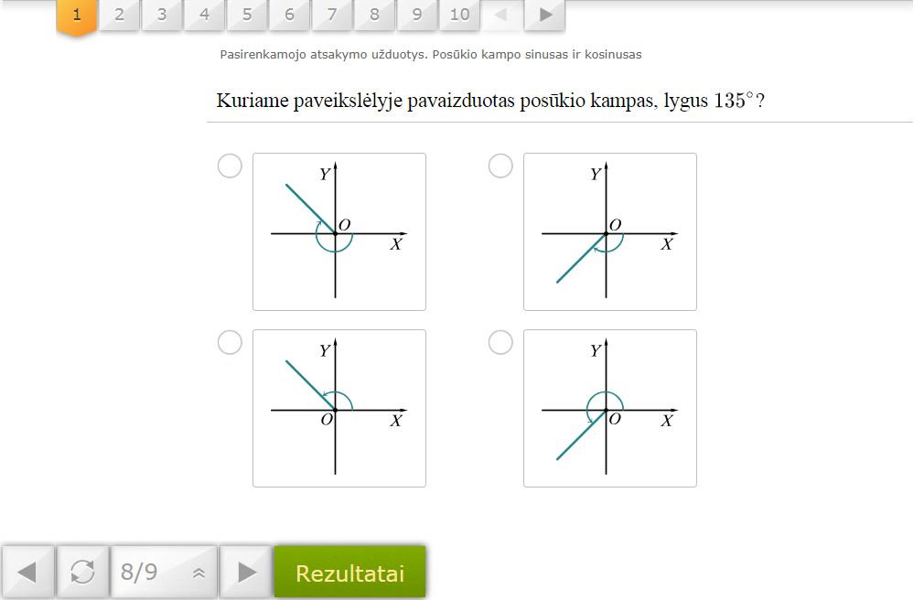

Slide 11
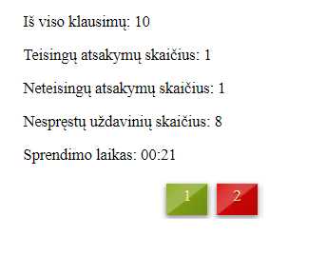
Tests
When you finish solving tests you get your statistics and opportunity to check where you did mistakes and once again repeat all theory and retry test.

Slide 12
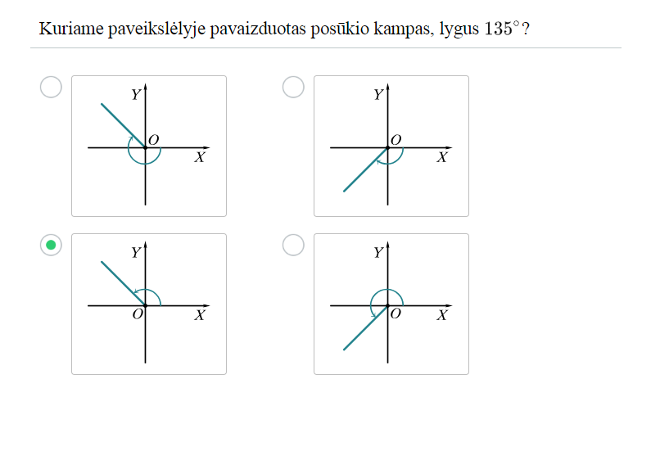

Slide 13
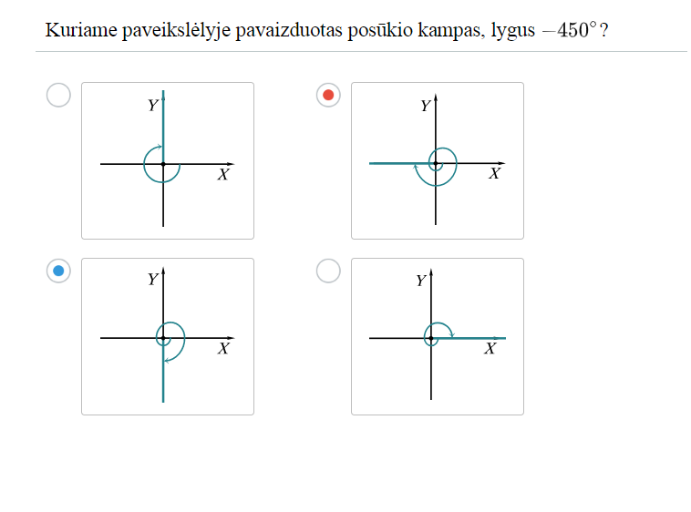

Slide 14
Digital Training Tool
This digital training tool is very helpful for all of us when we don‘t understand some themes in mathematics or we would like to deepen our knowledge.

