Slide 1
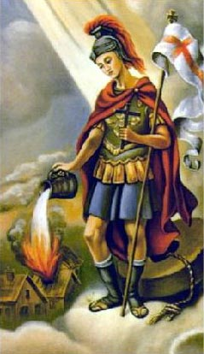
Firefighter’s Day in Sulmierzyce is May 4th
International Firefighter’s Day (IFFD) was instituted in 1999 to honor the memory of five firefighters who tragically died in a large bush fire in Australia. The date of May 4 was chosen because on this day the Catholic church honors Saint Florian, the patron saint of firefighters. Florian was a commander in the Roman army who organized and led firefighting brigades.

Slide 2
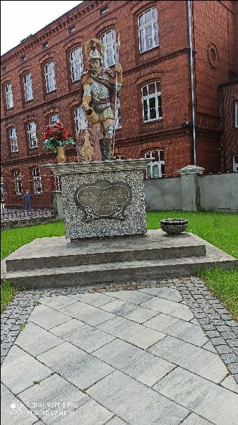
The image of Saint Florian, which is located at our church

Slide 3
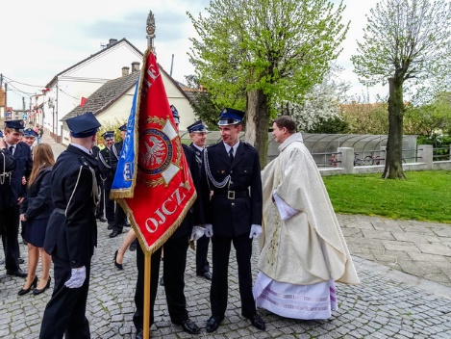
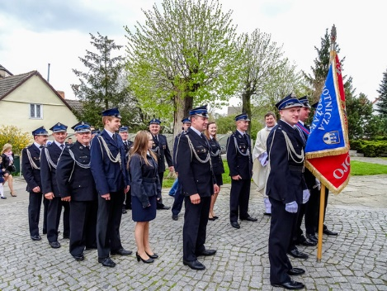
Firefighter’s Day in Poland is the professional holiday of all members of both state and volunteer fire brigades

Slide 4
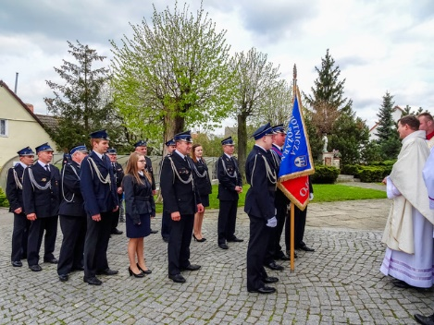
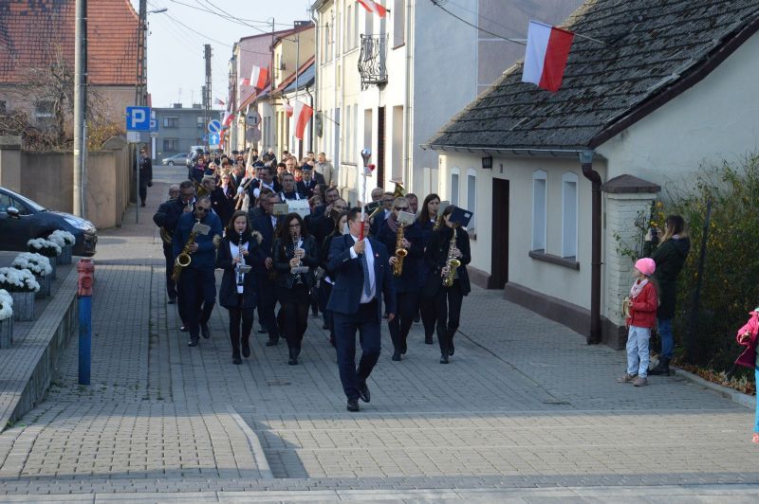
We have a volunteer fire brigade in Sulmierzyce. May 4th is their great holiday.

Slide 5
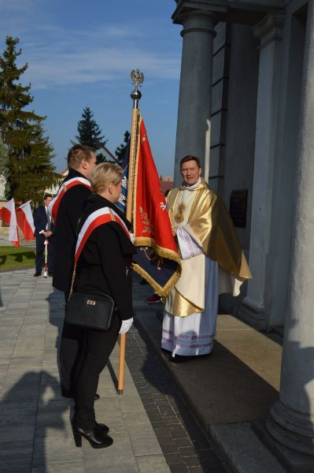
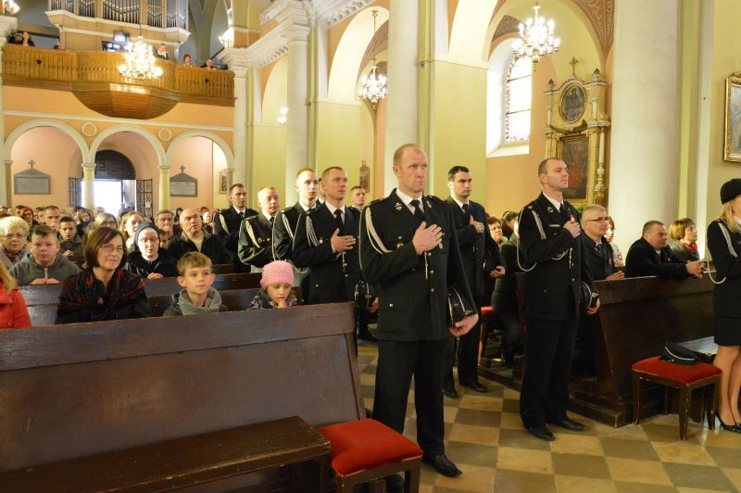
On this day, firefighters participate in the Holy Mass.

