Slide 1
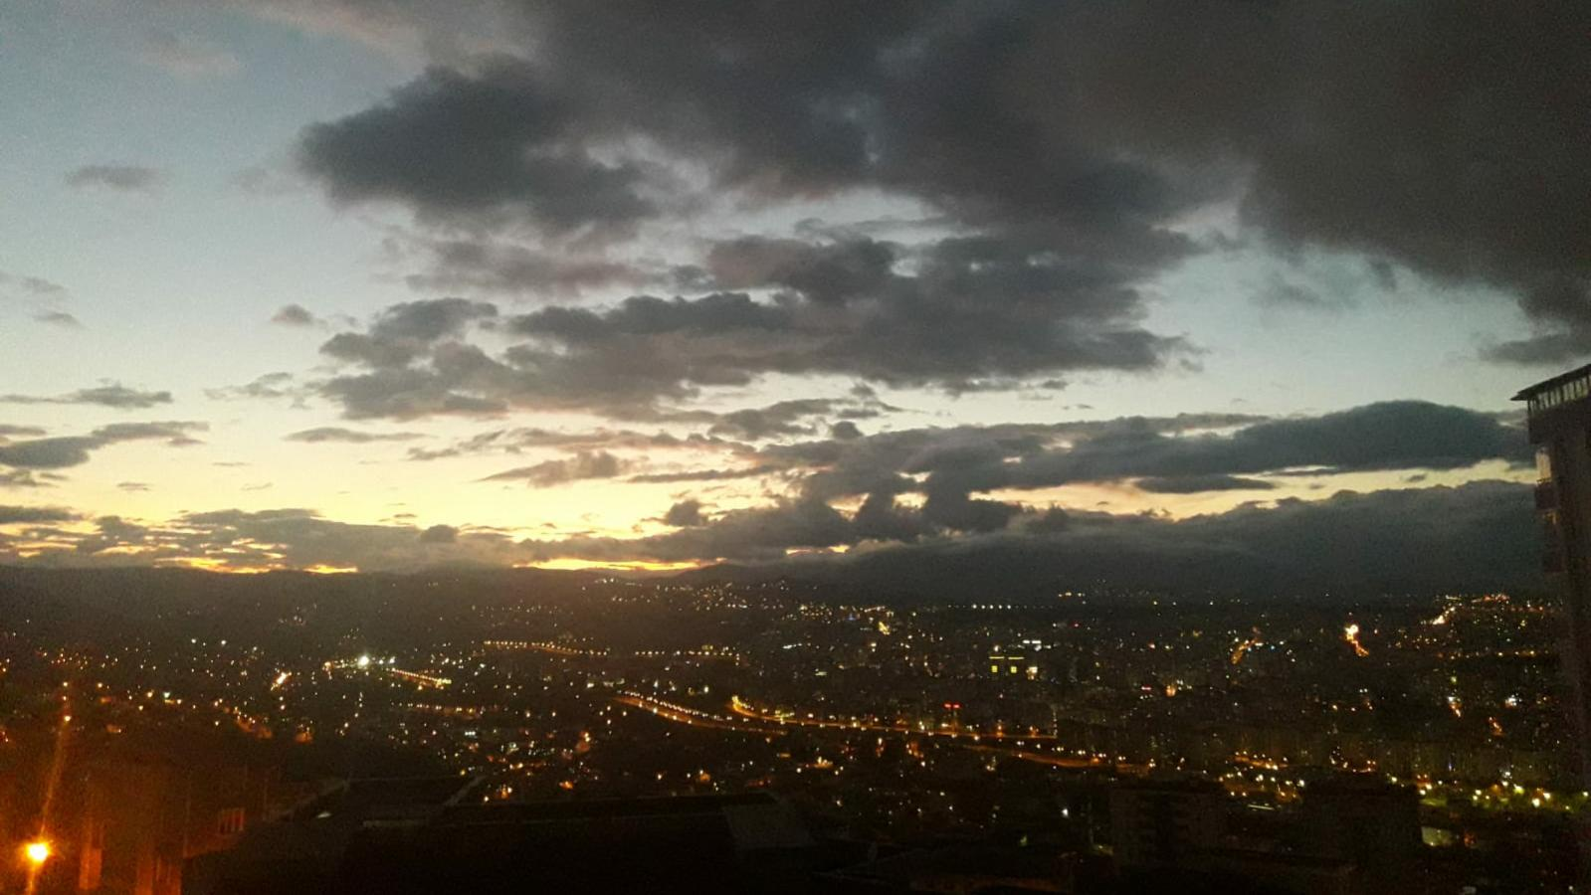
SAMSUN

Slide 2
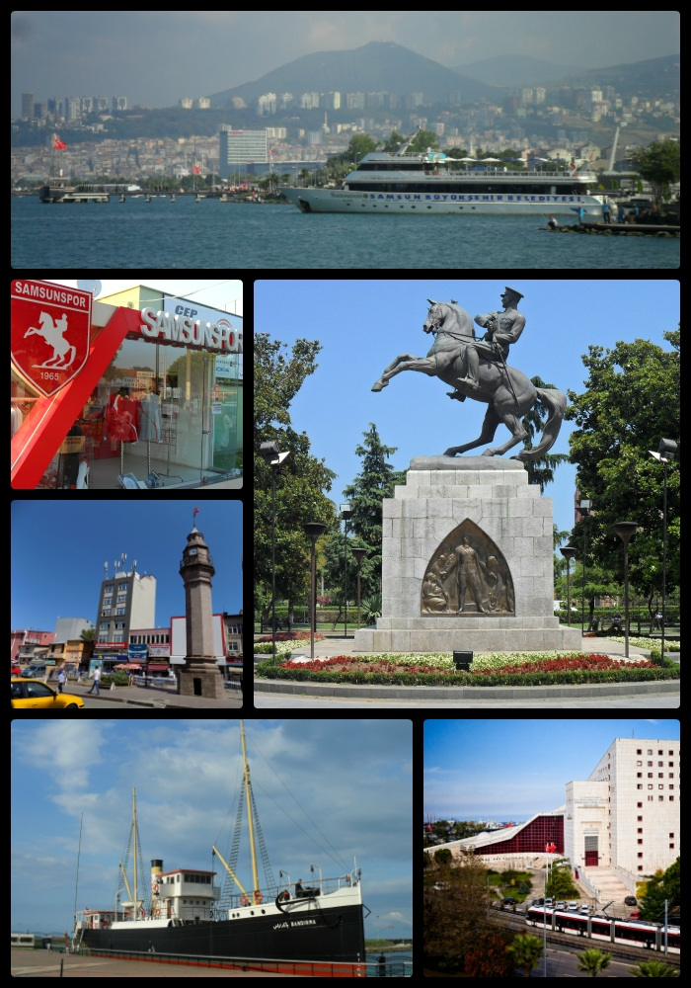
OUTLİNE
Geography
Economy
Education
History
Places To See

Slide 3
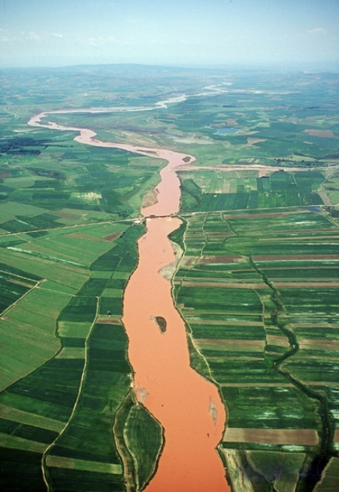
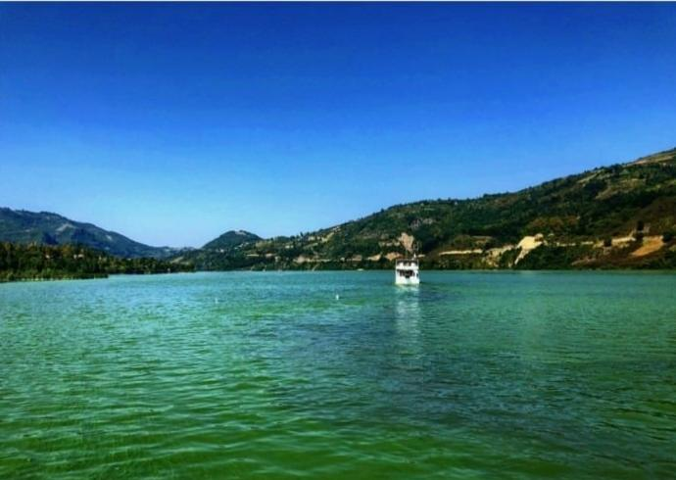
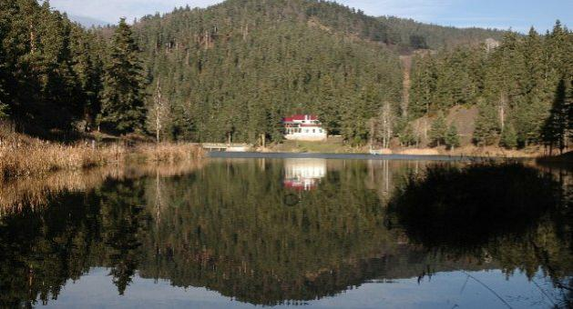
Geography
Samsun is situated between two river deltas which jut into the Black Sea. It is located at the end of an ancient route from Cappadocia: the Amisos of antiquity lay on the headland northwest of the modern city. To Samsun's west, lies the Kızılırmak ("Red River", the Halys of antiquity), one of the longest rivers in Anatolia and its fertile delta. To the east, lie the Yeşilırmak ("Green River", the Iris of antiquity) and its delta.
Rivers
Terme river, Yeşilırmak, Aptal river, Mert river, Kürtün river, Kızılırmak
Lakes
Akgöl, Dumanlı, Semenlik
Climate
Samsun has a humid, temperate, marine climate with cool winters and warm summers and high rainfall throughout the year.
Kızılırmak River
Yeşilırmak River
Akgöl Lake

Slide 4
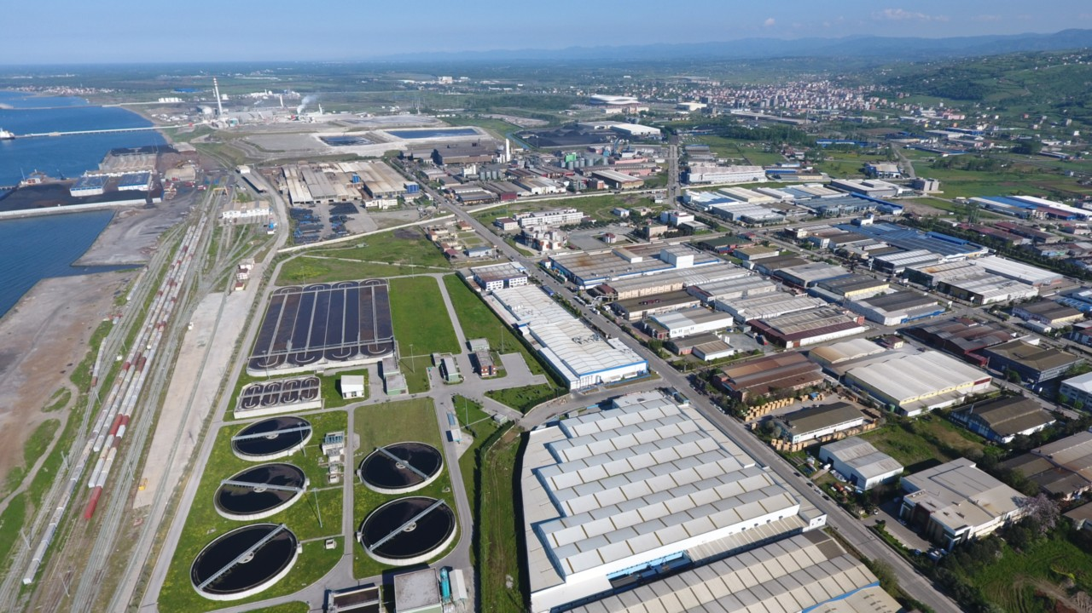
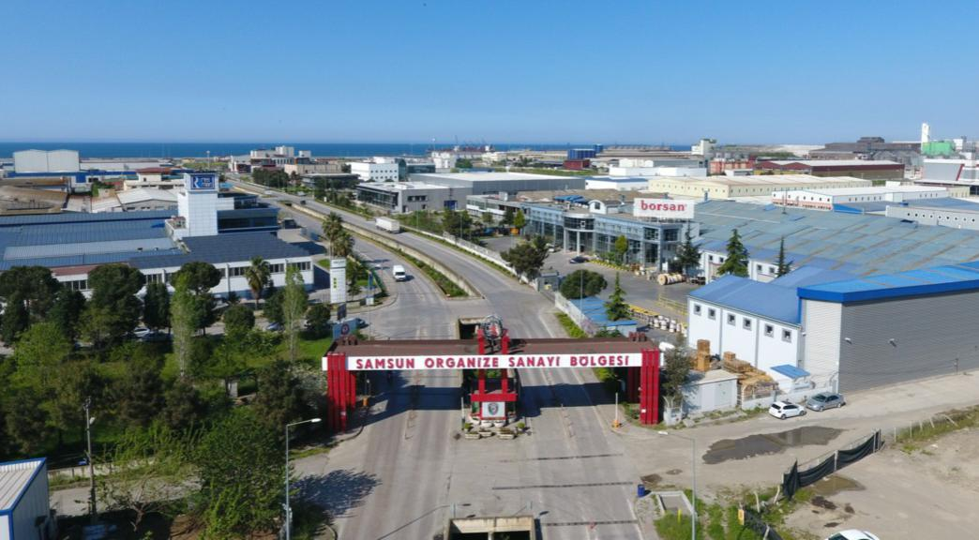
Economy
Samsun is an important Turkish trade centre and the most important port on the Black Sea coast. Samsun is one of the major Turkish tobacco producing provinces. In the later Ottoman period the land around the town mainly produced tobacco. The town was connected to the railway system in the second half of the 19th century, and tobacco trade boomed. The Çarşamba Valley and the Bafra Valley offer possibilities for farming.
A concern of automotive industries is located in Samsun.

Slide 5
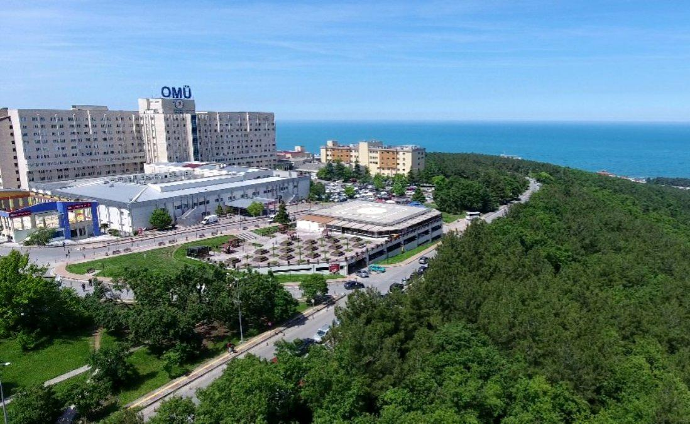
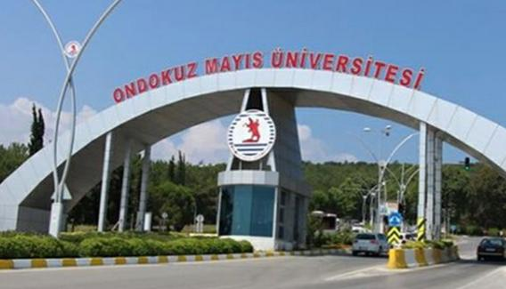
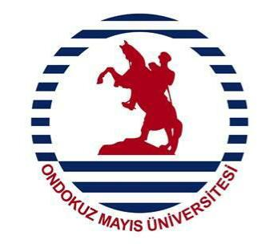
Education
The University of Samsun (19 Mayis Üniversitesi) is one of the seven best universities of Turkey. Moreover the city has colleges, 58 grammar schools, 1.048 primary schools and public libraires.

Slide 6
History
Samsun Samsun's ideal combination of fertile ground and shallow waters has attracted numerous trade interests. Greek colonists settled in the 6th century BC and established a flourishing trade relationship with the Anatolians. At that time, Samsun was part of the Greek colony of Amisus. In the 3rd century BC, Samsun came under the expanded rule of the Kingdom of Pontus. The Kingdom of Pontus had been part of the empire of Alexander the Great. However, the empire was fractured soon after Alexander's death in the 4th century BC. At its height, the kingdom controlled the north of central Anatolia and mercantile towns on the northern Black Sea shores.
Ataturk founded the Turkish republic movement at Samsun and it served as its base during the Turkish War of Independence.

Slide 7
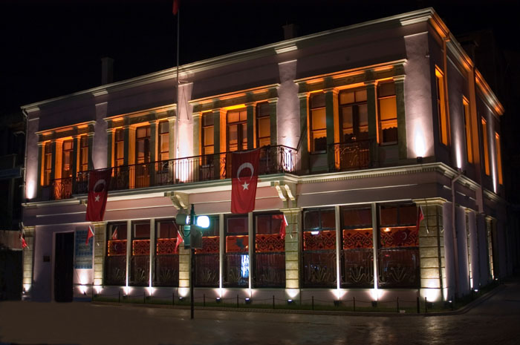
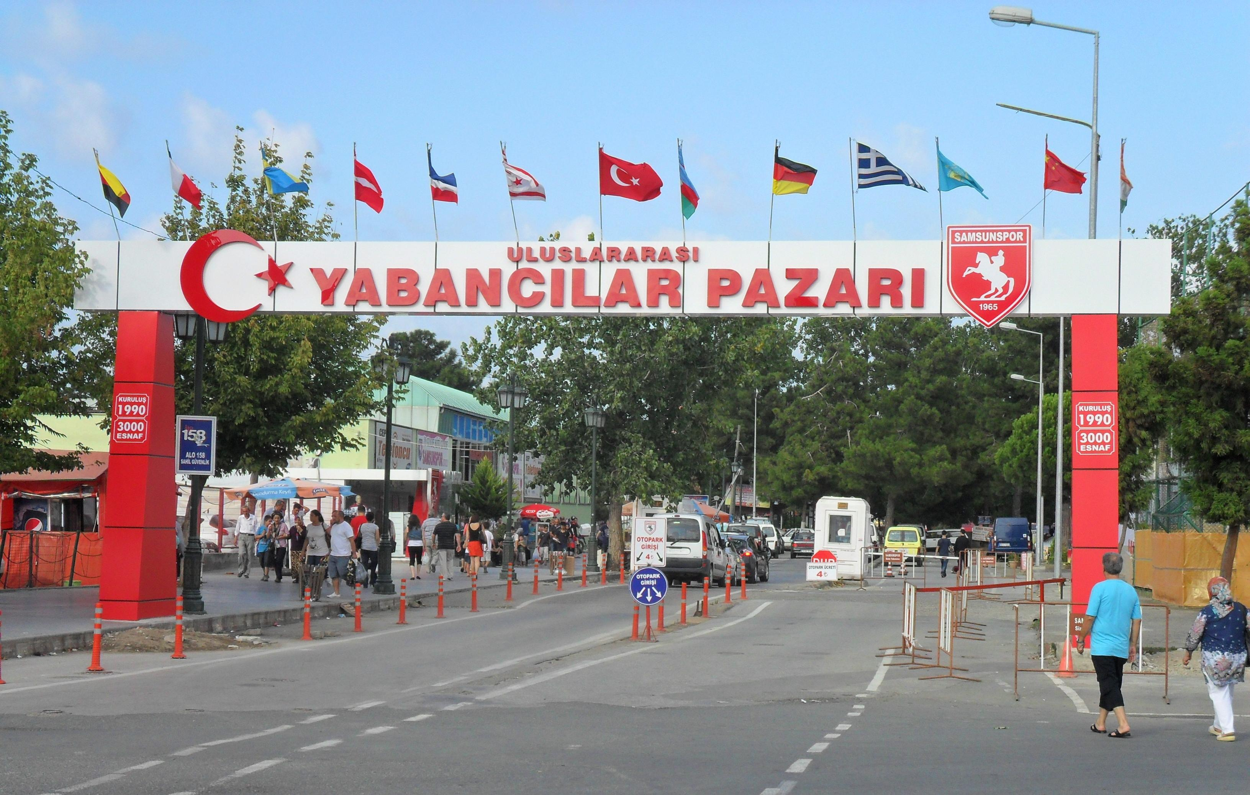
Places To See
Atatürk (Gazi) Museum. It houses Atatürk's bedroom, his study and conference room as well some personal belonging
The Russian Market (Rus Pazari).

Slide 8
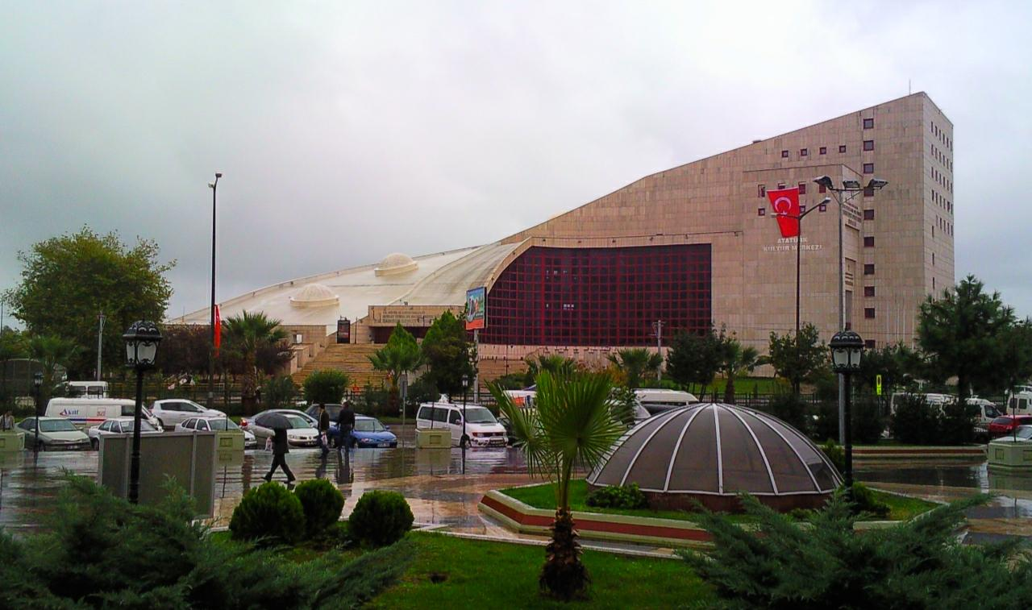
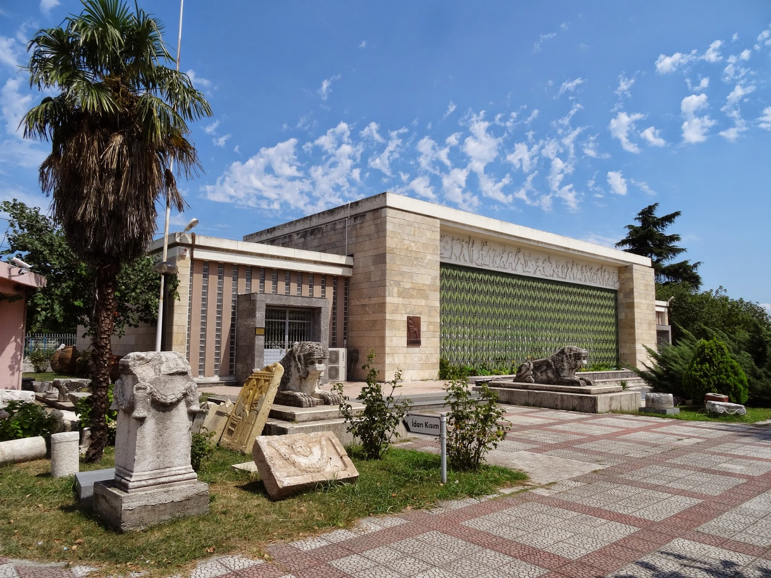
Kultur Sarayi (Palace of Culture). Concerts and other performances are held at the Kultur Sarayi, which is shaped much like a ski jump.
Archaeological and Atatürk Museum. The archaeological part of the museum displays ancient artifacts found in the Samsun area. The Atatürk section includes photographs of his life and some personal belongings. The museum is open from 8:30 till 12:00 and from 14:00 till 17:00.

Slide 9
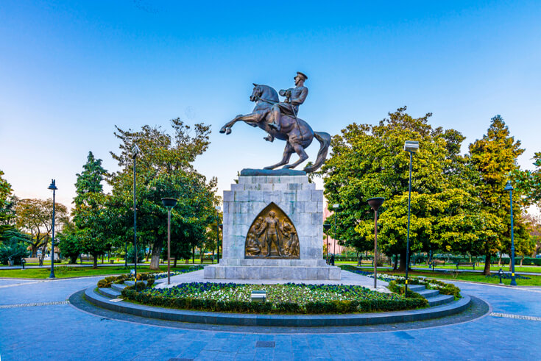
And the biggest symbol of Samsun
Statue of Atatürk. By Austrian sculptor Heinz Kriphel, from 1928 to 1931.

Slide 10
Thanks for Watching

