Slide 1
Smart Schools for Smart Age
Lesson: Mathematics
Class: IV G (12th)
Topic: Percent
Aim and goals:
To revise how to find out the part of the number and show it in percent;
To increase and decrease the number by the particular percent;
Kontroliniai.lt
https://www.youtube.com/watch?time_continue=25&v=-cTdCmvI7JI

Slide 2
The tasks:
The month plan of production – 286 t. It was produced 12 % down. How much was produced?
2. The worker earn 552 Lt which were increased 15%. How much does he earn before the increase of the salary?
3. 800 students study in school. 75% consists of boys. How many girls are there in the school?

Slide 3
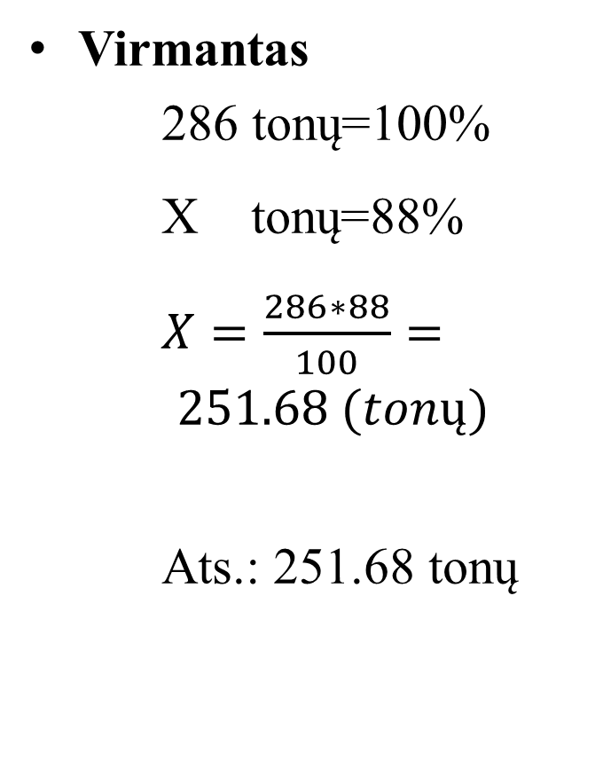
Students‘ solutions (task No. 1)
Virmantas
286 tonų=100%
X tonų=88%
$X=\frac{286∗88}{100}= 251.68 (tonų)$
Ats.: 251.68 tonų
Ilona
100% - 286t 12% - x t x=12*286/100=34,32t 286-34,32=251,68t

