Slide 1
Sulmierzyce- Our Home Town
Crest of Sulmierzyce Flag of Sulmierzyce

Slide 2
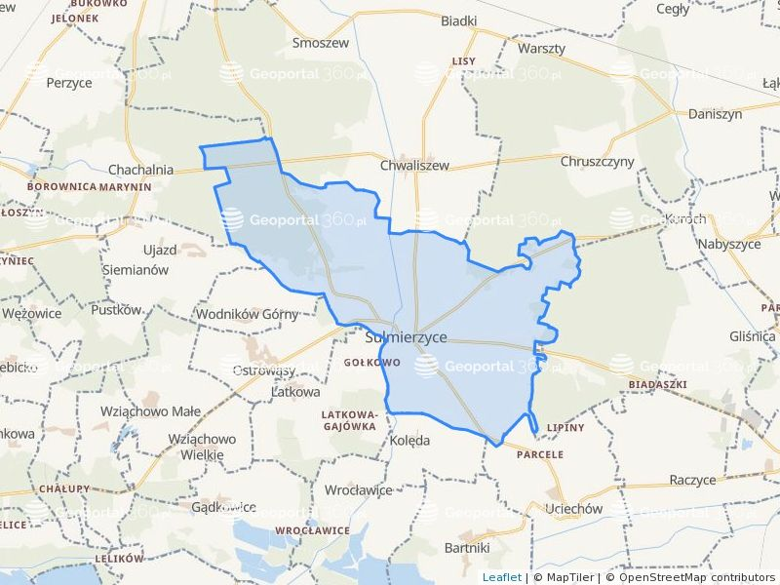
Map of Sulmierzyce
From the south, the town neighbors with dolnośląskie voyvodeship and it is in the immediate vicinity of the Barycz River Valley Landscape Park.
The town’s area is 28.9 km

Slide 3
Sulmierzyce in a few words
Sulmierzyce is a small town with not even 3 thousand residents, located in the county of Krotoszyn, by the Black Water River.

Slide 4
Town Council of Sulmierzyce

Slide 5
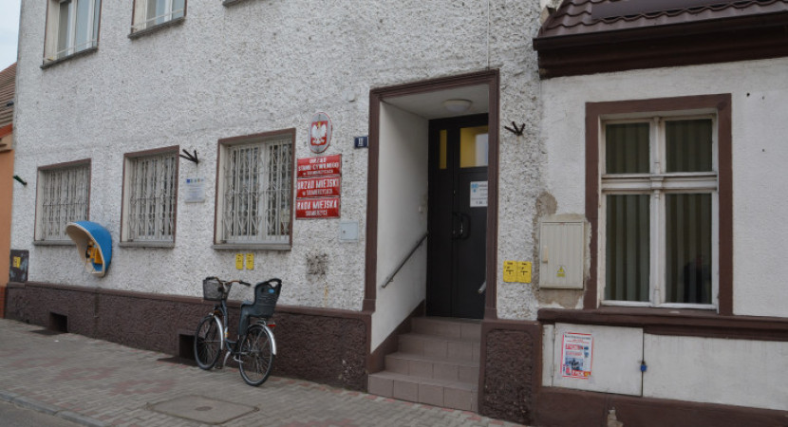
Town Hall in Sulmierzyce

Slide 6
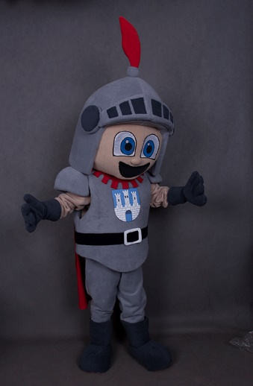
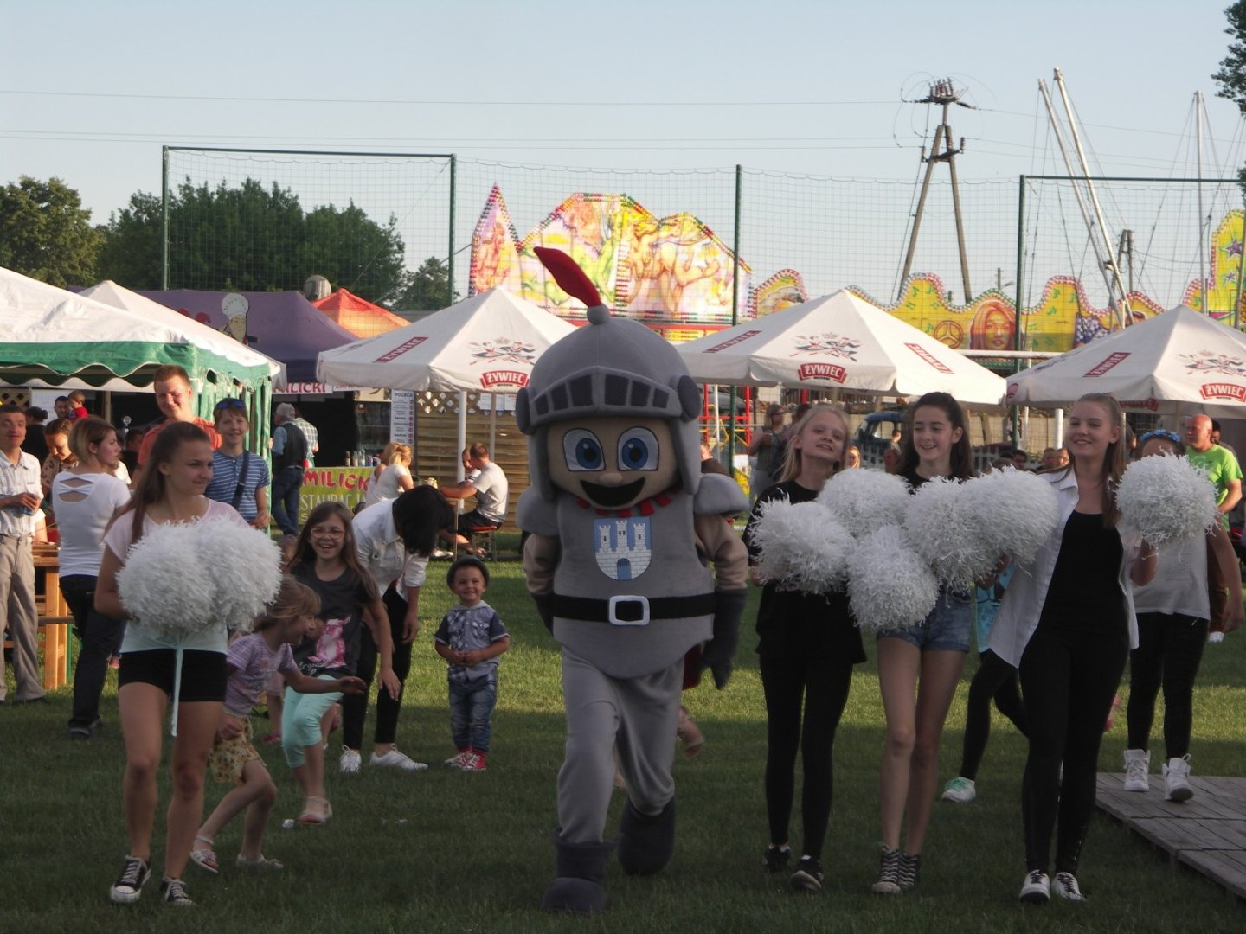
Mascot of Sulmierzyce

Slide 7
History
Sulmierzyce is one of the oldest towns in Greater Poland. Its history and tradition is over 550 years old. According to a centuries – old legend, the name of Sulmierzyce comes from „Sulimir” the probably founder of the first settlement here.

Slide 8
Under the foundation document dated 11 November 1457 issued by Mikołaj Gruszczyński, the starost of Odolanów, and approved of by Kazimierz Jagiellończyk, the King of Poland, a royal town was established and located on Magdeburg Law on territory of three royal village: Stare Sulmierzyce, Modne Sulmierzyce and Granowice.

Slide 9
Monuments

Slide 10
In 2007, Sulmierzyce celebrated the 550th anniversary of becoming a town.

Slide 11
VINTAGE BUILDINGS
IN SULMIERZYCE

Slide 12
PARISH CHURCH
The Neo-Baroque parish church dedicated to the Assumption of the Blessed Virgin Mary was reconstructed in 1878.

Slide 13
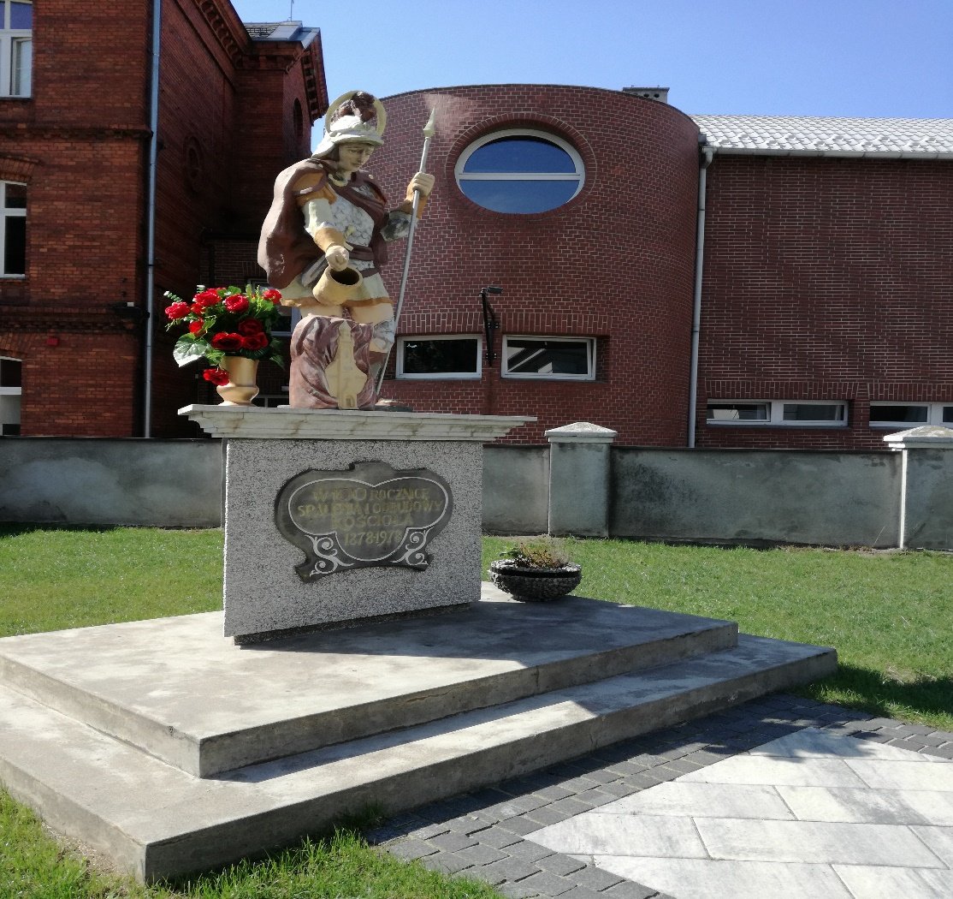
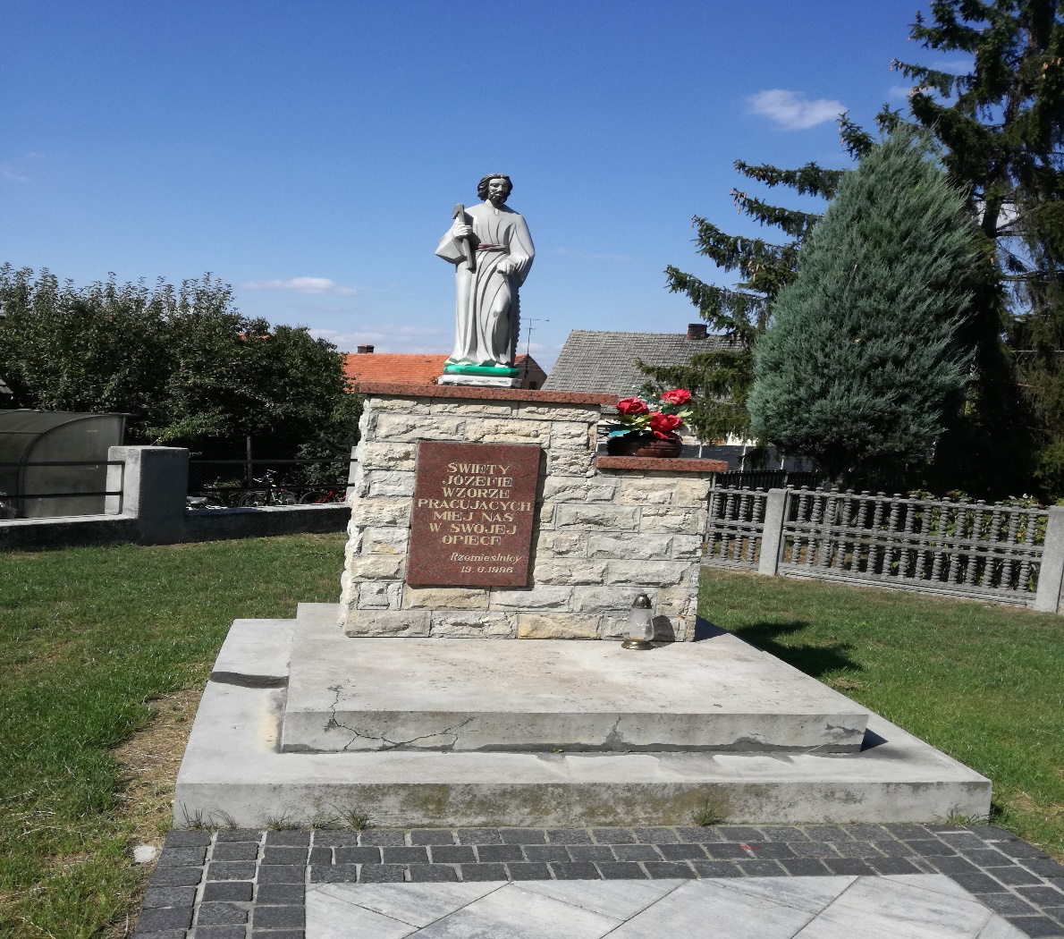
By the church there are two sculptures of:
St. Floriarn from 1980
St. Joseph from 1999

Slide 14
WOODEN WINDMILL FROM 1795
The windmill is a typical construction of this type with details characteristic for the region.

Slide 15
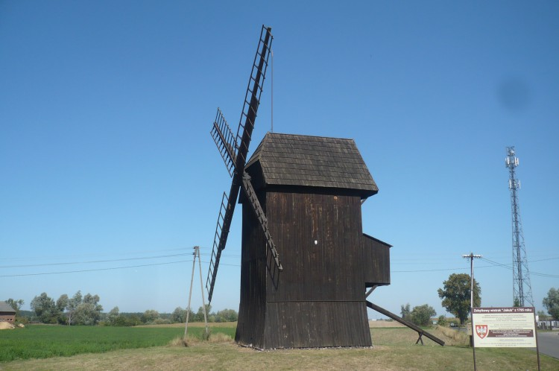

Slide 16
WOODEN TOWN HALL FROM 1743
The town’s central point is an old, rectangular Main Square with five streets radiating in five directions. In the middle of the Main Square there is a wooden plaza with an unique town hall made of wood and originating from 1743.

Slide 17
The town hall is a monument subject to a strict restorer’s protection and one of very few preserved small – town halls in Europe.

Slide 18
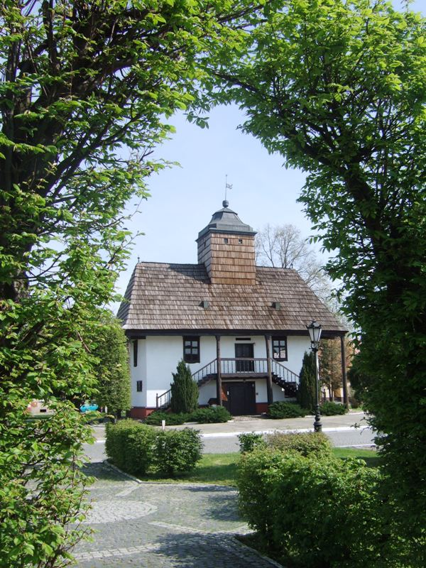
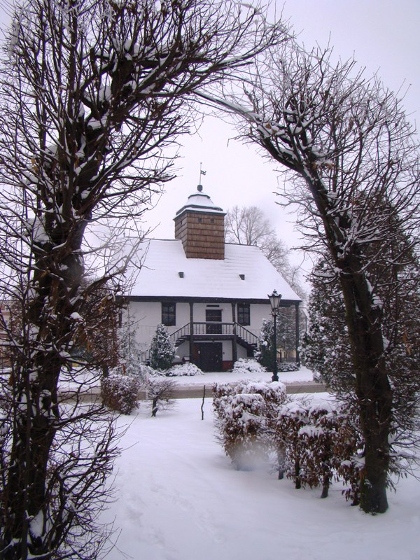

Slide 19
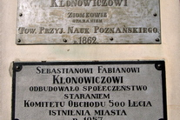
The monument of Sebastian Fabian Klonowicz

Slide 20
CULTURE
Cultural activities in the town are supervised by the following cultural institutions:
CULTURAL CENTER
LIBLARY
MUSEUM

Slide 21
Sulmierzyce Culture Center is a seat of „Cecylia” – Singing Club which plays a great role in developing the local culture and tradition for over 115 years.

Slide 22
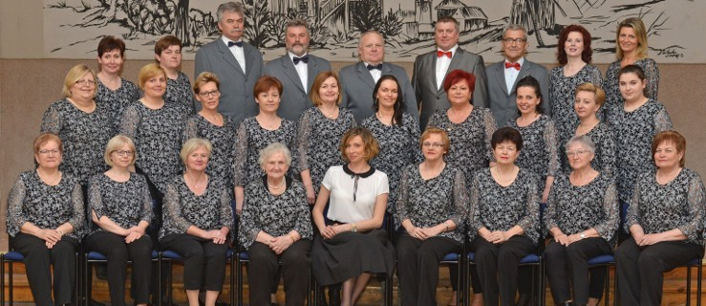

Slide 23
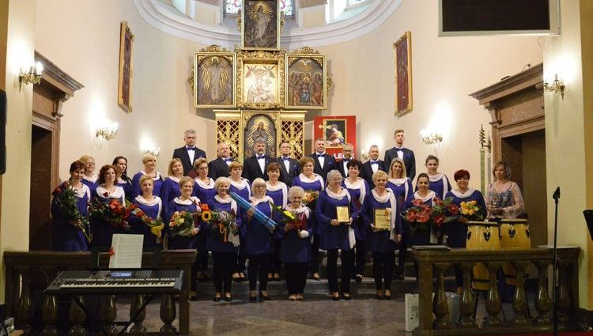

Slide 24
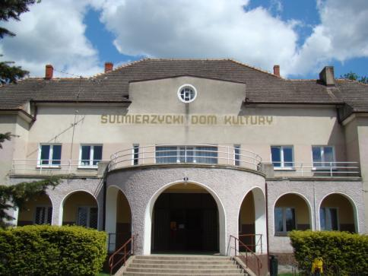
CULTURE CENTER

Slide 25
Sulmierzyce Brass Band
The Band concert at state and church celebrations in town and participate in reviews and concerts organized in Poland and abroad.

Slide 26
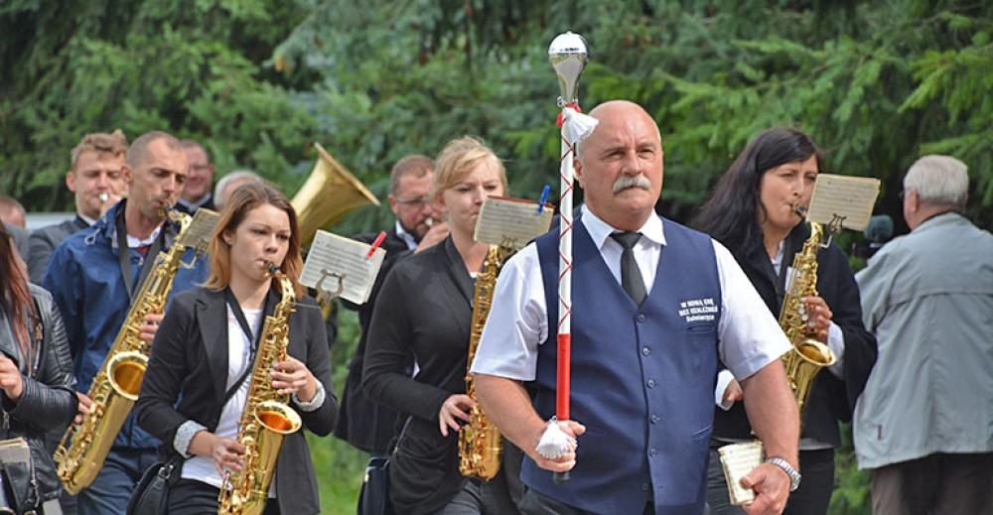

Slide 27
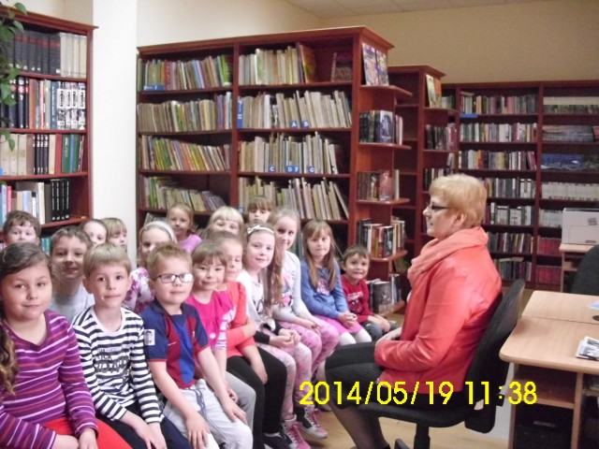
Sulmierzyce’s Public Library
There is a rich collection of books.

Slide 28
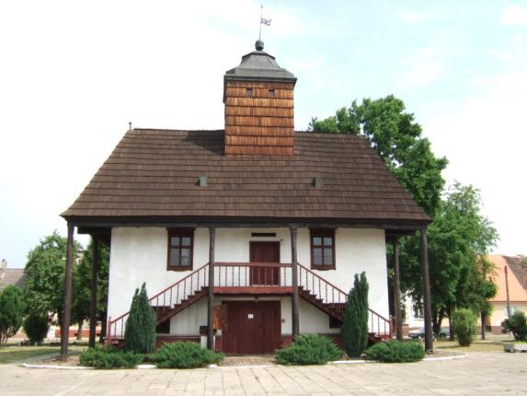
REGIONAL MUSEUM OF SULMIERZYCE LAND
The Museum is seated in the wooden Town Hall on the Main Square.
The Museum is an active participant in the town’s cultural and educational life. It organizes temporary exhibitions related to the town’s history and also to the competitions and museum lessons directed to the children and youth.

Slide 29
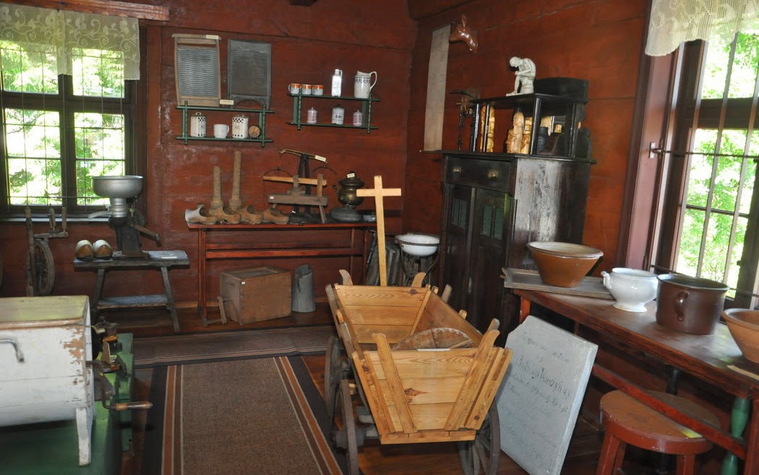
The Museum has four exibition halls. In the collections of the Museum there are numerous kerosene lamps, clocks and irons. Well-preserved orginal guid chests, a baptismal font from the 16th century and many intriguing objects and mementoes of the past are all a „must-see”.

Slide 30
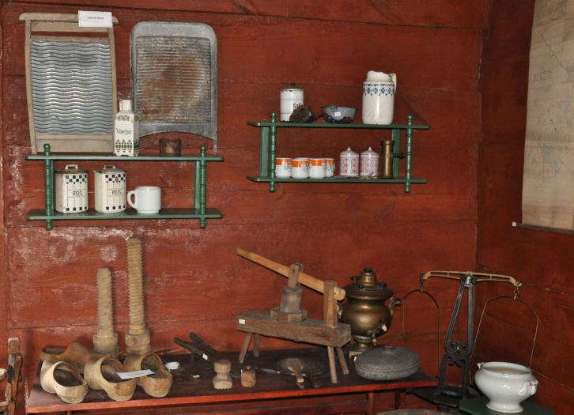

Slide 31
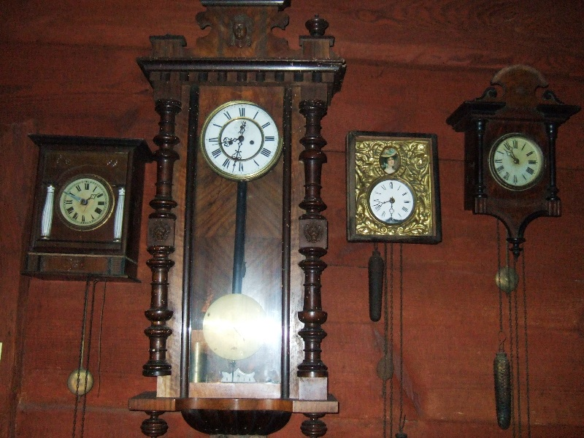

Slide 32
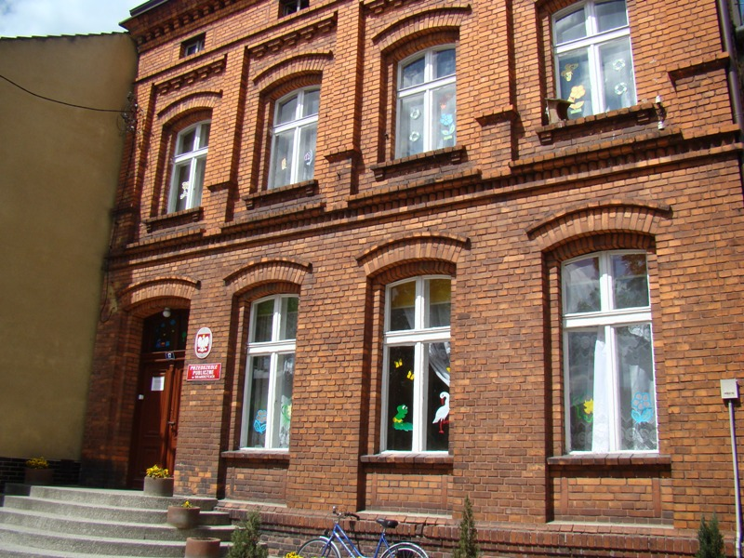
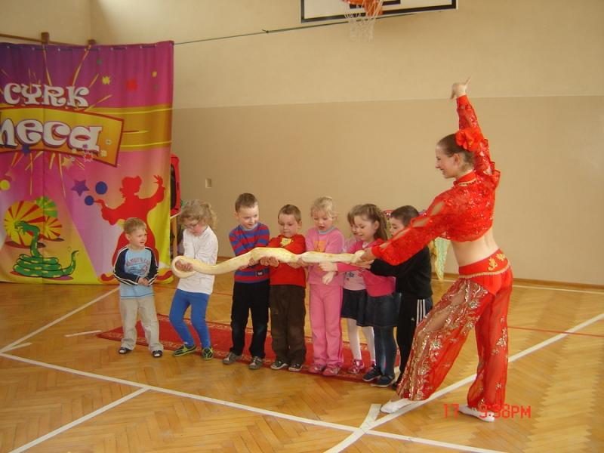
The Public Nursery School

Slide 33
Sports And Leisure Time Activities

Slide 34
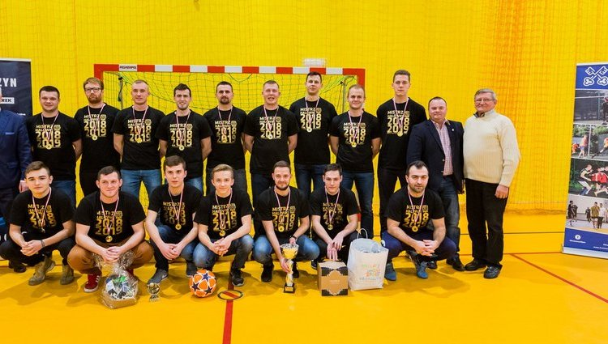
Currently, the football section is still active.

Slide 35
Sulmierzyce a cradle of wrestling
The history of wrestling in Sulmierzyce goes back to the 1950’s, when the first wrestling club was established.
Wrestlers at present. In 1999, the wrestling section was restored to Sulmierzyce.

Slide 36
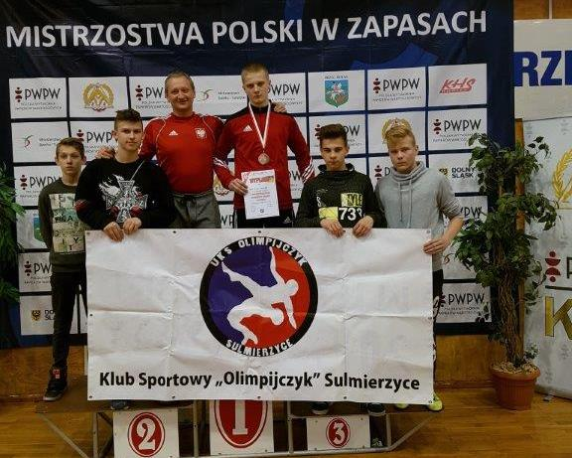

Slide 38
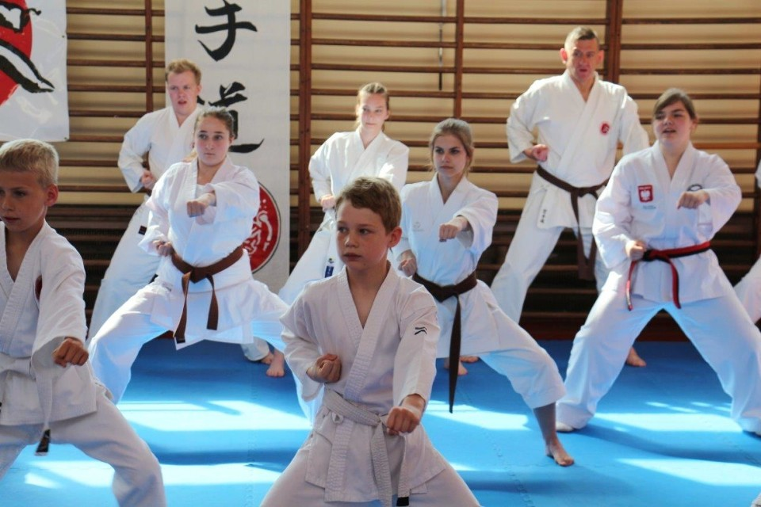
SHODAN-CARATE CLUB
Carate club was founded in 2011

Slide 39
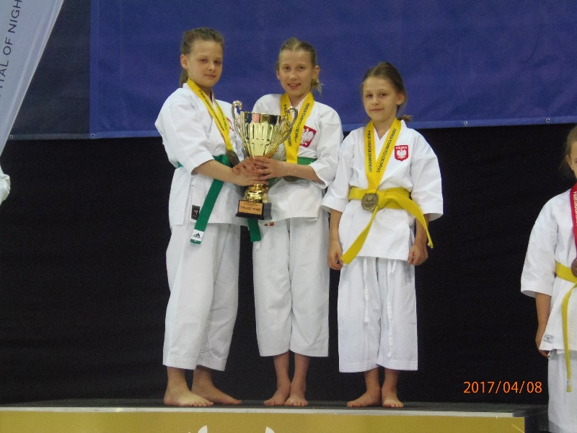

Slide 40
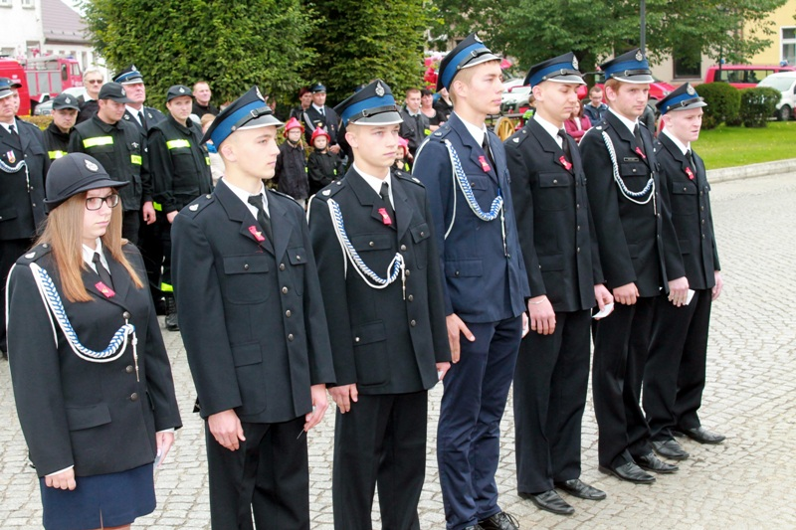
SOCIAL LIFE IN SULMIERZYCE
The Voluntary Fire Brigade is proud of its over one hundred years old history.

Slide 41
SULMIERZYCE
IN THE PAST
NOW

Slide 42
Sulmierzyce
In the past
now

