Slide 1
The Church of the Blessed Virgin Mary in Sulmierzyce

Slide 2
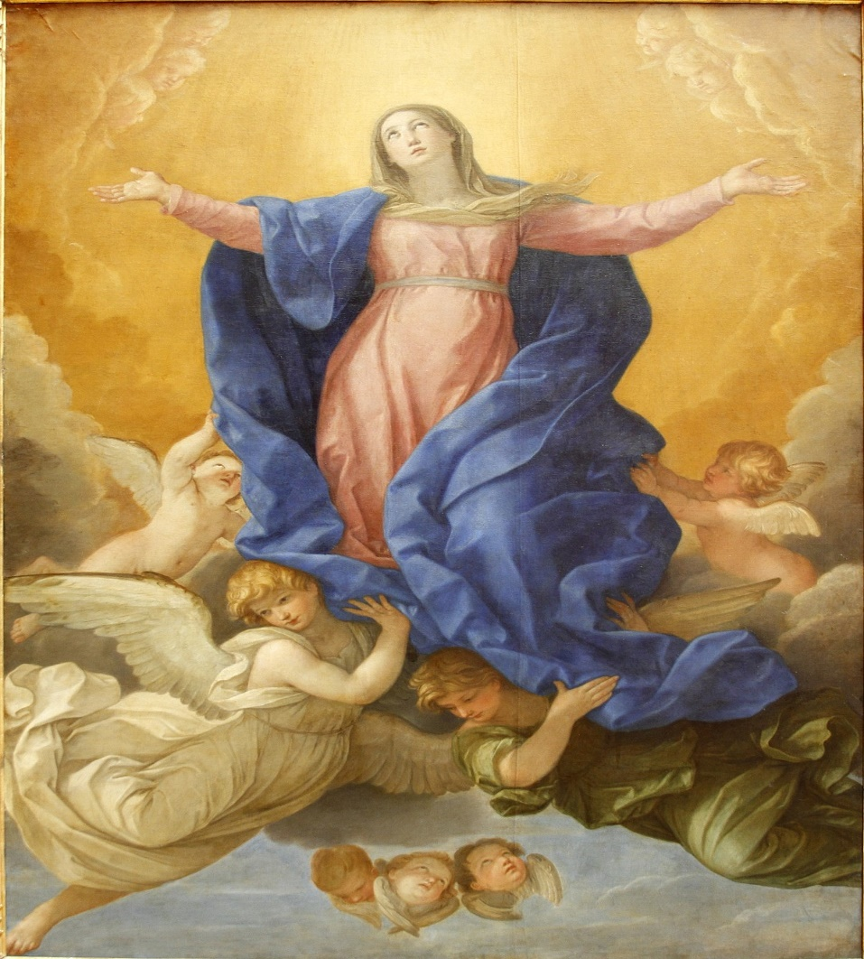
The day of the patronal feast
August of 15th
The day on which this patron was remembered in the liturgy became a celebration of the church and the parish associated with it. With the development of the science of indulgences, the possibility of obtaining them on the day of the patronal feast of a given church was added, and the celebration itself was called a parish indulgence.

Slide 3
In Sulmierzyce, such an indulgence takes place on August 15. On this day, the church is beautifully decorated. A large group of parishioners come to the church for the main mass called the indulgence sum. At the end of the mass, all parishioners take part in a solemn procession. On this day, a festival is organized with stalls selling toys and sweets.

Slide 4
On this day, a festival is organized, where residents can spend a good time together.

