Slide 1
website presentation

Slide 2
We are going to present a website that we use:
"Doyourmath"
https://www.doyourmath.com/

Slide 3
WHAT YOU CAN DO AT THIS WEBSITE: *Solve , simplify Equation, inequality or a system *factor an expression *expand a product or power *graph EQUATION, INEQUALITY OR A SYSTEM *find the gcf *find the lcf

Slide 4
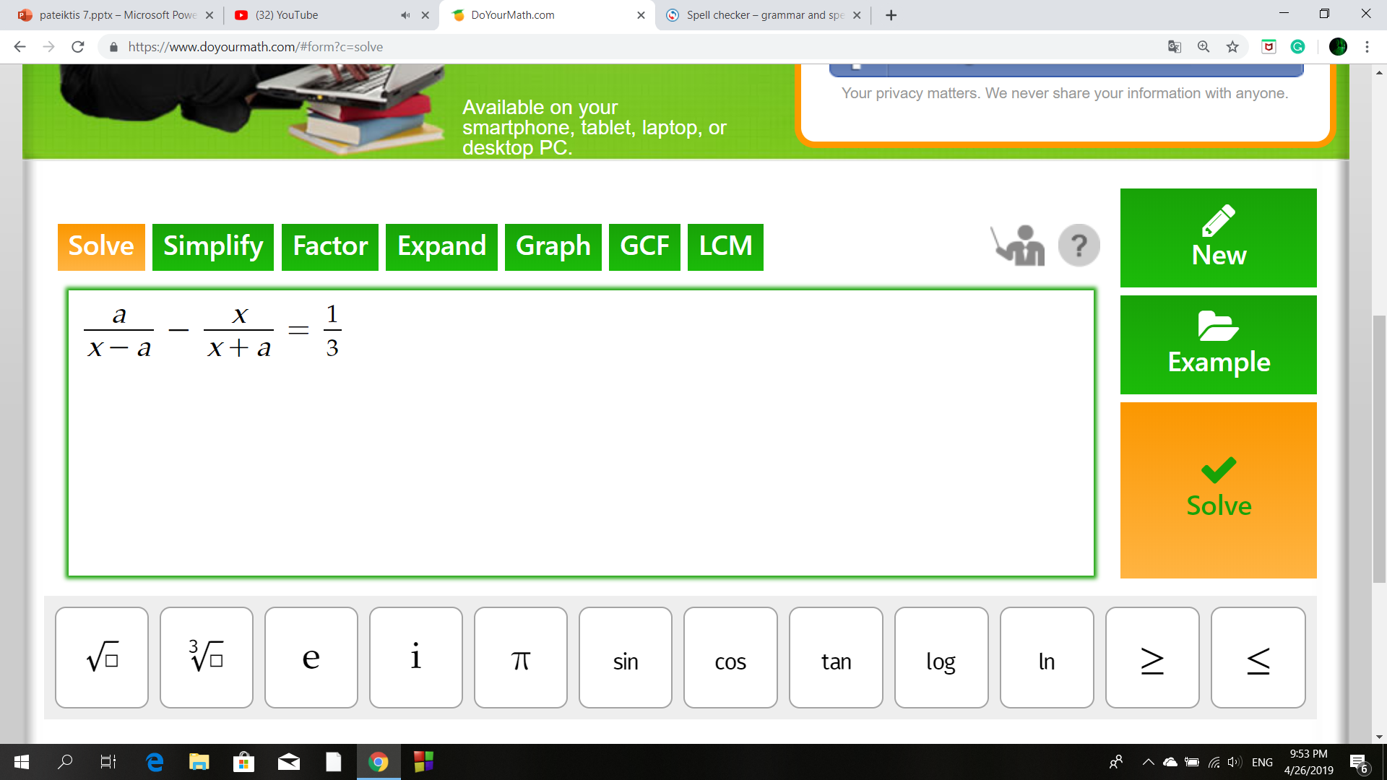
we are going to present an example of solving equations with the help of this website

Slide 8
benefits
It's free
Open for everyone
Explains all the steps

Slide 9
We recommend this website because it helps us solve math

