Slide 1
Smart Schools for Smart Age
Lesson: Literature
Class: II G (10th)
Topic: ‘Dieviškoji Komedija’ by Dantė. The metaphoricality of the hell
Aim: to analyse the extracts and find out the main phenomena and ideas of Medieval literature
Goals:
To learn about the life and the time Dantė lived at, its culture, political events.
To be able to explain the meanings of the symbols mentioned in the text.
To say the importance of the text for the personal experience.
https://www.youtube.com/watch?v=WbCngDp-ncQ&feature=youtu.be
https://quizizz.com/admin/quiz/5e57bb6bc25881001b0ae046/dant-pragaras

Slide 2
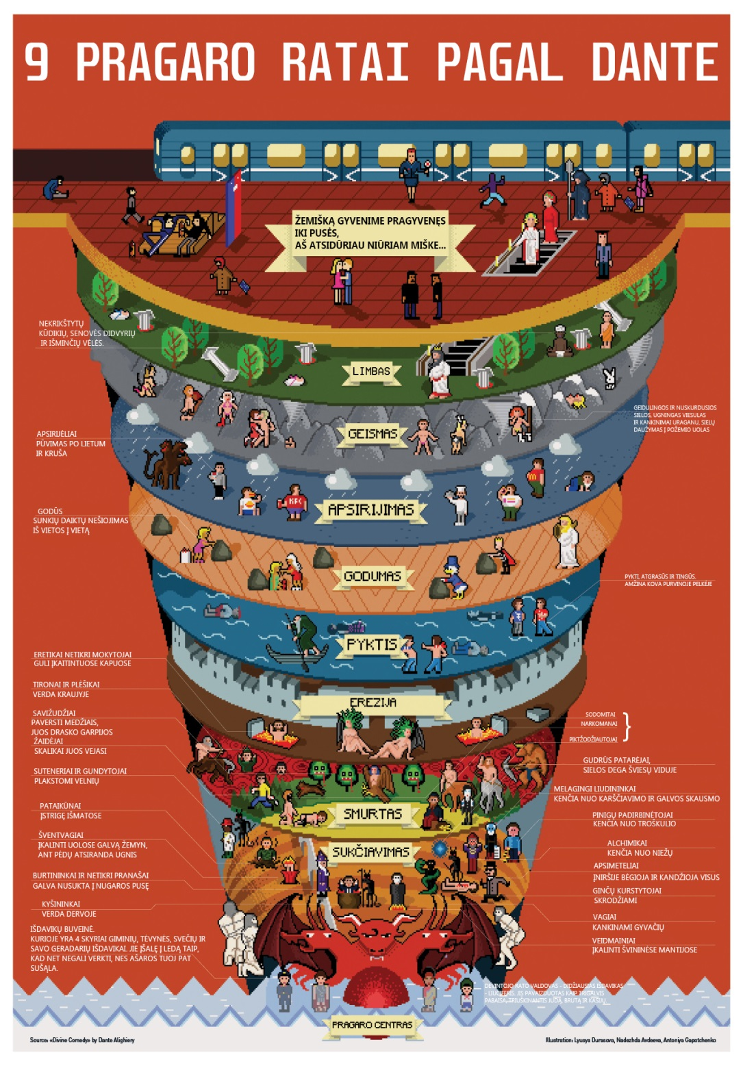
Self reflection and evaluation
https://quizizz.com/admin/quiz/5e57bb6bc25881001b0ae046/dant-pragaras

