Slide 1
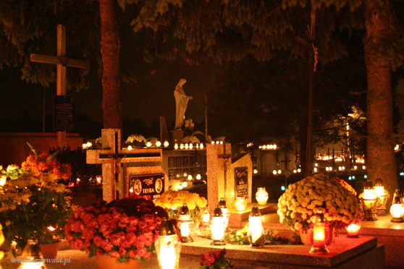
November 1st is “All Saints' Day” –
in Sulmierzyce

Slide 2
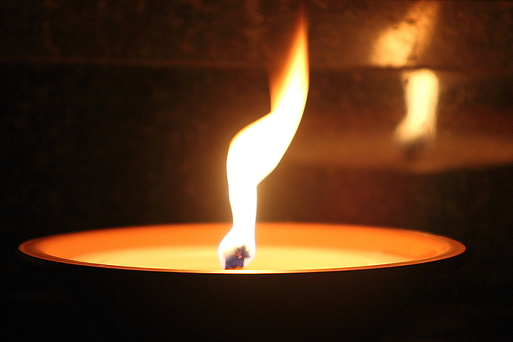
November 1st is “All Saints' Day” in Poland. On this day, hundreds of thousands of people will visit cemeteries to lay a candle on the graves of deceased family members. All Saints' Day is a national holiday.

Slide 3
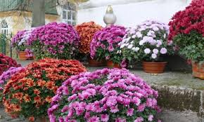
All Saints’ Day, a Polish tradition during which Poles from all over the country travel to their home cities to visit the graves of their deceased relatives.
Cemetery in Poland at the beginning of November, are decorated with thousands of candles and tons of flowers of all kinds (but mostly the Chrysanthemums).

Slide 4
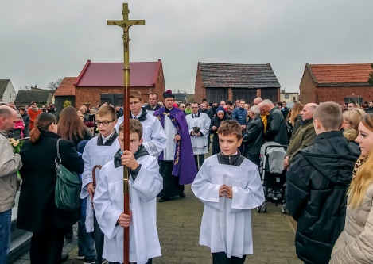
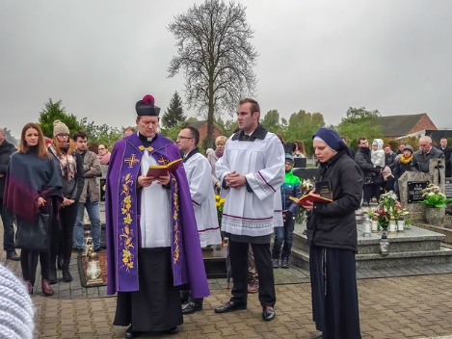
On this day, the inhabitants of Sulmierzyce participate in large numbers in the Holy Mass and in the funeral procession at our cemetery.

Slide 5
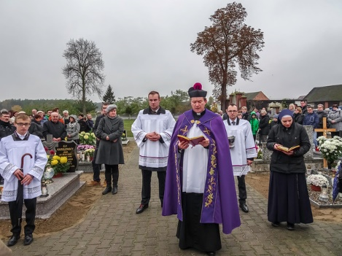
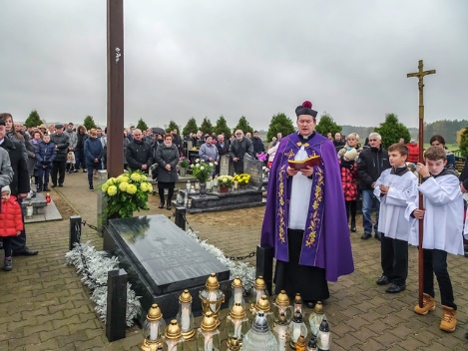
It is a day off from work. Residents visit the graves of their loved ones lighting a symbolic candle.

