Slide 1
Polish national Dances
Poland is a nation rich in culture, and musical tradition. In fact, Poland has five national dances :
-the Krakowiak,
-the Mazur (Mazurka),
-the Polonez (Polonaise),
-the Kujawiak,
- the Oberek.
These dances, which originated in the Polish countryside, were so popular that they found their way to the royal court, and were even incorporated into classical

Slide 2
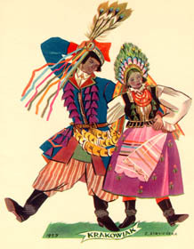
The Krakowiak
Known as the Polish dance and is danced in groups
The costume of Krakwiak is the one that is most identified with Poland.

Slide 4
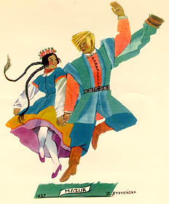
The Mazur
The Mazur originated in the Mazowsze region of central Poland in the 16th century,

Slide 6
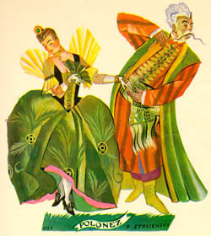
The Polonez
The Polonez, or Poland Dance of 18th century nobility traditionally opened up balls and weddings in country villages.

Slide 7
Polonez is danced at the studniówka, a ball for graduating high school students and at graduation for gymnasium – junior hihg school students. This is shown the dance for the graduation of one of our gymnasium class which takes place in our town of Sulmierzyce main square in the background of our historical, small, wooden city hall

Slide 9
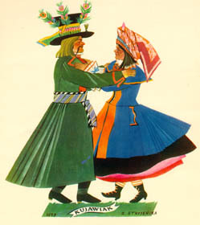
The Kujawiak
Kujawiak originated in the Kujawy region of North-Central Poland in the 19th century.

Slide 11
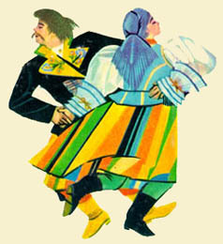
The Oberek
The Oberek originated in the Mazowsze region of central Poland in the 17th century,

