Slide 1
THE VALUES

Slide 2
Christianity - a monotheistic revealed religion, sometimes referred to as "Christianity." It is based on the teaching of Jesus Christ transmitted in the canonical gospels and the content of the religious scriptures that make up the Bible.

Slide 3
WHAT ARE CHRISTIAN VALUES?
Christian values are mainly religious and moral values, related to the human person and the church community, are personal and creative values. They contribute to the transformation of personal existence, but also the world, the creation of spiritual culture and God's environment.

Slide 4
The values we explore and strive to live by are:
-Service
-Thankfulness
-Compassion
-Endurance
-Love
-Creativity
-Justice
-Peace
-Wisdom
-Hope
-Humility

Slide 5
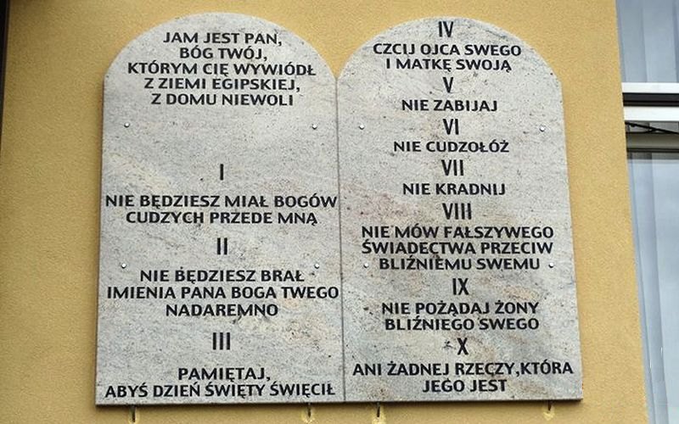
DECALOGUE

Slide 6
10 commandments of God
The decalogue is divided into two parts.
1. You will not have other gods before me.
2. You will not take God's name in vain.
3. Remember to keep the holy day.

Slide 7
4. Honor your father and mother.
5. Don’t kill.
6. Don’t commit adultery.
7. Don’t steal.
8. Don’t speak false testimony against your neighbor.
9. Don’t covet your neighbor's wife.
10. Nor any thing that is his.

Slide 8
7 deadly sins
1. Pride
2. Greed
3. Impurity
4. Jealousy
5. Immoderation in food and drink
6. Anger
7. Laziness

Slide 10
THANK YOU FOR YOUR ATTENTION!

