Slide 1
The word poetry comes from ancient Greece. It means “I create”. Poetry, when it is well written, goes much deeper than the words on a page. The ability to use written words to create images and feelings in the audience mark the abilities of a great poet. Poetry is an art using language, but it is also a state of mind.

Slide 2
Poetry moves, speaks and is written

Slide 3
What life cannot express, poetry does

Slide 4
What love cannot articulate, poetry does

Slide 5
What nature and humor cannot say, poetry does in a way that does not duplicate, but compliments

Slide 6
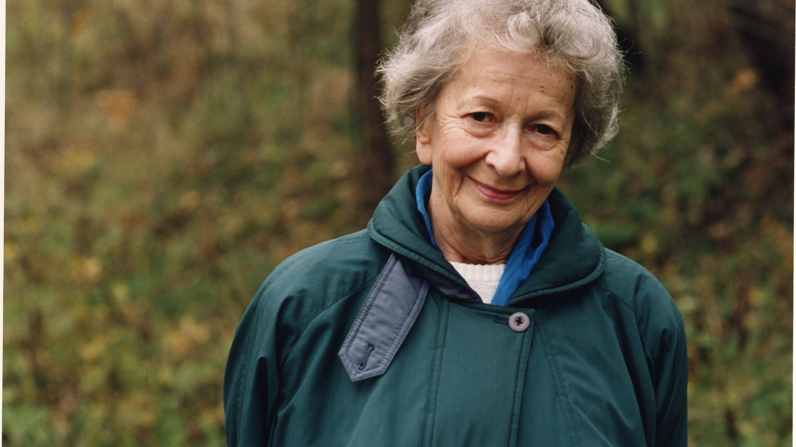
Wisława Szymborska

Slide 7
Facts
Poet and essayist, awarded the Nobel Prize for literature in 1996
Born on the 2nd of July 1923 in Bnin near Poznań and died in Cracow on the 1st of February 2012
poetical output– about 350 published poems (also in English)

Slide 8
Selected editions
"That’s Why We Are Alive" (1952)
"Questioning Yourself"(1954)
"Calling Out to Yeti"(1957)
"Salt"(1962)
"Selected Poetry"(1964)
"No End of Fun"(1967)
"Moment"(2002)
Rhymes for Big Kids (2003)
"Here"(2009)

Slide 9
Youth and childhood
She attended the Urszulanki Sisters’ Gymnasium then participated in underground educational gatherings during the German occupation, finishing her secondary school exams in 1941. She became a railway clerk in 1943, to avoid being deported to Germany.
With her unusual artistic talent, Szymborska illustrated a new edition of Jan Stanisławski's textbook First Steps in English. She kept writing, debuting in Kraków's "Polish Daily" in 1945 with the poem Looking for a Word. She studied Polish philology at the Jagiellonian University a year later, then changed to sociology before financial troubles forced her to discontinue her university education.

Slide 10
The poem „Nothing Twice”
Written by Wisława Szymborska

Slide 11
The poem Nothing Twice is divided into seven stanzas and each one has four verses. The work in its construction resembles a song.
In the first stanza lyrical subject stresses that in life nothing will happen twice. Our life is not a routine because it changes all the time. We always learn something new because nothing is the same.
Nothing can ever happen twice.
In consequence, the sorry fact is
that we arrive here improvised
and leave without the chance to practice

Slide 12
The lyrical subject convinces us that we should enjoy life and live with what we have at the moment because what is happening now should be the most important. The poem is a poetic illustration of the conviction that the fate of a human is unique – nothing can be relived again, corrected, settled otherwise.
No day copies yesterday,
no two nights will teach what bliss is
in precisely the same way,
with precisely the same kisses.

Slide 13
The person speaking in the poem underlines transience of every moment. Makes us aware that everything passes – as well as the good and the bad moments. Love is also very changeable – we can be very happy and in some time suffer. The last stanza is an optimistic summary. The lyrical subject says that in spite of differences, we look for the common way and at the end can be happy. With smiles and kisses, we prefer to seek accord beneath our star, although we’re different (we concur) just as two drops of water are.

Slide 16
Jan Twardowski (1915-2006) was a Polish poet and Catholic priest. He was a chief Polish representative of contemporary religious lyrics. He wrote short, simple poems, humorous, which often included colloquialisms. He joined observations of nature with philosophical reflections.

Slide 17
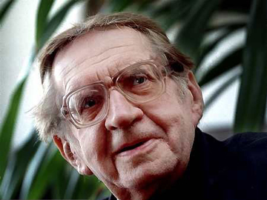

Slide 18
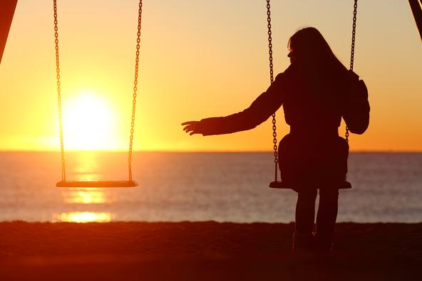
Let Us Hurry By: Father Jan Twardowski

Slide 19
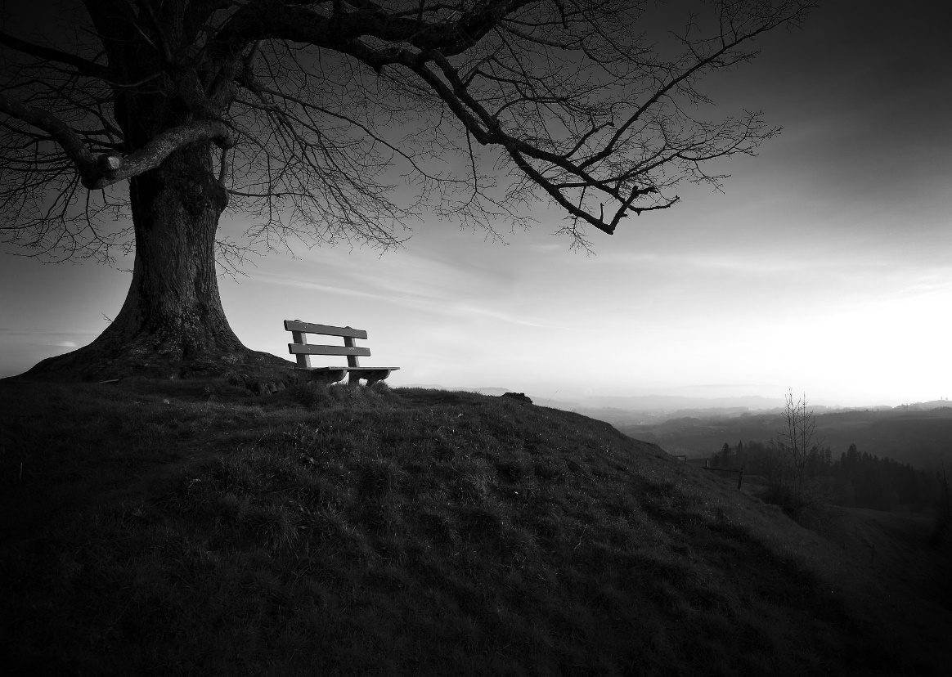
The lyrical subject raises a very serious topic which is a loss of a close person. The death is presented from a perspective of people who say goodbye to a loved one. The person speaking in the poem pays attention of how little we have left after the loved one.
Let us love people now they leave us so fast
the shoes remain empty and the phone rings on

Slide 20
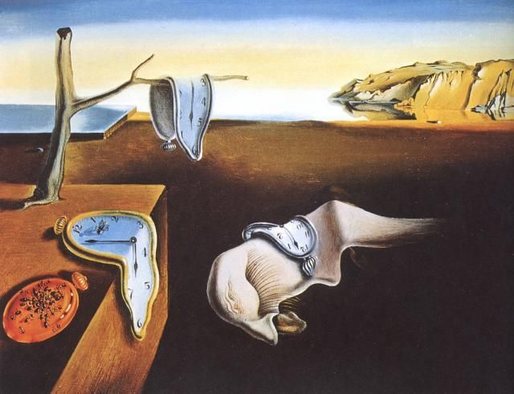
The poem makes you reflect on your own life which is extremely flying. You can be nothing sure about your life and we don’t know what can happen in a year, month, day, hour and minute….
Don't be sure you have time for there's no assurance

Slide 21
It’s worth thinking whether with our deeds we show our loved ones of how much we love them and need. The lyrical subject makes the readers conscious that we can’t turn back time. If we neglect somebody it can turn out that we won’t be able to fix our own mistake. After the death of the loved one we can regret that so many good words was left unspoken and so many tender gestures were unexercised.
though to be born is more of risk than to die
we love still too little and always too late.

Slide 22
The lyrical subject convinces that it’s not worth losing even one day. We should care about every relationship, nurture valuable feelings. We have to pay attention to the fact that we can regret of what we haven’t done.
Let us love people now they leave us so fast
and the ones who don't leave won't always return
and you never know while speaking of love
if the first one is last or the last one first.

