Slide 1
The Symbols

Slide 2
Religious symbols - symbols (archetypes, productions, gestures, works of art, natural phenomena, people or things) that are part of religious culture

Slide 3
ANCHOR
In the ancient world, the anchor symbolized security. The author of the Letter to the Hebrews adapted this symbol to the hope that Christians place in Christ: "Let us hold her as a safe and strong anchor of the soul, [the anchor] which penetrates beyond the veil, where Jesus predecessor came in after us, becoming a high priest forever in the pattern Melchizedek. " (Heb 6, 19-20)

Slide 4
.

Slide 5
Monogram IX
Monogram IX contains the Greek letters iota (I) and chi (X). Iota was the first letter of the Greek word "Jesus" and chi was the first letter of the word Christ. Together, they meant Jesus Christ.

Slide 6
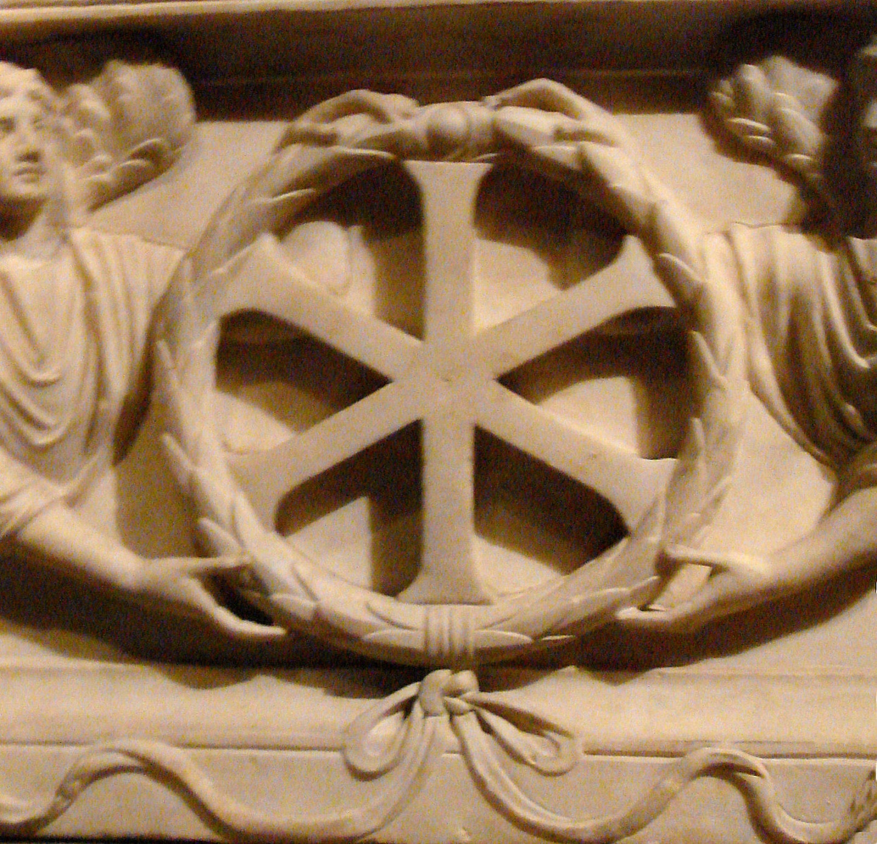
.

Slide 7
Ichthys
Ichthys is the Greek word for fish and was one of the most important symbols of the early Christians. Not only did the fish resemble some of Jesus' miracles, it was also an acronym for the Greek expression Iēsous Christos Theou Hyios Sōtēr, which means "Jesus Christ, God the Son, Savior."

Slide 8
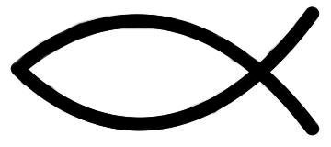

Slide 9
Alpha and Omega
In the Apocalypse of St. John Jesus says: "I am Alpha and Omega, First and Last, Beginning and End." (Rev 22.13) Alpha is the first letter of the Greek alphabet, omega the last. Combining them together symbolizes the eternity of Christ as the Son of God.

Slide 10
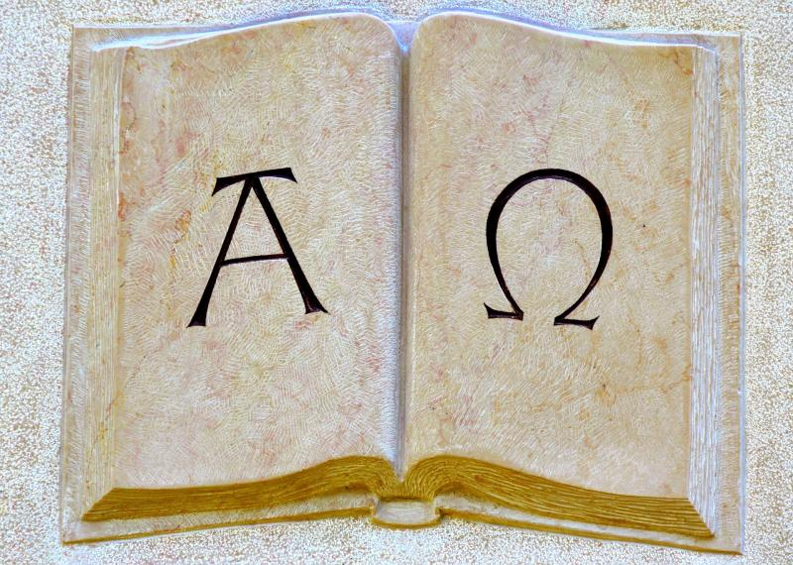

Slide 11
Cross
The cross is a simple, basic sign, like a square or circle, depicting the entire history of humanity. You can also come across the definition of the cross as a "sign mark". He has his reference in many areas of life. In science, it means adding, plus, a positive value. However, due to the crucifixion of Christ, he became a symbol of Christianity.

Slide 13
Pigeon
The dove has been the main iconographic symbol of the Holy Spirit since the first centuries of Christianity. And by order of Pope Benedict XIV - the only one.

Slide 14
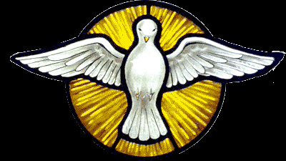

Slide 15
Peacock
The ancient Greeks believed that the peacock's body did not decay after death, so they became a symbol of immortality. The early Christians adopted this symbol as a representation of eternal life with God in heaven, which is why he was often moved with the Tree of Life.

Slide 16
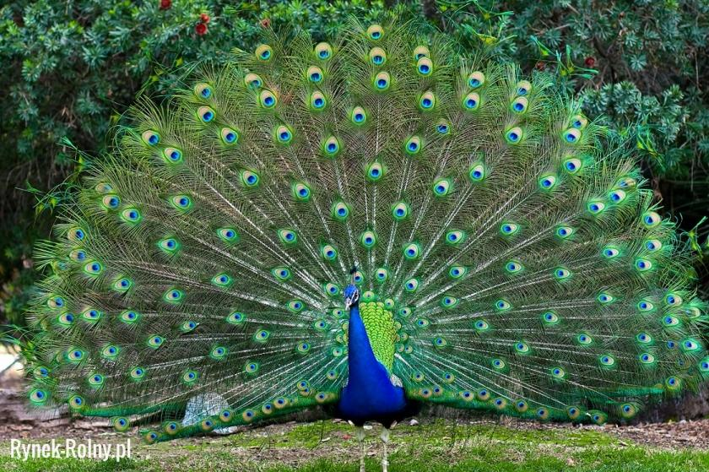

Slide 17
THANK YOU FOR
YOUR ATTENTION
☺

