Slide 1
THE MAIN RELIGIOUS FESTIVITIES

Slide 2
Epiphany – January 6
A Christian ceremony to celebrate God's revelation to man, God's presence in human history, as well as the ability of man to know God reasonably. The symbols of the holiday are the story of the Magi from the East came to Bethlehem to worship Jesus.

Slide 3
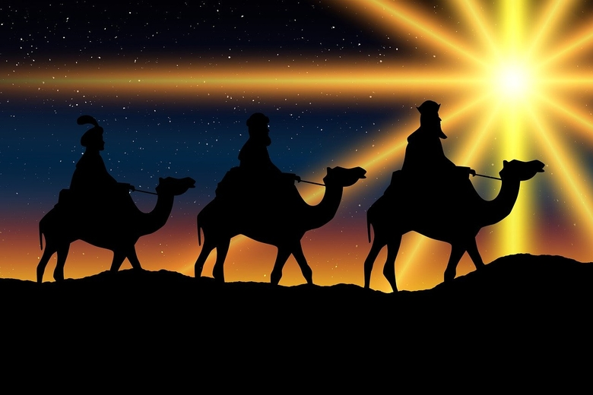

Slide 4
Easter
The oldest and most important Christian holiday celebrating the paschal mystery of Jesus Christ: his passion, death and resurrection. After separating the Church from the Synagogue, it became a simple annual festival preceded by one or several days of fasting, performed as an all-night vigil (Easter Vigil), during which the story of salvation was told (Moving holiday).

Slide 5
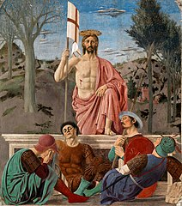

Slide 6
Corpus Christi
Solemnity of the Holy Body and Blood of Christ, sweat. Corpus Christi - a liturgical celebration in the Catholic Church to honor Jesus Christ in the Blessed Sacrament, is celebrated on Thursday after the octave of Pentecost (Moving holiday).

Slide 7
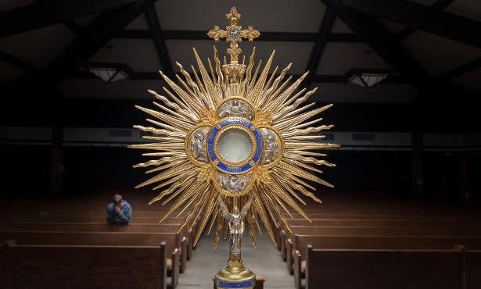

Slide 8
Assumption of the Blessed Virgin Mary, August 15
Assumption of the Blessed Virgin Mary, Latin. Assumptio Beatissimae Mariae Virginis in caelum - the subject of Christian faith regarding taking to heaven with the body and soul of the Virgin Mary after the end of her earthly life.

Slide 9
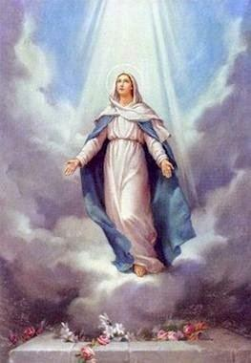

Slide 10
All Saints, 1 November
All Saints 'Feast - a celebration in the Catholic Church in honor of all Christians who have achieved salvation and stay in heaven, celebrated annually on November 1, in content combined with the subsequent celebration of All Souls' Day.

Slide 11
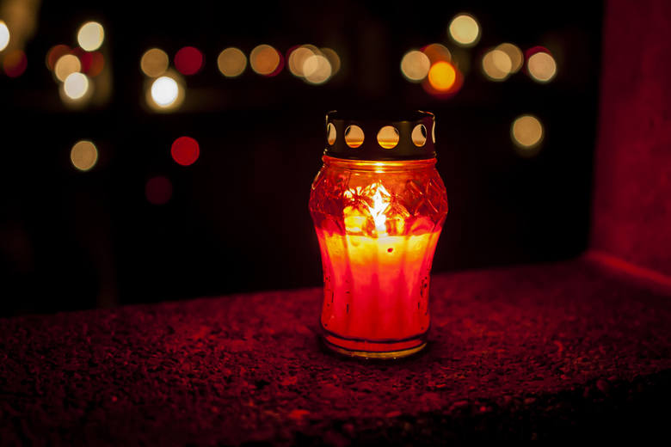

Slide 12
Christmas,24-26 December
24.December
Christmas Eve (Latin vigil) - originally meant night watch and waiting. In the church dictionary it is called the day preceding the major holiday. In the past, fasting was obligatory on every Christmas Eve. They sat at the Christmas Eve table when the first star shone. It was to resemble the Star of Bethlehem leading shepherds and magicians to Bethlehem.

Slide 13
25,26.December
in the Christian tradition - a holiday commemorating the birth of Jesus Christ. It is a permanent liturgical celebration on December 25. Christmas is preceded by a period of three weeks waiting (exactly four Sundays), called Advent. In the Catholic Church this is a mandatory holiday.

Slide 15
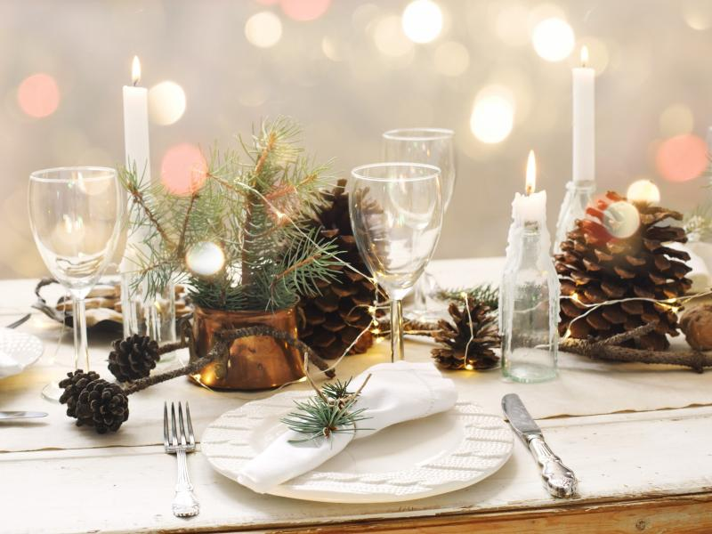

Slide 16
THANK YOU FOR YOUR
ATTENTION
☺

