Slide 1
Hungarian Educational System

Slide 3
In a nutshell1
Kindergarten
Primary school
Secondary school…
General Levels

Slide 4
In a nutshell2
From secondary school
College
University

Slide 5
In a wider sense…
Duration (years) | Form of education | Age
3-4 | Kindergarden | 3
8 | Primary School | 6
4 (in our school 5) | Secondary School | 14
Min. 4 | University (BSc, MSc or BA, MA) | 18+
3 | Training in Doctorate

Slide 6
Assessment
Grades vary from 1 to 5
5 being the best
1 being the worst
Exceptional students are awarded a 5* and at the end of the year a 5d (d=merit)

Slide 7
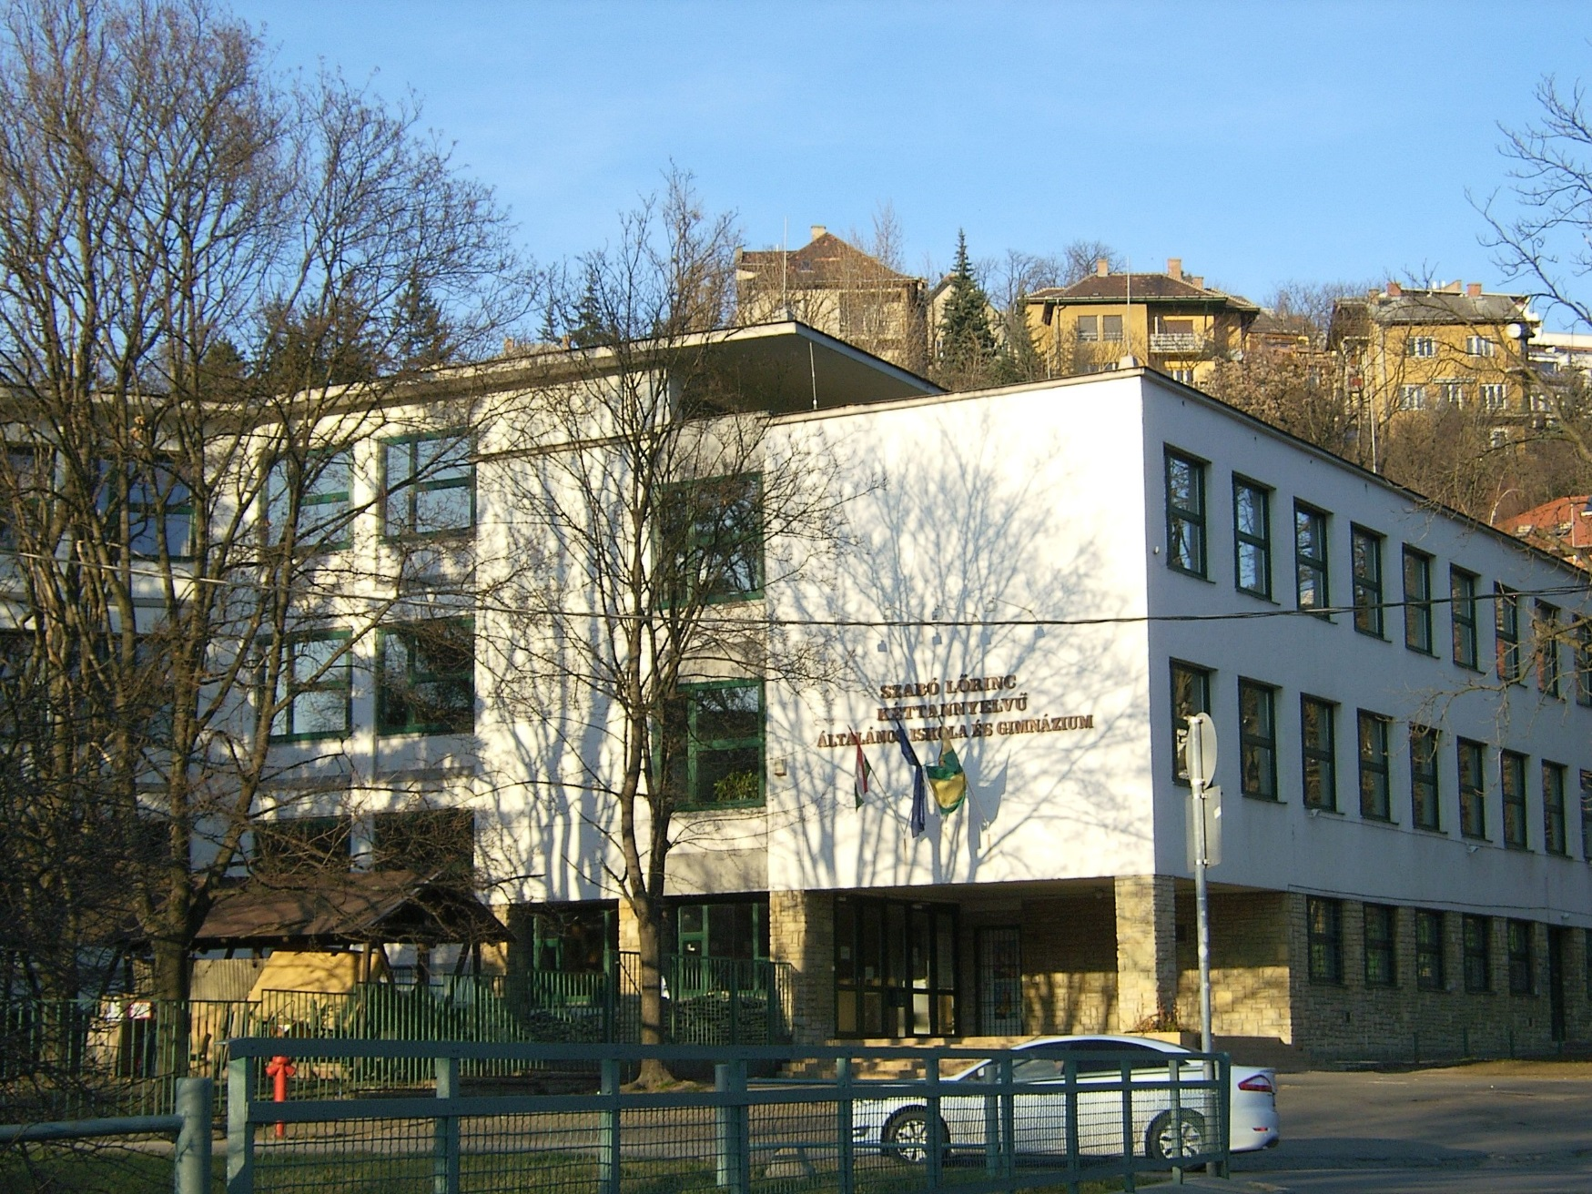
Szabó Lőrinc Bilingual Primary and Secondary School

Slide 8
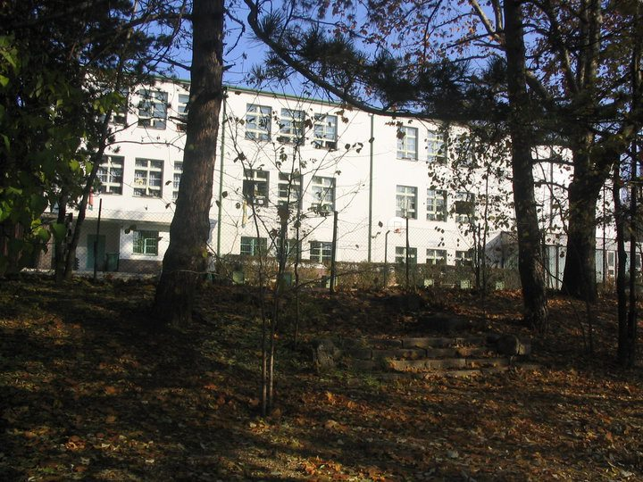
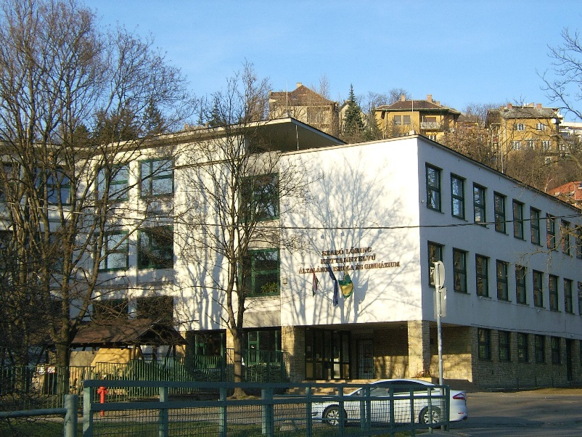
Basic information: 2 buildings:
Location: Fenyves utca
From the 1st year to the 4th
3 parallel classes: usually 1 bilingual + 2 normal
Location: Pasaréti út
From the 5th year to the 12th
+1 extra year: after the 8th year Only English / German language learning
2 parallel classes: 1 bilingual +1 normal

Slide 9
Examination:
1) exam in the 8th year: to get in the secondary school
2) at the end of the extra year (9.kny / 9. ny): an English / German language exam
3) final exam / matura exam: admission to university or college depends on the results at this exam
Min. 5 subjects:
Hungarian language and literature
Mathematics
History
1 foreign language
1 optional subject

