Slide 1
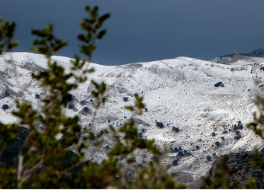
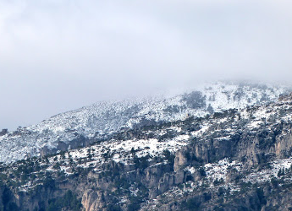
Ports de Tortosa-Beseit
La Sénia, Spain
Made by Martin Jakovina, Croatia

Slide 2
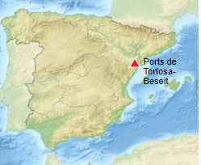
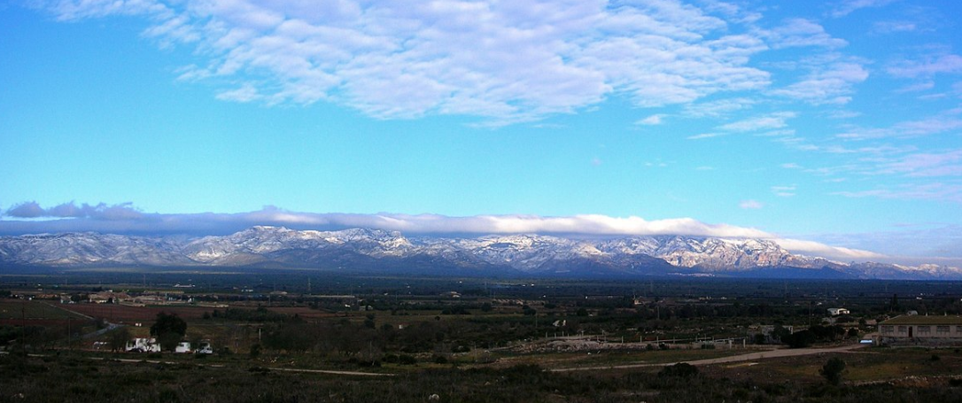
Ports de Tortosa-Beseit
Ports de Tortosa-Beseit also known as Ports de Beseit, or simply as Els Ports or Lo Port by locals, is a limestone mountain massif located at the north-eastern end of the Sistema Iberico, a complex system of mountain ranges and massifs in the centre of the Iberian Peninsula.
Its highest point is Mont Caro, (1,441 m).
Rivers such as the Matarranya and the Sénia have their source in these mountains.

Slide 3
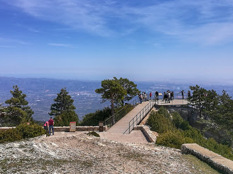
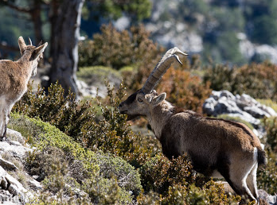
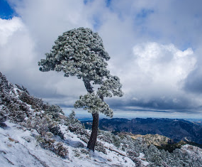
Mont Caro, 1,441 m

Slide 4
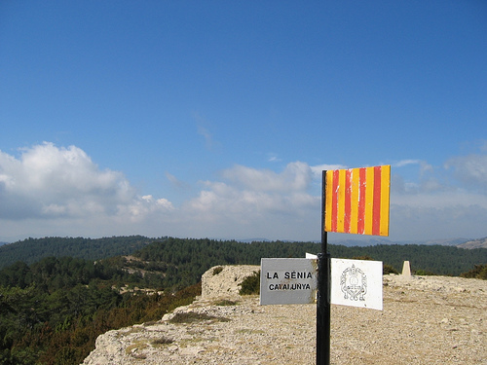
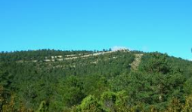
Tossal dels Tres Reis
At the 1350 m high Peak of the Three Kings, where the borders of the ancient Kingdoms of Valencia, Catalonia and Aragon meet
It is mostly a limestone massif, with many steep cliffs, jagged peaks, deep valleys, shafts and caves.
The area is mostly uninhabited except for small villages.

Slide 5
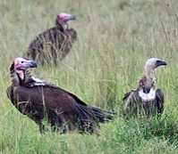
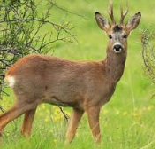
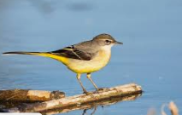
Ecology
One of the largest colonies of griffon vultures in Europe, as well as Spanish Ibex, Roe Deer, Wild Boar, European badgers, common genets, grey wagtails, among others, have their habitat in these lonely mountains.
Among the aquatic animals there are trout in some of the rivers and amphibians such as the Marbled newt in many of the ponds of the range.
The vegetation of the Ports is rich and varied.
Besides the Mediterranean species, there are also species belonging to Alpine flora and colder temperate regions at high altitudes and in protected valleys.

Slide 6
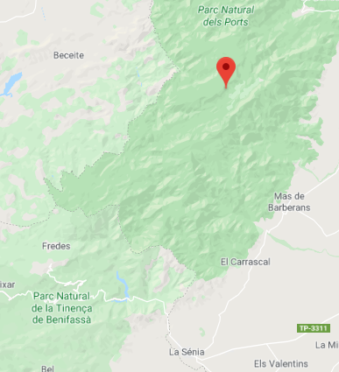
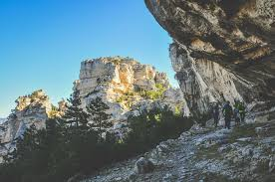
Protected areas
Parc Natural dels Ports on the Catalan side
Parc Natural de la Tinença de Benifassà on the Valencian side.

Slide 7
Made by martin jakovina, 7a
Primary School Ivana Brlić-Mažuranić

