Slide 1
THE PLANT SORTS AND THE ANIMAL WORLD
PRIGORJE BRDOVEČKO
By Ivan Obranković

Slide 2
ANIMAL WORLD

Slide 3
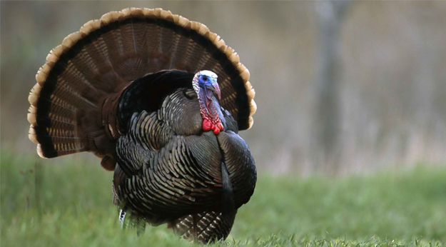
PURAN
Turkey cock
Adult males stand up to 1 meter in height and weigh about 10 pounds

Slide 4
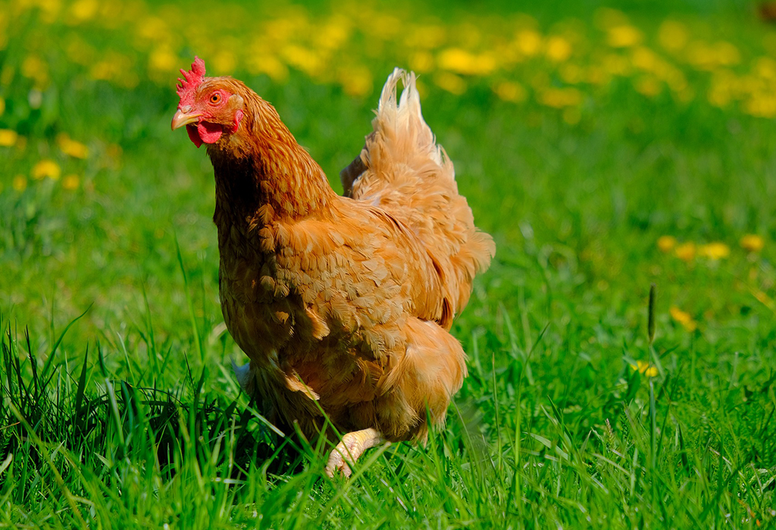
KOKOŠ
Hen
the hen is bred in a wide variety of shapes, characteristics and color variations.

Slide 5
PLANT SORTS

Slide 6
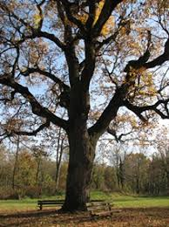
HRAST
Oak
The motive of oak is on the 5 kuna coin of the Croatian kuna.

Slide 7
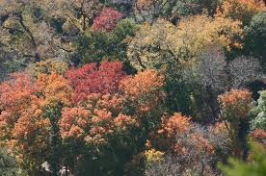
BJELOGORICNE ŠUME
Deciduous forests
Decidous forests are called forests dominated by tree species that reject leaves in the fall.

Slide 8
THANK YOU FOR ATTENTION!!!
Osnovna škola Ivane Brlić-Mažuranić
Elementary School Ivana Brlić-Mažuranić

