Slide 1
LET'S PROTECT THE MOUNTAINS FROM POLLUTION
Dora d’istria school
Albania
VIII A
eTwinning
ALLPPT.com _ Free PoëerPoint Templates, Diagrams and Charts

Slide 2
Types of pollution
To protect the mountains, as a start we need to know who its polluters are :
Air pollution
Soil pollution
Fire pollution and deforestation

Slide 3
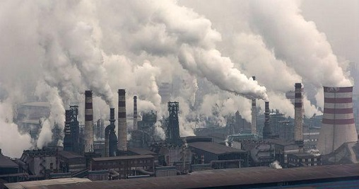
Ndotja e Ajrit
Gases from car exhaust, toxic gases from factories, combustion plants that emit carbon monoxide (CO), nitrogen (Nox), sulfur (So2), gasoline and still fuels, are all those substances that are harmful and change our air. The problem of air pollution arose from the moment man decided to exploit the non-renewable resources that our planet has offered us (such as fossil resources).
The main causes of air pollution are due to human activities. Transportation is one of the main human activities with which it produces high levels of smog in the air. Pollution from cars depends a lot on the type of fuel used:
Gasoline vehicles produce carbon dioxide (CO2) and Nox emissions. Just think that every year the number of new car registrations is constantly increasing.
The causes of air pollution do not end here. In addition to the vehicle sector, there are several anthropogenic sources that derive from human activity such as domestic heating
Not to mention the industry sector from which large amounts of solvents, acid fogs, heavy metals and powders released by machine processing come. Other pollutants also come from the agriculture and waste treatment sector.

Slide 4
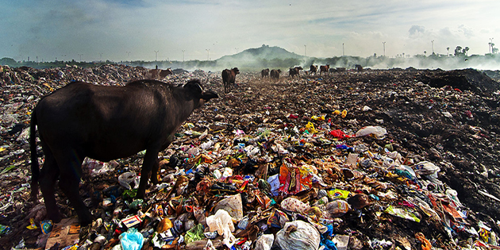
Ndotja e tokës
Soil pollution is mainly due to these causes:
Solid, liquid and gaseous wastes: paper, glass, plastic, discharged batteries, expired medicines and organic waste are solid waste. Some of this waste may be organic biodegradable, but the rest is not biodegradable. The latter, to be dismissed, are sent to the landfill. In some places, like ours, there is another type of departure: special gathering; Liquid waste includes insecticides, fertilizers, chemical fertilizers, mercury, expired liquid medicines, used liquid batteries, which are very harmful to the environment as they reach underground aquifers and can damage their delicate balance
Three important elements led to an excessive increase in pollution: population growth, major urban development, and the use of environmentally hazardous technologies. It is no coincidence that the peak of pollution occurred with the onset of the Industrial Revolution, in the second half of the 18th century, which was characterized by the introduction of various polluting machines that preferred the use of coal as fuel. A strong urbanization process began, which included the degradation of the city and its physical structures. A development philosophy based on the idea that well-being was an exclusive function of industrial production and that the latter was destined to grow indefinitely over time and thus inaugurated the era of an energy consumption and such that have caused a change of deep of terrestrial climatic conditions.

Slide 5
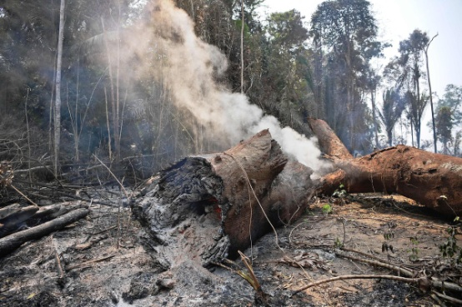
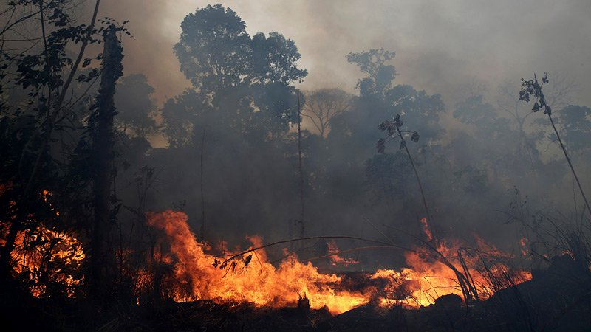
fire pollution and deforestation
Two major natural causes of wildfire ignitions exist:
Natural
dry climate
lightning
volcanic eruption
Artificial
The most common direct human causes of wildfire ignition include arson, discarded cigarettes, power-lines arcs (as detected by arc mapping), and sparks from equipment. Forested areas cleared by logging encourage the dominance of flammable grasses, and abandoned logging roads overgrown by vegetation may act as fire corridors. Annual grassland fires in southern Vietnam stem in part from the destruction of forested areas by US military herbicides, explosives, and mechanical land-clearing and -burning operations during the Vietnam War.
Deforestation is the permanent removal of trees to make room for something besides forest. This can include clearing the land for agriculture or grazing, or using the timber for fuel, construction or manufacturing.
Soils are reinforced by the presence of trees, which secure the soil by binding their roots to soil bedrock. Due to deforestation, the removal of trees causes sloped lands to be more susceptible to landslides.
Deforestation in China's Loess Plateau many years ago has led to soil erosion; this erosion has led to valleys opening up. The increase of soil in the runoff causes the Yellow River to flood and makes it yellow colored.
This problem has many more side effects that you think and that I can tell here but it is really a great damage when deforestation is done in our beloved the mountains.

Slide 6

How To protect mountains from pollution
Even if you've heard them a thousand times, these tips are the only thing we can do for our mountains, so follow them to save them.
Use public transport or ecological means
The use of public transport is one of the best options for not polluting. The use of alternative means of transport that are self-sufficient and environmentally friendly are increasingly frequent. The use of a bike, for example, has advantages that go beyond pollution: in fact, it allows you to constantly train your physical shape.
Differentiate
It should be an established habit, by now, to make the separate collection of waste.
The separate collection allows the recycling of almost all the elements to be thrown away. In fact, it is possible to recycle plastic, glass, paper and cardboard, fabrics, tires, aluminum and steel. In addition to recycling, any collected and sorted waste is no longer abandoned in landfills, decreasing the impact of incinerators.

Slide 7
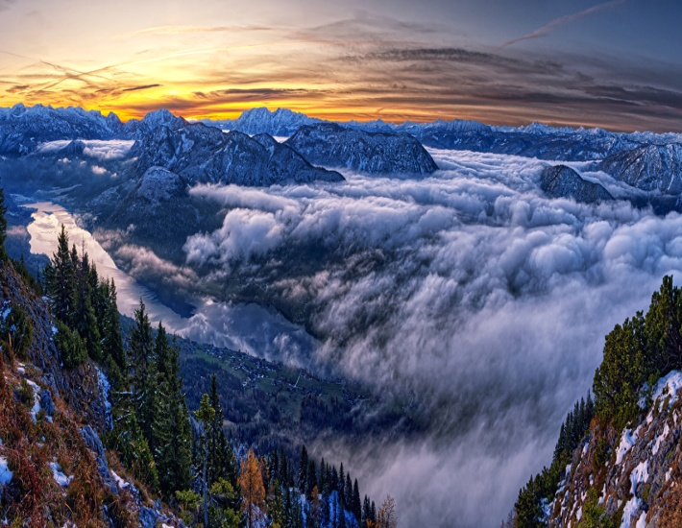

No to the plastic bag
Another trick inherent in spending that can reduce waste and therefore pollution is to bring a bag from home. Better if made of cloth, since plastic bags - even if biodegradable - take many years to decompose.
Save trees, don't waste paper
Forests are the lung of the Earth, it is well known. Not wasting paper is a duty for everyone also because nowadays, thanks to technology, it is absolutely possible to reduce prints.
Plant a tree
In addition to reducing the prints to protect the trees, it could be an idea to create a small forest in your own home, perhaps using compost as your natural fertilizer. Gardening is a healthy and inexpensive pastime with which it is possible to help nature to fight air pollution.

