Slide 1
Mountain
Babia Góra

Slide 2
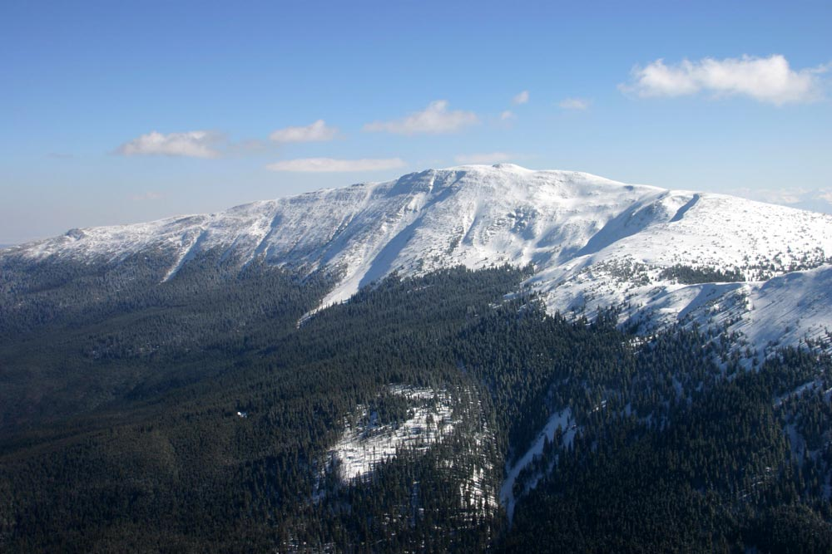
Babia Góra is one of the most beautiful mountains in Poland

Slide 3
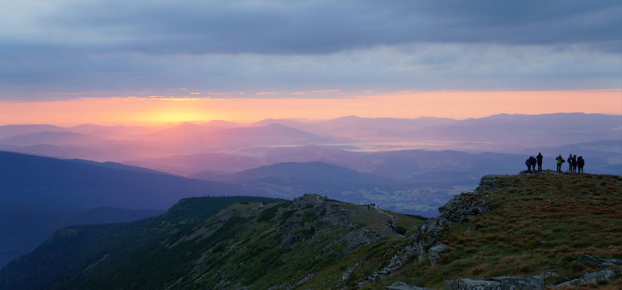
It is the highest peak of the Western Beskids and the highest peak in Poland outside the Tatry.

Slide 4
The origin of the name Babia Góra is explained by numerous folk legends. One of them says that it is a pile of stones poured out of the cottage by a giant woman, according to another he is a lover of a robber who petrified with regret seeing them carry her killed beloved. According to other legends, the name of the mountain comes from the fact that in the caves under this mountain, robbers hid their captives. The name may also be associated with some meanings of the word baba (a type of cake or a stone cult statue) The height and prominence of the Babia Góra massif meant that in the nineteenth century she was given the name of the Queen of the Beskids, because of the very variable weather she was also called the Mother of the Poor or the Capricious, and recently the inhabitants of Orava also call her the Orava Holy Mountain

Slide 5
Nature
In 1954, the Babia Góra National Park was created in the Babia Góra massif. In recognition of the extraordinary natural values, Babiogórski National Park was inscribed in 1977 by UNESCO on the list of world biosphere reserves. The rare plant species in Poland include Moravian monkshood, monocoten, alpine cornea, red deer, northern twinflower, flea sedge, alpine toccia

Slide 6
So much for Babia Góra By Klaudia and Marysia for eTwinning Project „Mountains are life, let’s keep them safe”..

