Slide 1
ZIGANA MOUNTAIN

Slide 2
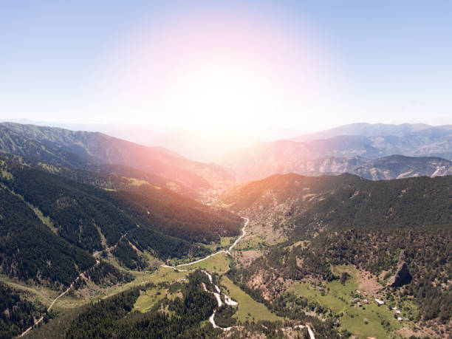
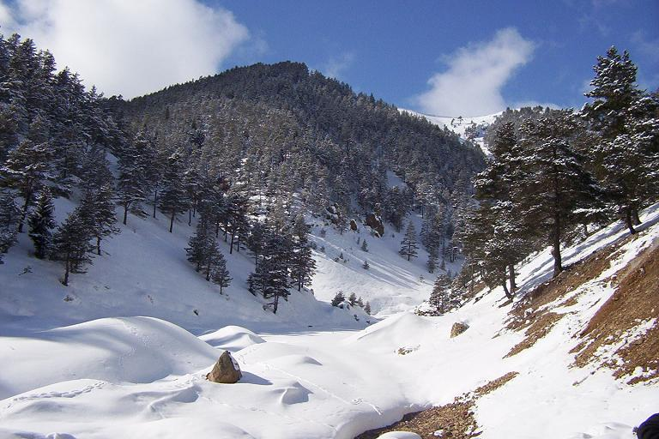
FACTS
Northern Turkey
2032 m
Snow-covered 5 months a year
The Zigana Tunnel under the pass is one of longest tunnels in the country

Slide 3
TOURISM IN ZIGANA MOUNTAIN

Slide 4
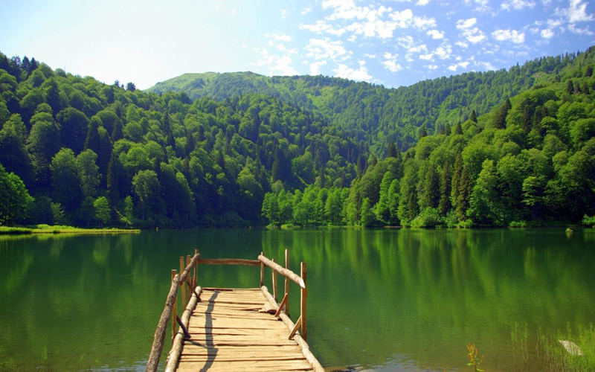
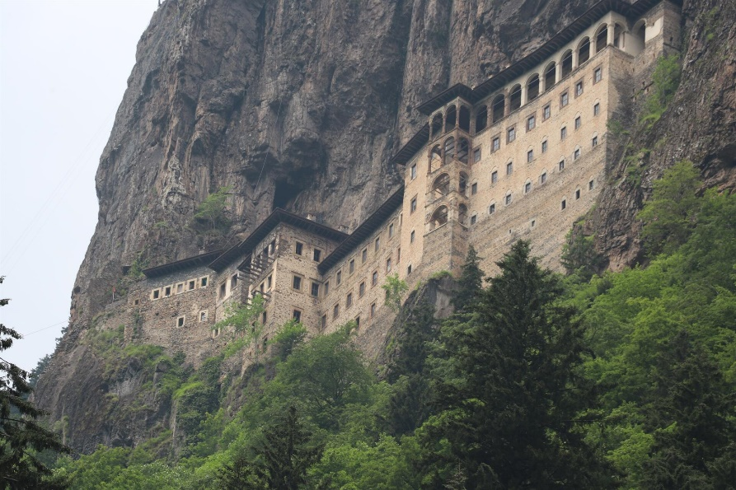
TOURISM
The village of Zigana southwest of the tunnel is a popular ski-resort
In closeness is Lake Limni
It's nearby Soumela monastery
On 25th January 2009, an avalanche killed 11 hikers on Mount Zigana

Slide 5
SOURCES
http://zh.trekearth.com/gallery/Middle_East/Turkey/photo1131218.htm
https://www.istockphoto.com/photo/view-from-the-top-of-the-zigana-mountain-gm827696154-134693849
https://heaventurizm.com/trip-to-trabzon-turkey/?lang=en
http://www.hurriyetdailynews.com/sumela-monastery-still-draws-visitors-to-trabzon-134362
http://freeweb.t-2.net/limbarskagora/

Slide 6
PLANTS IN ZIGANA MOUNTAIN

Slide 7
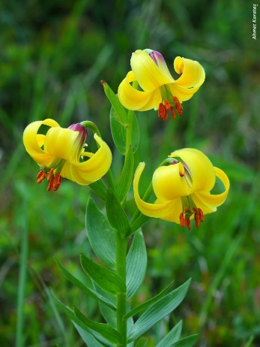
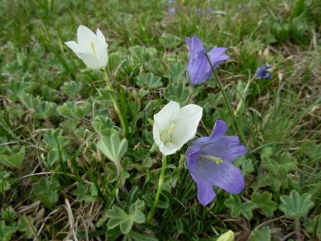
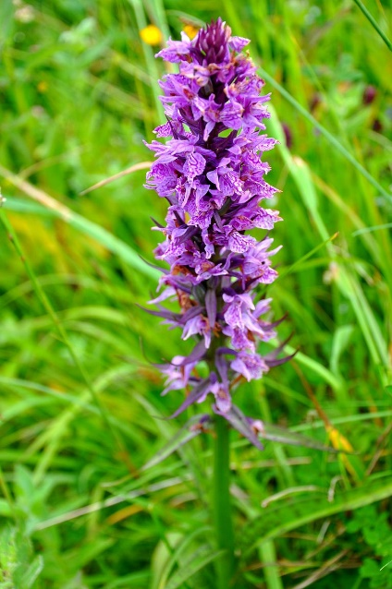
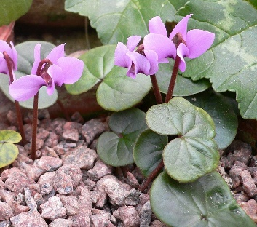
PLANTS
Lilium monadelphum var armenum – yellow flower, Marijn – pink and white flower, rose, Cyclamen parviflorum – it grows near the ground and it is pink colour, Campanula tridentata – it grows near the ground and it is white and purple colour, Dactylorhiza urvilleana – a tall violet flower. Near are pine and spruce trees. There is a lot of meadows. Due to the frozen soil layer (permafrost) of the root they cannot reach deeper layers of soil and receive water through capillarity.

Slide 8
SOURCES
http://dogalhayat.org/property/zigana-zambagi/
https://en.wikipedia.org/wiki/Cyclamen_parviflorum#/media/File:Cyclamen_parviflorum.jpg
http://www.pavelkaalpines.cz/Photos/Turkey2010/campanulatridentataziganapassturkey.html
https://www.dailysabah.com/travel/2018/11/19/enjoy-nature-extreme-sports-at-lake-limni-and-mount-zigana

Slide 9
CLIMATE
Jakob Trojer

Slide 10
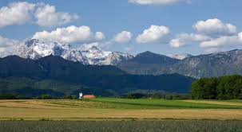
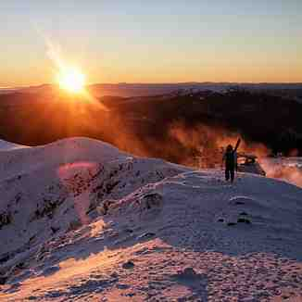
Precipitations
There is 41 mm of rain in January, 32 mm of rain in February61 mm of rain in April, 75 mm of rain in May, 58 mm of rain in June, 19 mm of rain in July, 19 mm of rain in August, 29 mm of rain in September, 50 mm of rain in October 50 mm of rain in November and 51 mm of rain in December.61 mm of rain in April, 75 mm of rain in May, 58 mm of rain in June, 19 mm of rain in July, 19 mm of rain in August, 29 mm of rain in September, 50 mm of rain in October 50 mm of rain in November and 51 mm of rain in December.

Slide 11
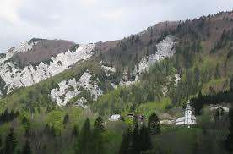
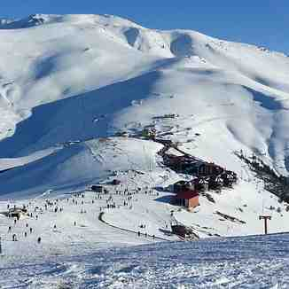
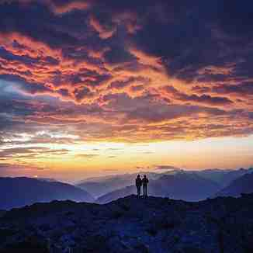
Temperature
There are from -2C ° in January and 19C ° in July and August.
There is a sub-polar climate.

