Slide 1
DRESS UP
“Dress up always there to protect our Reunionese population”

Slide 2
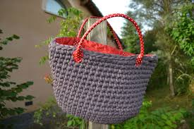
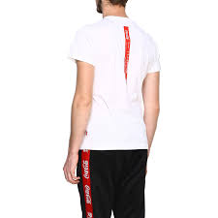
the company's production
is a company that sells clothing, underwear and accessories, in recycled fabric.

Slide 3
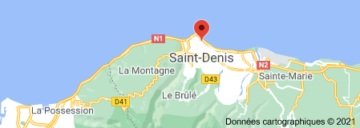
where is the store located? And number phone?
this company is established on the island of Reunion more precisely in the village of st denis 14 rue les kalao
the number phone is 0692123567

Slide 4
how the company helped during the pandemic?
our company helped the hospitals of the meeting and the reunionese against the covid-19 by participating in the productivity of the masks
which costs 1 euro per unit and a package of 20 to 10 euro

Slide 5
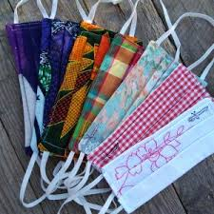
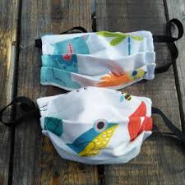
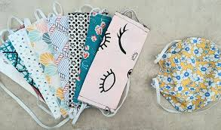
what is the mask made of ?
our mask is also made of recycled fabric

Slide 6
thank you and take care of yourself!

