Slide 1
Oula’s restaurant
A legendary flavour

Slide 2
Manager co-founders
Oula is a restaurant whose manager and chef are world-famous, Their expertise is reconignized internationally.
Our chef is considered the 3rd best chef in the world: Loïc Btk, his meat is considered to be the best in Europe.
Noah Fountain also known as Sarazin, has organized grandiose birthdays and festivities for Qatari princes and businessmen, he is a reference in the field of restauration and his restaurants always receive the best reviews. Oula is just one of his projects.
Rousha is the best waitress in Latin America her catering services are a real spectacle, similar to the greatest Broadway shows.

Slide 3
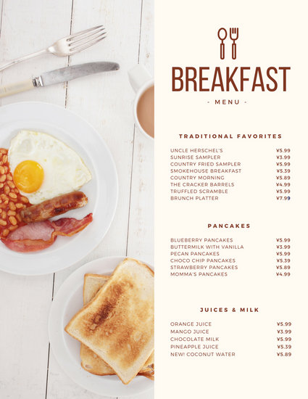
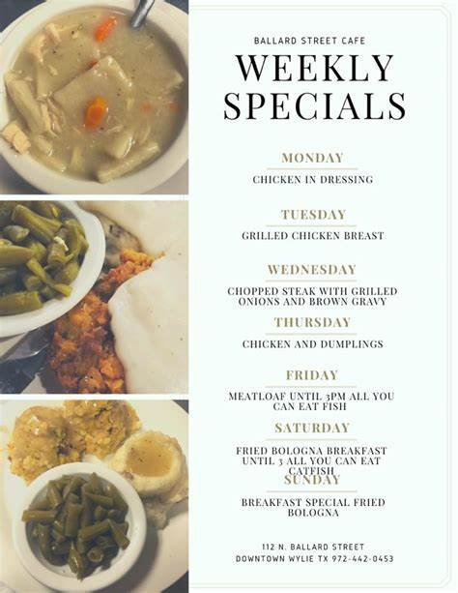
Our menu, Our specialties
We can offer you some diferent dishes from diferent country!
The chef specialty is Creole style grilled chicken with vegetable mousse for £20,
« Paëlla Valencia » prepared by our international chef for 25£
The best Tiramisu ever only for 10£
More ever in our menu!

Slide 4
To get in touch
If you have any question about our menu or something else you can join us on:
Email us to get in touch, we aim to respond within 24 hours.
email: oulasrestaurant@yahoo.com
Call us to make a reservation on this phone number
0004 656 1234
Follow us on instragram and facebook: Oula's resto

