Slide 1
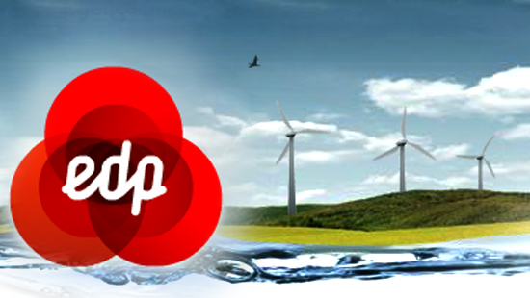
Beatriz Coutinho
Marcio Baptista
Tiago Antunes
Carina Lopes

Slide 2
EDP
30 July 1976
It is the world's fourth largest wind energy producer
66% of the energy produced is renewable
Located in 19 countries

Slide 3
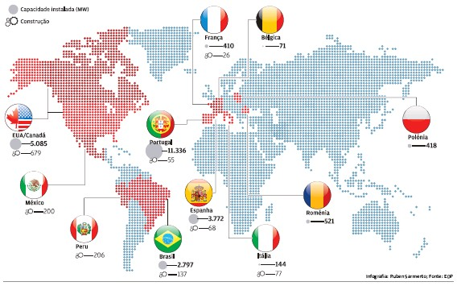
EDP IN THE WORLD

Slide 4
EDP
EDP ​​is divided into several subsidiaries:
EDP gas
HC Energy
Naturgás
EDP Distribution
EDP Commercial
EDP renewable

Slide 5
Institution
In 2004, EDP founded a non-profit private institution of public utility.
It aims to support projects that improve the quality of life of socially disadvantaged people. It also aims at contributing to the integration of communities at risk of social exclusion.
In 2015, EDP Solidária started to be structured in 3 annual programs, with a total allocation of 2.1M euros: Social inclusion of Health and Education.

Slide 6
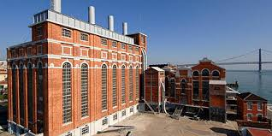
The Electricity Museum
The Electricity Museum is an old museum which belonged to the EDP Foundation. It is located in the old Central Tejo, in Belém.
When visiting the Museum you can learn how electricity was produced in the past.

