Slide 1
LARANJA-TE
TIAGO ANTUNES
RAFAELA SOUZA
TAÍSA DAIANE
TG20

Slide 2
PRESENTATION PLAN
Theme: prepare a little market
Purpose of the presentation: show our idea.
Presentation topics: who we are, our intentions and the way we want to make it happen.
Materials and equipment used: iPad, pen, paper and smart phone;
Estimated duration: 10-15 minutes.

Slide 3
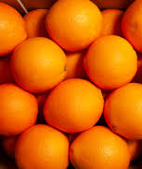
INTRODUCTION
We want to present our little company to you. We intend to sell 100% natural orange juice.
(We will show you how the process of production will be; we will let you know about the suppliers and the costs.)

Slide 4
Laranja-te is the name of our company.

Slide 5
THIS IS US
Hi, I’m Taissa and I’m the CEO of the company. I control the whole process.
Hi, I’m Tiago and I’m the CFO of the company. I control stocks, I check product inputs and outputs and I control the financial part.
Hi, I’m Rafaela and I’m the COO of the company. I am the store boss and my job is to assure customer satisfaction.

Slide 6
Reasons for our choice:
We chose this product because of its benefits:
It has a lot of vitamins that helps fighting various diseases;
It is fully natural.

Slide 7
WHO ARE WE?
We are a small business.
We built this company with the purpose of providing a fully natural product to our customers.

Slide 8
WHY LARANJA-TE?
We chose this name because we are trying to get the following message across: as a society we must make healthier choices.

Slide 9
The preparation process
We preserve the oranges so we can have them all year;
We make the juice in front of our clients.
We buy raw material from suppliers;

Slide 10
MRFrutas
10kg 60 oranges
70kg 420 oranges
10kg 17€
70kg 119€

Slide 12
WHAT DO WE DO?
We make the juice just a few minutes before it is served and we make it in front of our clients.
Our juice is a 100% natural.

Slide 13
HOW WE DO IT?
We keep the oranges stocked at the right temperature so we can have oranges all year round.
We serve the juice in recyclable orange flavoured cups.

Slide 14
Price list
33 dl 1,25€
50 dl 1,75€
1l 2,30

Slide 15
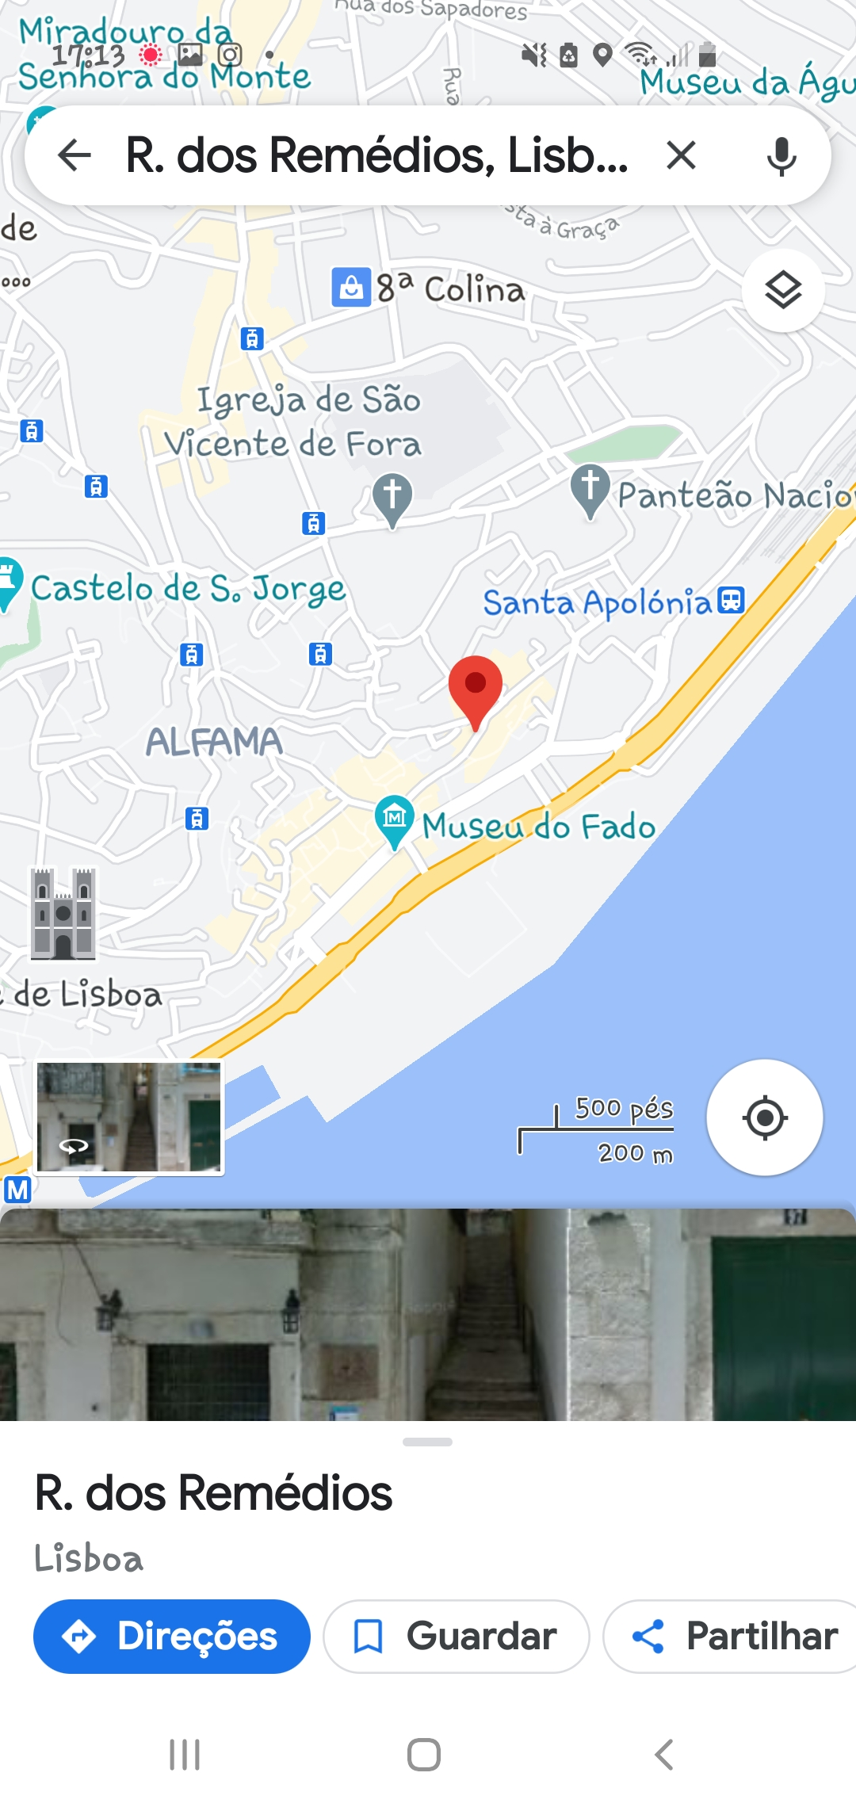
CONTACTS
Mail: laranjate.inete@gmail.com
Address: Rua dos Remédios-Alfama
Phone Number: 985647830

Slide 16
CONCLUSION
With this project we learned how to be more autonomous and resilient.
We also learned to respect and listen to others’ opinions, as setting up any business.

