Slide 1
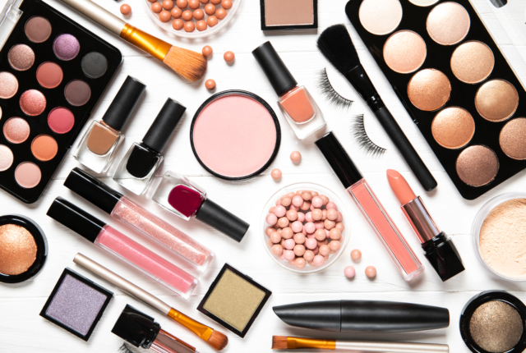
MLCOSMETICS Wake-up your beauty

Slide 2
CHARACTERIZATION
Private company
Two managers
Small business ( TPE)
In the field of cosmetics
Local field of action REUNION ISLAND
Tertiary sector

Slide 3
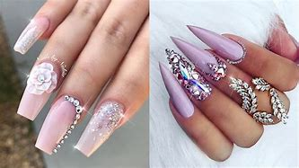
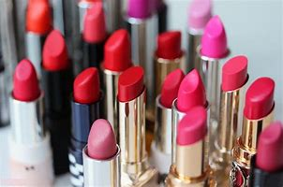
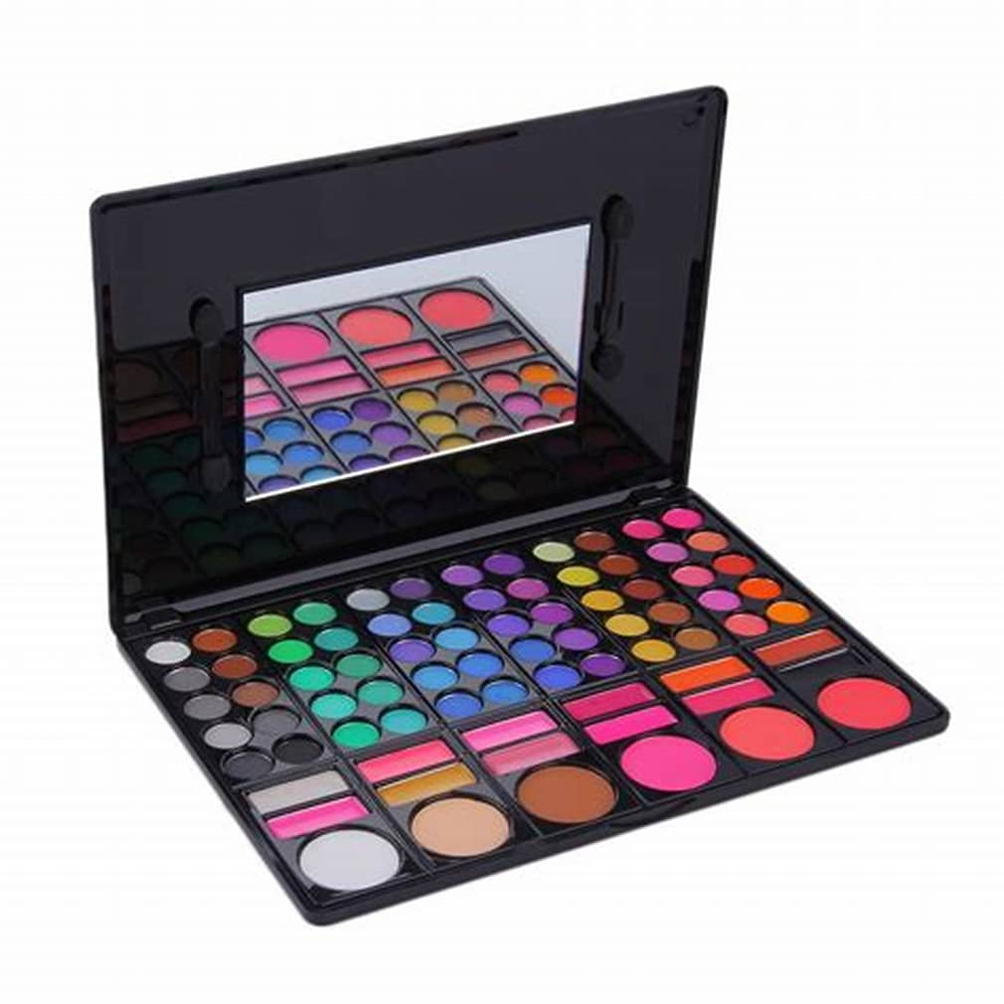
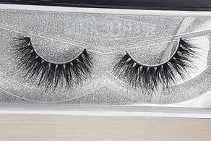
PRODUCTS
Complexion products
Lipstick
Fake eyelashes
Khol
Mascara
Makeup
Nail service

Slide 4
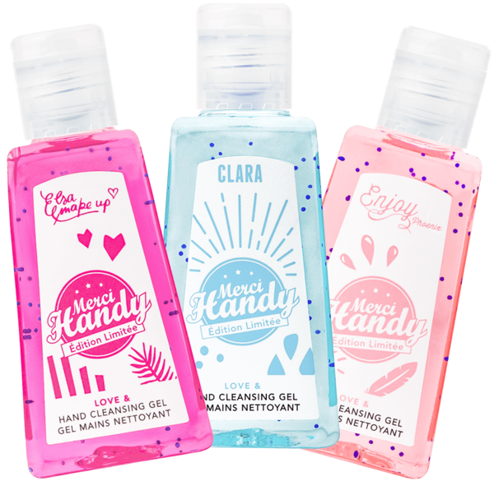
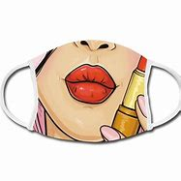
ACTION IN THE HEALTH CRISIS
Product delivery for customers
Setting up beauty tutorial on the store’s online site
Creating hand sanitizer gel and mask
Distribution of mask and hydro-alcoholic gel to the needy
Free beauty sessions

Slide 5
HISTORY OF COMPANY
The company was created in 2018, with two female executives.
The leaders are named Loriane and Maëlle the company was created by Maëlle who was a nail prosthetist already in the beauty industry. Her friend Loriane created a beauty product website. To make themselves better known, they decided to join forces in order to have more customers and a greater reputation.

