Slide 1
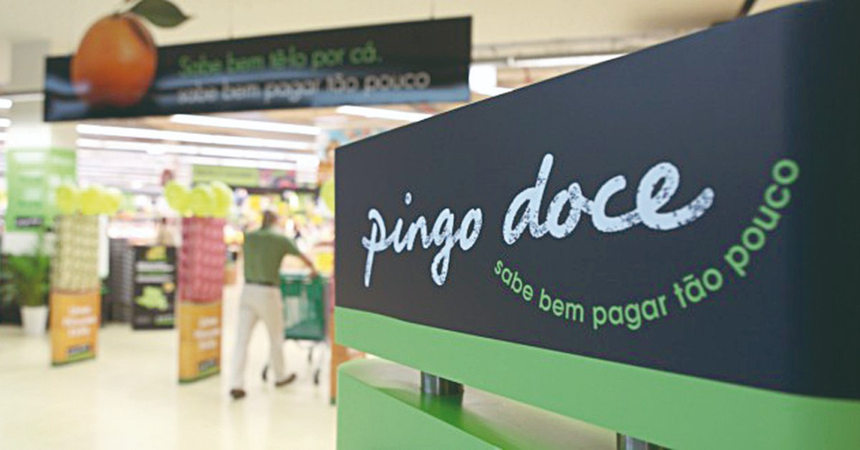
pingo doce
Rafaela Souza
Marcos Almeida
Taíssa Horta
Giovanna Vicente

Slide 2
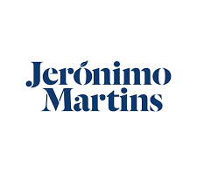
What is pingo doce?
Pingo doce is a chain of Portuguese supermarkets and hypermarkets. Is the brand of the Jerónimo Martins grupo mostly present in urban areas. Actually, there are 432 shops spread over 293 locations.

Slide 3
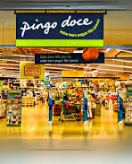
History
In 1980 the company pingo doce was formed and the definition of a clear strategy for exploring the supermarket segment was established.
In 2010, pingo doce added the restaurant and take-away services to their super and hypermarkets premisses.

Slide 4
History
In 2015, the company openned the first pingo doce Go Store, a new concept of covenience shop in partnership with BP gas stations. These Go Stores offer a 24/7 service.
In January 2019, pingo doce owned 432 shops.

Slide 5
What does pingo doce do?
Pingo doce’s mission is always to improve the supermarkets chain in Portugal. To this end, they focus on meeting customers’ needs by providing high quality food products.

