Slide 2
Futuristic
Czech village
billboards
websites
Google
NAME
MARKETING
advertisements
Modern technologies
ONEN SVĚT
PRODUCT
Instagram
TARGET GROUP
IT companies
Electronic accessories
Tablets
students
Electronic pens

Slide 3
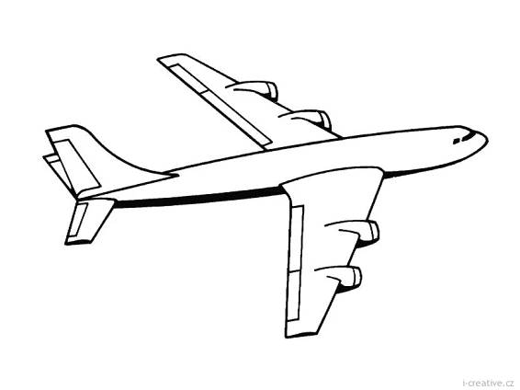
ONEN SVĚT – company department
Finance and accounting department
Service department
Sales department
Production department

Slide 4
Found: 2002
Founders: Kotarac, Cao Viet, Radostová
Headquarters: Onen Svět
Products: tablets, electronic pens
Services: online shopping

Slide 5
PRODUCTS - tablet
Single price: 150€ – 350€
Quantity price: 10% (10 – 20 tablets)
15% (20+ tablets)
Shipping: free in Czech, 20 € in EU
Delivery: within 3 and 7days
Guarantee: 2 years

Slide 6
PRODUCTS - Electronic pens
Single price: 20€ – 60€
Quantity price: 10% (10 – 20 pens)
15% (20+ pens)
Shipping: free in Czech, 20€ in EU
Delivery: within 3 and 7days
Guarantee: 2 years

