Slide 1
Mischelin s.r.0
Niki Asadova
Valeria Cortelazzi

Slide 2
Phylosophy
The name Mischelin stands for a family, a company, a brand, and a philosophy: To give our utmost to produce high-quality products using the gifts of nature. The people, their needs and in our case taste, enjoyment, health and refreshment are at the centre of this philosophy. This means that at every level of the production process we apply the highest quality standards, which we ensure through constant monitoring and controls. We take great care when selecting, processing and bottling. We believe that innovation, development and continuous improvement are a reflection of a living brand.

Slide 3
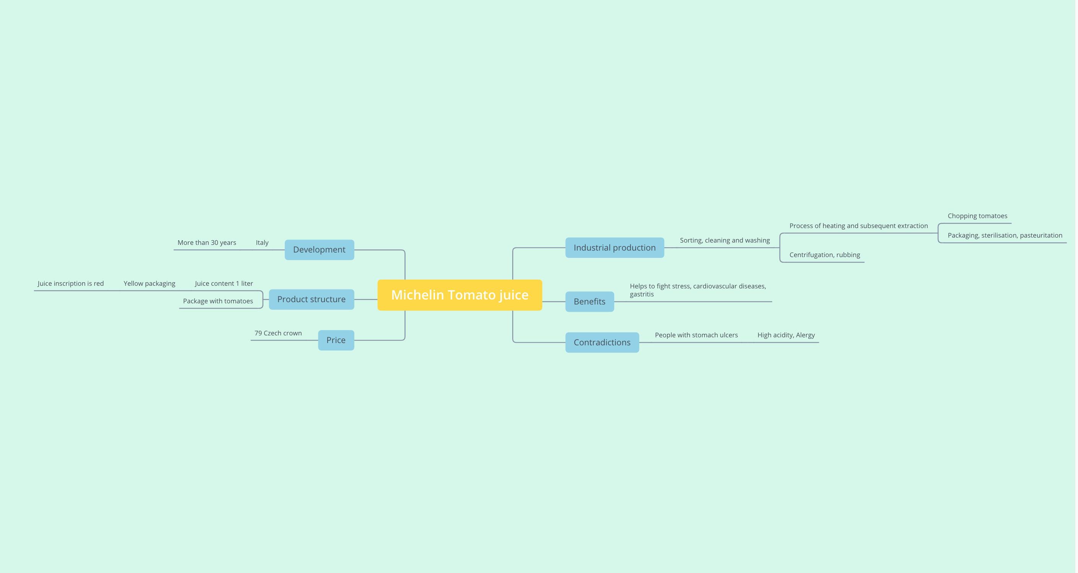
Mind map

Slide 4
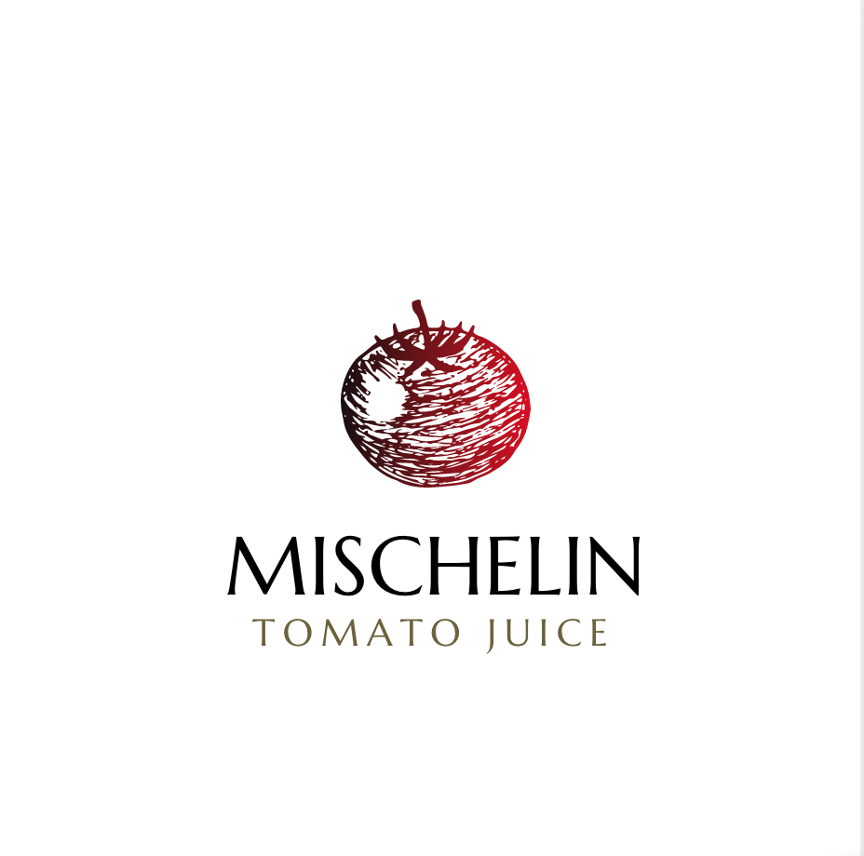
Our history
Mischelin was founded in 1985 in the province of Parma and immediately became an icon thanks to its innovative packaging: the carton brick that makes it easy to recognize the tomato sauce in any country to which it is exported. Today, Mischelin is synonym of: a controlled supply chain, Italian quality, tomato traceability, sustainability of the production and transformation processes. In fact, Mischelin is produced with the tomato of 370 farming companies belonging to the Consorzio Casalasco del Pomodoro, cultivated on over 7,000 hectares between Cremona, Parma, Piacenza and Mantua in the North of Italy, at an average distance of 50 km from the processing establishments.
Our tomato is 100% Italian, cultivated respecting the environment and the health of our consumers.

Slide 5
shipping
Shipping is carried out by d’Amico for 2 € worldwide.
The price of 1 package is 2,5 € for 1 liter.
Can be ordered from 3 to 6 packs
Possible discounts range from 10% to 30 %

Slide 6
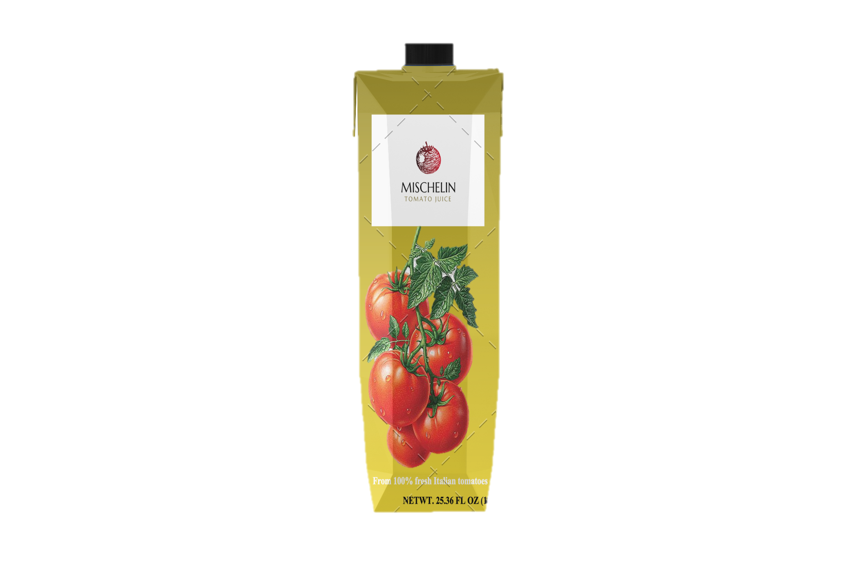
Certified Sustainability
Mischelin is guarantee of a healthy and safe product, 100% Italian and 100% sustainable, from the environmental, economic, ethic and social stand points. We work on sustainability from every angle to make the farming and processing of the tomatoes always more sustainable.

Slide 7
Farming
We have adopted precision agriculture, tools and predictive models to protect the territory, fertirrigation systems that allow saving up to 25% of water. We apply highly restrictive integrated production regulations. We monitor all the phases of the production - cultivation, harvesting, assignment and processing - with a responsible approach to the territory and the health of consumers.

Slide 8
Processing
We save energy in every phase of production, limiting carbon dioxide emissions. We apply scrupulous waste management and we work in compliance with high standards of environmental management and food safety.

