Slide 1
DATOM HOLDING a.s.

Slide 2
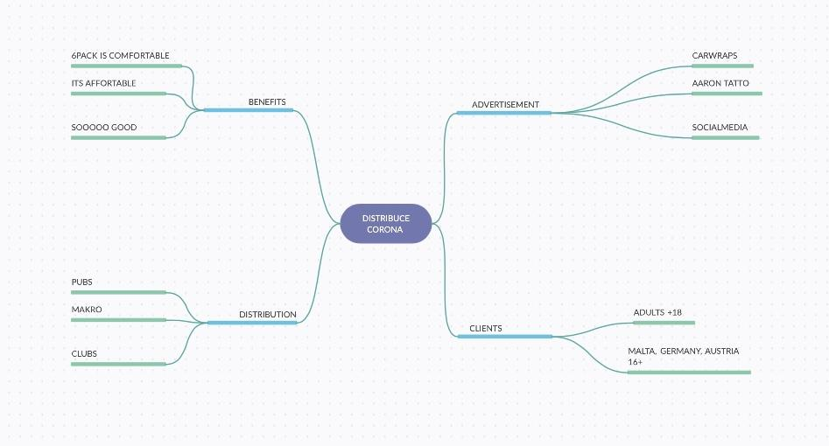

Slide 3
Acquaintance with the company
We are main distributors of Corona beer and accessories for Eastern Europe.
Once a year we organize Corona festival.
Our goal is to grow bigger and above all to make people happy.

Slide 4
Price list
Can 0,355l | 1,5 €
Can 0,7l | 1,5 €
Bottle 0,355l | 1,5 €
Barrel 56,78l | 250€

Slide 5
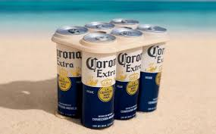
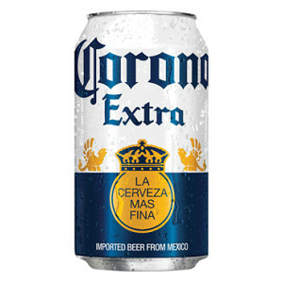
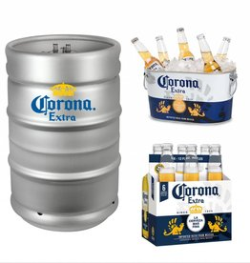
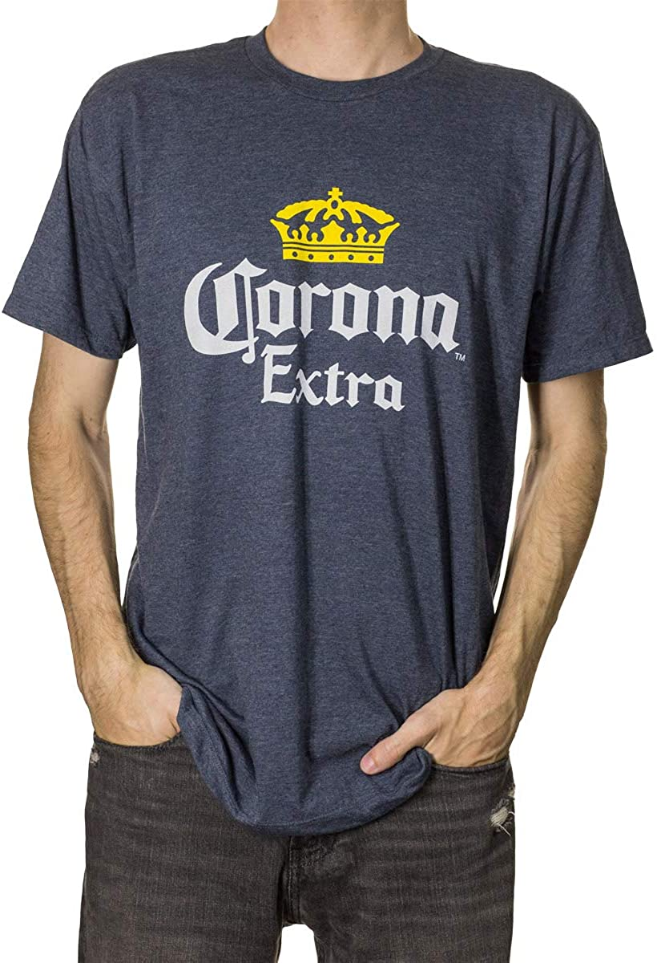
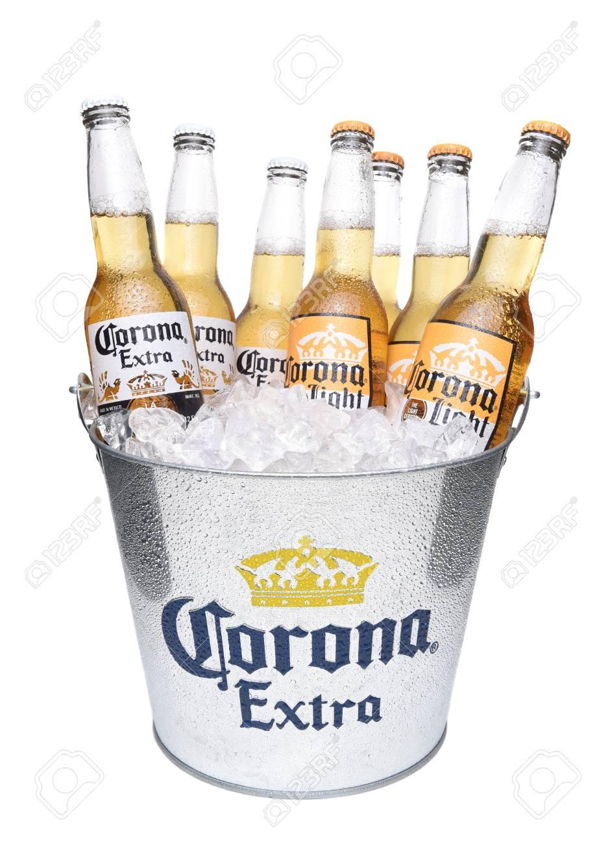
Our products:
We have everything from clothes to alcohol.

