Slide 1
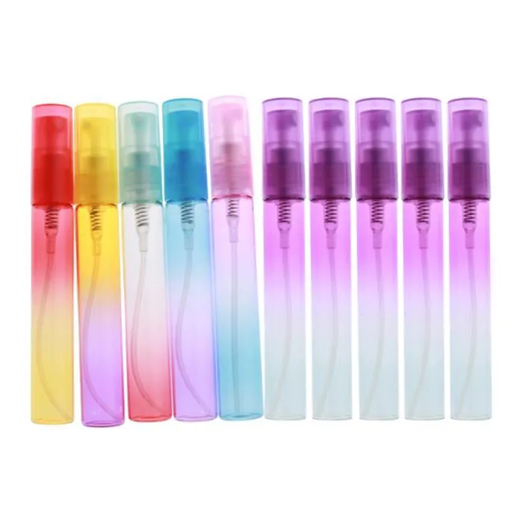
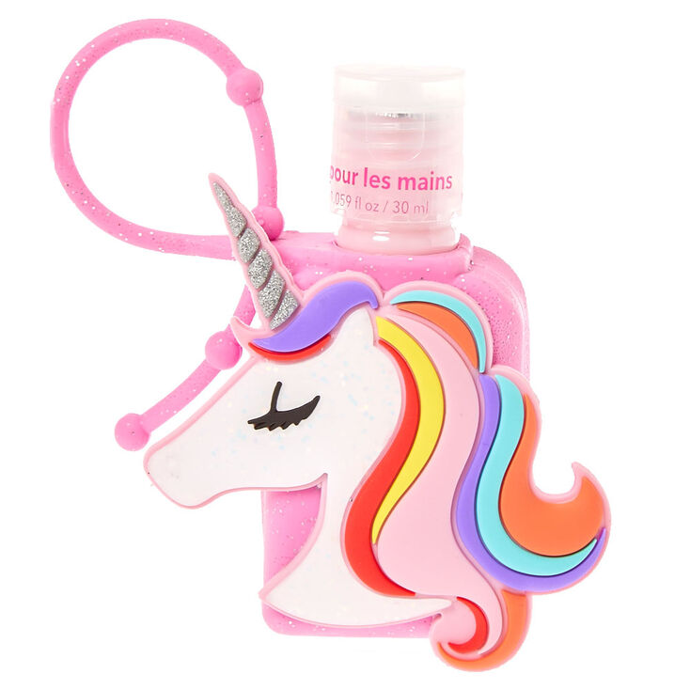
Unicorn Sanitizer
Cute but crazy (1 rue des brisant st Gilles les Bains la Reunion)

Slide 2
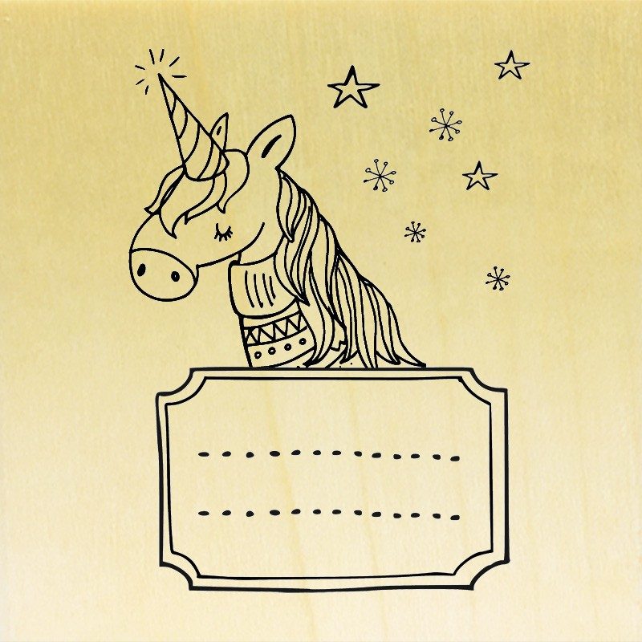
Unicorn Sanitizer
Company Description
Unicorn sanitizer is a company specializing in the production of sparkling gel or with a hydroalcoholic party scent. We have a wide range of cute products, we have our own local boutique located in Reunion Island. If you would like to purchase our products, you can call us at 36 35 89 or by visiting our website: unicornsanitizer.com or go there at: 1 rue des brisant st Gilles les Bains la Reunion
Unicorn Sanitizer

Slide 3
Who are we
Marie-Lou : Manager
Lorna : Boss

Slide 4
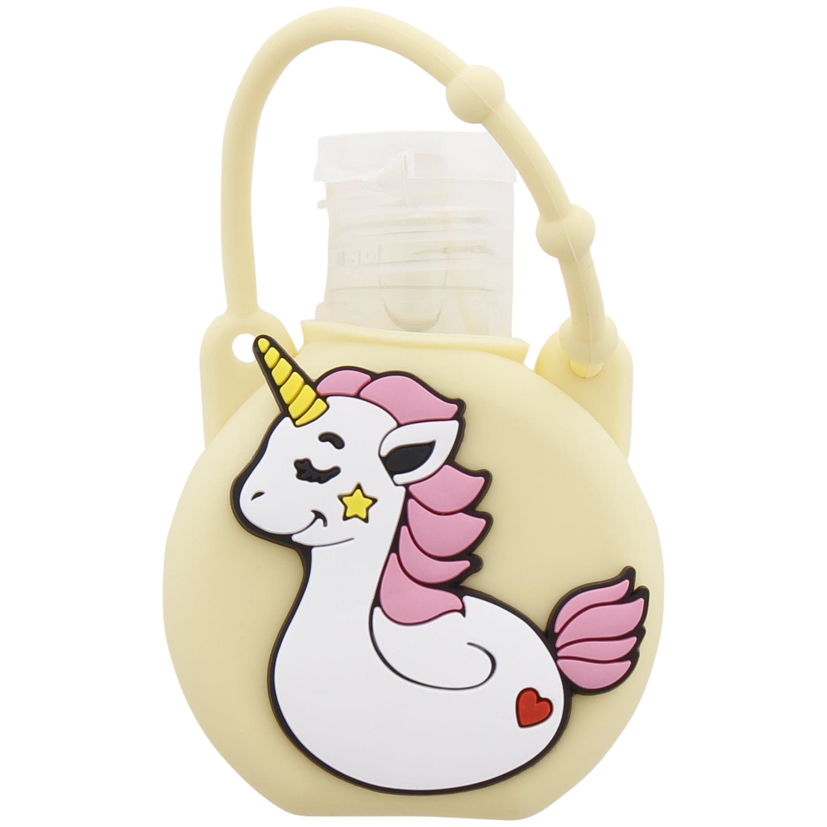
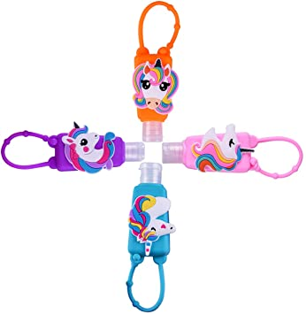
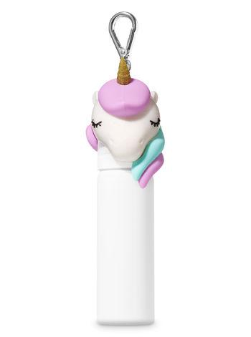
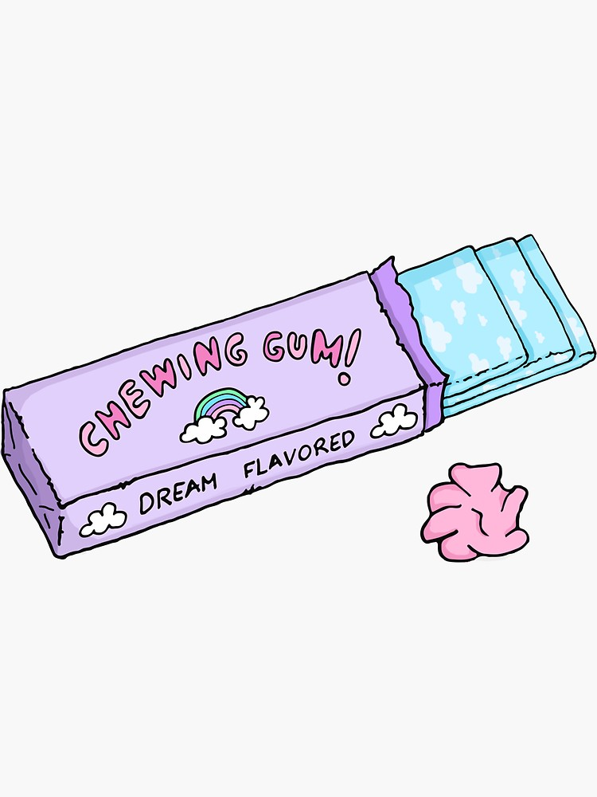
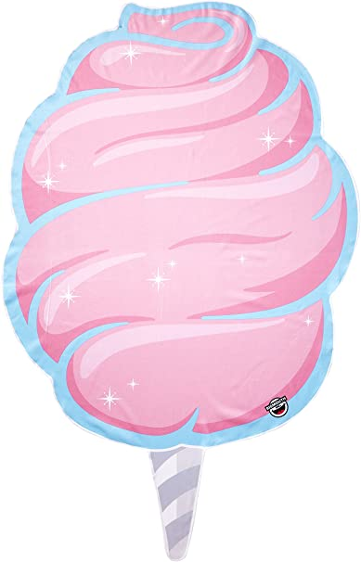
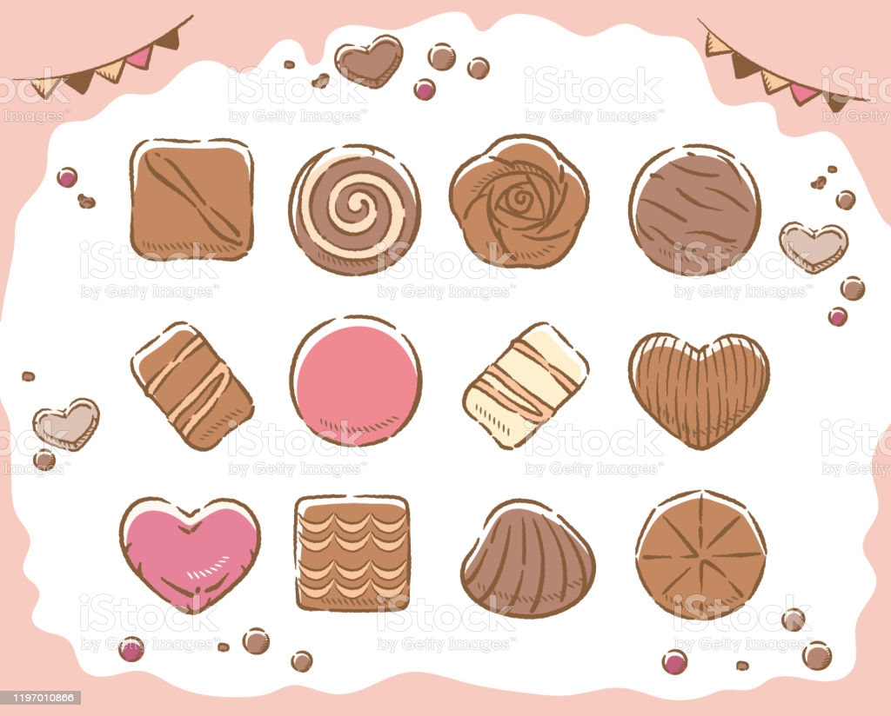
Our Products
Your hands will stay soft and satiny with these adorable strawberry, chewing gum, praline or even lemon meringue scented unicorn hand lotions. It comes in a pretty pink glitter case and features a cute design on the front.

Slide 5
...
Price: 3 euros 45 ml or 5 euros 75 ml
Flavor: Strawberry, chewing gum, meringue, citron, cotton candy, sugar, caramel
Type: 100 prct organic / reusable and washable case
biodegradable bottle
We created this company with the aim of fighting the virus

