Slide 1
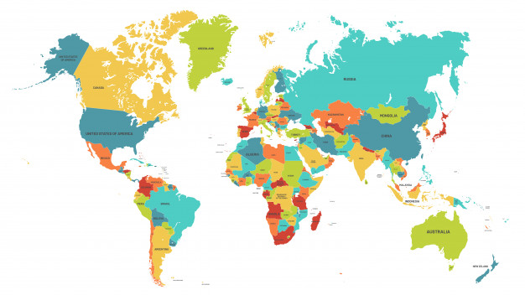
Our Wine branches
Madalena Monteiro and Francisco Duque Portuguese team

Slide 2
Our initiatives
Our main objective is to highlight our company, Our Wine.
We will partner in locations in the cities of each company so that we can have more visibility globally, we will also sell our wine in coffee shops, markets ... we will sell in the cities of the respective companies, so that we can make a profit.

Slide 3
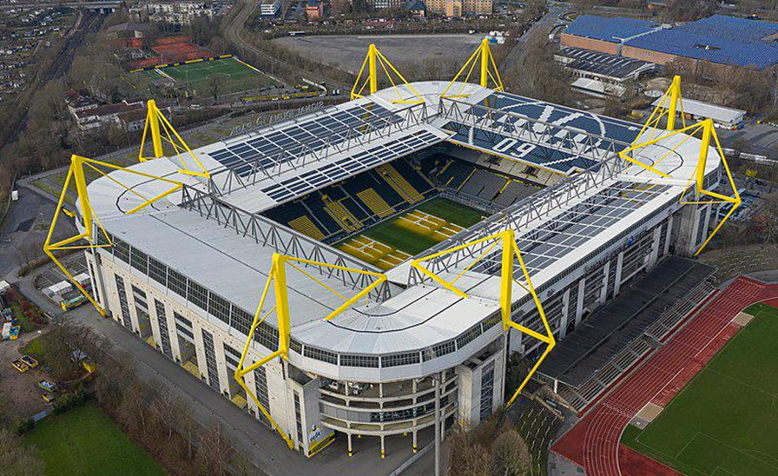
My Furniture
In the location where the company My Furniture is located in Dortmund, we have the stadium, where we will offer wine samples to people who are in the VIP areas. We will also have a partnership with the park there, where we will sell our wines in the cafe inside the park!

Slide 4
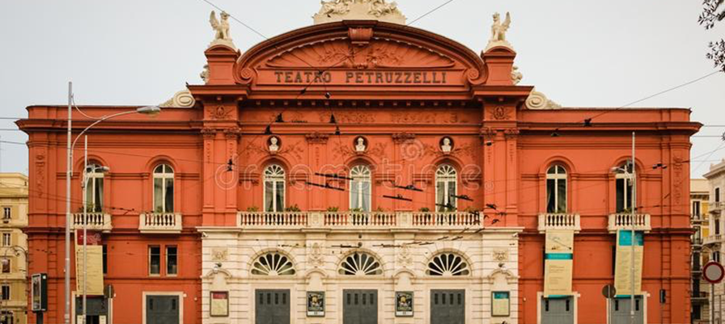
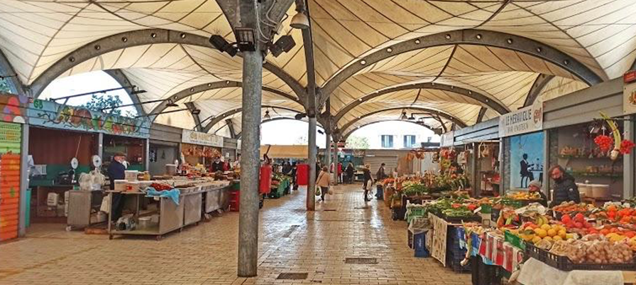
Driving tour by fiat 500 car in 2 hours
In Bari, Italy, we will sell our wine at the Teatro Petruzzelli. We will partner with the company by conducting a tour in a fiat 500 car in 2 hours, by providing a two-hour tour to clients to whom our wine will be offered.

Slide 5
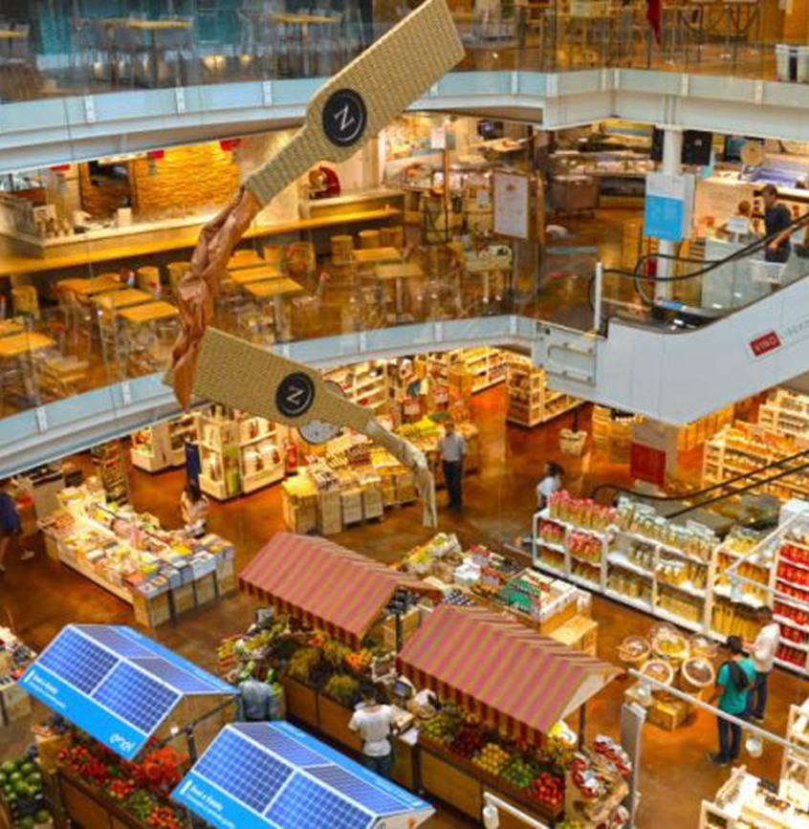
Biodiesel
In Milan, we will sell our wines in one of the best and busiest restaurants in the area, Eataly Milano Smeraldo. This is another marketing strategy, which will allow us to increase our recognition in the international arena and consequently our sales!

Slide 6
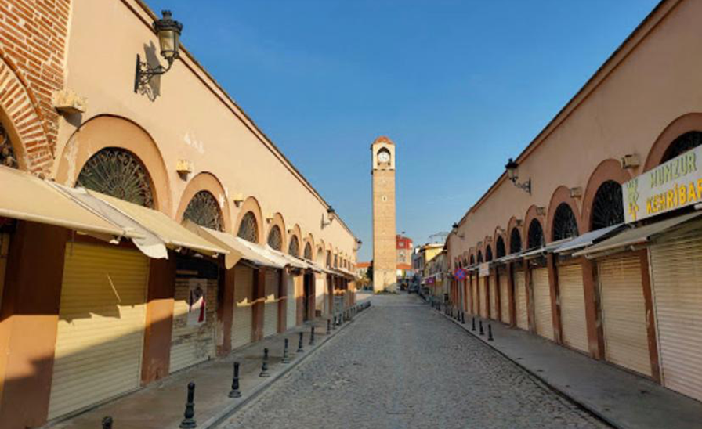
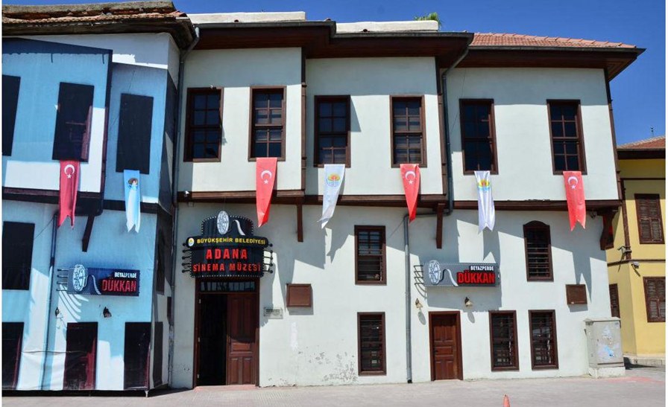
CMC
In Adana Turkey we will give samples of our wine at the Adana Cinema Museum and we will have a partnership or a counter in the local market called Buyuk Saat to sell our wines!

Slide 7
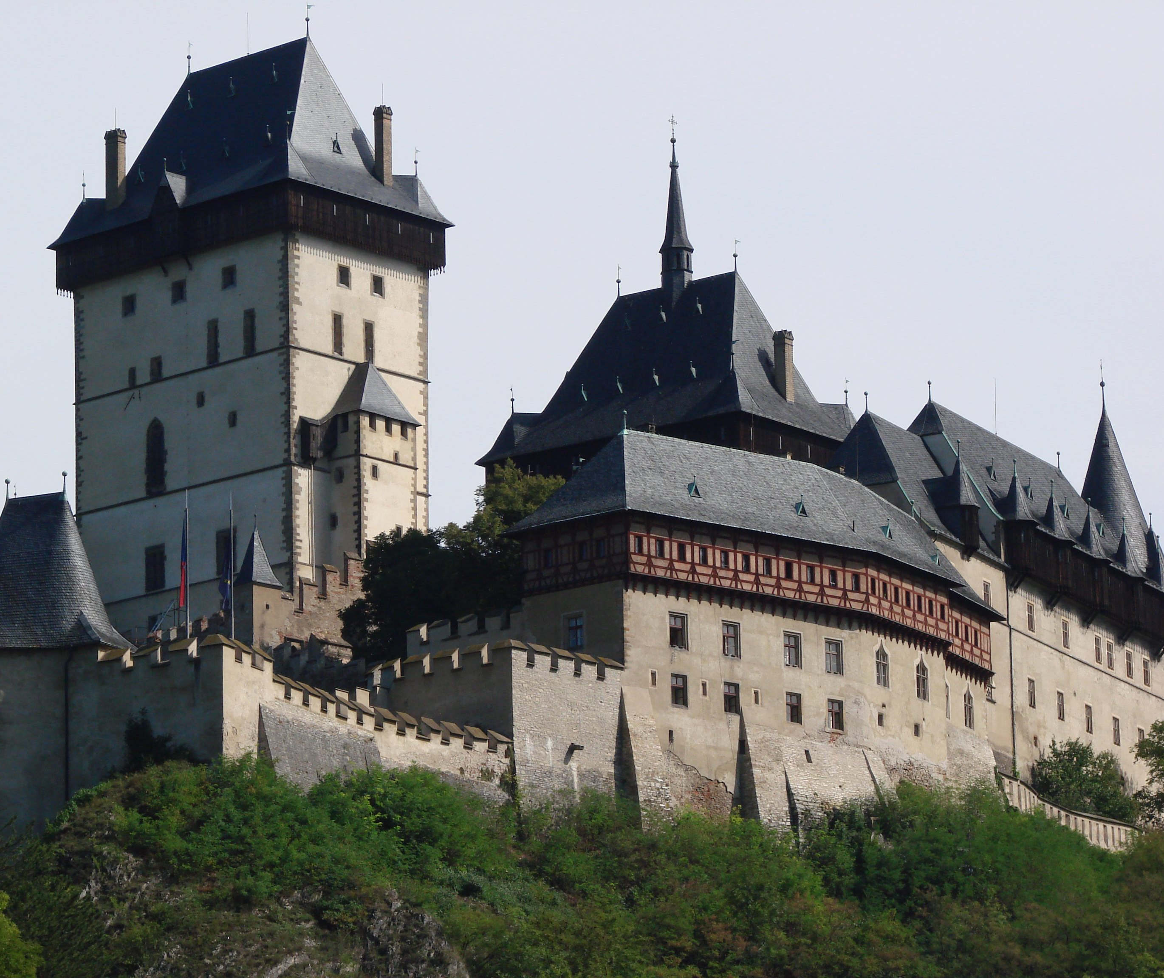
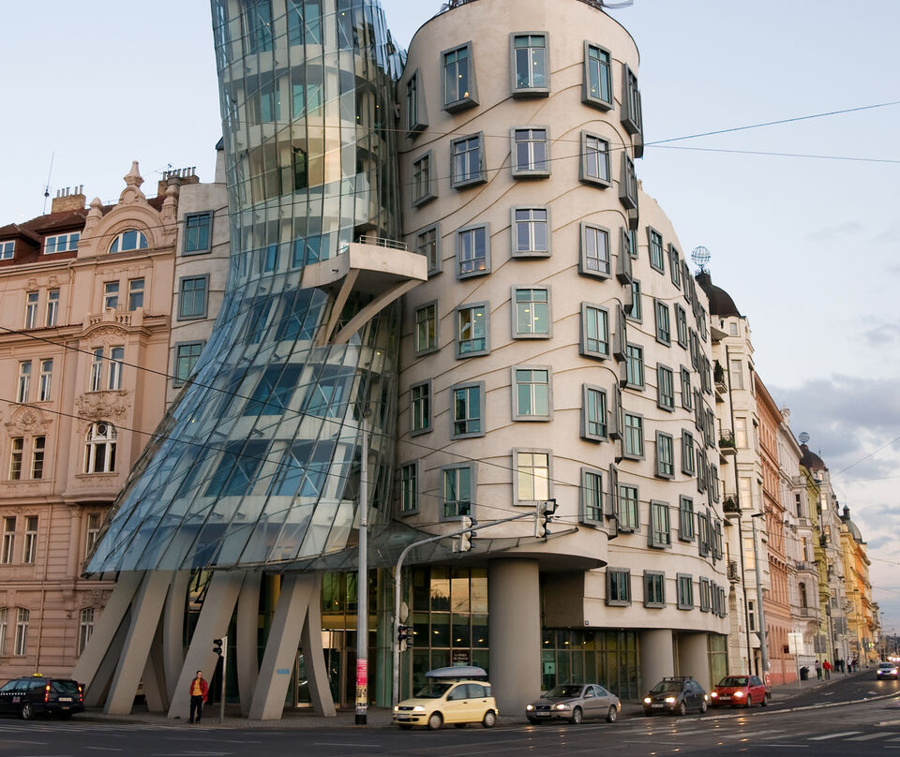
Mischelin s.r.o
In Prague Czech Republic we will offer samples of our wine at the entrance to Karlstein Castle when people buy the ticket to visit the castle, and then we will sell our wines at Casa Dançante which has a cafe on the top floor.

Slide 8
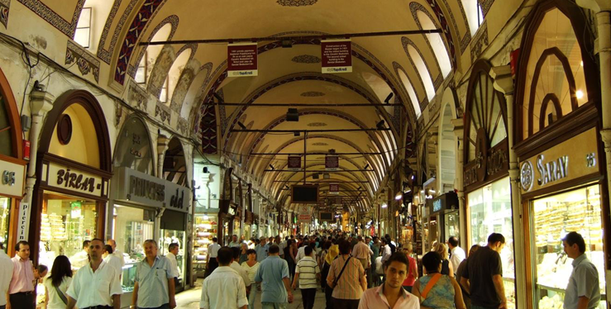
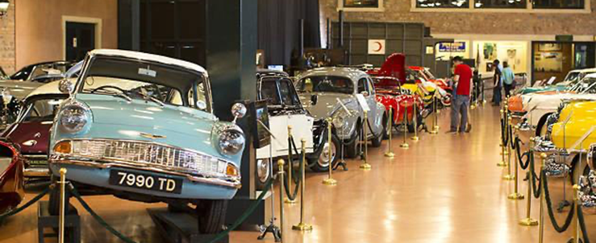
Turkish Baklava
In Istanbul, Turkey, we will be present at the Grand Bazaar market.
Additionally, we will have a collaborator at the Rahmi M. Koç Museum, offering samples of our wines to the museum visitors

